Slide 1
Job Satisfaction in
Higher Education
Josh and Ha

Slide 2
Introduction
What impacts job satisfaction?
Physical health and psychological wellbeing (Johnson 2005)
Factors other than income (Tang 1995)
Look beyond income as a predictor
Analyze at 3 different variable groups related to job satisfaction
Demographic, Work-Related, Benefits
Notes:
Josh
We are interested in analyzing job satisfaction in higher education, because we are undergraduate students interested in ways we can look for jobs that would improve our satisfaction. Our main research question is what factors impact job satisfaction. One article suggests that job satisfaction could be due to different levels of emotional labor. For example, junior police officers report a lot of stress, whereas senior police officers report less stress. Another article suggests that job satisfaction is difficult to control as an employer, because changing a person’s income does not always help improve satisfaction levels. Our study looks beyond just income as a predictor. We instead look at 3 different groups of variables to analyze satisfaction: demographic variables, work-related variables, and benefits.

Slide 3
Methods
response variable: job satisfaction
explanatory variables: 3 subgroups (work, benefits and demographics)
ordinal regression was used: logit [P(Y ≤ j)] = αj – βx with j = 1, …, J−1
we modeled the log odds of being in one level of satisfaction versus being in levels above it.
subtract (rather than add) the slope coefficient β => a negative slope coefficient of a predictor is associated with increased job satisfaction.
polr function from the MASS package in R
Notes:
Ha

Slide 4
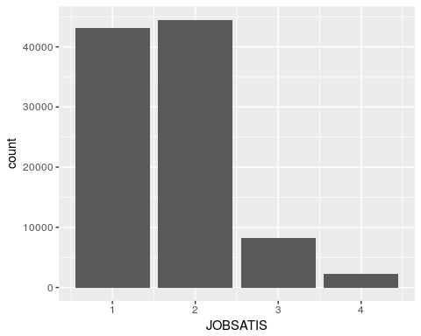
Results
Exploratory data analysis:
Satisfaction Level | Frequency
Very Satisfied | 43147
Somewhat Satisfied | 44508
Somewhat Dissatisfied | 8178
Very Dissatisfied | 2218
Notes:
Ha

Slide 5
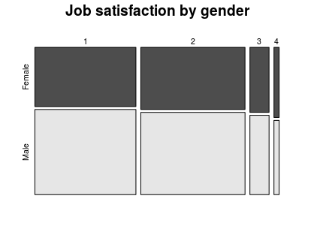
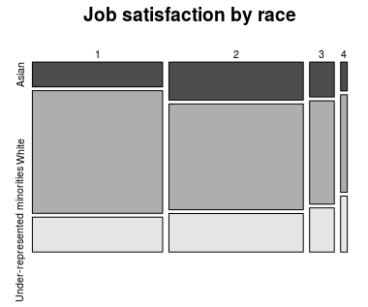
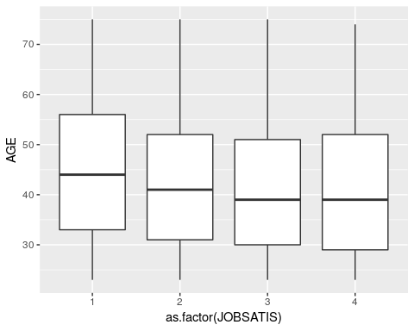
Results
Ordinal regression with demographic factors : gender, age and race
Increased satisfaction is associated with being older, White, male
Notes:
Ha

Slide 6
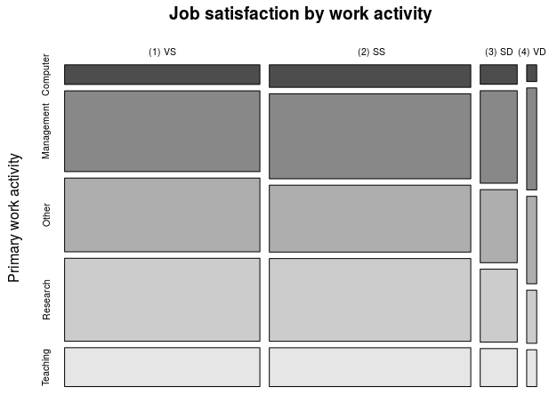
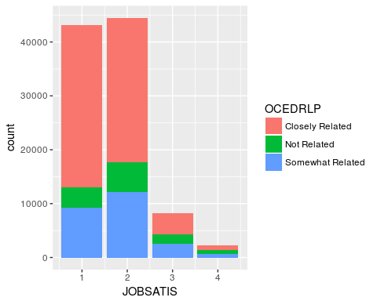
Results
Ordinal regression with work-related factors
Biological and life science jobs have lower satisfaction, Non-science and engineering-related jobs had the highest
Having job not related to highest degree greatly decreased job satisfaction
Teaching & Researcher have the highest satisfaction verses management and administration
Notes:
Josh
From our work-related smaller model, our analysis indicates that that biological and other life science jobs had lower satisfaction than other occupations, while non-science and engineering jobs had the highest satisfaction. Expectedly, having a job not related to a person’s highest degree greatly decreased job satisfaction. Lastly, teaching and research as primary positions have higher satisfaction than jobs that involve management and administration.

Slide 7
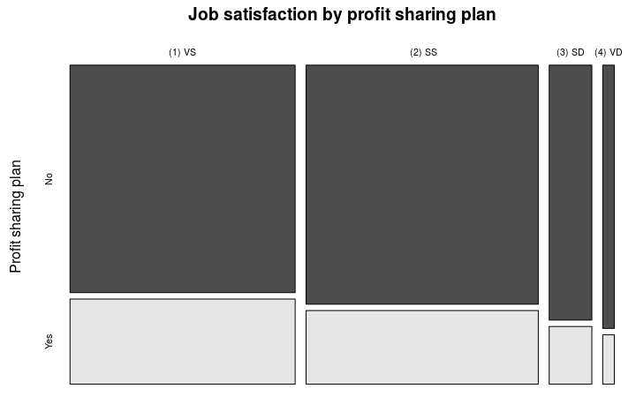
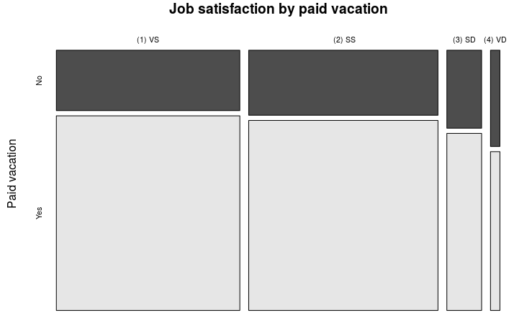

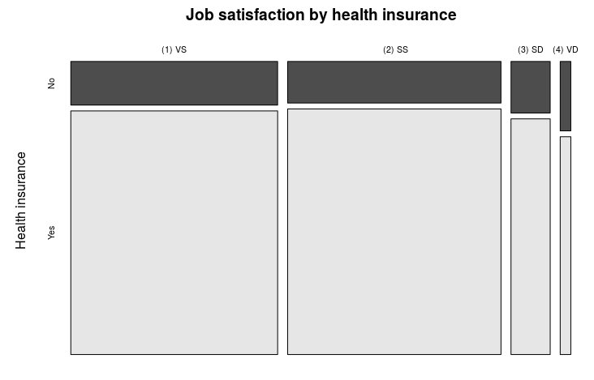
Results
Ordinal regression with benefit factors
Increased salary is associated with increased satisfaction
Pension plan and profit sharing plan is associated with increased satisfaction
Paid vacation and health insurance is associated with decreased satisfaction (opposite from the EDA)
Notes:
Josh
This model looks at salary, and the binary variables pension plan, profit sharing plan, paid vacation, and insurance plan. From our EDA and from our smaller model, we found that increased salary is associated with increased satisfaction. Also, having a pension plan and profit sharing plan is associated increased satisfaction. However, unlike our EDA, our smaller model indicates that there decrease in satisfaction when a company has an insurance plan or a paid vacation plan. This was something we were hoping would change if we accounted for other variables, because it did not make a lot of sense.

Slide 8
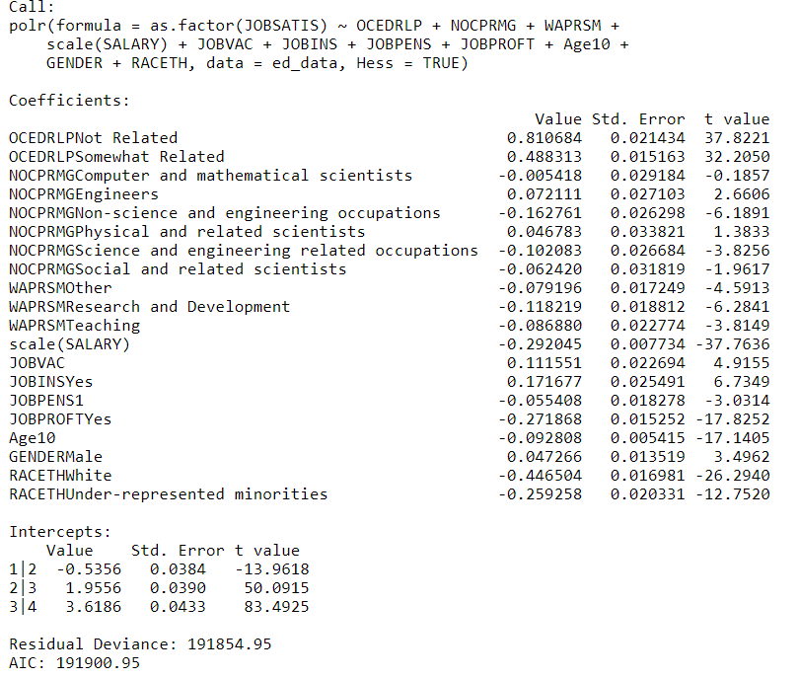
Results
Final Model
Non science and engineering-related fields have the highest odds of being very satisfied versus being in other levels of satisfaction
Engineers specific has the lowest
Odds of being very satisfied if job relates to highest degree is 2.25 times higher than if it does not
Odds of being very satisfied in research and development 1.13 times higher than management and administration
Notes:
Josh
We created a final model that included all the significant variables in our 3 models. Our analysis indicates that that biological and other life science jobs had lower satisfaction than other occupations, while non-science and engineering jobs had the highest satisfaction. Expectedly, having a job not related to a person’s highest degree greatly decreased job satisfaction. Lastly, teaching and research have higher satisfaction than jobs that involve management and administration.

Slide 9
Results
Final Model
Odds of being very satisfied versus being in other levels of satisfaction is 1.06 times higher for pension plan, 1.31 times higher for profit sharing plan
NOT having health insurance plan or paid vacation are related with decreased odds
Unlike our EDA
Notes:
Ha

Slide 10
Discussion
Main findings:
Job satisfaction varies across job fields.
Example: Non-science and engineering-related fields have the highest satisfaction level, yet engineers have the lowest satisfaction.
Among four primary work activities, research and teaching are associated with higher satisfaction than management/ administration.
Jobs that are closely related to major degree is associated with increased satisfaction
Possible explanations:
Support the study of Johnson et al. (2005): there are different levels of job satisfaction across occupations in higher education => may imply different fields being associated with different levels of physical health and psychological well-being.
Not support Tang et al. (1995): higher job satisfaction tend to have higher income on average.
Notes:
Ha
Non-science and engineering-related fields have the highest satisfaction level, followed by science and engineering-related occupations. However, engineers have the lowest satisfaction.
Among four primary work activities, jobs that mainly involve research and development are associated with higher satisfaction than those that involve teaching and management/ administration.
Jobs that are closely related to major degree is associated with increased satisfaction

Slide 11
Discussion
Limitations:
Self-report satisfaction data -> possible response-bias
More information in the “satisfied” than “dissatisfied” categories
Many subjects report $0 in salary -> they may be self-employed or work for non-profit
Weight variable was not controlled for -> assume all weights equal
Future directions:
Control for psychological traits because such as standard for satisfaction
Consider correlation for subjects within an organization or county
Notes:
Josh
Some of our limitations are the there is self-reported satisfaction data, which may lead to response bias. Also, there are many more people who answered satisfied compared to dissatisfied, so we have more information in the higher 2 levels of satisfaction. There were also many subjects who reported $0 for salary, and this could be because we did not account for them being self-employed or working for non-profit organizations. Lastly, we had weighted variables, and we assumed all weights were equal. A possible future direction could be controlling for psychological traits that may impact satisfaction, or considering correlations for individuals with similar backgrounds (e.g. same county, within an organization, etc.).

