Slide 1

Analysis of Immigrants from Travel Ban Countries
By Josh, Pony, So, and Thu Ha
Notes:
Introduction
We worked on the

Slide 2
Outline
Cluster Analysis
Background
Research Questions
Analysis
Longitudinal Model
Conclusion/Limitation
Item Response Theory

Slide 3
Background
Immigrants comprise about 14% of the total U.S population
However
In 2017, nationals from these Muslim-majority countries: Egypt, Iran, Libya, Sudan, Yemen, Iraq, Somalia and Syria were banned from entering the US
Negative stereotypes related to violence were presumed to have initiated this
Furthermore
Idea of America as the land of opportunities
Notes:
I think we can all attest to the fact that in the past years the presence and role of immigrants in the U.S has become the topic of discussion in all media outlets and even in our classes and social gatherings.
Immigrants comprise about 14% of the total U.S population but the current political administration has and is implementing immigration policies to reduce the number of immigrants entering and staying in the U.S.
So we decided to focus on the most current policy, the travel ban which was implemented in 2017, where nationals from 11 of the muslim-majority countries were refused entry into the U.S on the belief that by restricting them, the government will be protecting U.S citizens from domestic and international terrorism. For example Paul moore, 21 year old decided to do the “country a favor” by trying to kill Zaynab Hussein a somali immigrant and her daughter.
Furthermore seeing that

Slide 4
Research questions
Do states discriminate against immigrants from 8 travel ban countries based on states’ political affiliation, demography, economic standing, and religion?
Does immigrant arrival from travel ban countries increase violent crime?
Do immigrants get the chance to attain the same level of success as non-immigrants?
Notes:
Pony

Slide 5
Three Analysis Outline
Investigates discriminant variables among different clusters of states, which might indicate preferences of accepting certain groups of immigrants
Cluster Analysis
Investigates the relationship between violent crime and immigrant arrival from the travel ban countries, which may debunk negative stereotypes against immigrants
Longitudinal Model
Item Response Theory
Assesses whether immigrants get to achieve the same level of success as non immigrants
Notes:
So

Slide 6
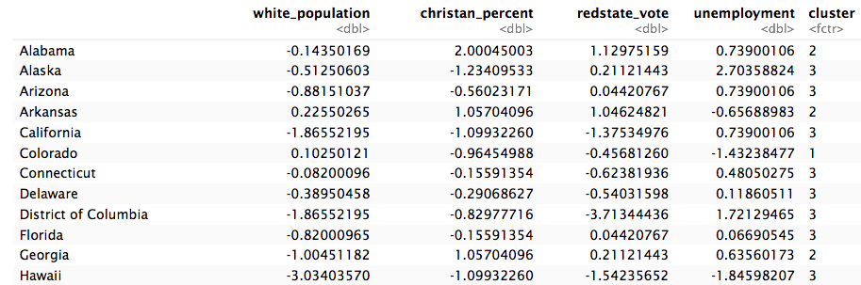
Cluster Analysis (State level data structure)
Do states discriminate against immigrants from 8 travel ban countries based on states’ political affiliation, demography, economical standing, and religion?
State level clustering
Political Affiliation
Christian Percent
Demography
Unemployment rate
Assigning cluster numbers by K-means clustering
Notes:
While researching on the topic immigrants, these four features ____, which also highly related to social justice issues, brought up as potential detrimental factors of accepting immigrants. So,I chose four variables and make 3 clusters, which is the optimal number of cluster from k-means clustering by a measure of Sum of Squared Error (you can think of it as mse) among 51 states so that I can find groups of objects such that the objects in a group will be similar (or related) to one another and different from (or unrelated to) the objects in other groups.

Slide 7
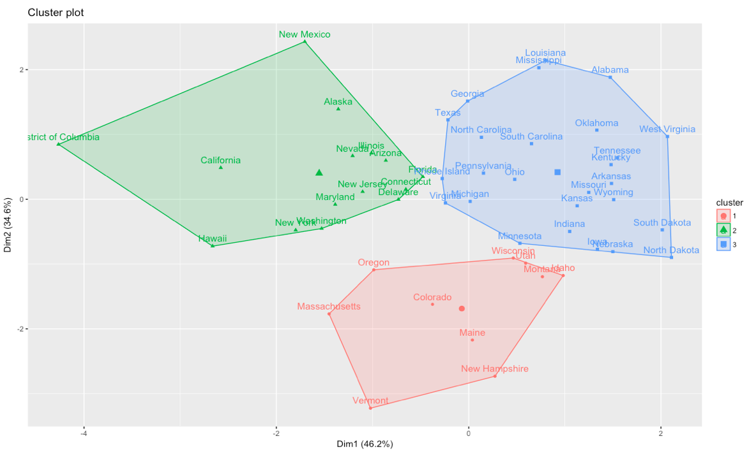
Cluster Analysis (State level)
Group 1: Predominantly white, liberal, rich states (mostly New England states)
Group 2: Diverse population, blue states, and less rich states
Group 3: (Mostly) poor and predominantly white states (mostly Southern states)
Notes:
It is the results of clusterings. Stating 1,2,3 : notice that 1 is the most privileged group. And it is also interesting it was somewhat divided by geographycally.

Slide 8
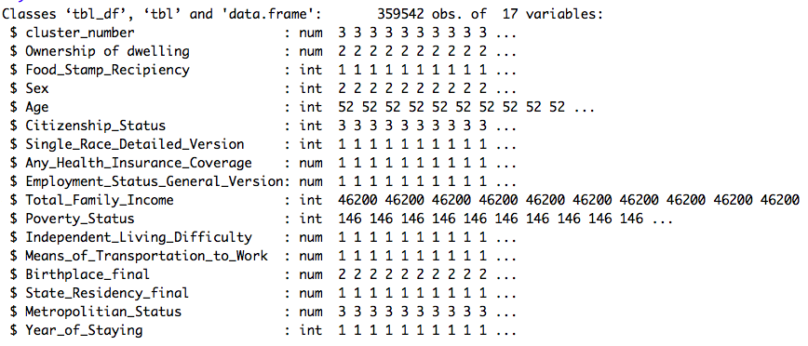

Cluster Analysis (Immigrant level data structure)
Immigrant Cluster Comparison Analysis
Family Income
Employment status
Food Stamp Recipiency
Means of transportation
etc.
Assigning cluster numbers by immigrants’ state residency
Notes:
And then, I looked at immigrant individual data from IPUMS US. There are 359542 immigrants from 8 travel ban countries who immigrated to the US during 2005-2016 reported by Censuses. And I chose 17 variables that tell person’s socioeconomic standings and state residency. What I did was to assign cluster number to a person based on their state residency. If a person’s resident state is in group 1, then I assigned the cluster number of a person to 1. So on. For example, if an immigrant lives in Vermont, which belongs in cluster 1, the person’s cluster number is 1. I may interchangly use cluster to group for the reference.

Slide 9
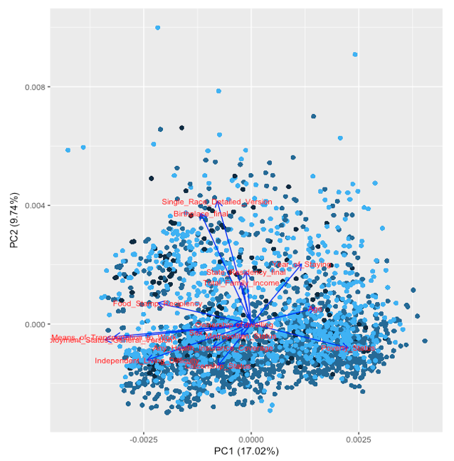
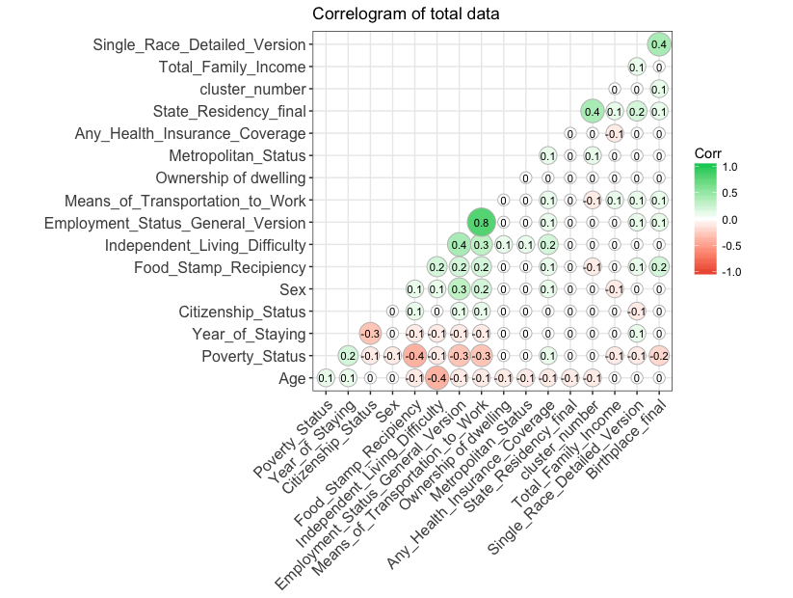
Cluster Analysis (immigrant level)
Notes:
Principal Component Analysis (PCA) was used to measure weights of variables of individual data and see correlations of variables. Since there are 17 variables in individual data, it is crucial to use PCA for reducing dimensions of data. PCA analyzes effects of each of 17 variables of individual data. These variables were scaled before conducting PCA. Left one is PCA plot, and each point represents an immigrants, so there are 359542 points in the plot. For the readability of the plot, the longer the arrow is more significant effect that the variable is, and similar directions of arrows imply that variables are correlated to each other.
Race, Birthplace, Independent living difficulty, Poverty, Food Stamp Recipients, Means of Transportation, Employment Status have larger weights than Total family income, Age, Sex, State Residency, Citizenship Status, and Health Insurance Status. Also, Year of Staying, Age, and Poverty Status are less correlated to other variables and are likely to have negative correlation with other variables. The correlation can be verified by the correlogram, and the trend follows as PCA plot implies about variables

Slide 10
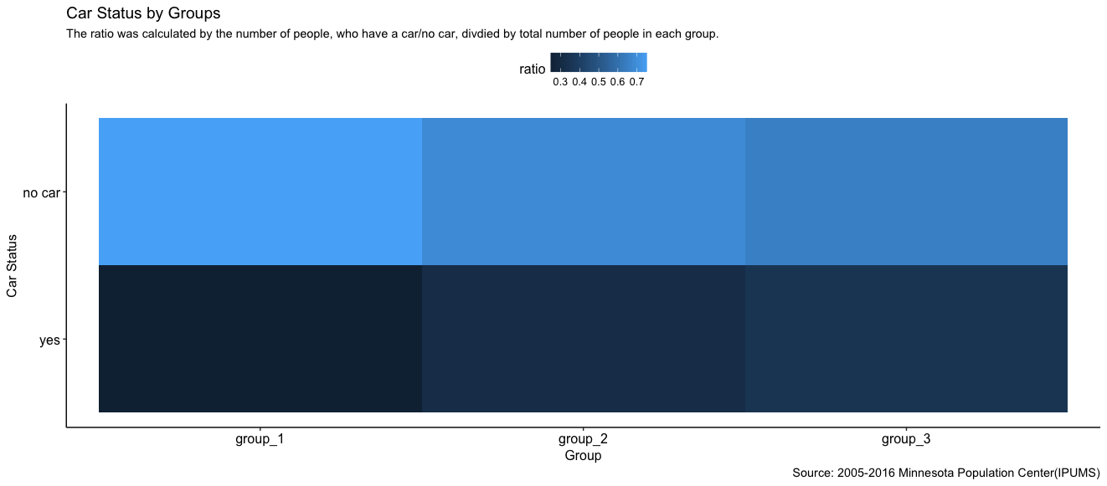
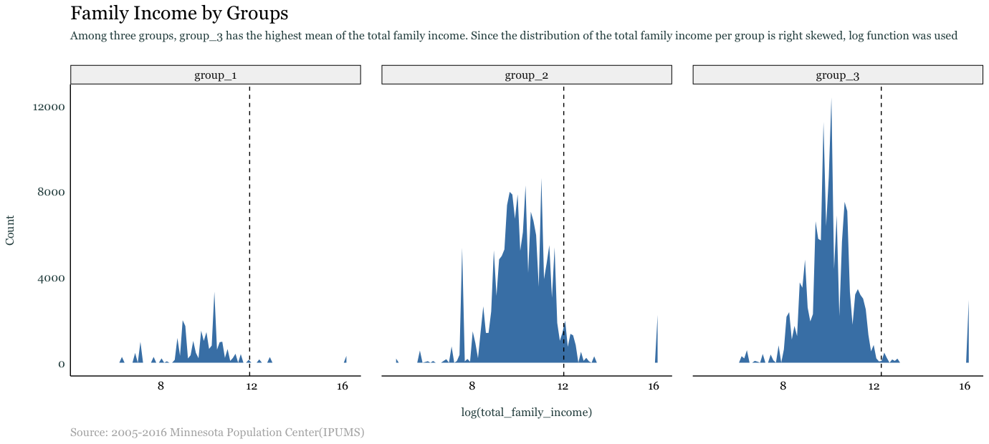
Cluster Analysis (immigrant level)
Group 1: Predominantly white, liberal, rich states (mostly New England states)
Group 2: Diverse population, blue states, and less rich states
Group 3: (Mostly) poor and predominantly white states (mostly Southern states)
Notes:
Because the distribution of total family income by groups is right skewed, we used the log function was used to visualize data. Group 2 has the highest total family income among three groups (with log function: group 1=10.17, group 2=10.70, group 3=10.41, and all groups=10.43 | without log function: group 1=$26,226, group 2=$44,175, group 3=$33,411, and all groups= $34,604 )
The plot indicates that a large proportion of people from group 1 have no car (0.753). However, group 2 and group 3 have similar ratios of people who have a car, compared to people who do not have a car (group 2 no car: 0.686 and group 3 no car: 0.650)

Slide 11
Cluster Analysis (Conclusion)
Immigrants from group 1 are less privileged than immigrants from other two groups. Compared to group 2 and group 3, group 1 has higher ratio of immigrants who are unemployed, do not have a car, receive Food Stamps, and have the lowest mean of family income of all three groups
The disparity of living condition can cause the polarization of immigrant group and non-immigrant group
Potential negative stereotypes that immigrants are poor, which can lead to a difficult transition for immigrants to adapt their life in the US
Notes:
We can conclude that individuals from group 1 are less privileged than individuals from other two groups. Compared to group 2 and 3, group 1 has higher ratio of people who are unemployed, do not have a car, receive Food Stamps, and have the lowest mean of family income of all three groups.
Results can be interpreted that immigrants living predominantly white, liberal, and rich states tend to be underprivileged. Because immigrants are under-privileged in more privileged states, the disparity of living condition can cause the polarization of immigrant group and non-immigrant group. This polarization issue might be related to negative stereotypes that immigrants are poor, which can lead to a difficult transition for immigrants to adapt their life in the US.

Slide 12
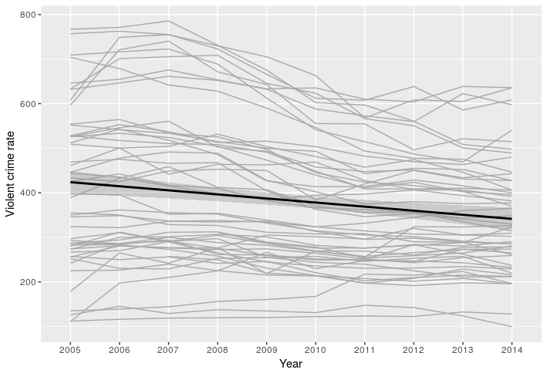
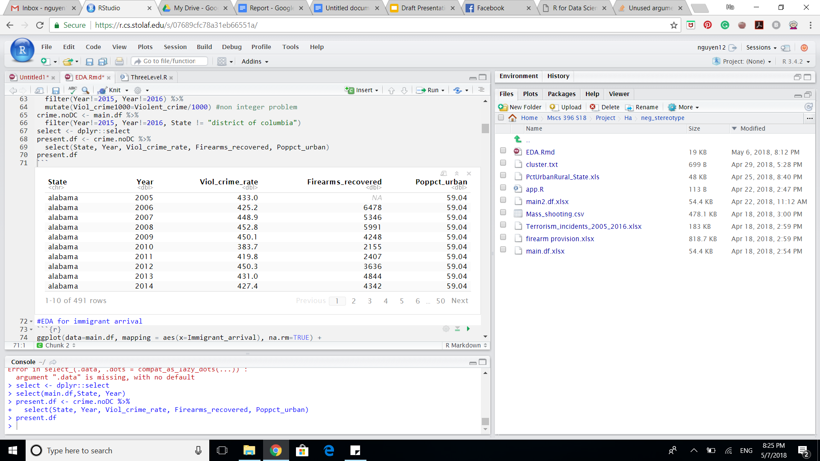
Multilevel model (Data structure)
What is the relationship between immigrant arrival and violent crime?
Level 1: within-state covariates that change over time
main variables: immigrant arrival, violent crime rate, firearms recovered, firearm regulations, legislative composition
Level 2: state-specific variables that do not change over time
main variables: percent population living in urban area, percentage of urban area
Violent crime rates for 50 states decrease over time from 2005 to 2014
Differences among states in starting points and slopes suggest that multilevel model with state as level 2 is appropriate
South Carolina
Alaska and Nevada
Vermont
Notes:
Talk about x axis and y axis for graphs
“We can see here that violent crime is decreasing with immigrants”

Slide 13
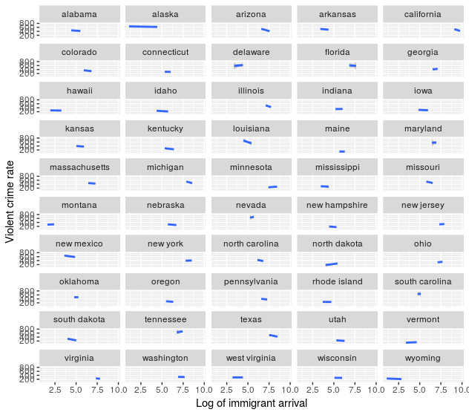
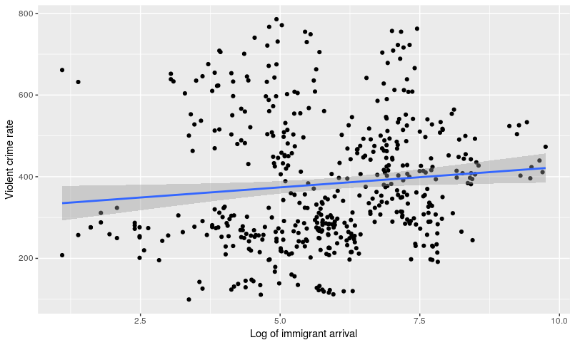
Multilevel model (EDA)
While violent crime rate seems to be positively correlated with immigrant arrival, the positive trend disappears when individual states are examined.

Slide 14
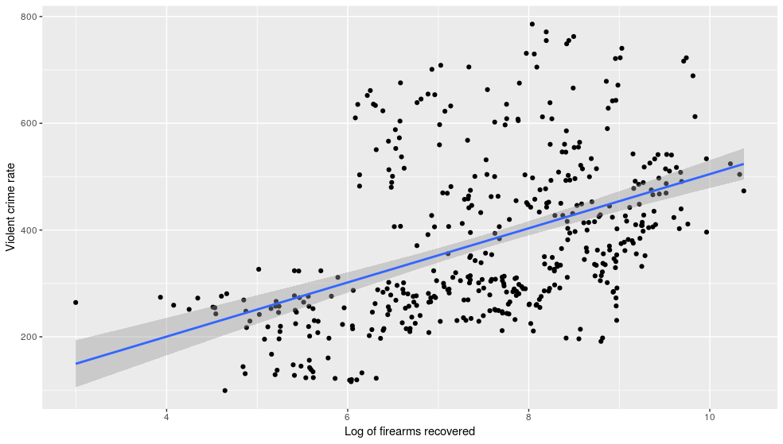
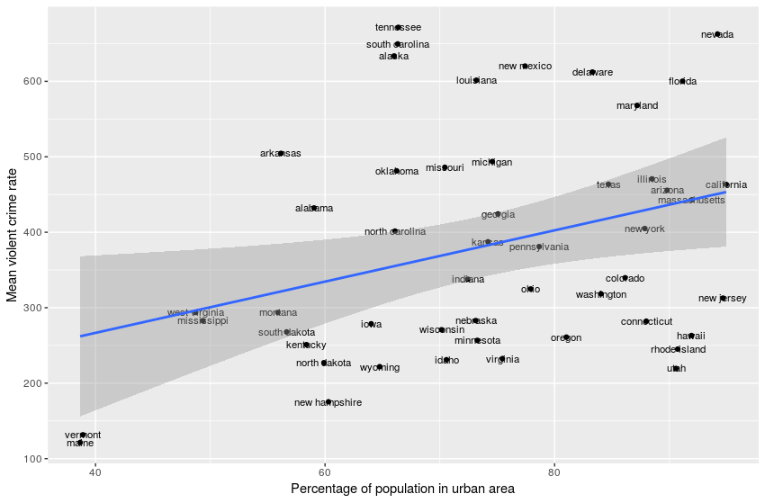
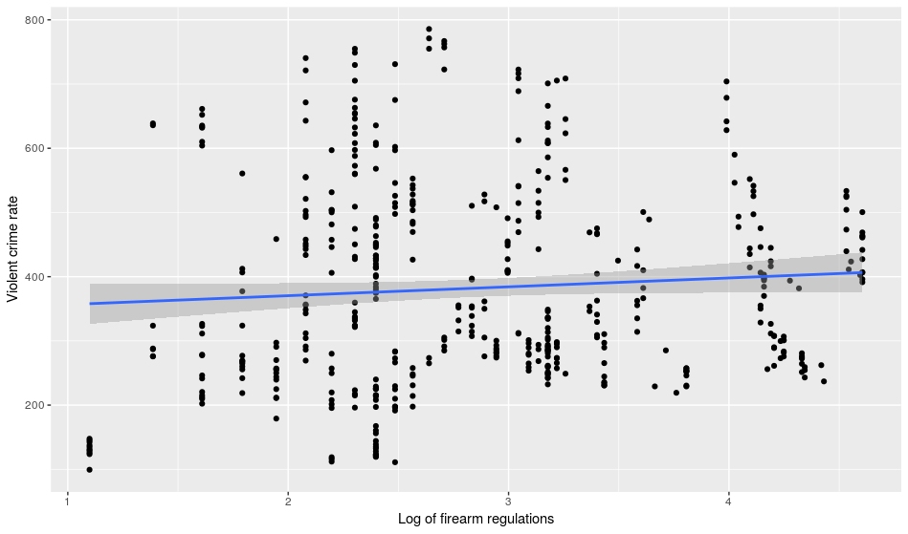
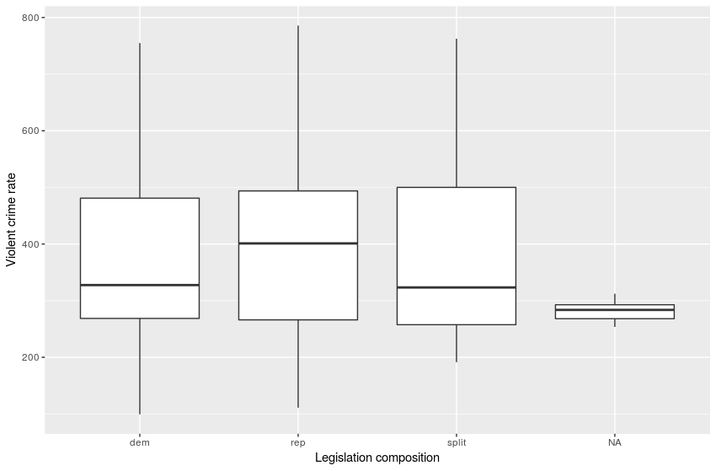
Multilevel model (EDA)
Based on the results of the exploratory data analysis, the best predictors for our longitudinal model to explain violent crime rate are immigrant arrival, firearms recovered and percent population living in urban area.
A
B
C
D

Slide 15
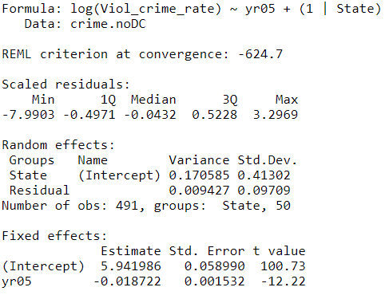
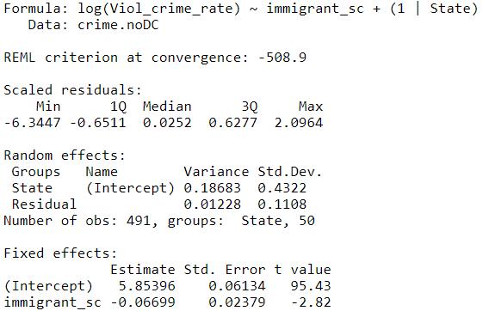
Multilevel model
Model 1: Unconditional growth model
L1: Y_{ij}= a_{i} + b_{i}*Year05_{ij} + ϵ_{ij}
L2: a_{i}= α₀ +u_{i}
b_{i}= β₀ + v_{i}
Model 2: Immigrant arrival as sole predictor
L1: Y_{ij}= a_{i} + b_{i}*Immigrant_{ij} + ϵ_{ij}
L2: a_{i}= α₀ +u_{i}
b_{i}= β₀ + v_{i}
AIC = -616.7; BIC = -599.9
AIC = -500.9; BIC = -484.1
Notes:
Don’t have to mention level1/level 2
“...significant decline in violent crime rate.”

Slide 16
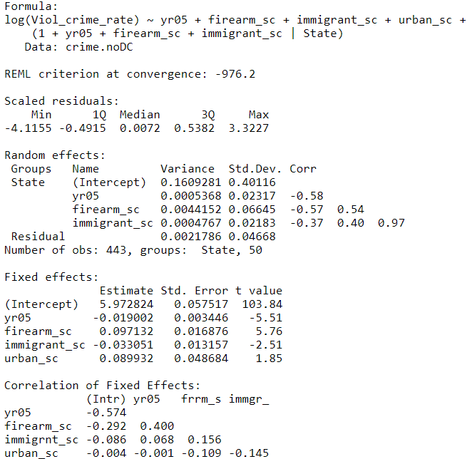
Final multilevel model
Final longitudinal model:
Level One:
Y_{ij} = a_{i} + b_{i}*Immigrant_{ij} + c_{i}*Year05_{ij} + d_{i}*Firearm_{ij} + ϵ_{ij}
Level Two:
a_{i} = α₀ + α₁*UrbanPop_{i} + u_{i}
b_{i} = β₀ + v_{i}
c_{i} = γ₀ + w_{i}
d_{i} = δ₀ + z_{i}
Output:
AIC = -944.14; BIC = -878.69
Conclusion:
It appears that there is a negative association between violent crime rate and immigrant arrival

Slide 17
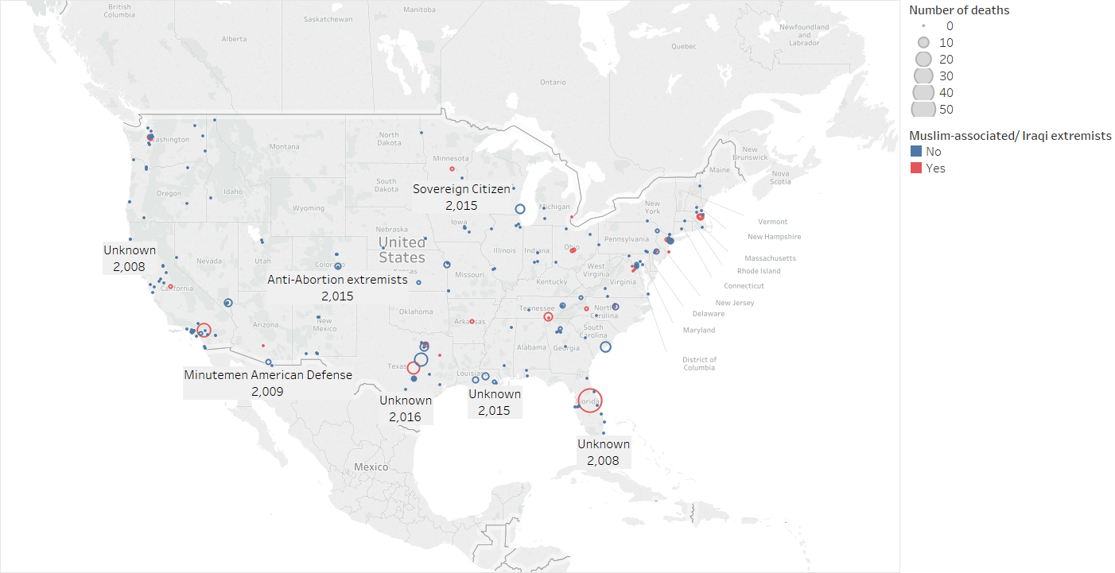
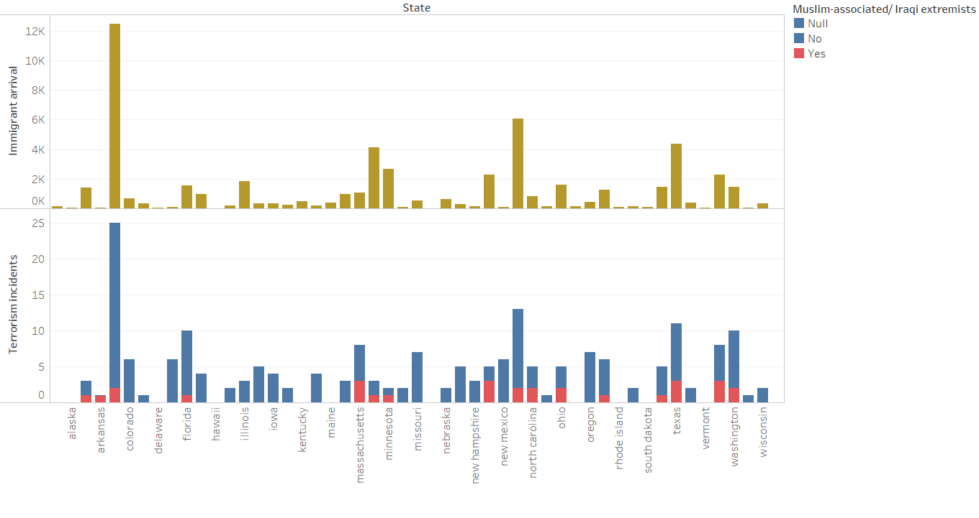
Terrorism incidents
What is the relationship between immigrant arrival and terrorism?
Conclusion:
It appears that there is not an association between terrorism incidents and immigrant arrival. The majority of terrorism attacks were not carried out by Muslim associated or Iraqi extremists.
Notes:
Point out different scales in first plot

Slide 18
Measuring Success
Dataset from iPums USA
Immigrant dataset - dataset containing individuals from the 8 banned countries
Filtered by Age : 25 years and above
From 2005 - 2016
N = 21,500
Non-immigrant dataset - dataset not containing individuals from the 8 banned countries
Filtered by Age : 25 years and above
From 2005 - 2016
N = 10,000

Slide 19
Measuring Success
Definition of success in this study
Employment
Poverty
Food stamps
Ownhome
Health
Notes:
Say IPUMS USA on slide
Say “and” sampled

Slide 20
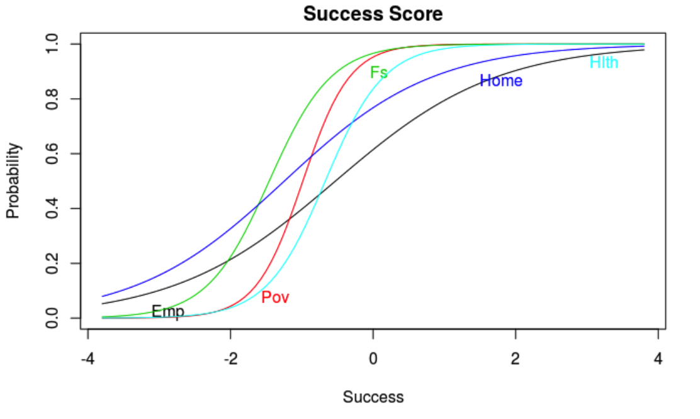
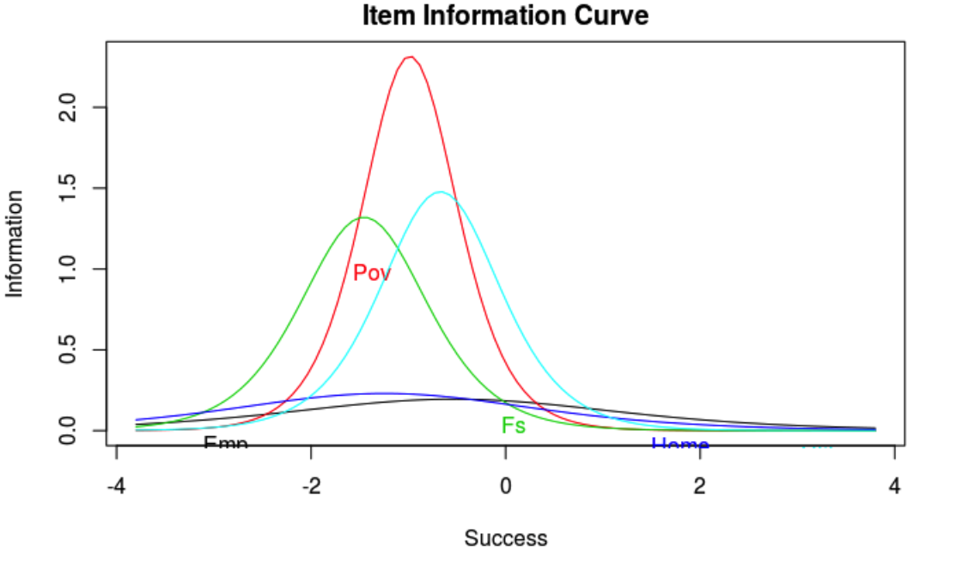
Item Response
Notes:
Discrimination parameter - examinees well below average would have a 88% chance of answering that they are employed , 95% chance of owning a home
The upper curve has a high level of discrimination since the curve is quite steep in the middle where the probability of correct response changes very rapidly as ability increases.
Say this is everybody (both immigrants and nonimmigrants)
In general the probability of those well below average to be above the poverty level , not have foodstamps and have private health insurance increases rapidly as the success score increases.

Slide 21
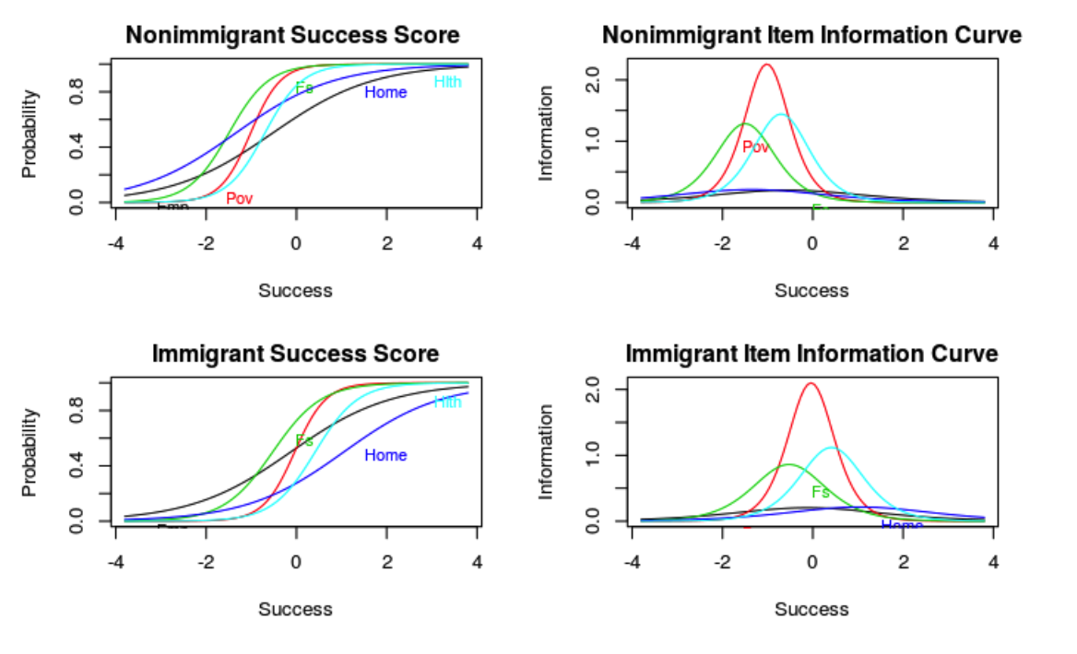
Nonimmigrant vs Immigrant Item Response

Slide 22
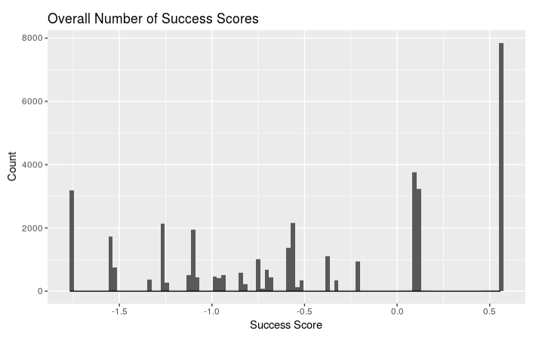
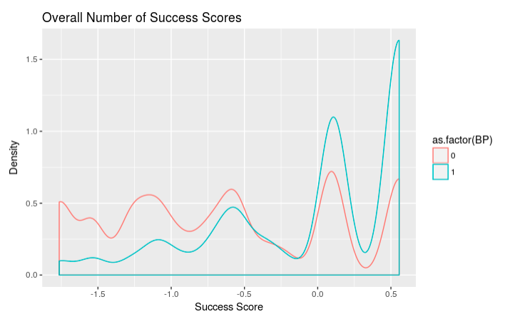
Success EDA
Notes:
Josh
Here we have a histogram of the success scores, with the success score on the x axis and a count of the number of successes on the y-axis. We can see that it is fairly left skewed and that the most successes are about 0.55 (which is actually the maximum success score). However, when we look at the density plot between the immigrants and nonimmigrants, with the red being immigrants, we can see that many of these high success scores are in the nonimmigrant group. Not only that, but we can see that there are more immigrants than nonimmigrants who have success scores lower than 0, and then as the success increases, the number of nonimmigrants becomes higher than the number of immigrants.

Slide 23
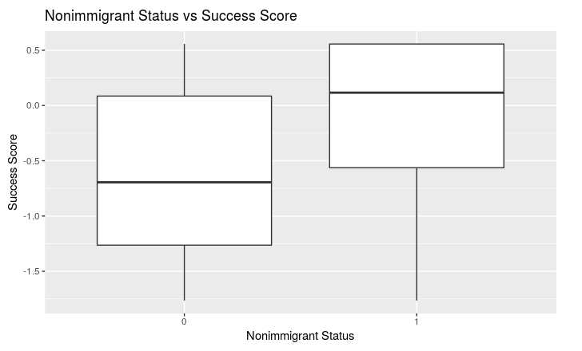
Success EDA (cont.)
Group | Success Mean | Success Median
Overall | -0.4773753 | -0.5628491
Immigrant | -0.6343786 | -0.694841
Nonimmigrant | 0.05434582 | 0.1158217
Notes:
Josh
This boxplot tells a similar story as the histogram and density plot, with 0 being the immigrants and 1 being the nonimmigrants on the x axis, and the success score on the y axis. We can see that the success scores for immigrants are fairly normally distributed with the median being -0.695. However, we can also see that the nonimmigrants are skewed right, and that the median is much higher at 0.1158. The boxplot shows that the top 50% of nonimmigrants, are still higher that the bottom 75% of immigrants.

Slide 24
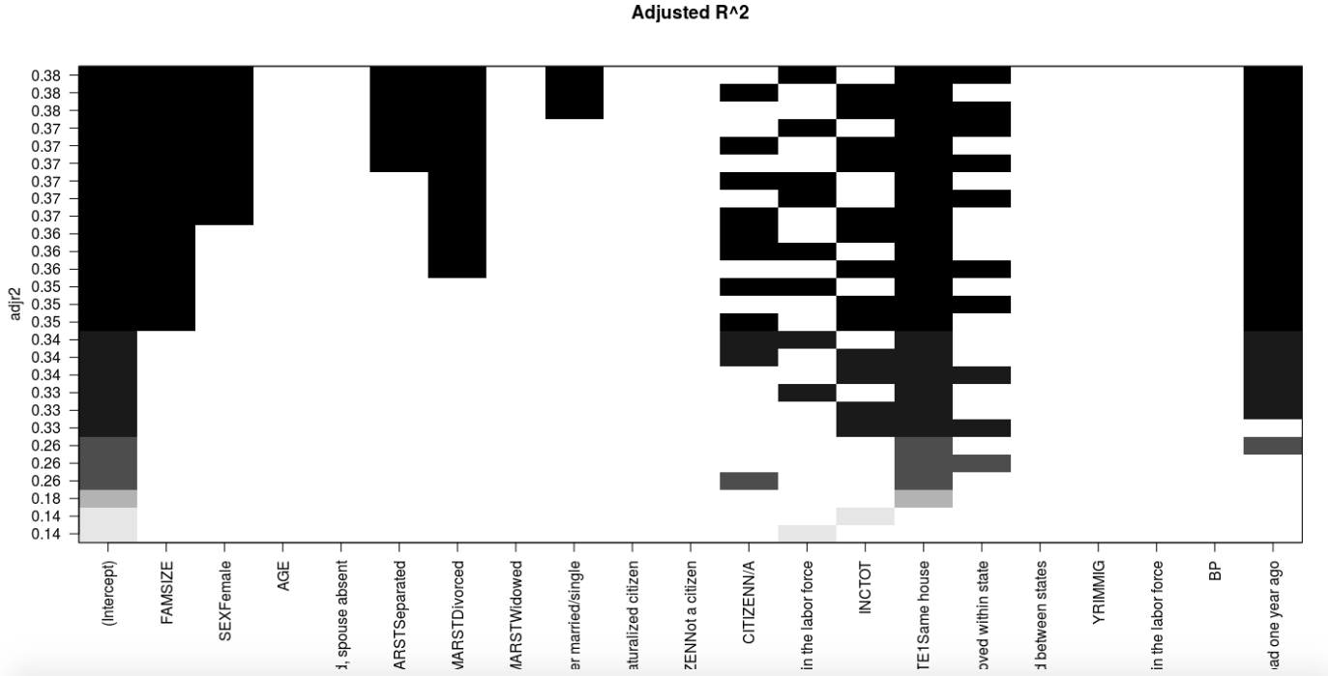
Model Selection
Use best subset to maximize R^2
Included 10 variables:
FAMSIZE + SEX + AGE + MARST + CITIZEN + LABFORCE +INCTOT + BP+MIGRATE1 + YRIMMIG
Maximum R^2 is 0.38
Notes:
Josh
Create Variable with 10 coefficients
Our next step was to create a linear model to predict the success scores. The best subset regression model maximizes an R^2 value out of the 10 variables we chose to use. From the graph, we see that the maximum R^2 value is 0.38, and the black rectangles indicate which variables to include if we want that R^2 value.

Slide 25
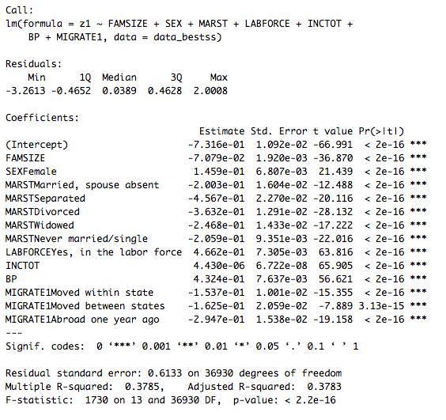
Final Model
Included 7 Variables
Included BP even though it wasn’t in maximum R^2
Notes:
Josh
Our final model includes family size, sex, marital status, health insurance coverage, labor force, total income, immigrant/non immigrant indicator, and migration status. We compared this to a few different models such as one without the migration variable, and found that this model is the best. We also added total income, because we felt like it is a good variable that we would be able to compare between the two different groups, and a good measure of success. Though our final model has an adjusted R-squared of 0.3785 instead of 0.38, we felt as though it is okay to lose some of the variability, if we can also account for income and immigrants/nonimmigrants.
From our summary statistics, we see that if a person is single, male, married, does not have health insurance, is not in the labor force, is not an immigrant, and did not move within the last year, then the estimated success score is -0.73. For every one person increases in family size the estimated success score decreases by 0.07. When we look specifically at the immigrant/non-immigrant indicator (BP), we find that the estimated success score (z1) increases by .43 points if the person is a non-immigrant, after accounting for all other variables (p = 2e-16). Another interesting notion is that if a person is in the labor force the estimated success score increases by 0.466, after accounting for other variables. This is the highest increase for all of the variables in our model.

Slide 26
Conclusion & Limitation
It appears there is a negative association between violent crime rate and immigrant arrival from the travel ban countries from 2005 to 2014
Immigrants within more privileged states are often under-privilege making their living conditions more polarized → negative stereotypes
Immigrants obtain significantly less success than non-immigrants → the disparity in the available opportunities for both groups
Notes:
Josh
Have person who said result say it
Our longitudinal model suggests that there is no significant relationship between violent crime rate and immigrant arrival from the travel ban countries from 2005 to 2014. This invalidates the negative stereotypes that drive the Trump Administration to ban people from Muslim-majority countries to ensure “the safety and security of the American people”.
In fact, cluster analysis infers that immigrants living predominantly white, liberal, and rich states tend to be underprivileged. In these states, we see lower total family income and a higher ratio of immigrants who are unemployed, do not own a car, and receive Food Stamps compared to those living in other states. This is because immigrants within more privileged states are often under-privileged making their living conditions more polarized. This likely prompts negative stereotypes that immigrants are poor, which then makes their integration into the US even harder.
In fact, results from the Item Response Theory authenticate this further by showing that immigrants obtain significantly less success than non-immigrants. This is because their definition of success is achieved through owning a home instead of having health insurance as it is the case for nonimmigrants. This leads to our conclusion that there is an economic gap between immigrants and nonimmigrants which could be attributed to the disparity in the available opportunities for both groups. Further research should be done to create policy changes that provide economic equity and prevent polarization of immigrants and nonimmigrants.

Slide 27
Conclusion & Limitation
Limitation of unsupervised learning methods
Using training and test samples
No control for more state-level variables in the longitudinal model that explains violent crime rate
Assumption of independence of variables
Notes:
Josh
Our research project faces several limitations. It is often hard to evaluate results from unsupervised learning methods because there is no such prediction model to validate results, which are subject to different interpretations. In this way, although there is no such true answer to compare, the results can be used to check works before modeling. Because of time limit, we could not include and control for more state-level variables in the longitudinal model that explains violent crime rate. We were not able to model terrorism incident data because it is too sparse. For the analysis that uses item response theory, we assume independence between all variables. However, it is difficult to assume true independence between all factors (e.g. poverty and food stamps).

