Slide 1
Seq-2-Seq Model for Chatbots (DNLP)
----Pengfei (Leoanrd) Li

Slide 2
Chatbot in customer service

Slide 3
Introduction and Motivation
Chatbot is one of the most prevailing and state-of-art deep learning model. One can take a look at the Microsoft’s latest product bot developer framework.
Neural Machine Translation.
Two ways: retrieval-based models and generative models.
The former one chooses the response from a bag of responses, i.e. answers.
The latter generates the responses word by word. It is less likely to produce many grammatical errors.
Basically, the chatbot, an indispensable component of bot platforms
NLP (natural language processing)
deep learning techniques
Mimic the human-like conversations.

Slide 4
Problem definition
The seq-2-seq model is the whole point of chatbot (a conversation agent.). We propose a query and then the PC provides an answer. As a machine learning model, the inputs and outputs can be clarified briefly as follows.
The inputs and outputs are English questions and answers in our everyday life. They are the oral sentences or phrases in our daily conversations (or the dialogs in the movie).
Examples of the input: ‘Right. See? You’re ready for the quiz.’, ‘hi.’, and ‘Sure have.’
Examples of the output: ‘I don’t want to see that through.’, ‘Looks like things worked out tonight.’, and ‘I really, really wanna go.’

Slide 5
Solution
As mentioned above, our model is a seq-2-seq model that consists of two stacked LSTMs.
As the major concern in this model is that the output should be ordered grammatically. The LSTM is well-suited to solve sequence modelling.
Comparing to RNN, it can save the short-term memory for a long time thus mimic the mechanism of English conversation. It is also good at dealing with gradient exploding and vanishing.

Slide 6
Design
I the details upon the seq-2-seq model.
The diagram above provides us a big picture of the seq-2-seq model.
As we can see, the input is “Are you free tomorrow?” and the output “Yes, What’s up?”. Each word of the input is fed into each left LSTM cell one by one sequentially. Meanwhile, each word of the output is the return of each right LSTM cell, and every previous word is also fed into the next LSTM cell.

Slide 7
Architecture (Algorithm)
NLP : Text Substitution, List and Dictionary
Model Splitting and Evaluation.: Next Page
Deep Learning:
1. Encoder RNN, Decoder RNN,
Word Embedding,
Learning Rate Decay, Adam Optimizer and Clipped Gradient
Attention-based mechanism
Dropout Method

Slide 8
Evaluation of Model
Common metrics such as BLEU is not suitable. In fact, in How NOT To Evaluate Your Dialogue System: An Empirical Study of Unsupervised Evaluation Metrics for Dialogue Response Generation researchers find that none of the commonly used metrics really correlate with human judgment.
Thus, our model is designed in this way. Training and validation set of 85/15 ratio of the whole dataset. The loss function of training and validation is the cross-entropy function.
We justify our result by asking our own questions, which can be seen as the testing dataset.

Slide 9
Data
My data is the Cornell Movie Dialogs Corpus.
The collectors are Cristian Danescu-Niculescu-Mizil and Lillian Lee. They made the data from IMBD movie scripts database. They handled the data in a systematical way, e.g. discarding the movies with less that 5 votes, removing the pairs with less than 5 conversational changes, etc.
It has 220,579 conversational exchanges between 10,292 pairs of movie characters. The sentences are of various length.

Slide 10
Implementation
Python
“re” library : “re.sub”,
Parse, text substitution, for loop, append method
“TensorFlow” library: “tf.placeholder”, “tf.strided_slice”, “tf.contrib.rnn.BasicLSTMCell”
I assembled the graph based upon the architecture above. Then I executed the computation. The code is running on Google Collaboratory.

Slide 11
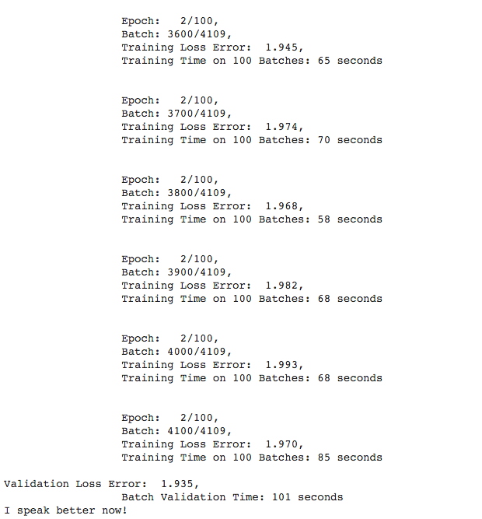
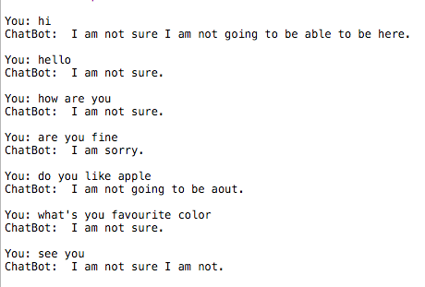
Results

Slide 12
Related Works
It is a very hot topic. And many others have a lot of fancy results. Two links provided below.
Chatbots with Seq2Seq by Suriyadeepan Ram
Pytorch-chatbot by Alexis David Jacq
I also recommend to read Deep Learning for Chatbots, Part 1 – Introduction
to get more details.

Slide 13
Conclusion
Deep learning is a boosting and extremely comprehensive topic. And maybe what most of us know is a tip of iceberg. In this object,. This DNLP provides a brain simulation to let the machine mimic the behavior of a human.
Besides, I spend plenty of time finding a computation cluster and end up with Google Colab. But it can only train some epochs (as it is free). To delve deeper, one need to invest in GPU and have such a machine at hand.
In order to get better results, the NLP part also matters a lot, e.g. what special symbol to filter out. When we play with model, we need to carefully tune the parameters. It would be a heavy workload.

Slide 14
Thank you

