Slide 1
RSA ENcryption
Presented by Aaron, Dan, Mario, and Sean

Slide 2
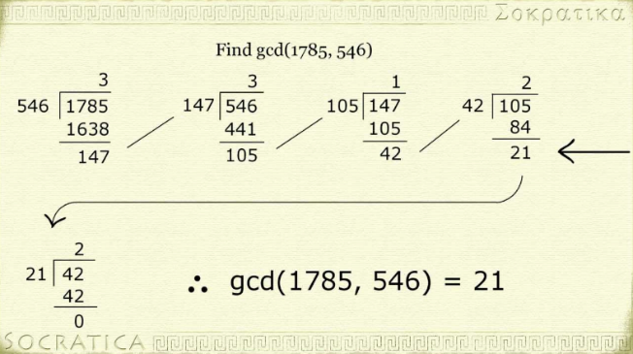
The euclidean algorithm

Slide 3

Important Theorems
Euler’s Generalization: For the Euler totient function $φ\left(n\right)$ and $a, n$ relatively prime, $a^{φ(n)}≡1$mod($n$)
Also important: $φ\left(pq\right)=(p −1)(q −1)$ for two primes

Slide 4
Public key cryptography
In public key cryptography there are two keys
Public key: This key is used to encrypt messages and is made available to the world
Private key: This key is not made known to the world and is used to decrypt messages

Slide 5
RSA Concepts
RSA encryption breaks an input message into manageable pieces that are converted to numbers and then encrypted before being sent to the receiver and decrypted.
RSA is a public key encryption.

Slide 6
RSA Constants
p = a large prime
q = a large prime
n = p * q
e: gcd(e, phi(n)) = 1
d: e * d = 1 mod phi(n)

Slide 7
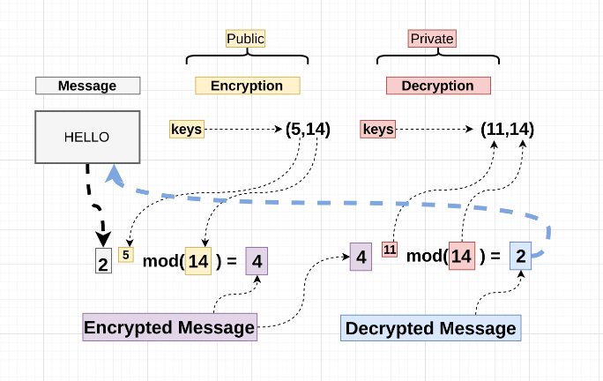
RSA explained

Slide 8

Small RSA Example
Let $p = 13$ and $q = 7$
Let $M = 5$, and select $e = 23$
Encryption: Compute $M^{e}$
We can determine that $d = 47$
Decryption: Compute ${(M^{e})}^{d}$

Slide 9
How to crack rsa…?
One way to break RSA is to factor N. This is very difficult to do with large values for p and q since factoring a large number is very inefficient.
Most factoring algorithms do not help much to factor N in a reasonable amount of time.
Issues regarding the correctness of the system are very rare for sufficiently large N.

Slide 10
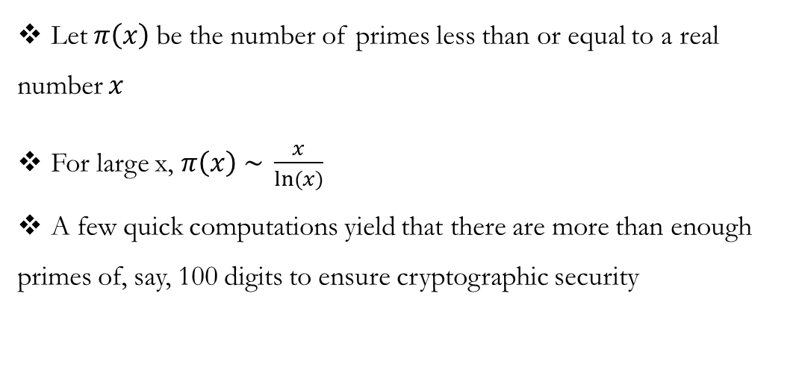
Prime Number Theorem
Let $π\left(x\right)$be the number of primes less than or equal to a real number $x$
For large x, $π\left(x\right) \sim \frac{x}{ln⁡(x)}$
A few quick computations yield that there are more than enough primes of, say, 100 digits to ensure cryptographic security

Slide 11
Quantum computing
A quantum computer could instantly break RSA.
Quantum computers aren’t limited to two states, because they have quantum superposition.
According to physicist David Deutsch, this parallelism allows a quantum computer to work on a million computations at once, while your desktop PC works on one.

Slide 12
Shor’s algorithm
Given an integer n find its prime factors.
If a quantum computer with a sufficient number of qubits could operate without succumbing to noise and other quantum decohernece phenomena, Shor’s algorithm could be used to break public-key cryptography schemes such as RSA
RSA is based on the assumption that factoring large numbers is computationally intracable.

