Slide 1
EEE 495 FINAL PRESENTATION
Team No: 1
Team Members:
Pelinsu Acar
Alihan Koçoğlu
Emre Uludağ
İbrahim Burak Yorulmaz

Slide 2

Motivation
COVID-19, today's biggest problem and many people have suffered from this. Our aim is to help overcome the pandemic process without any trouble by using technology and make it accessible to everyone.

Slide 3
PRODUCT
The final product has 2 main functions.
Checking the body temperature of the people going in to make sure they are not sick.
To follow that the people inside obey the mask rules.
The data obtained from these two systems can be followed from the android application with the help of the server.

Slide 4
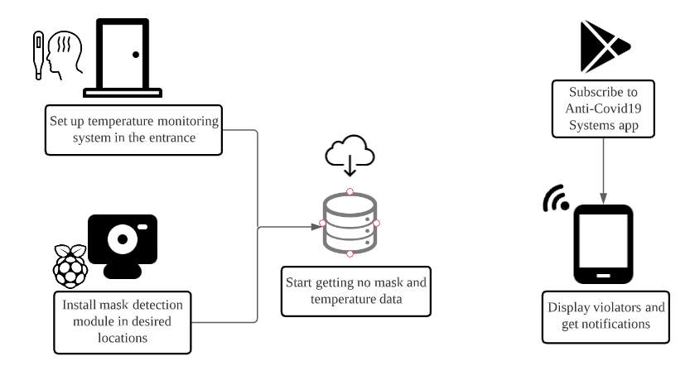
Product design

Slide 5
Hardware & software design specifications
The hardware system consists of two main submodules.
One module is designed for face mask detection using Raspberry Pi and camera.
Other module is in use for temperature monitoring and entry permit. This system is powered by Arduino Uno and sensors. Also this part of the system includes the connection to Android phone through server.
The software system consists of three different parts which are running on Raspberry Pi, Android application and cloud server.

Slide 6
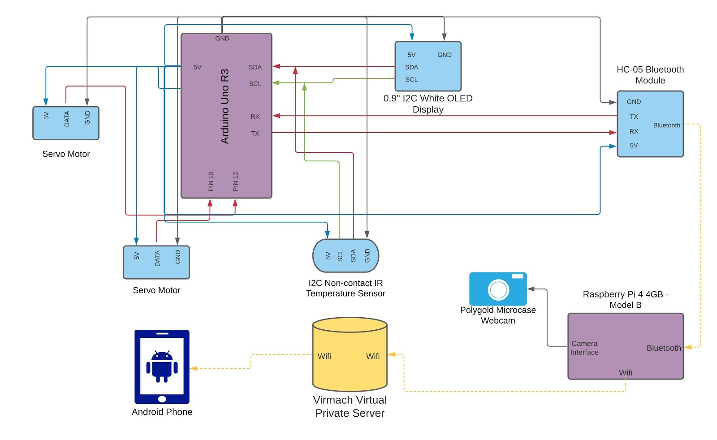
HARDWARE Block diagram

Slide 7
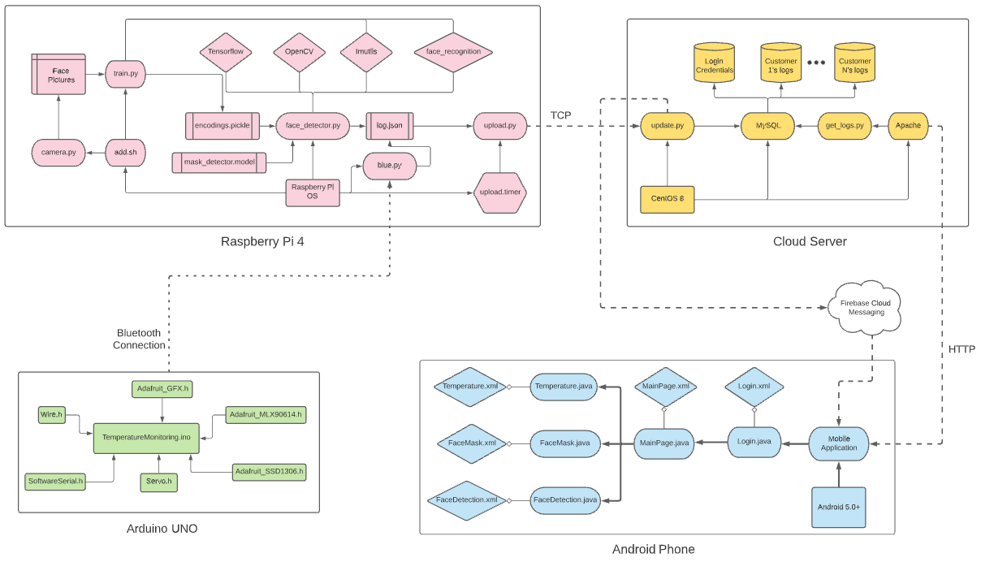
Software block diagram

Slide 8
achievements
By the face mask detection system, we were able to detect people who do not wear masks and understand who they are if their faces are registered in the system.
With the temperature system, by measuring the temperature of the people who entered, we were able to detect people who were sick and prevent them from entering.
We managed to transfer all the information to the android application by using the server over the Internet.

