Slide 1

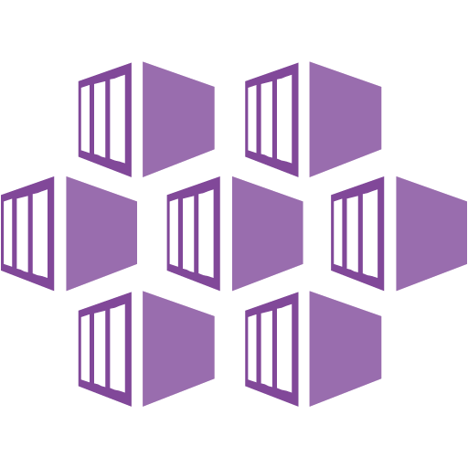
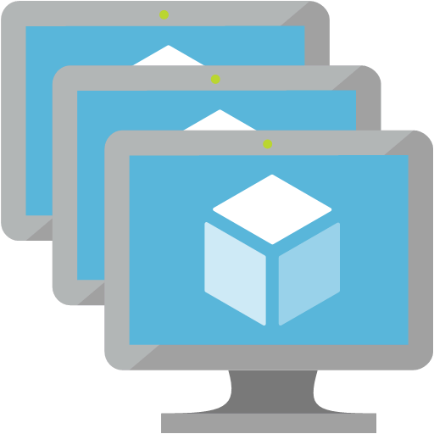




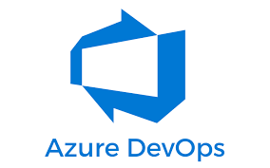





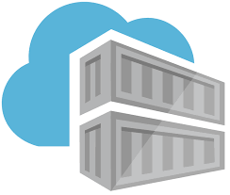
QA
VNET
snet-clusteringingressservices subnet
snet-clusterpools subnet
snet-applicationgateway
AKS
AKS nodepool
”npsystem”
AKS
subnet
NSG
AKS nodepools
subnet
NSG
Appgw
Public IP
Appgw
subnet
NSG
AKS ILB
AppGW+WAF
AKS nodepool
”npuser01”
Service Connection
(Contributor+User Access Admin)
Private endpoint key vault
Egress
Public IP
DNS Zone
Keyvault
Managed identity
mi-appgateway-frontend
Managed identity
mi-aks-control plane
Managed identity pod-ingress-controller
replication
Keyvault
(Public Access for test only)
Container Registry
Container Registry
Replica
Notes:
- podmi-ingress-controller - User Managed Identity for the cluster's ingress controller pods. Used for Azure Key Vault Access.
- mi-appgateway-frontend - Managed Identity that App Gateway is assigned. Used for Azure Key Vault Access.
- mi-aks-control plane - The control plane identity used by the cluster. Used for networking access (VNET joining and DNS updating)
- Service Connection is Service Principal in AAD with Contributor and User Access Admin rights in Subscription

Slide 2
PROD
VNET
snet-clusteringingressservices subnet
snet-clusterpools subnet
snet-applicationgateway
AKS
AKS nodepool
”npsystem”
AKS
subnet
NSG
AKS nodepools
subnet
NSG
Appgw
Public IP
Appgw
subnet
NSG
AKS ILB
AppGW+WAF
AKS nodepool
”npuser01”
Private endpoint key vault
Private endpoint Container Registry?
DNS Zone
Keyvault
DNS Zone Container Registry?
Managed identity Appgw
Managed identity AKS control plane
Managed identity pod-ingress-controller
replication
Keyvault
(Only private Access)
Container Registry
(Only private Access?)
Container Registry
Replica
Notes:
- podmi-ingress-controller-identity is connected to
-

