Slide 1

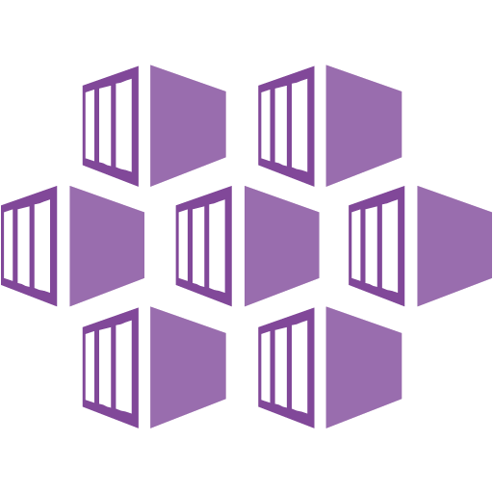
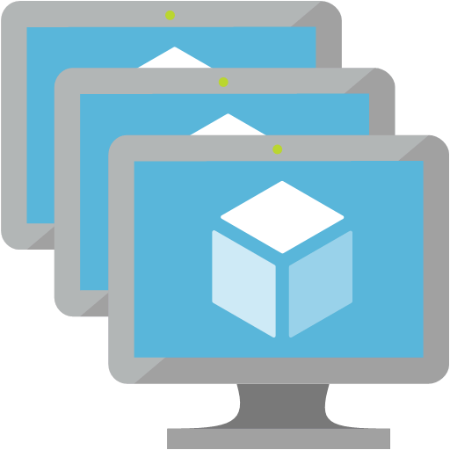




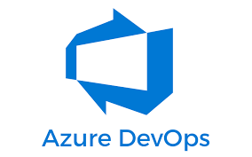





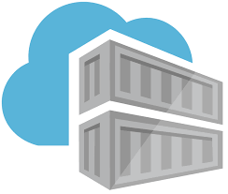
QA
VNET
snet-clusteringingressservices subnet
snet-clusterpools subnet
snet-applicationgateway
AKS
AKS nodepool
”npsystem”
SSL – tobii.com
SSL – internal.tobii.local
AKS
subnet
NSG
AKS nodepools
subnet
NSG
Appgw
Public IP
Appgw
subnet
NSG
AppGW+WAF
AKS ILB
AKS nodepool
”npuser01”
Service Connection
(Contributor+User Access Admin)
Private endpoint key vault
Egress
Public IP
DNS Zone
Keyvault
Managed identity
mi-appgateway-frontend
Managed identity
mi-aks-control plane
Managed identity pod-ingress-controller
replication
Keyvault
(Public Access for test only)
Container Registry
Container Registry
Replica
Notes:
- podmi-ingress-controller - User Managed Identity for the cluster's ingress controller pods. Used for Azure Key Vault Access.
- mi-appgateway-frontend - Managed Identity that App Gateway is assigned. Used for Azure Key Vault Access.
- mi-aks-control plane - The control plane identity used by the cluster. Used for networking access (VNET joining and DNS updating)
- Service Connection is Service Principal in AAD with Contributor and User Access Admin rights in Subscription

Slide 2
PROD
VNET
snet-clusteringingressservices subnet
snet-clusterpools subnet
snet-applicationgateway
AKS
AKS nodepool
”npsystem”
AKS
subnet
NSG
AKS nodepools
subnet
NSG
Appgw
Public IP
Appgw
subnet
NSG
AKS ILB
AppGW+WAF
AKS nodepool
”npuser01”
DevOps
Build VM/agents
Service Connection
(Contributor+User Access Admin)
Private endpoint key vault
Private endpoint Container Registry?
Egress
Public IP
DNS Zone
Keyvault
DNS Zone Container Registry?
Managed identity Appgw
Managed identity AKS control plane
Managed identity pod-ingress-controller
replication
Keyvault
(Only private Access)
Container Registry
(Only private Access?)
Container Registry
Replica
Notes:
- podmi-ingress-controller-identity is connected to
-

