Slide 1
Administering Eclipse site-wide for a large developer base
Michael Pellaton
Netcetera AG

Slide 2
Outline
Deploying the Eclipse SDK
Deploying additional features using an update site
Deploying plug-ins in a shared extension location
Per user plug-in directories
Common preferences
References

Slide 3
Deploying Eclipse SDK
any tool that is able to extract or copy files and add a shortcut to the start menu will do the job
What we do
  create a master Eclipse installation
    extract the original zip file downloaded from eclipse.org
    add some configurations (eg. links subdirectory)
  repackage the master installation using a product called NetInstall
  Deploy Eclipse using a NetInstall client program
Other tools that proved to fit the requirements are
  MacOS X: dmg
  Linux: rpm / dpkg
  Windows: NSIS

Slide 4
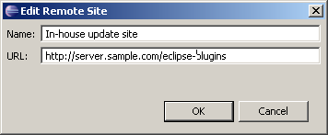
Deploying additional features using an update site
Create an in-house update site to offer features and updates:
  download features / updates you want to offer
  wrap plug-ins in a feature project of none exists
  create an update site project containing all the features
  compile and upload update site to a server
Add your new update site to the list of update sites in Eclipse
Developers can then install the features from the internal site

Slide 5
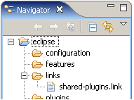
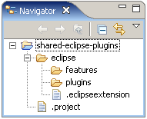

Deploying plug-ins in a shared extension location
Plug-ins can be loaded from a shared extension location
File system structure
in Eclipse install dir:
File system structure
in shared location:
Link file content:

Slide 6
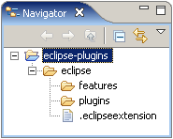
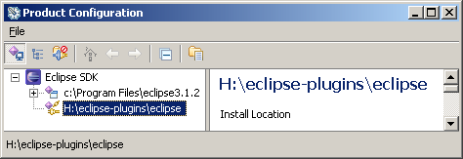
Per user plug-in directories
Eclipse is configured to use each developers own plug-in directory ~/eclipse-plugins as extension location
File system structure
in ~/eclipse-plugins:
Configuration of extension locations:

Slide 7
Common preferences
We use two levels of settings:
  common workspace preferences
  Company-wide set of preferences that are mandatory for each developer (eg. file encoding, use spaces for indention, …)
  project preferences
  We store as much preferences as possible within the projects to attain a high flexibility on the project level and to make sure all developers of a project use same settings.
Deployment of the settings is done using *.epf files and
import and export preferences functions

Slide 8


References
http://help.eclipse.org/help31
http://eclipsewiki.editme.com
http://www.eclipsefaq.org
Eclipse Distilled
by David Carlson
Addison-Wesley, 2005
ISBN: 0-321-28815-7
Eclipse Rich Client Platform
by Jeff McAffer; Jean-Michel LeMieux
Addison-Wesley, 2005
ISBN: 0-321-33461-2

