Slide 1
Python Coding
https://pellcorp.github.io/coding/docs/python-coding.pdf

Slide 2

Windows Terminal Tips
In windows Terminal you can use the arrow keys
The up and down arrows can be used to use previous commands
The left and right arrows can be used to edit a command in place.
The TAB key can be used for command completion.
For instance, I want to change to the Documents folder, I can type cd Do and then the TAB key and Windows Termimal will complete the command for me.

Slide 3
Python
We are going to learn by doing, including playing with and changing some sample code.

Slide 4
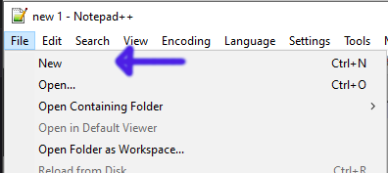
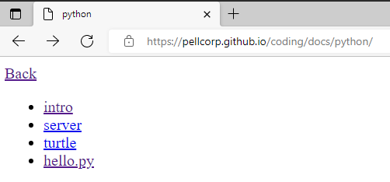
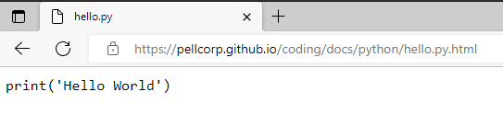
Python Hello World
Open Chrome or Edge
Type coding.pellcorp.com into the location bar and hit the Enter key.
Click on the hello.py link
Select all the code by using CTRL key and A key
Copy the selected code by using CTRL key and C key
Back to Notepad++
Use File → New to open a new tab
Paste the code into the new Notepad++ tab using CTRL key and V key

Slide 5
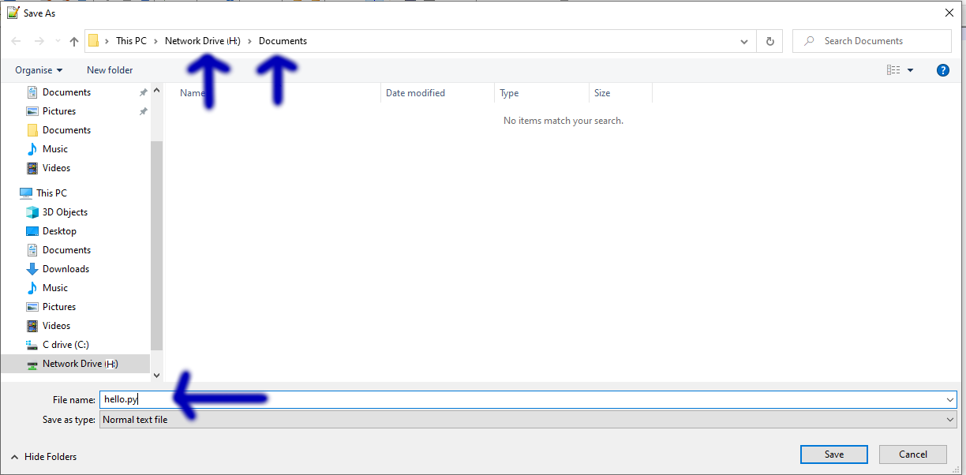

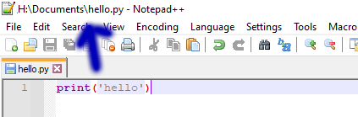
Save hello.py to H:\Documents Cont.
Click File → Save As
Save to H:\Documents folder with hello.py as the File name
You should now see H:\Documents\hello.py at the top of Notepad++

Slide 6
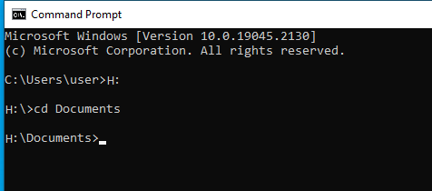
Windows Terminal
Windows Key + R Key
Then cmd and Enter key
Change the drive letter to H: by typing H: and Enter key.
Change to H:\Documents by typing cd Documents and Enter key

Slide 7
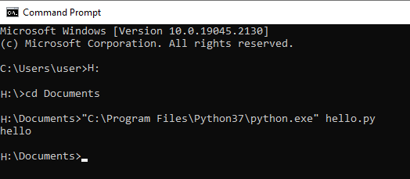
Run hello.py
“C:\Program Files\Python37\python.exe” hello.py

Slide 8
Exercises
Run and modify hello.py
  Change the text that is printed from ‘hello’ to whatever you want, just be sure to keep the single quotes!
  See what happens if you remove the quotes

Slide 9
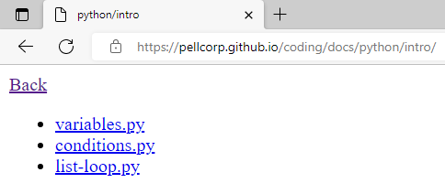
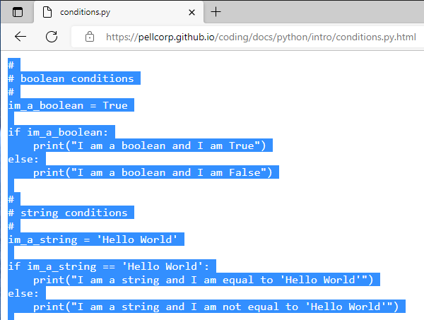
Python Conditions
Open Chrome or Edge
Type coding.pellcorp.com into the location bar and hit the Enter key.
Click on the 2-conditions.py link
Select all the code by using CTRL key and A key
Copy the selected code by using CTRL key and C key
Back to Notepad++
Use File → New to open a new tab
Paste the code into the new Notepad++ tab using CTRL key and V key

Slide 10
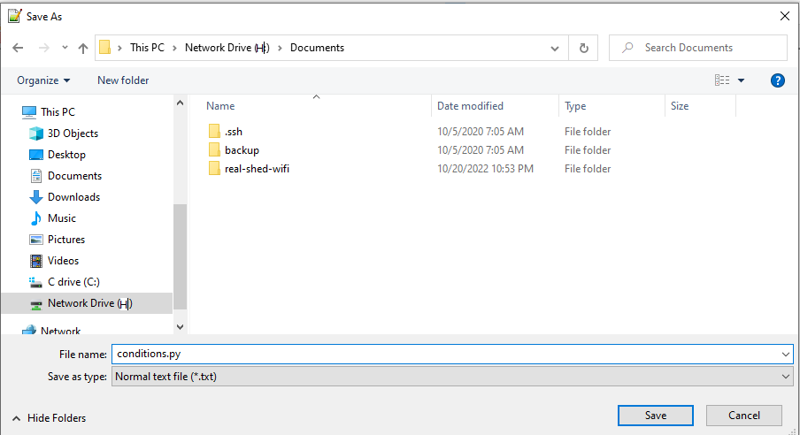
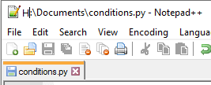
Python Conditions
Click File → Save As
Save to H:\Documents folder with conditions.py as the File name
You should now see H:\Documents\conditions.py at the top of Notepad++

Slide 11
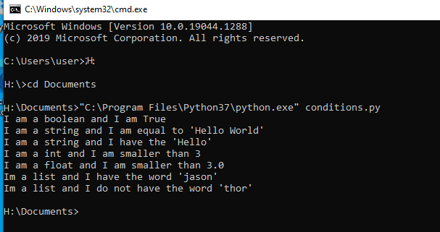
Run conditions.py
“C:\Program Files\Python37\python.exe” conditions.py

Slide 12
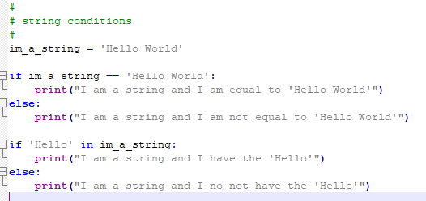
If Statement
Condition operators include:
  == equals
  != not equals
  > greater than
  >= greater than or equal
  < less than
  <= less than or equal
  in value in a string
  not in value not in a string
Comment
Equals Comparison
Partial Comparison
Some of the conditions you can use make more sense for comparing numbers than comparing strings.
For instance >= or <= and so on

Slide 13
Exercises
Run and modify conditions.py
  For each of the boolean, string, int and float if statements change the im_a_ variable so that the a different print statement is executed
  Find the bug(s)

