Slide 1
Python Turtle
https://realpython.com/beginners-guide-python-turtle/
https://docs.python.org/3/library/turtle.html

Slide 2
What is Resolution?
Your laptop has a resolution, this is described in terms of how many pixels can be displayed at once.
A Youtube or TicToc video will have a resolution, described the same way, for instance 720p or 1080p which is also expressed as:
  720p = 1280x720
  1080p = 1280x1080
The first number is usually the width, the second is the height.
So a 720p video is 1280 pixels wide and 720 pixels high

Slide 3
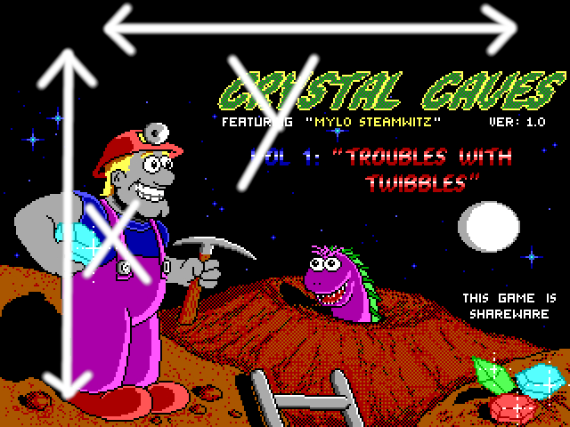
X, Y Coordinates
In Computer Graphics the position of a pixel is expressed as its X, Y coordinates.
The Y is the position across the screen or windows width, while the X is the position across its height.

Slide 4
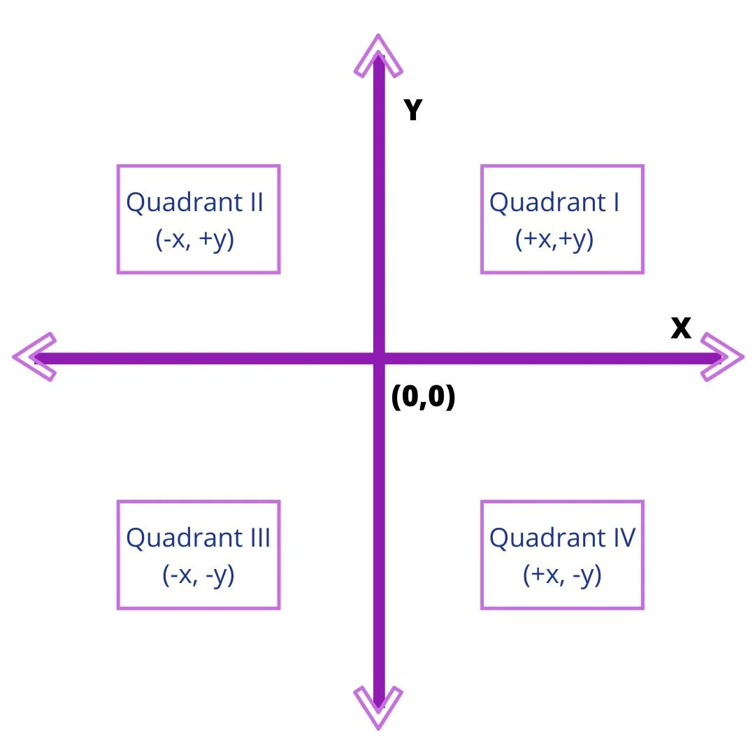
Python Window Coordinates
The goto(x, y) command for turtle positions the turtle in the window.
The coordinates are a bit weird, when X=0, and Y=0, the turtle is in the middle of the window!
Top left of a 360x360 window is:
  X=-160, Y=160
Bottom right of a 360x360 window is:
  X=-160, Y=-160

Slide 5
Samples
square.py – draws a square (obviously :-)
Initials.py – try to draw your initials with the turtle
race.py – race those turtles
pong.py – a version of the rather ancient game called pong, advanced users might be able to figure out how to make it single player

Slide 6
Exercises
Change square.py
  Change the colour
  Draw a different shape
  See how many shapes you can draw all at once!
Change race.py
  Change the Finished text to display the name of the winning turtle, for example change ‘Finished’ so it says ‘Blue Finished First’, of course if blue finished first!
    You will need to think a little about this and perhaps use an if statement with conditions!
  Rig the race, so that your favourite coloured turtle always wins!
Improve the pong game
  You have to move the paddle to make the ball bounce of it, otherwise it goes right through
  Make it single player (no left paddle)

