Slide 1
Python Coding
https://pellcorp.github.io/coding/docs/python-coding.pdf

Slide 2
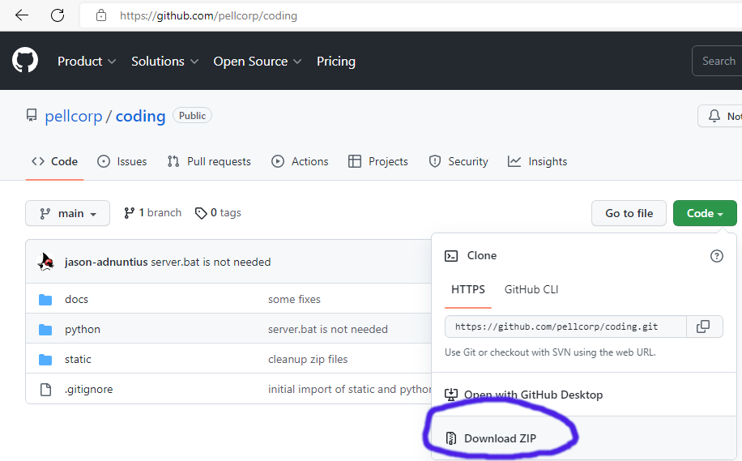
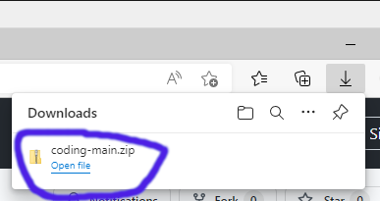
Getting the Sample Code
Open Chrome or Edge and navigate to: https://github.com/pellcorp/coding
Click the green Code button and then the Download ZIP button
Click open file for coding-main.zip in the browser download window.

Slide 3
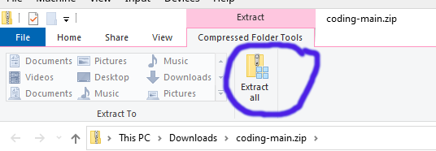
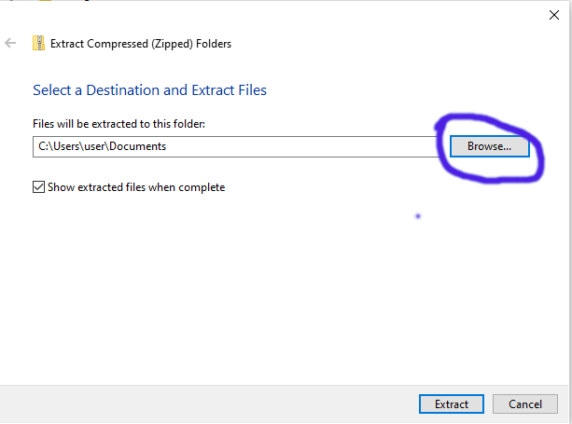
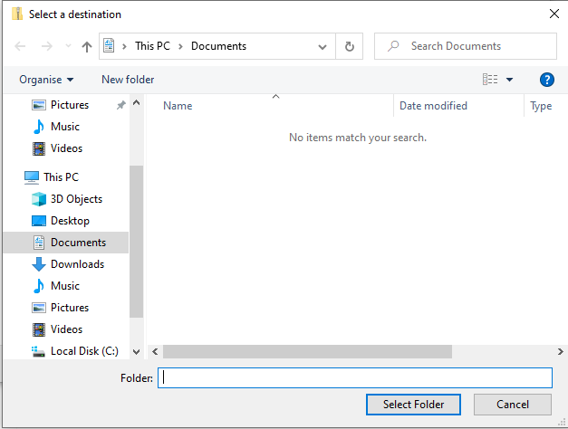
Getting the Sample Code Cont.
Click the Extract all button
When Prompted to Select a Destination and Extract Files, click the Browse… button
And choose your School Drive Folder
Click Extract

Slide 4
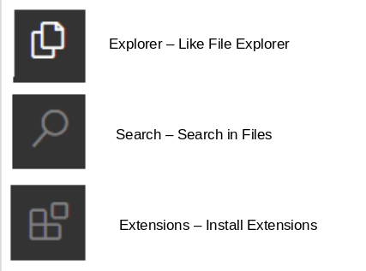
Visual Studio Code (VSC)
Visual Studio Code is also a text editor
But it also makes it easy to run our python scripts directly.
There a few important parts of Visual Studio Code you should familiarise yourself with.
Important buttons:
Don’t worry too much about the others for now

Slide 5

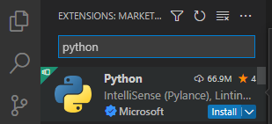
VSC: Add the Python Extension
Start up Visual Studio Code
Click the Extensions button
Search for python and click the install button
And then Wait for it to finish installing
And that is it, once its done we will be able to do some python coding!

Slide 6


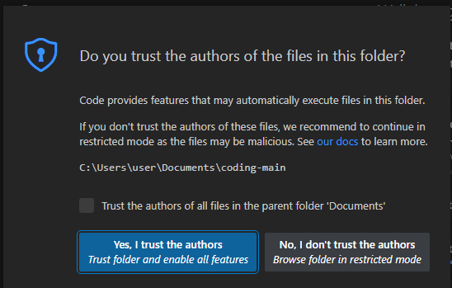
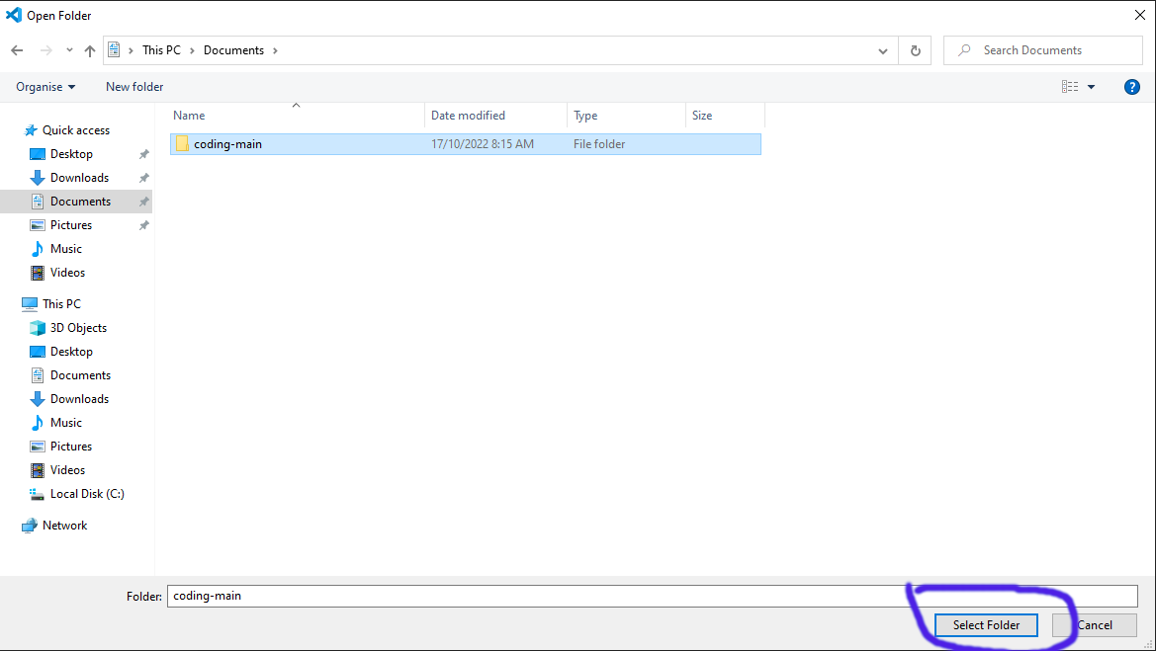
VSC: The Sample Code
Click the Explorer button
Click the Open Folder button
Navigate to the coding-main folder you extracted earlier into your School Drive Folder
Click Select Folder
In the next window, Click the Yes, I trust the authors button.

Slide 7
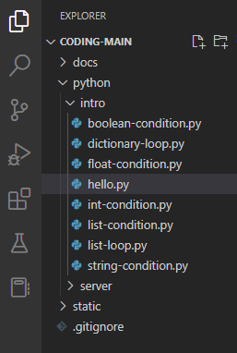
VSC: The Sample Code Cont.
You should see this now:

Slide 8
What is Python
A programming language which is very popular, especially for beginners.
We are going to learn by doing, including playing with and changing sample code.
What are we going to do:
  Output – printing to the console
  Variables
  Conditional Statements
  Loops
The turtle if we have time!

Slide 9
Python - Variables
Strings
  “Hello World”
Integer Numbers
  Are whole numbers, numbers without decimal points
Floating Point Numbers
  Are numbers with a decimal points.
Booleans
  True or False
  Boolean arithmetic
Lists
  A way to group values into a structure, so that python can operate on them together, an example would be:
    states = [‘VIC’, ‘NSW’, ‘TAS’, ‘SA’, ‘NT’, ‘QLD’, ‘WA’]

Slide 10
Python If Statements
We are going to be playing with IF statements today, they look like this:
if <condition>:
  statement
elif <condition>:
  statement
else:
  statement
Don’t worry too much about understanding it all, hopefully once we start hacking on the samples some of it will become a bit clearer.

Slide 11
Python If Statement Conditions
A condition is something that evaluates to true or false, and example would be.
A condition is of the format:
  value or variable <operator> value or variable
Condition operators include:
  == equals
  != not equals
  > greater than
  >= greater than or equal
  < less than
  <= less than or equal
  in value in a list or string.
  not in value not in a list or string

Slide 12
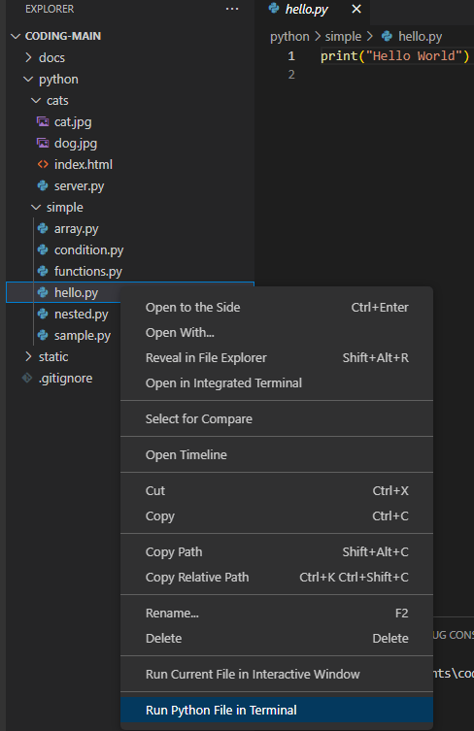
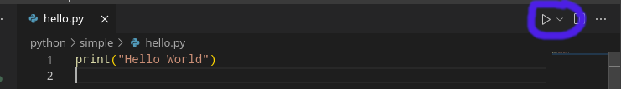
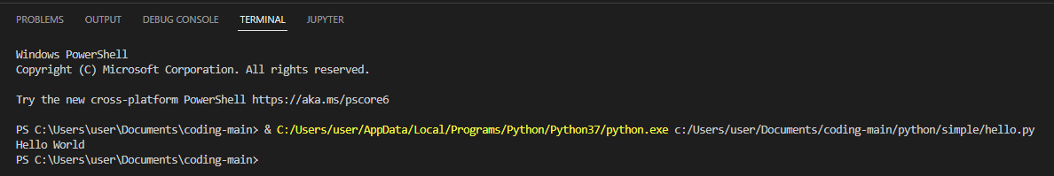
Running Python from VSC
Right Click on a .py file (for example hello.py) and choose Run Python File in Terminal
You can also click the Play button over on the right
The output is in the Terminal

Slide 13
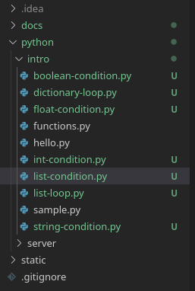
Samples
The python intro folder
The Basics:
  Hello World
  If Statements
  Lists
  Dictionaries
Functions
All together now!

Slide 14
Exercises
Run the hello.py
  Change the text that is printed to the VSC Terminal window
Hack the following scripts:
  string-condition.py
  int-condition.py
  float-condition.py
  boolean-condition.py
  list-condition.py
Change the code so that it prints different message(s) in elif and else statements.
Run the turtle/star.py
  See if you can get it to draw different things, for help go to:
https://docs.python.org/3/library/turtle.html

