Slide 1
Windows Fundamentals

Slide 2
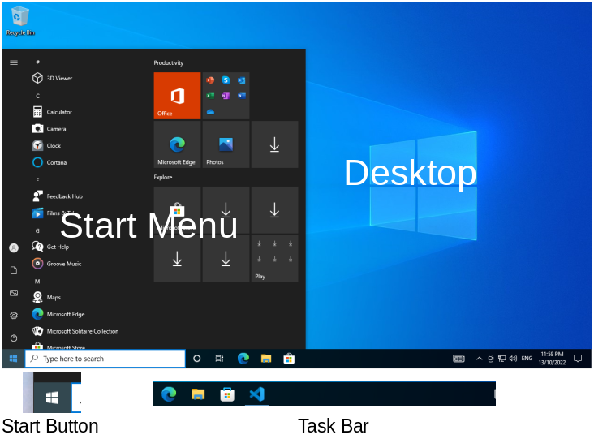
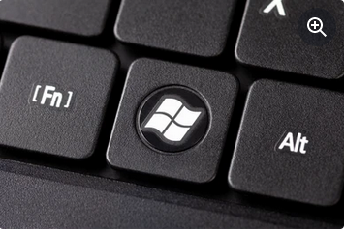
Windows Desktop
Desktop
Start Button
Start Menu
Task Bar
Windows Key

Slide 3
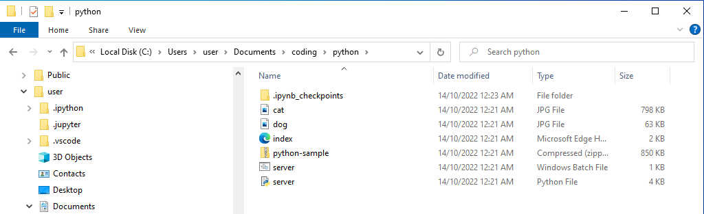
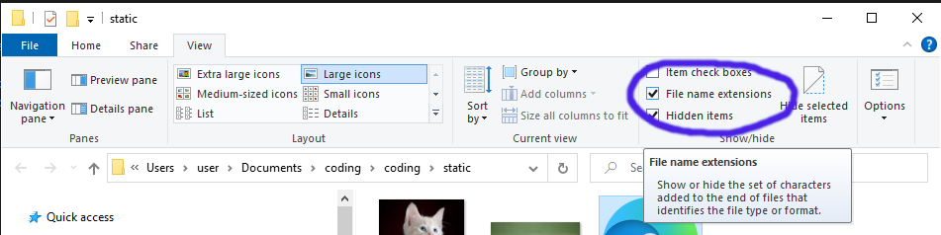
Windows File Explorer
File Explorer allows you to Navigate your C:\ drive.
Enable View File Name Extensions
What is a File?
  A file is an image, a document, a text file, etc
  A file also has some characters after a dot at the end, which is known as the file extension. Windows Hides these by default but we want to see them!
What is a Folder?
  A folder is a collection of files
What is a C:\ Drive?
  The C drive is the ‘hard drive’ inside your computer. It stores all your files and folders

Slide 4
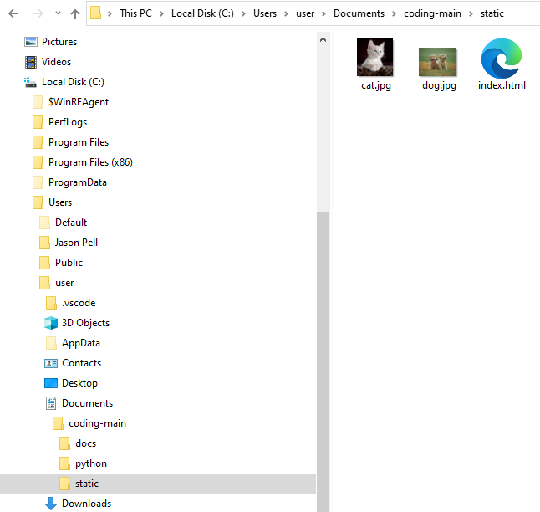
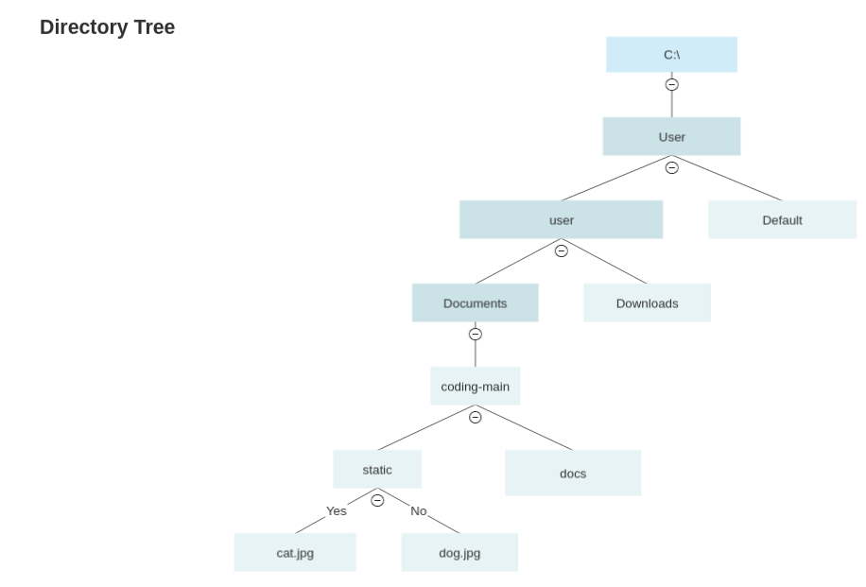
What is a Disk Drive
Is a Folder, with Folders and Files inside it

Slide 5
Files
There are many types of files including:
  Text files – these are simple files that have characters you can read, like letters, numbers and symbols
  ZIP Files – more on those next
  Images – PNG, JPEG, etc
  Documents – like word, excel documents. These are files only the related application can read and understand
Examples of text files include:
  HTML files – for the internet
  Javascript
  Python
To edit text files we use a Text Editor like Notepad++ or Visual Studio Code.

Slide 6
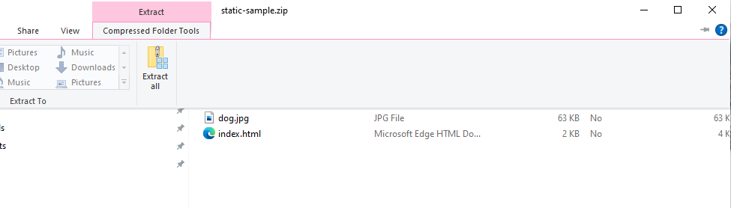
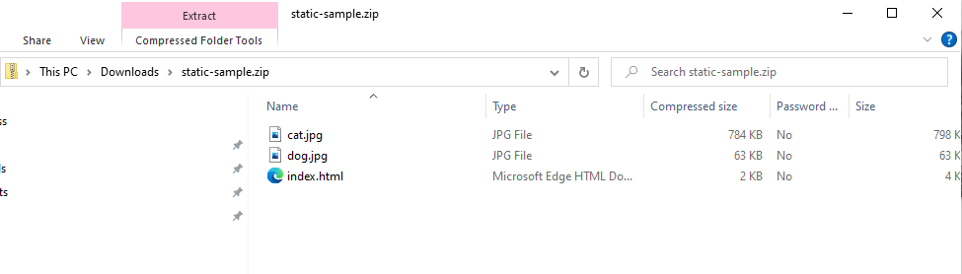
Zip Files
Imagine a ZIP file is a box with books in it, you need to unpack that box to get the books out.
A zip file is like that, you need to unpack it to get the files out.
The static-sample.zip from last week is an example of a zip file.
Windows calls this Unpacking Extract All

Slide 7
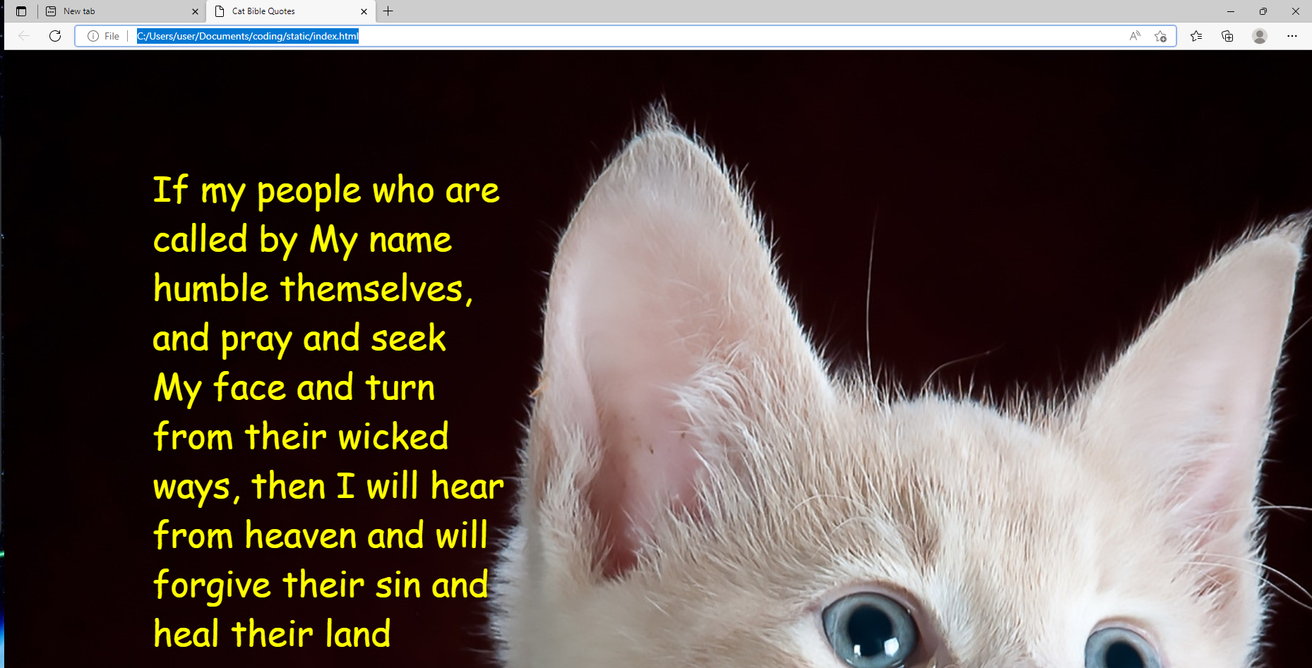
Web Browser
A Web Browser is an application to browse the internet
Popular browsers include:
  Firefox
  Chrome
  Chromium
  Edge
  Safari
All websites use a type of file called a HTML file
In addition web sites are constructed using some additonal files such as:
  Images
  JavaScript
  CSS
I won’t go into these here today though!

Slide 8

File Paths and File URLs
File Explorer and Browsers have different ways of referencing local files and folders.
A browser uses a File URL
File Explorer uses a File path
A File URL looks a lot like a File Path, except the slashes are different!
The File URL:
The File Path:

Slide 9
Browser URLs
Browsers use URLs for the internet too
They look a bit different to File URLs though.
There are few important parts to a URL:
  The Domain Name
  The Path
  Query Parameters
https://gbc.pellcorp.com/installers/?type=vege&name=carrot
The important parts are:
  gbc.pellcorp.com is the domain name
  /installers is the path
  type=vege&name=carrot is the query string, and its everything past the ? Of the URL.
Urls can have ports too:
  http://localhost:8080/quote?type=vege&name=carrot
  localhost is the domain
  8080 is the port
  /quote is the path

Slide 10
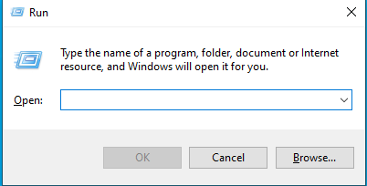
Windows Run Command
Remember the Windows Key?
Windows Key and the R key give you a Run Command window
You can use it to run applications if you know their name.
Lets start Notepad using the Run Command.
Type ‘notepad’ into the Run window and hit the Enter / Return key to start notepad

Slide 11
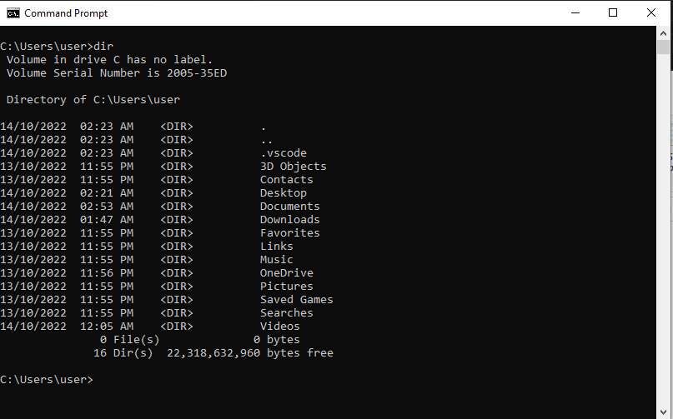
Windows Terminal
The CMD terminal is where you can run applications by typing their name
Use the Run Command window, type ‘cmd’ and hit enter.
With Terminal you can navigate your C:\ drive just like with File Explorer
Some common commands include:
  dir – to display folder contents (give it a try, type ‘dir’ by itself)
  cd <folder name> to change to a different folder
  type <filename> - to display what is inside a file

Slide 12
Windows Terminal Cont.
Exercises
  change to c:\windows
  Display a list of the files in the c:\windows folder
  List all files in c:\windows that have a .exe extension (this might be tricky for some of you, google might help)
  Display the contents of the win.ini file
  Change to your home folder
  Display a list of all files in your home folder

