Slide 1
Python Save File
http://coding.pellcorp.com/python-save-file.pdf

Slide 2
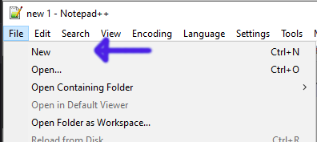
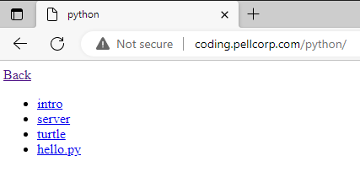
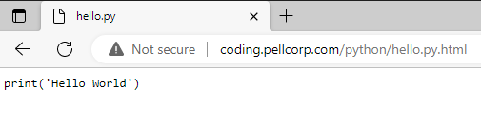
Save hello.py to H:\Documents
Open Chrome or Edge
Type coding.pellcorp.com into the location bar and hit the Enter key.
Click on the python file link you want to copy, for example hello.py
Select all the code by using CTRL key and A key
Copy the selected code by using CTRL key and C key
Back to Notepad++
Use File → New to open a new tab
Paste the code into the new Notepad++ tab using CTRL key and V key

Slide 3
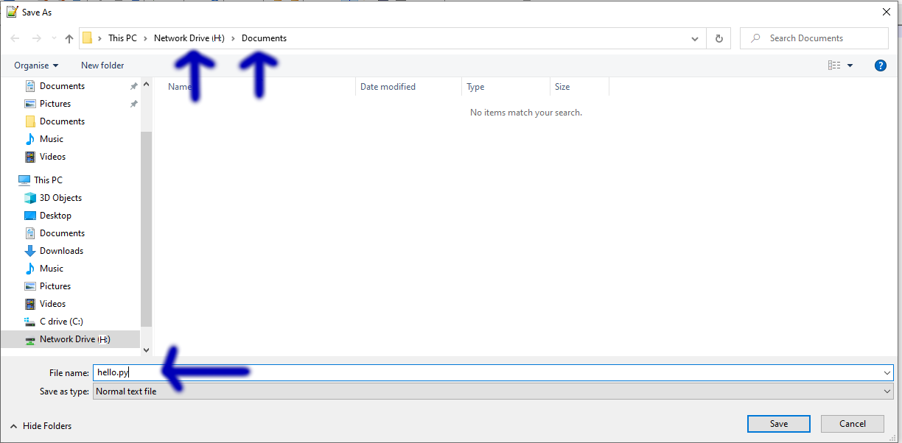

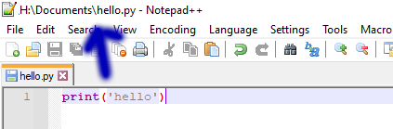
Save hello.py to H:\Documents ...
Click File → Save As
Save to H:\Documents folder with hello.py as the File name
You should now see H:\Documents\hello.py at the top of Notepad++

Slide 4
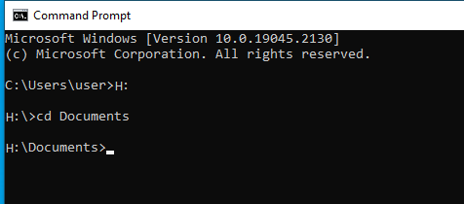
Windows Terminal
Windows Key + R Key
Then cmd and Enter key
Change the drive letter to H: by typing H: and Enter key.
Change to H:\Documents by typing cd Documents and Enter key

Slide 5
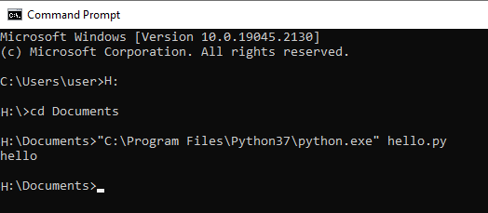
Run hello.py
“C:\Program Files\Python37\python.exe” hello.py

