Slide 1
Mango
https://pelle.io/mango

Slide 2
What is Mango
Model based Framework for Web applications
Generic UI for CRUD UI

Slide 3
Project Bootstrapper 1/2
curl -s https://pelle.io/mango/bootstrap.sh | bash -s "org.example.Project1"
Template project for a quick start
Can be used as seed for your project
No prerequisites needed

Slide 4
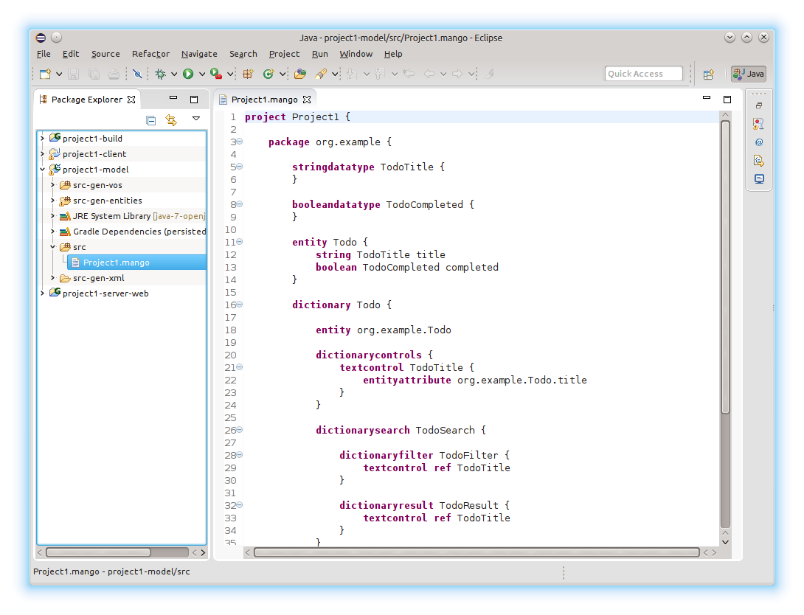

Slide 5
Generated artifacts
Entities
  XML
  WSDL for import/export
  Value Objects
Spring application context
Services
  GWT Remote Service Interface

Slide 6
Architecture
Spring Framework
Gradle
Hibernate
GWT

