Slide 1



Comodulation of h- and Na+/K+ Pump Currents Expands the Range of Functional Temporal Bursting Properties in a Central Pattern Generator
Parker J. Ellingson¹, William Barnett¹, Daniel Kueh², Alex Vargas¹, Ronald L. Calabrese², Gennady Cymbalyuk¹
¹Neuroscience Institute, Georgia State University, Atlanta GA 30303 USA
²Department of Biology, Emory University, Atlanta GA 30322 USA
Neuromatch Conference 2020 5/25 – 5/27

Slide 2
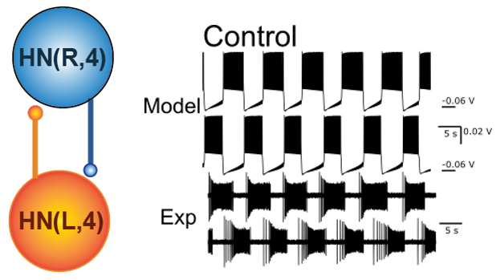
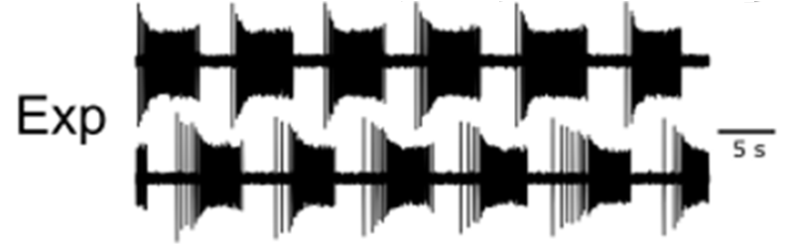
Leech Heart Interneuron Pacing CPG is
a Half-Center Oscillator Circuit
The timing control circuit in the heartbeat CPG of medicinal leeches is well characterized, and ideal for studying questions about rhythm generation from an ion channel level
Leech heart interneuron (HN) pairs in ganglia 3 and 4 form inhibitory synapses with their contralateral counterparts, assembling a Half Center Oscillator (HCO), and pace activity in the CPG circuit

Slide 3
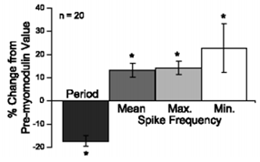
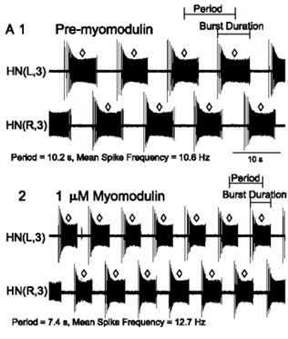
Comodulation of h-current and Na/K Pump by Myomodulin
The Na/K pump is comodulated with h-current under application of 1uM Myomodulin
H-current increases
Pump current decreases
Burst period/duration decreases, and spike frequency increases
Tobin A-E, Calabrese RL (2005) Myomodulin Increases Ih and Inhibits the Na/K Pump to Modulate Bursting in Leech Heart Interneurons. J Neurophysiol 94:3938–3950.

Slide 4
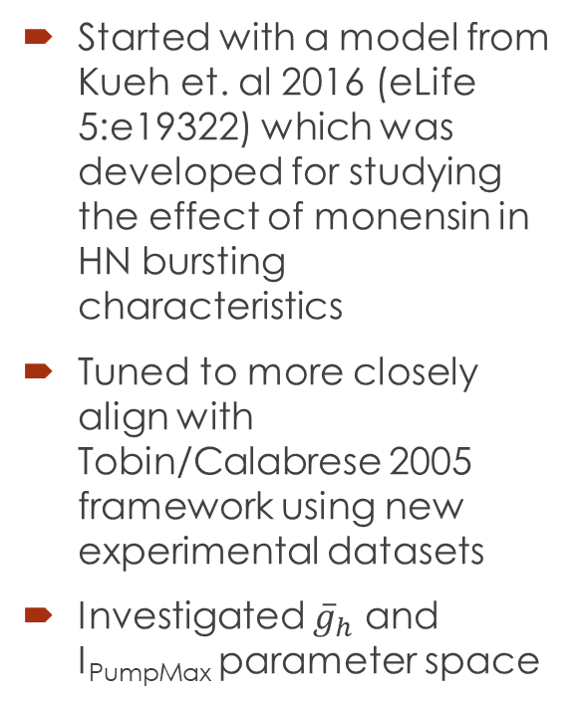
Tuned Model to experimental data from Leech Heart Interneurons in Myomodulin
Started with a model from Kueh et. al 2016 (eLife 5:e19322) which was developed for studying the effect of monensin in HN bursting characteristics
Tuned to more closely align with Tobin/Calabrese 2005 framework using new experimental datasets
Investigated ${\overline{g}}_{h}$ and I_{PumpMax} parameter space
Extracted temporal burst characteristics at the steady state for each parameter pair to produce a dimensionally reduced map of activity patterns for analysis

Slide 5
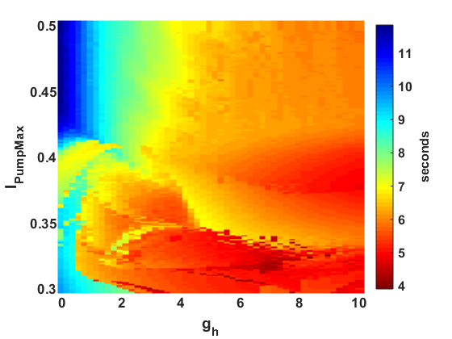
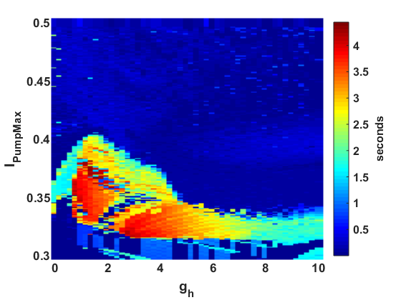
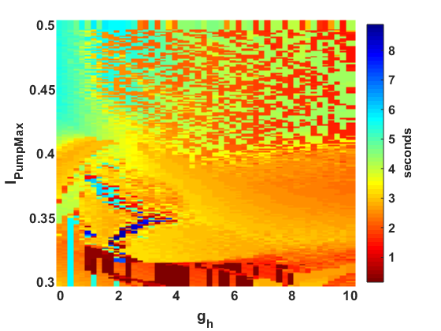
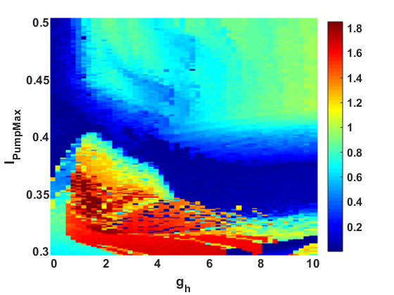

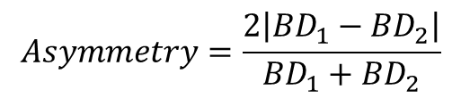

Half Center Oscillator Model Parameter Sweeps
Mean Burst Period (s)
STD Burst Period (s)
I_{PumpMax} (nA)
I_{PumpMax} (nA)
${\overline{g}}_{h}$ (nS)
${\overline{g}}_{h}$ (nS)
Mean Burst Duration (s)
Asymmetry
I_{PumpMax} (nA)
I_{PumpMax} (nA)
$$Asymmetry=\frac{2\left|{BD}_{1}−{BD}_{2}\right|}{{BD}_{1}+{BD}_{2}}$$
${\overline{g}}_{h}$ (nS)
${\overline{g}}_{h}$ (nS)

Slide 6
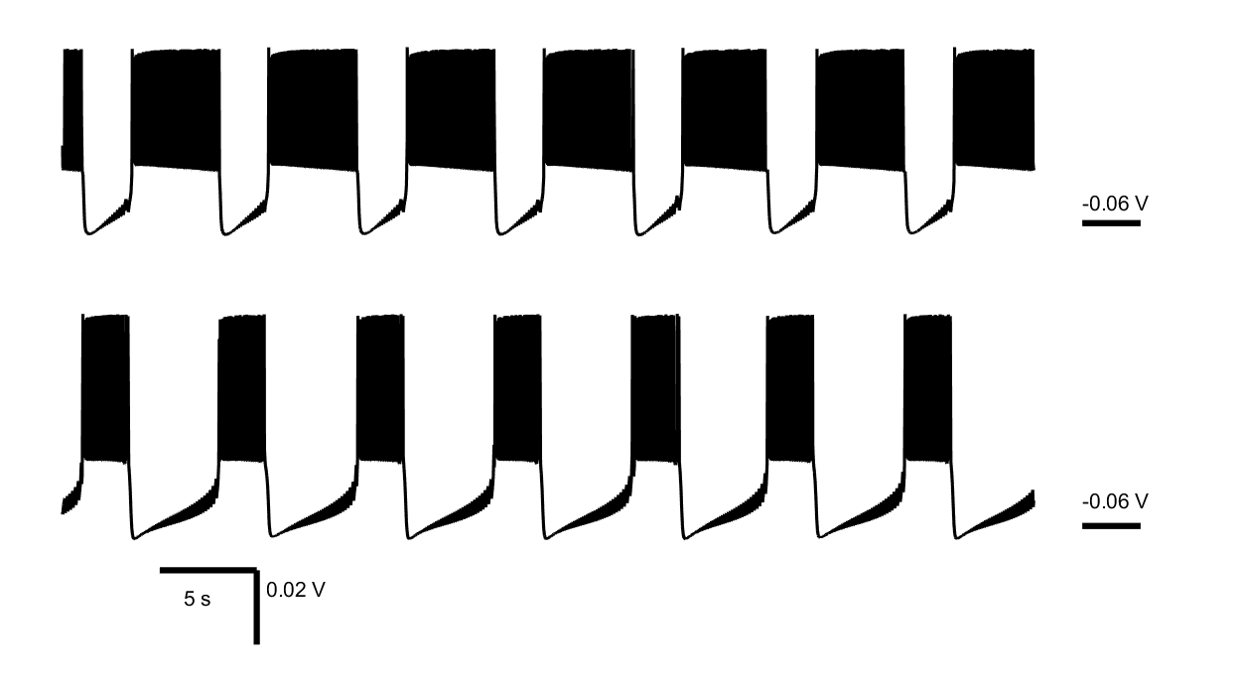
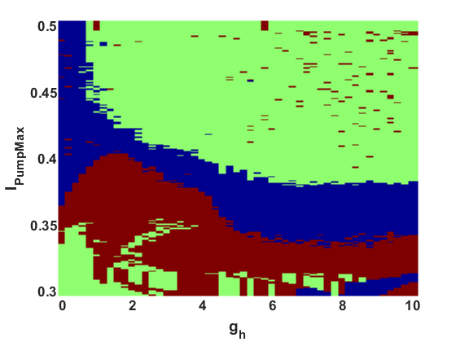
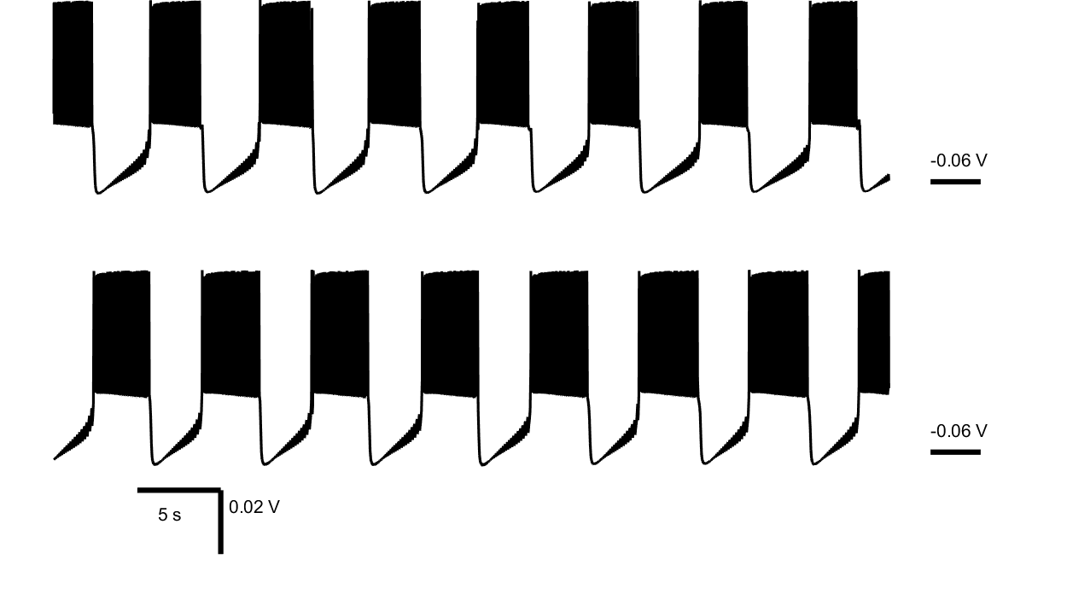
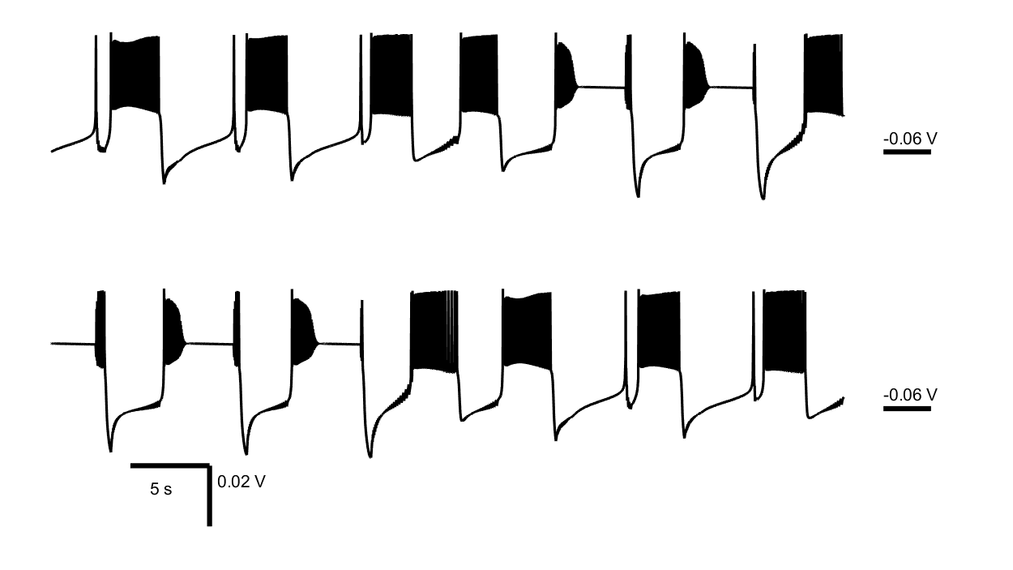
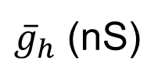
Regime Classification of HCO model
Asymmetric
I_{PumpMax} (nA)
Functional
Highly Variable
${\overline{g}}_{h}$ (nS)

Slide 7
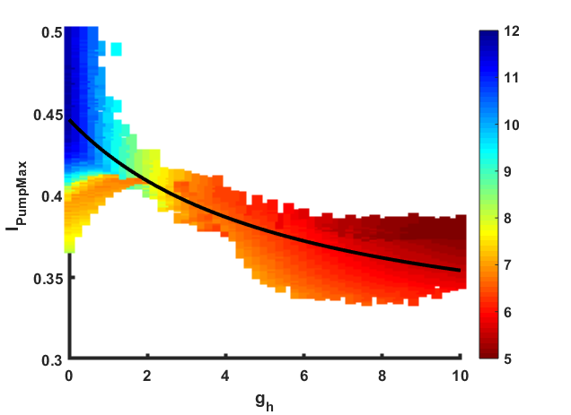



Comodulation Avoids Asymmetric and Highly Variable Regimes
Myomodulin
I_{PumpMax} (nA)
Burst Period (sec)
$${\overline{g}}_{h}$$
I_{PumpMax}
$${\overline{g}}_{h}$$
${\overline{g}}_{h}$ (nS)

Slide 8
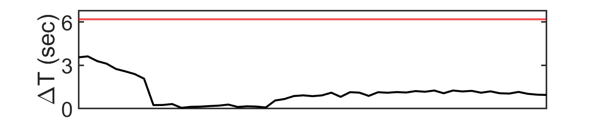
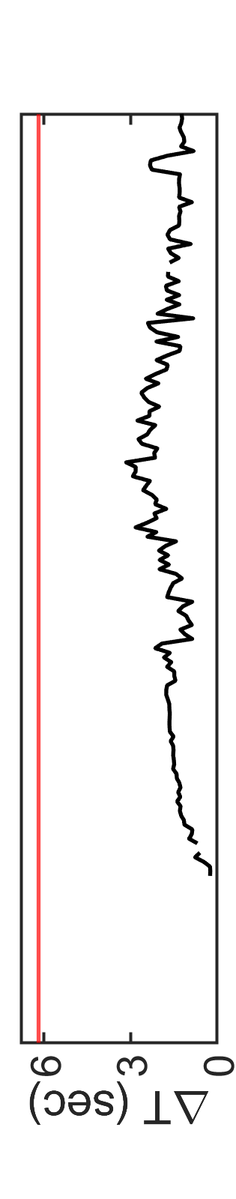


Comodulation Expands the Range of Functional Temporal Burst Characteristics
I_{PumpMax} (nA)
Burst Period (sec)
$${\overline{g}}_{h}$$
${\overline{g}}_{h}$ (nS)
Notes:
3.74, 0.7

Slide 9
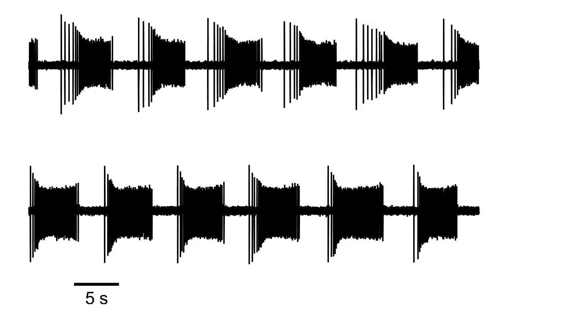
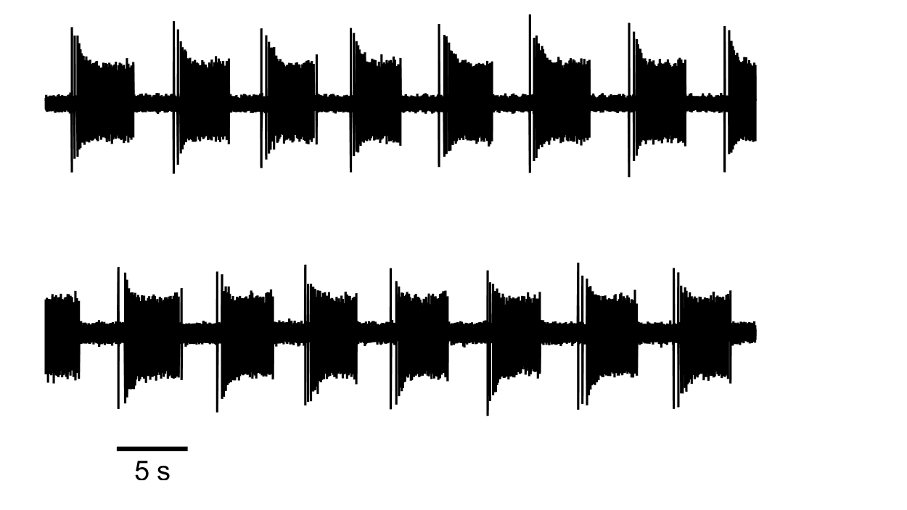
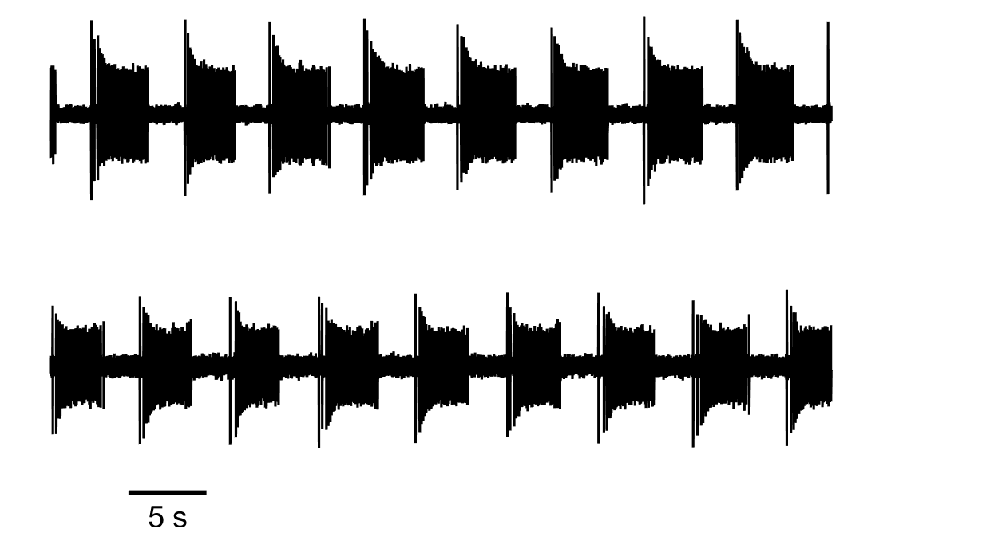
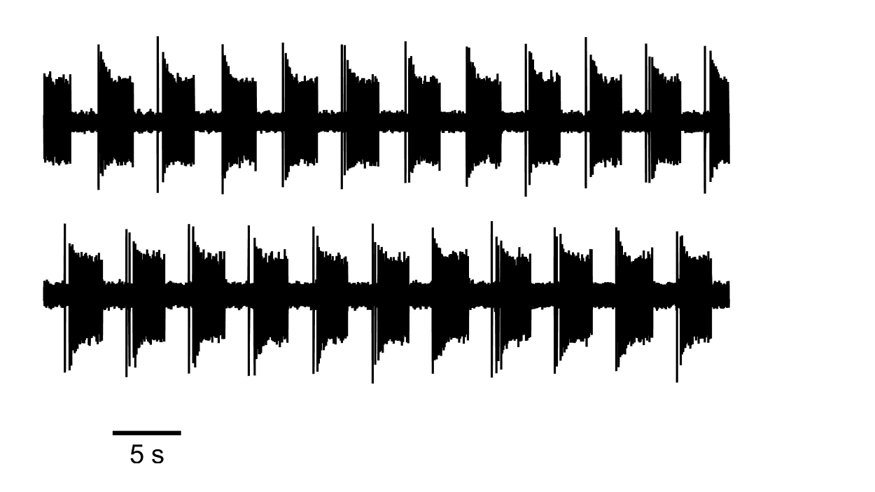
Experimental Data Display a Dose-Response to Myomodulin
Control
Myomodulin 1uM
#
*
*
*
5 s
5 s
Myomodulin 10uM
Myomodulin 100uM
#
*
*
*
5 s
5 s

Slide 10
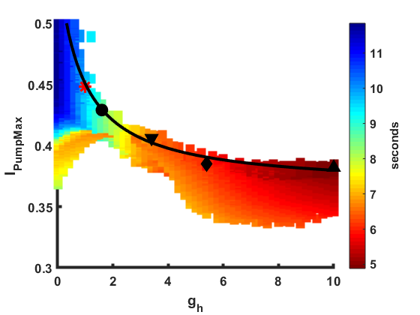

Experimental Data Maps Well to Model Parameter Space
I_{PumpMax} (nA)
Burst Period (sec)
$${\overline{g}}_{h}$$

Slide 11
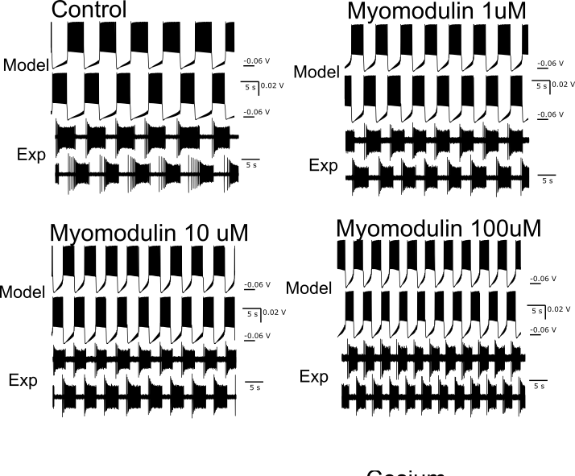

Experimental Data Maps Well to Model Parameter Space
I_{PumpMax} (nA)
Burst Period (sec)
$${\overline{g}}_{h}$$

Slide 12
Experimental Data Maps Well to Model Parameter Space
I_{PumpMax} (nA)
Burst Period (sec)
$${\overline{g}}_{h}$$

Slide 13
Experimental Data Maps Well to Model Parameter Space
I_{PumpMax} (nA)
Burst Period (sec)
$${\overline{g}}_{h}$$

Slide 14
Experimental Data Maps Well to Model Parameter Space
I_{PumpMax} (nA)
Burst Period (sec)
$${\overline{g}}_{h}$$

Slide 15
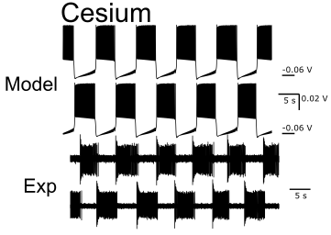
Experimental Data Maps Well to Model Parameter Space
*
I_{PumpMax} (nA)
Burst Period (sec)
$${\overline{g}}_{h}$$

Slide 16
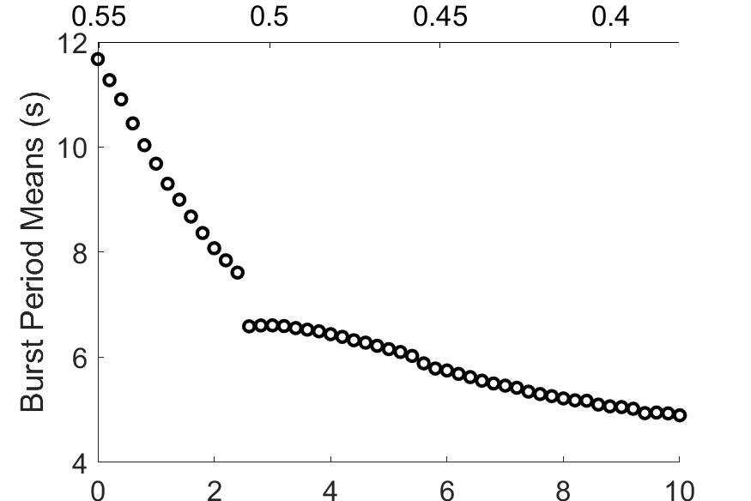
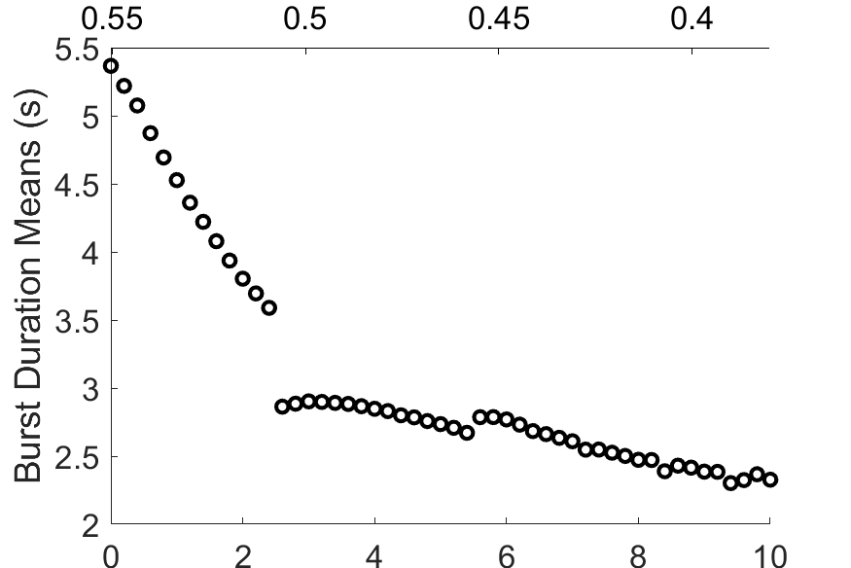
Simulation Along the Axis of Comodulation Compares Well to Experimental Results
Comodulated I_{PumpMax} (nA)
#
*
*
*
Comodulated ${\overline{g}}_{h}$ (nS)
Comodulated I_{PumpMax} (nA)
#
*
*
*
Comodulated ${\overline{g}}_{h}$ (nS)

Slide 17
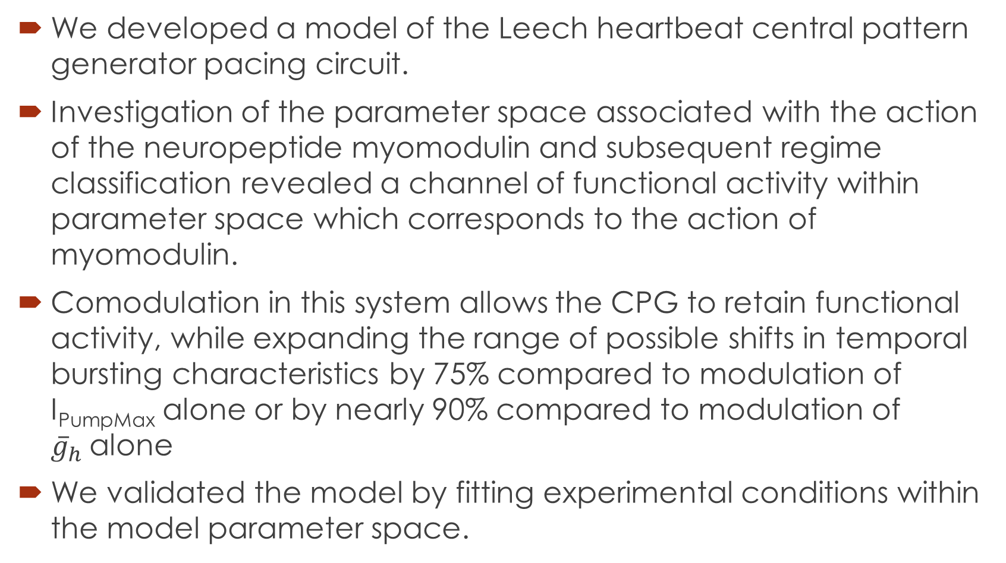
Conclusions
We developed a model of the Leech heartbeat central pattern generator pacing circuit.
Investigation of the parameter space associated with the action of the neuropeptide myomodulin and subsequent regime classification revealed a channel of functional activity within parameter space which corresponds to the action of myomodulin.
Comodulation in this system allows the CPG to retain functional activity, while expanding the range of possible shifts in temporal bursting characteristics by 75% compared to modulation of I_{PumpMax} alone or by nearly 90% compared to modulation of ${\overline{g}}_{h}$alone
We validated the model by fitting experimental conditions within the model parameter space.

Slide 18
Acknowledgements
GSU Brains and Behavior Fellowship
Funding me
NIH Grant 1 R21 NS111355 issued to GC and RC
Project funding, and funding for me for Fall 2020
Please feel free to contact me at pellingson3@gmail.com
Thank you for listening

