Slide 1
IMProv project preparation
Presented by
MassSpecStudio Development Team

Slide 2
Introduction
Overview of IMProv for IMP and PMI.
Getting Started with the sample project ( PRC2 ) on github.
Prepare IMP Topology and Config files using MassSpecStudio.
Deployment of the IMProv project on AWS, Cedar or PC.
Notes:
How presentation will benefit audience: Adult learners are more interested in a subject if they know how or why it is important to them.
Presenter’s level of expertise in the subject: Briefly state your credentials in this area, or explain why participants should listen to you.

Slide 3
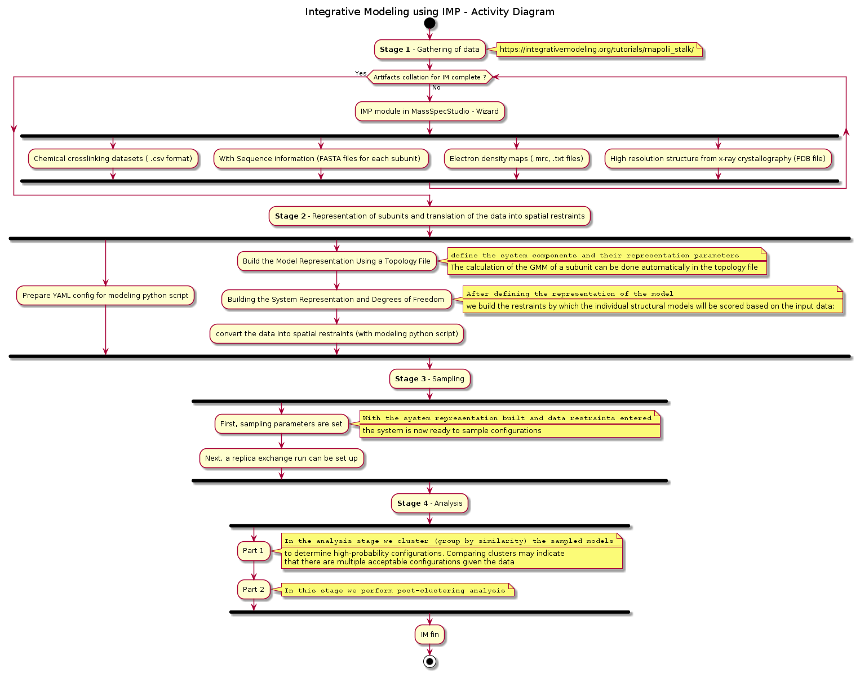
Activity Diagram
Stage 1 – Gathering data
Stage 2 – Representation of subunits and translation of the data into spatial restraints
Stage 3 – Sampling
Stage 4 - Analysis

Slide 4


Slide 5
Overview
Create a new Integrative modeling project
Add Proteins.
Add Protein Topology
Add Link Data
HX-XL Classification
Configure IMP
Amendments
Adjustments to existing IMP project.
Deployment of the Project
Perform a modeling run.
Notes:
Lesson descriptions should be brief.

Slide 6
Create a new Integrative modeling project
Familiarize yourself with the IMProv wizard steps.
The goal here is to produce the Topology and ConfigImp.yaml files.
Pull together the various raw data files needed for the modeling run.
Obtain the python driver script that reads the ConfigImp.yaml file
Understand the folder structure of the export bundle and where the files reside.
Notes:
Example objectives
At the end of this lesson, you will be able to:
Save files to the team Web server.
Move files to different locations on the team Web server.
Share files on the team Web server.

Slide 7
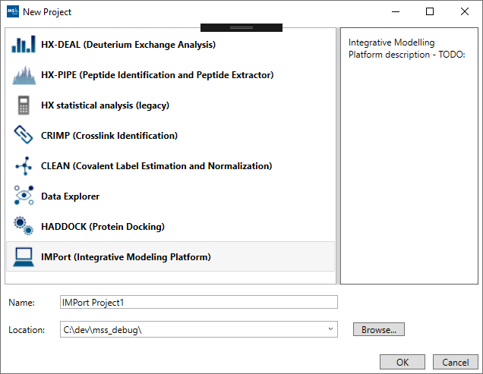
New Project
IMProv ( Integrative Modeling Platform )

Slide 8
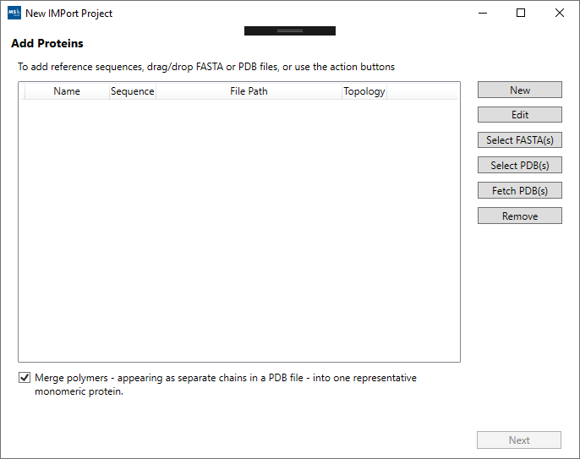
Wizard Steps
Add Proteins.
Add Protein Topology
Add Link Data
HX-XL Classification
Configure IMP

Slide 9
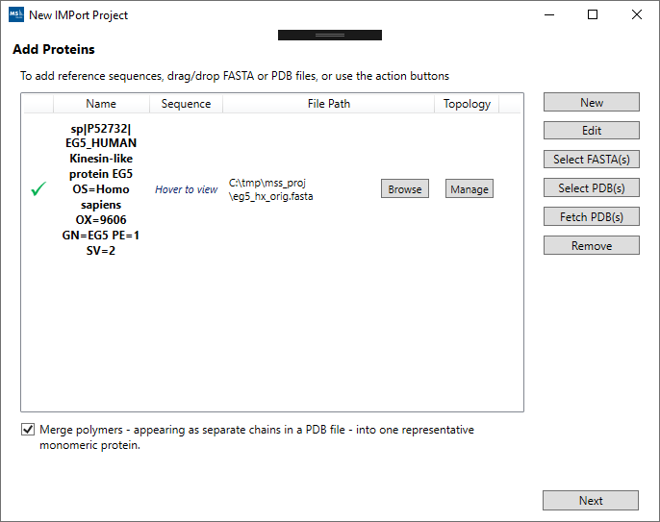
Wizard Steps
Add Proteins.
Add Protein Topology
Add Link Data
HX-XL Classification
Configure IMP

Slide 10
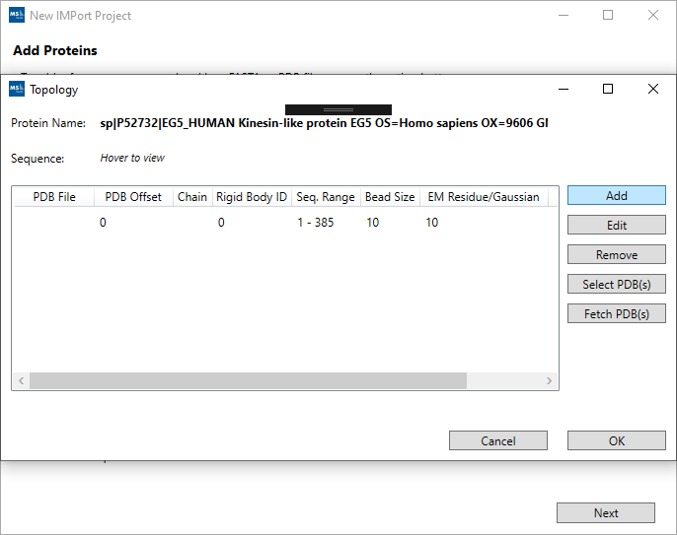
Wizard Steps
Add Proteins.
Add Protein Topology
Add Link Data
HX-XL Classification
Configure IMP

Slide 11
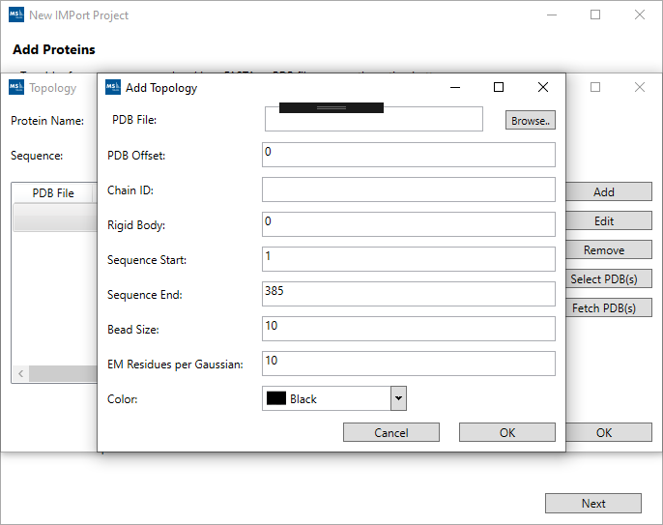
Wizard Steps
Add Proteins.
Add Protein Topology
Add Link Data
HX-XL Classification
Configure IMP

Slide 12
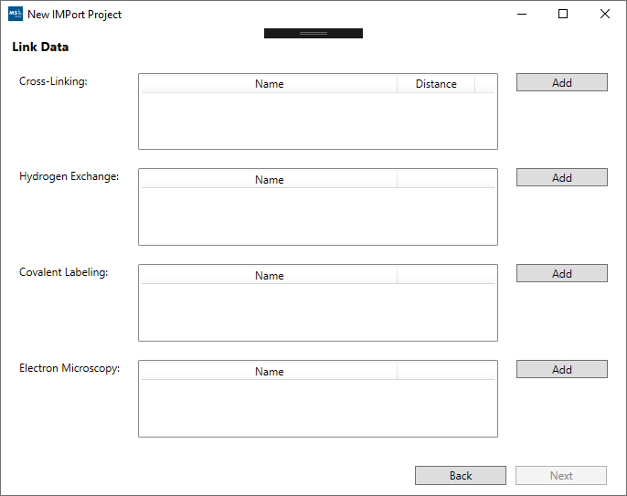
Wizard Steps
Add Proteins.
Add Protein Topology
Add Link Data
HX-XL Classification
Configure IMP

Slide 13
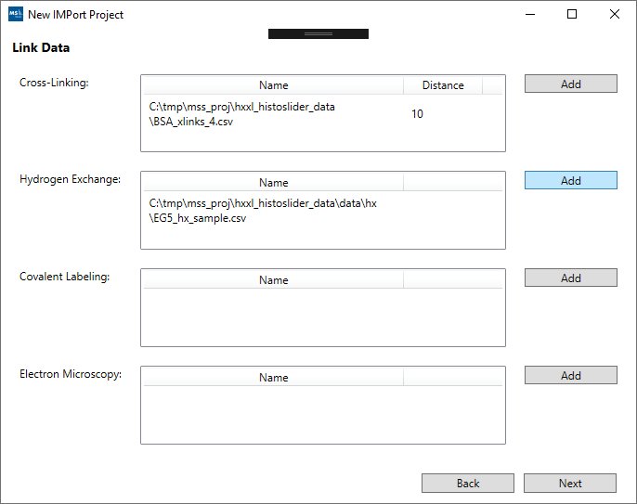
Wizard Steps
Add Proteins.
Add Protein Topology
Add Link Data
HX-XL Classification
Configure IMP

Slide 14
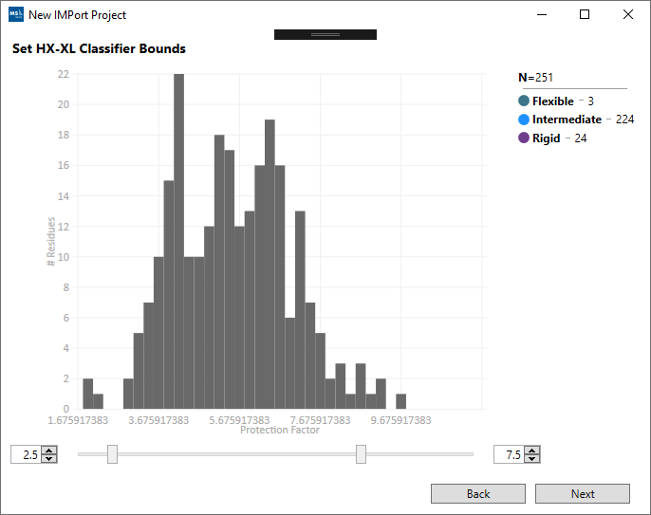
Wizard Steps
Add Proteins.
Add Protein Topology
Add Link Data
HX-XL Classification
Configure IMP

Slide 15
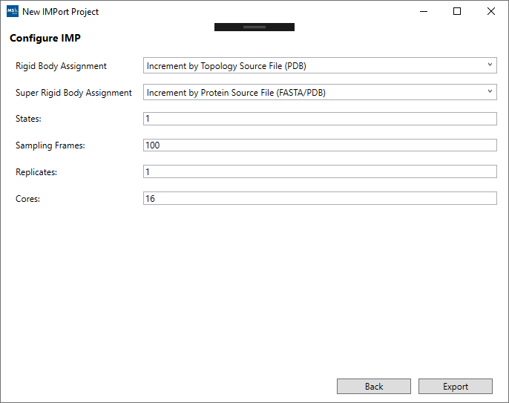
Wizard Steps
Add Proteins.
Add Protein Topology
Add Link Data
HX-XL Classification
Configure IMP

Slide 16
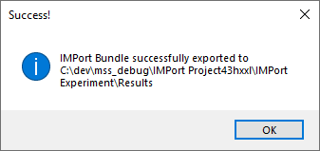
IMProv Data File and Script Bundle - Export
Generate the IMProv Export Bundle.
Navigate the folders.
Review the Topology and ConfigImp.yaml files.

Slide 17
Folder Hierarchy
Results
data
cl
em
Imp_model
ConfigImp.yaml
Root
main
content
fasta
hx
topo
xl
xtal
Imp_job_run.py
Topology.txt
data
cl => crosslink
em => electron density maps
fasta =>
hx =>
topo => topology file
xl =>
xtal => xray-crystallography
imp_model
config and driver scripts

Slide 18
Completion of IMProv wizard steps
Review output generated.
Prepare output for deployment.

Slide 19
Amendments
Modifying the Topology and ConfigImp.yaml is an iterative process.
Re-open an existing IMProv project and make the edits you require.
In the final step you can perform the export again to capture the updates.

Slide 20
IMProv lifecycle
Add Proteins
Protein Topology
Link Data
HX-XL Processing
IMP Config
Export
Deployment
Run Model
Amend Inputs and Configuration
Analysis
Prepare Export bundle using MassSpecStudio wizard steps
Prepare Deployment
Run Modeling job
Review

Slide 21
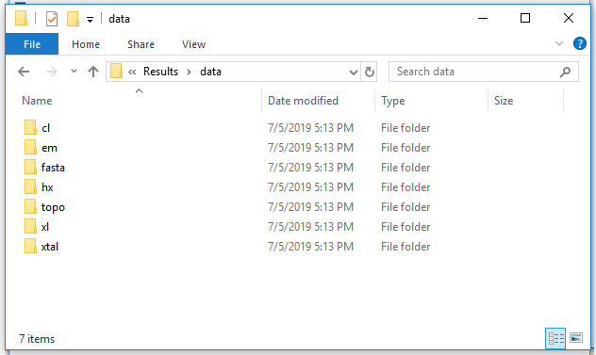
Example 2: IMProv PRC2
Present another IMProv project

Slide 22
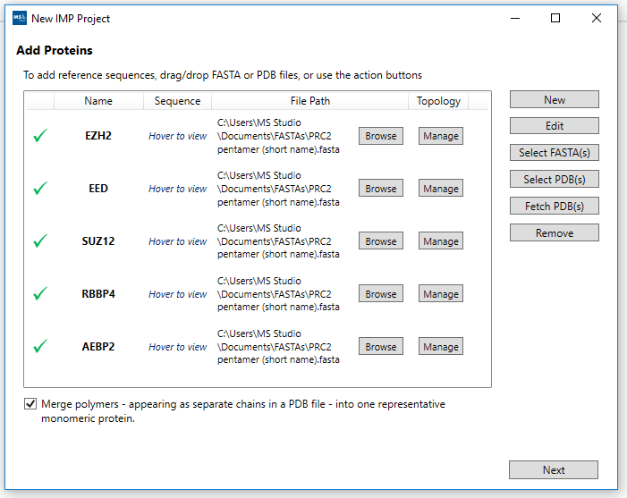
Wizard Steps
Add Proteins.
Add Protein Topology
Add Link Data
HX-XL Classification
Configure IMP

Slide 23
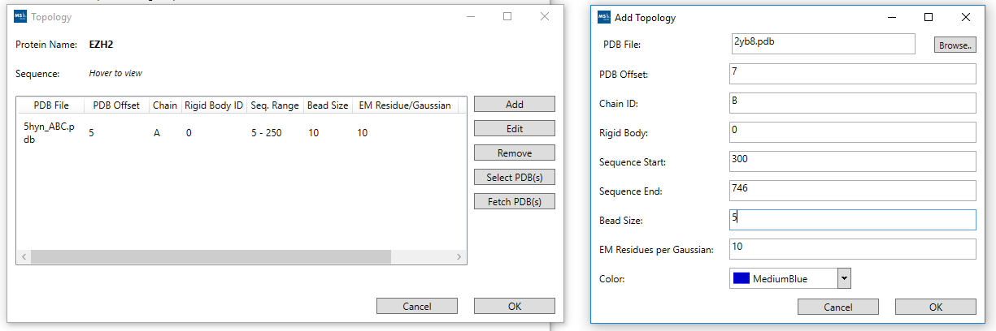
Wizard Steps
Add Proteins.
Add Protein Topology
Add Link Data
HX-XL Classification
Configure IMP

Slide 24
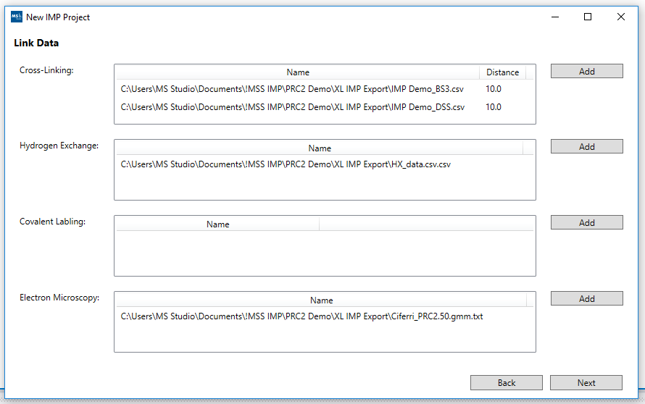
Wizard Steps
Add Proteins.
Add Protein Topology
Add Link Data
HX-XL Classification
Configure IMP

Slide 25
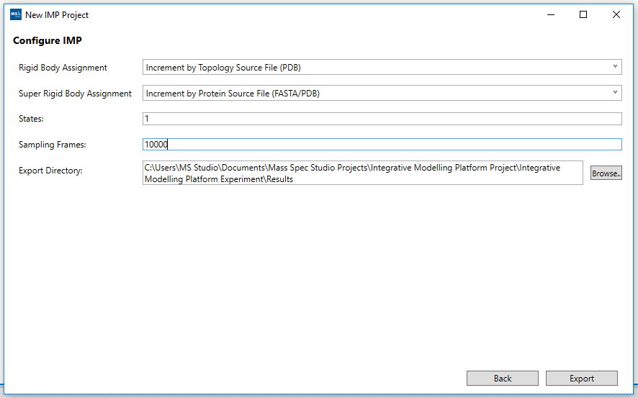
Wizard Steps
Add Proteins.
Add Protein Topology
Add Link Data
HX-XL Classification
Configure IMP

Slide 26
Example 2 completed
We have seen two IMProv projects.
The first had HX-XL profiling
The second only had XL

Slide 27
Deployment of the Project
List the intended outcomes for this training session.
Each objective should be concise, should contain a verb, and should have a measurable result.

Slide 28
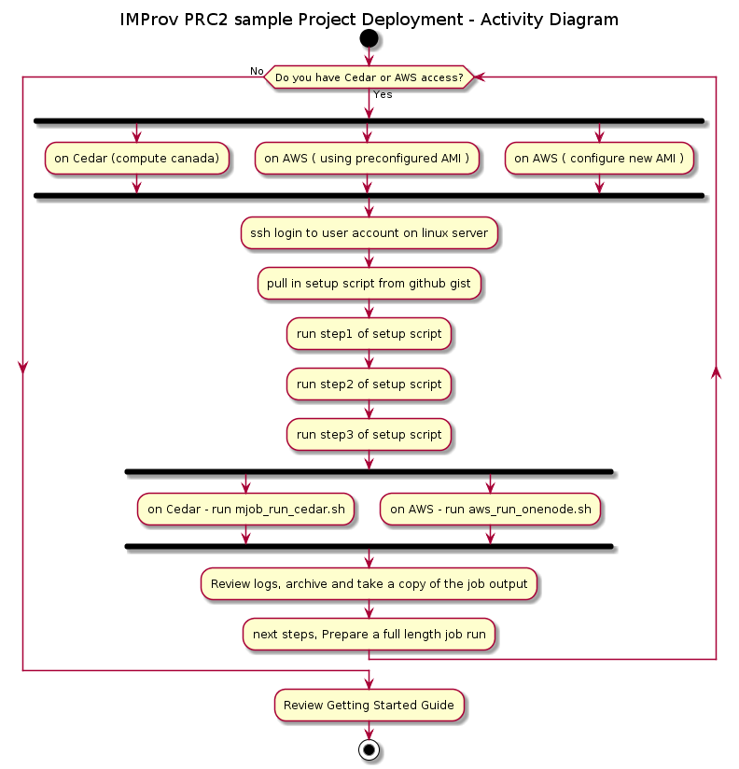

Slide 29
Lesson 3: Content
Add text here.
To add a picture, chart, or other content in the right column, click the appropriate icon.
To add a slide, click New Slide on the Insert menu, or press CTRL+M.

Slide 30
Lesson 3: Wrap-up
Summarize important points.
Allow time for questions.

Slide 31
Summary
IMProv lifecyle.
Online guides and tutorials.
IMProv_msstudio_tut.md ( tiny url )
uml_activity_diag_improv.svg
IMProv_on_AWS_tut.md
IMProv_on_Cedar_tut.md

Slide 32
Assessment and Evaluation
How is the python driver script and IMPConfig.yaml a convenience?
what would you need to do if there are not available?
IMProv comprises file preparation and deployment. How would you go about performing each?
Did you find this guided tutorial helpful?

Slide 33
Abbreviations
Cryo-EM: cryoelectron microscopy | https://www.sciencedirect.com/science/article/pii/S0304416517302374
FDR: False Discovery Rate | https://www.bioinfor.com/fdr-tutorial/
HPC: High Performance Computing | https://docs.computecanada.ca/wiki/Getting_started
HX-MS: Hydrogen eXchange Mass Spectrometry | https://neu.hxms.com/research/tutorial_theory.htm#:~:text=Hydrogen%20exchange%20(HX)%20combined%20with,of%20proteins%20and%20protein%20structure.
IMP: Integrative Modeling Platform | https://integrativemodeling.org/
PMI: Python Modeling Interface | https://integrativemodeling.org/
PRC2: Polycomb Repressive Complex 2 | https://www.ncbi.nlm.nih.gov/pmc/articles/PMC5008062/
SLURM: Simple Linux Utility for Resource Management | https://en.wikipedia.org/wiki/Slurm_Workload_Manager
XL-MS: Crosslinking Mass Spectrometry | https://www.technologynetworks.com/proteomics/articles/cross-linking-mass-spectrometry-a-key-player-in-the-structural-biologists-toolbox-322446
FASTA: The FASTA format is sometimes also referred to as the "Pearson" format (after the author of the FASTA program and ditto format). | https://www.bioinformatics.nl/tools/crab_fasta.html ; https://en.wikipedia.org/wiki/FASTA_format
PDB: The Protein Data Bank (pdb) file format is a textual file format describing the three-dimensional structures of molecules held in the Protein Data Bank | https://pdb101.rcsb.org/learn/guide-to-understanding-pdb-data/introduction ; https://www.rcsb.org/
AWS: Amazon Web Services | https://aws.amazon.com/console/
Cedar: Compute Canada HPC Cluster | https://status.computecanada.ca/
Linux: Operating System, RedHat Enterprise Linux (or variants, such as CentOS or Scientific Linux) |

