Slide 1
IMProv project preparation
Presented by
MassSpecStudio Development Team

Slide 2
Introduction
Overview of IMProv for IMP and PMI.
Getting Started with the sample project ( PRC2 ) on github.
Prepare IMP Topology and Config files using MassSpecStudio.
Deployment of the IMProv project on AWS, Cedar or PC.
Notes:
How presentation will benefit audience: Adult learners are more interested in a subject if they know how or why it is important to them.
Presenter’s level of expertise in the subject: Briefly state your credentials in this area, or explain why participants should listen to you.

Slide 3
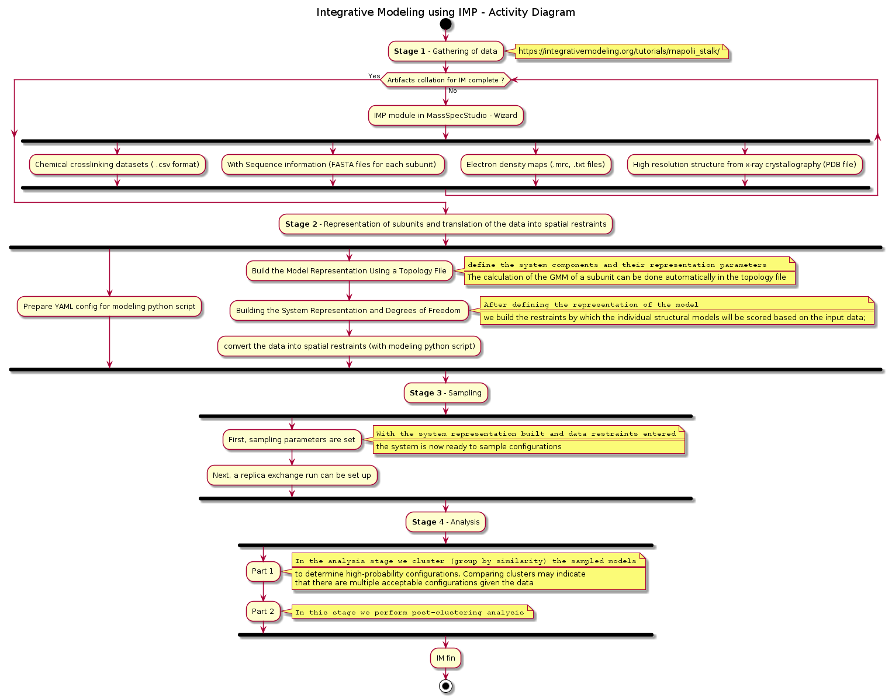
Activity Diagram
Stage 1 – Gathering data
Stage 2 – Representation of subunits and translation of the data into spatial restraints
Stage 3 – Sampling
Stage 4 - Analysis

Slide 4


Slide 5
Overview
Create a new Integrative modeling project
Add Proteins.
Add Protein Topology
Add Link Data
HX-XL Classification
Configure IMP
Amendments
Adjustments to existing IMP project.
Deployment of the Project
Perform a modeling run.
Notes:
Lesson descriptions should be brief.

Slide 6
Create a new Integrative modeling project
Familiarize yourself with the IMProv wizard steps.
The goal here is to produce the Topology and ConfigImp.yaml files.
Pull together the various raw data files needed for the modeling run.
Obtain the python driver script that reads the ConfigImp.yaml file
Understand the folder structure of the export bundle and where the files reside.
Notes:
Example objectives
At the end of this lesson, you will be able to:
Save files to the team Web server.
Move files to different locations on the team Web server.
Share files on the team Web server.

Slide 7
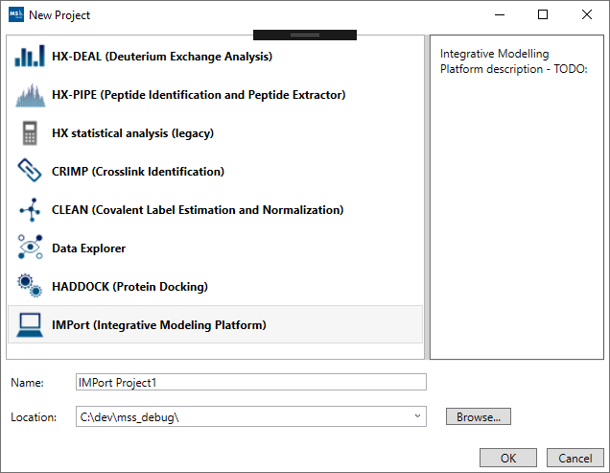
New Project
IMProv ( Integrative Modeling Platform )

Slide 8
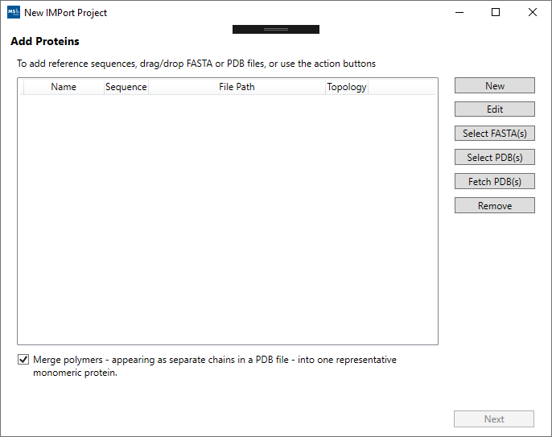
Wizard Steps
Add Proteins.
Add Protein Topology
Add Link Data
HX-XL Classification
Configure IMP

Slide 9
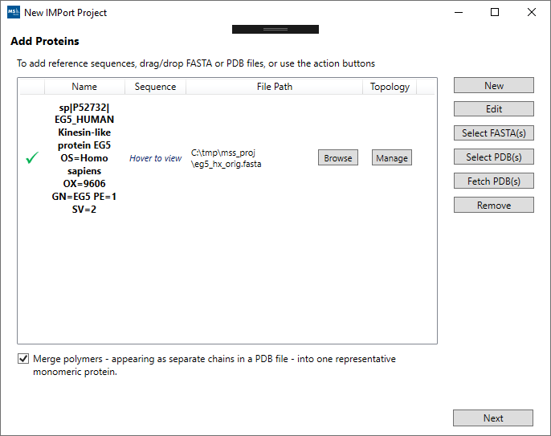
Wizard Steps
Add Proteins.
Add Protein Topology
Add Link Data
HX-XL Classification
Configure IMP

Slide 10
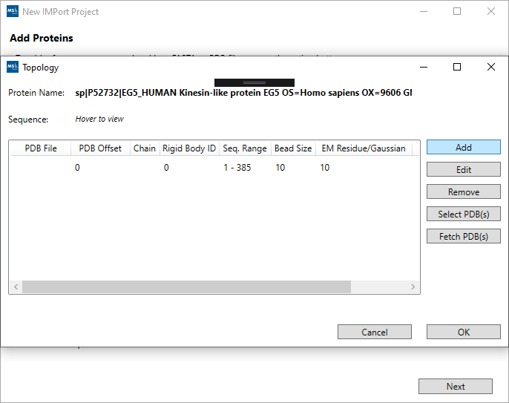
Wizard Steps
Add Proteins.
Add Protein Topology
Add Link Data
HX-XL Classification
Configure IMP

Slide 11
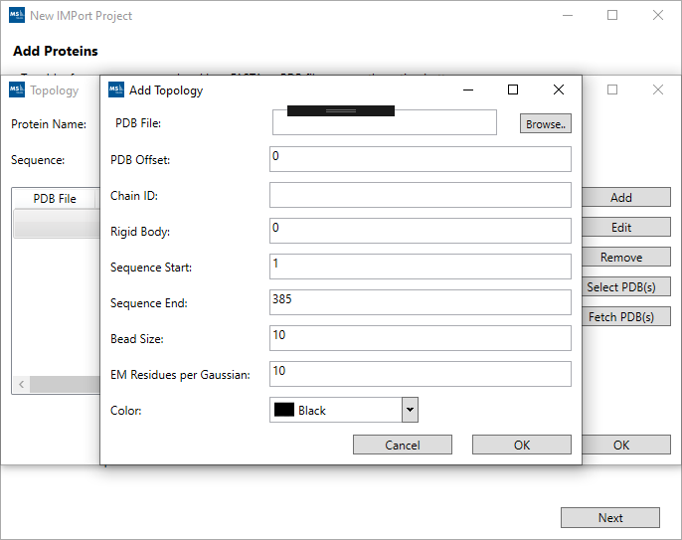
Wizard Steps
Add Proteins.
Add Protein Topology
Add Link Data
HX-XL Classification
Configure IMP

Slide 12
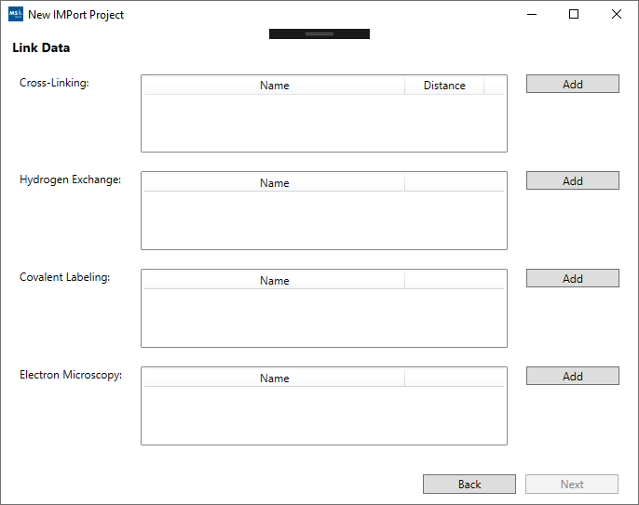
Wizard Steps
Add Proteins.
Add Protein Topology
Add Link Data
HX-XL Classification
Configure IMP

Slide 13
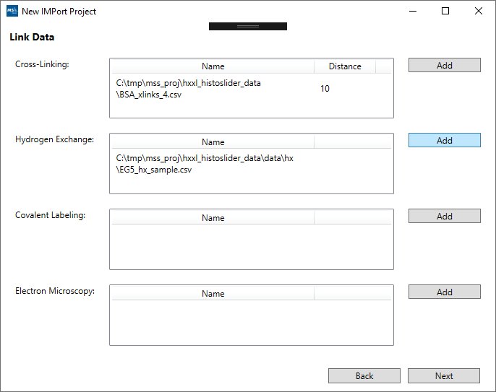
Wizard Steps
Add Proteins.
Add Protein Topology
Add Link Data
HX-XL Classification
Configure IMP

Slide 14
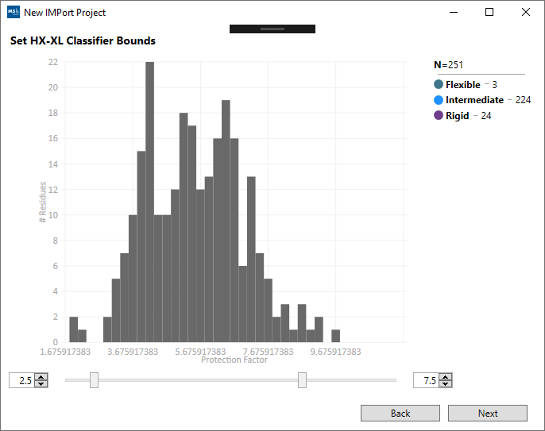
Wizard Steps
Add Proteins.
Add Protein Topology
Add Link Data
HX-XL Classification
Configure IMP

Slide 15
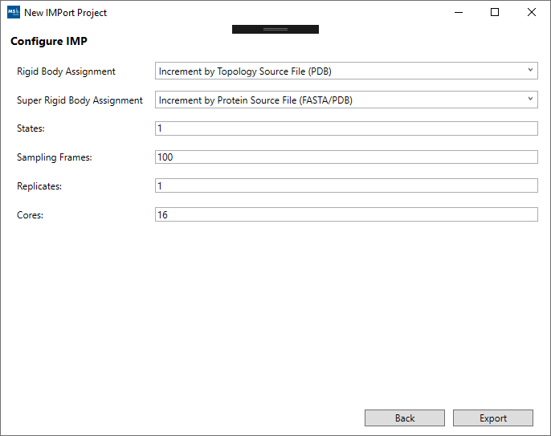
Wizard Steps
Add Proteins.
Add Protein Topology
Add Link Data
HX-XL Classification
Configure IMP

Slide 16
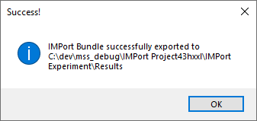
IMProv Data File and Script Bundle - Export
Generate the IMProv Export Bundle.
Navigate the folders.
Review the Topology and ConfigImp.yaml files.

Slide 17
Folder Hierarchy
Results
data
cl
em
Imp_model
ConfigImp.yaml
Root
main
content
fasta
hx
topo
xl
xtal
Imp_job_run.py
Topology.txt
data
cl => crosslink
em => electron density maps
fasta => protein amino acid sequence
hx => hydrogen exchange
topo => topology file
xl => cross linking
xtal => xray-crystallography
imp_model
config and driver scripts

Slide 18
Completion of IMProv wizard steps
Review output generated.
Prepare output for deployment.

Slide 19
Amendments
Modifying the Topology and ConfigImp.yaml is an iterative process.
Re-open an existing IMProv project and make the edits you require.
In the final step you can perform the export again to capture the updates.

Slide 20
IMProv export bundle
Review Topology.txt and ConfigImp.yaml
Review python driver scripts

Slide 21
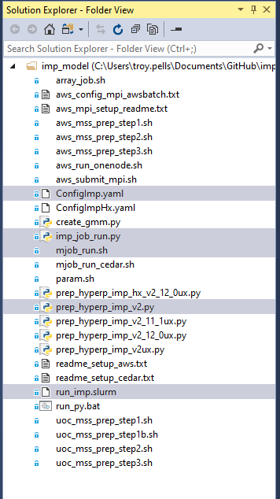
ConfigImp.yaml and driver scripts
Sample PRC2 project contains the ConfigImp.yaml and driver scripts
We also find setup scripts for Cedar and AWS. These are discussed later, when we cover the deployment steps.

Slide 22
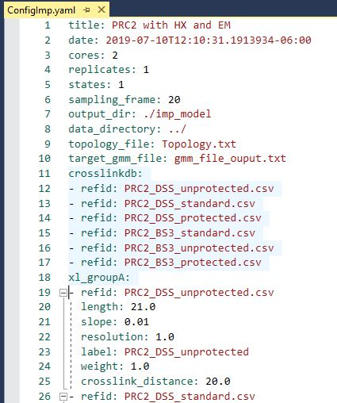
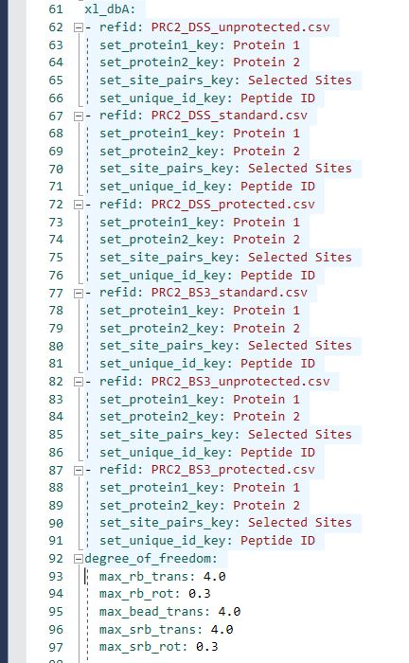
ConfigImp.yaml

Slide 23
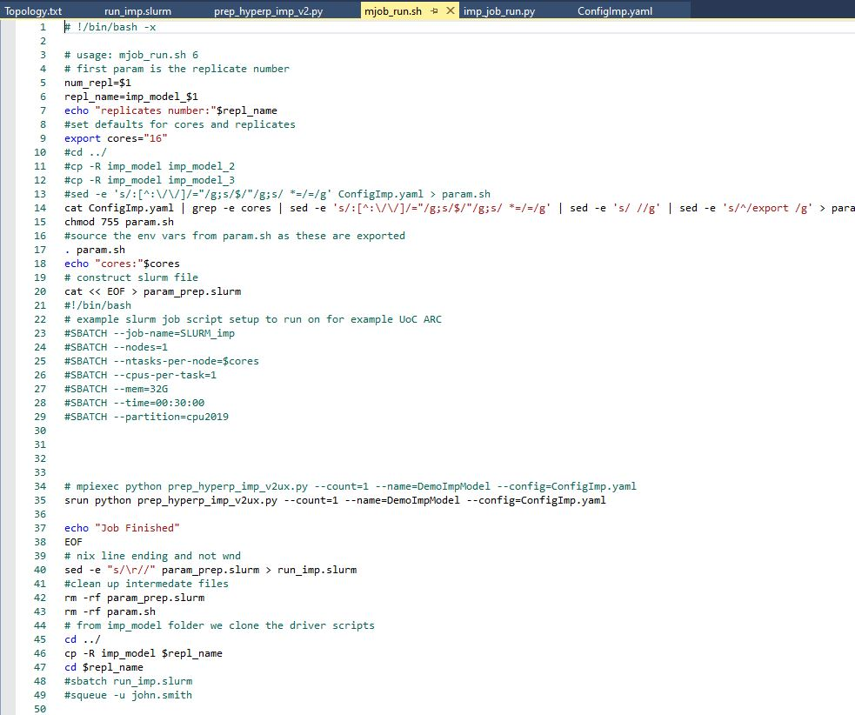
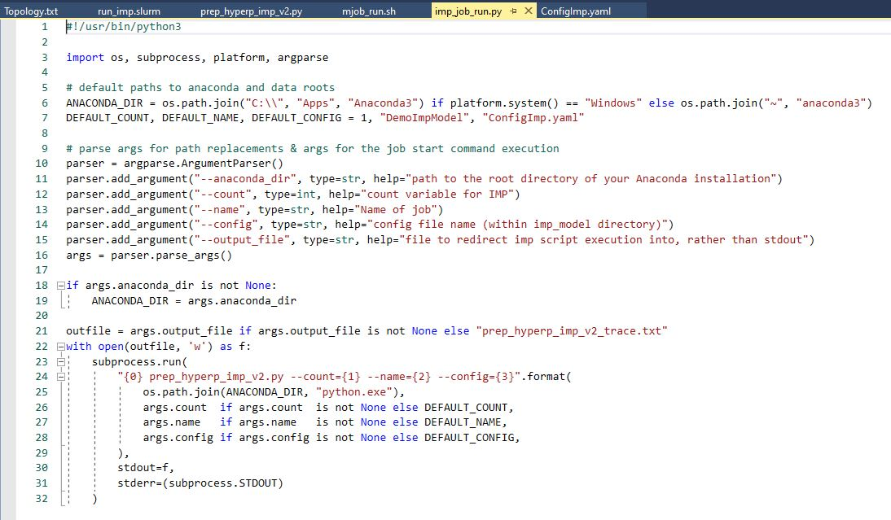
imp_job_run.py and mjob_run.sh scripts

Slide 24
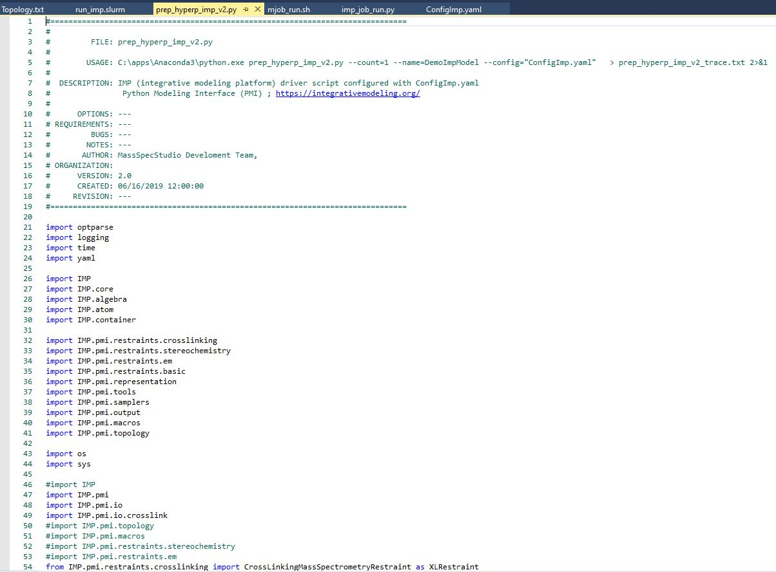
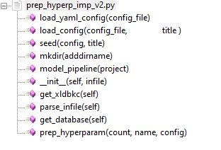
prep_hyperp_imp_v2.py script content

Slide 25
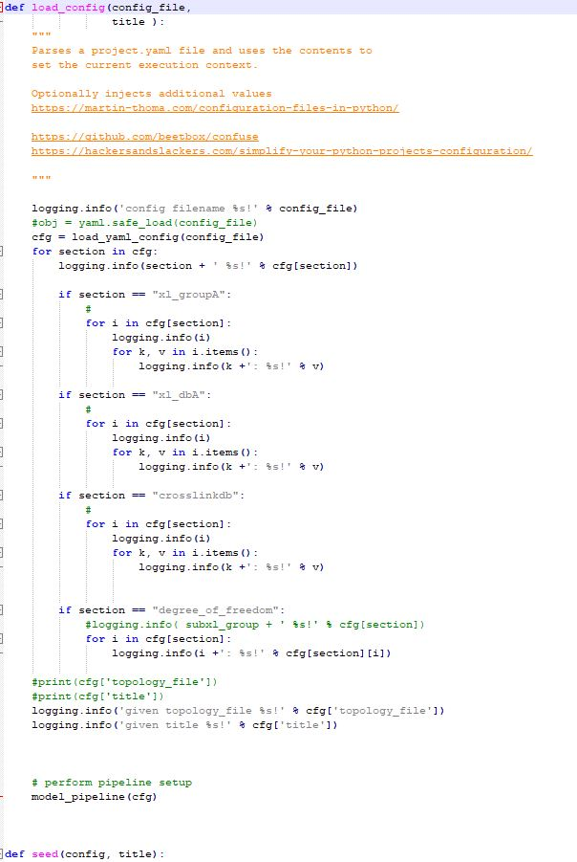
load_config

Slide 26
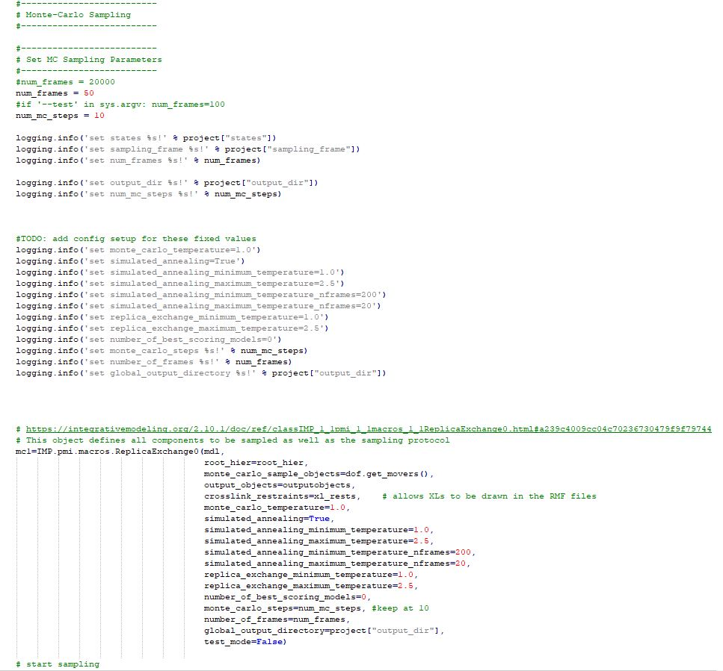
Monte-Carlo Sampling

Slide 27
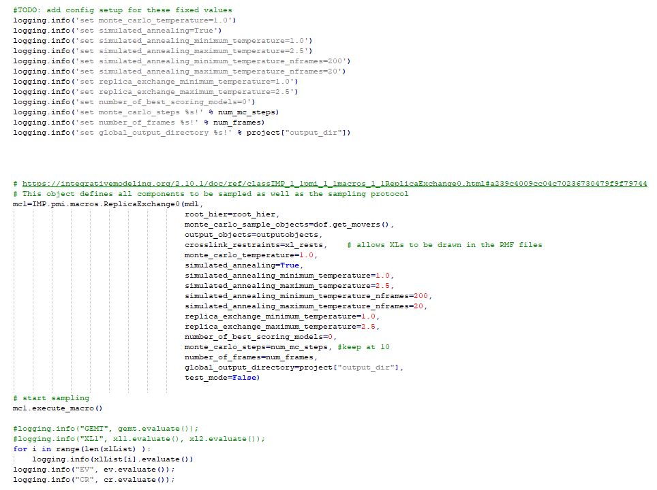
ReplicaExchange

Slide 28
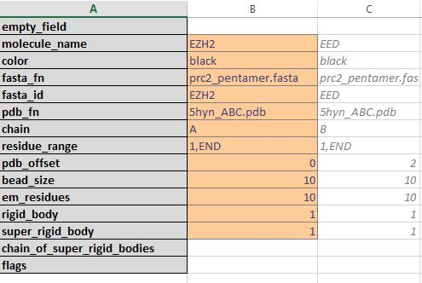
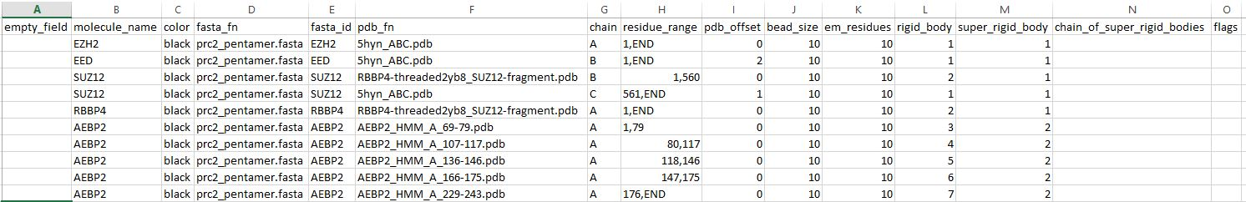
topology.txt data dictionary

Slide 29
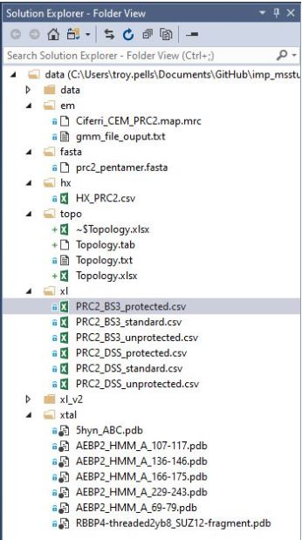
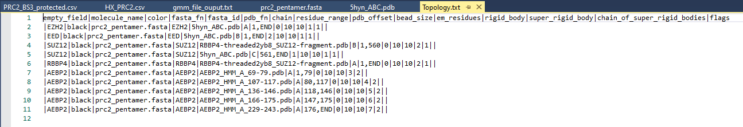
data folder content

Slide 30
IMProv lifecycle
Add Proteins
Protein Topology
Link Data
HX-XL Processing
IMP Config
Export
Deployment
Run Model
Amend Inputs and Configuration
Analysis
Prepare Export bundle using MassSpecStudio wizard steps
Prepare Deployment
Run Modeling job
Review

Slide 31
Example 2: IMProv PRC2
Present another IMProv project

Slide 32
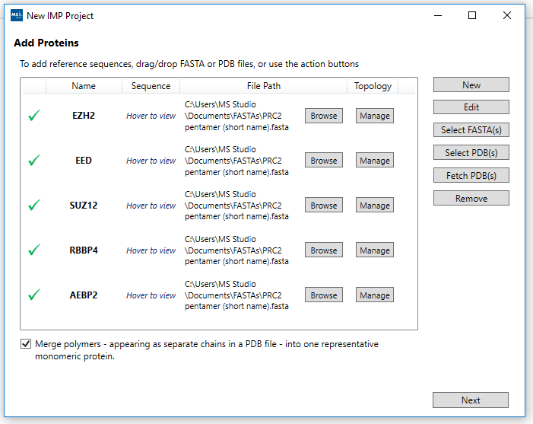
Wizard Steps
Add Proteins.
Add Protein Topology
Add Link Data
HX-XL Classification
Configure IMP

Slide 33
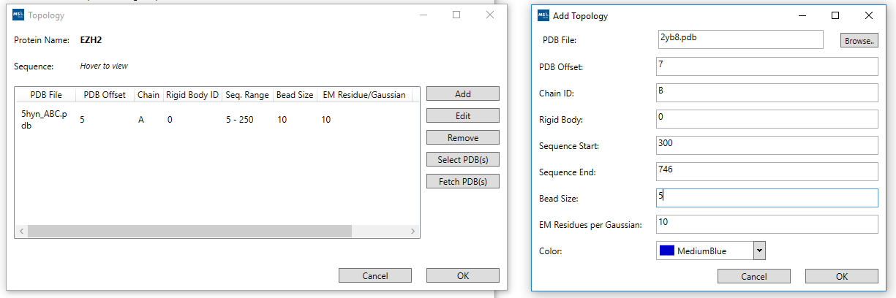
Wizard Steps
Add Proteins.
Add Protein Topology
Add Link Data
HX-XL Classification
Configure IMP

Slide 34
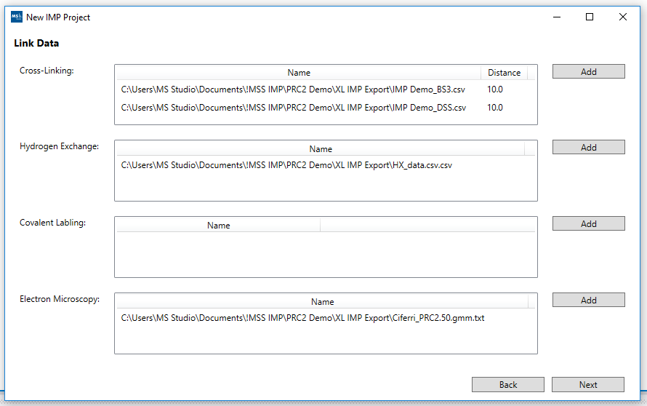
Wizard Steps
Add Proteins.
Add Protein Topology
Add Link Data
HX-XL Classification
Configure IMP

Slide 35
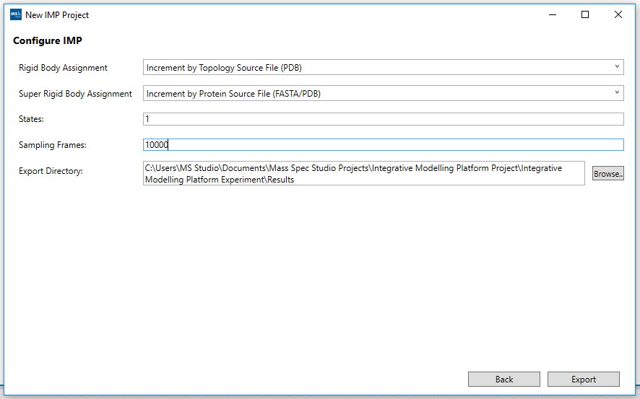
Wizard Steps
Add Proteins.
Add Protein Topology
Add Link Data
HX-XL Classification
Configure IMP

Slide 36
Final remarks on IMProv
We have seen two IMProv projects.

Slide 37
Deployment of the Project
Deployment follows a 3 step setup process.
Deployment to Cedar.
Deployment to AWS.

Slide 38
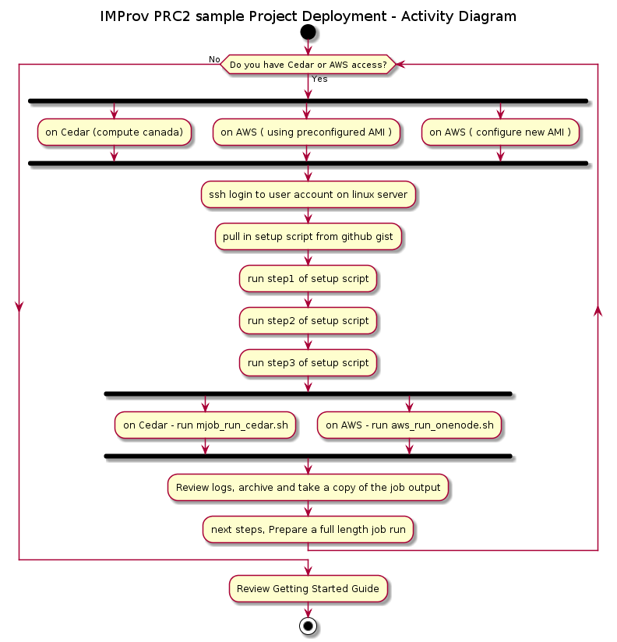
Deployment steps
Launch the modeling run on a multi-cpu machine
MPI is the message passing interface used to leverage multi-cpu machine when performing the Monte-Carlo sampling.
The step1 through step3 scripts mentioned are provided in the sample PRC2 project on github. The link is given in the reference section at the end.

Slide 39
Deployment: Cedar
The github repo for imp_msstudio_init contains the online tutorials together with the PRC2 sample project. The bootstrap scripts are also available.
https://github.com/pellst/imp_msstudio_init
IMProv_on_Cedar_tut.md: https://github.com/pellst/imp_msstudio_init/blob/master/IMProv_on_Cedar_tut.md
#### get the setup script from github gist and review before running:
~~~
curl -LOk https://gist.githubusercontent.com/pellst/4853822ea5ca74785af61d0ad39cf84d/raw/uoc_mss_prep_step1.sh
chmod 755 uoc_mss_prep_step1.sh
~~~
#### run the script uoc_mss_prep_step1.sh in order to get the sample folders and scripts setup
~~~
./uoc_mss_prep_step1.sh
~~~
#### in the folder /scratch/$USER/imp/imp_msstudio_init-master/mss_out/imp_model, the following shell scripts are now available
~~~
uoc_mss_prep_step1.sh
uoc_mss_prep_step2.sh
uoc_mss_prep_step3.sh
~~~

Slide 40
Deployment: AWS
The github repo for imp_msstudio_init contains the online tutorials together with the PRC2 sample project. The bootstrap scripts are also available.
https://github.com/pellst/imp_msstudio_init
IMProv_on_AWS_tut.md: https://github.com/pellst/imp_msstudio_init/blob/master/IMProv_on_AWS_tut.md
# make use of this gist to get the prep_step* shell scripts located here
# /shared/imp/imp_msstudio_init-master/mss_out/imp_model
curl -LOk https://gist.githubusercontent.com/pellst/9f7ad519133dae87f8f813b506b45aac/raw/aws_mss_prep_step1.sh
chmod 755 aws_mss_prep_step1.sh
./aws_mss_prep_step1.sh
# prepare anaconda install
#/shared/imp/imp_msstudio_init-master/mss_out/imp_model/aws_mss_prep_step2.sh
#/shared/imp/imp_msstudio_init-master/mss_out/imp_model/aws_mss_prep_step3.sh

Slide 41
Modeling Run Review
A new folder is created with the run number ( imp_model_nn ) as a copy of the imp_model folder content.
The data folder is referenced and is not duplicated when performing multiple run’s in parallel on a HPC platform ( replicate run’s ). Avoid confusion with MPI which will be performed within a single run and hence each instance thereof in a parallel run of for example 3 modeling jobs at the same time ( ie: 3 replicates each performing independent MC sampling ).
A subfolder of imp_model_nn is the output folder which has sub-folders
pdbs
rmfs
When run on 16 cpu. There will be one .rmf3 file per cpu ( 0 through 15 )
stat.*.out and stat_replica.*.out files
Note that the modeling run generates several files in the imp_model_nn folder ( where nn is the run number given )
included.*.db
excluded.*.db
missing.*.db
The trace files are created as
prep_hyperp_imp_v2.log
slurm-nnnnnnn.out

Slide 42
Deployment: Wrap-up
Deployment can be to your local PC, AWS or on Compute Canada HPC platform ( Cedar ) .
Performing a test run with the sample PRC2 project enables one to validate the installation and confirm that IMP together with Anaconda are correctly installed.
Your own IMProv project can then be copied to the deployment folder and launch a modeling run. Start with 100 frames for testing purposes.
Check the output folder and log files to confirm that MPI is using the cpu count you specified.

Slide 43
Summary
IMProv lifecyle.
Online guides and tutorials.
IMProv_msstudio_tut.md ( tiny url )
uml_activity_diag_improv.svg
IMProv_on_AWS_tut.md
IMProv_on_Cedar_tut.md

Slide 44
Assessment and Evaluation
How is the python driver script and IMPConfig.yaml a convenience?
what would you need to do if there are not available?
IMProv comprises file preparation and deployment. How would you go about performing each?
Did you find this guided tutorial helpful?

Slide 45
Abbreviations
Cryo-EM: cryoelectron microscopy | https://www.sciencedirect.com/science/article/pii/S0304416517302374
FDR: False Discovery Rate | https://www.bioinfor.com/fdr-tutorial/
HPC: High Performance Computing | https://docs.computecanada.ca/wiki/Getting_started
HX-MS: Hydrogen eXchange Mass Spectrometry | https://neu.hxms.com/research/tutorial_theory.htm#:~:text=Hydrogen%20exchange%20(HX)%20combined%20with,of%20proteins%20and%20protein%20structure.
IMP: Integrative Modeling Platform | https://integrativemodeling.org/
PMI: Python Modeling Interface | https://integrativemodeling.org/
PRC2: Polycomb Repressive Complex 2 | https://www.ncbi.nlm.nih.gov/pmc/articles/PMC5008062/
SLURM: Simple Linux Utility for Resource Management | https://en.wikipedia.org/wiki/Slurm_Workload_Manager
XL-MS: Crosslinking Mass Spectrometry | https://www.technologynetworks.com/proteomics/articles/cross-linking-mass-spectrometry-a-key-player-in-the-structural-biologists-toolbox-322446
FASTA: The FASTA format is sometimes also referred to as the "Pearson" format (after the author of the FASTA program and ditto format). | https://www.bioinformatics.nl/tools/crab_fasta.html ; https://en.wikipedia.org/wiki/FASTA_format
PDB: The Protein Data Bank (pdb) file format is a textual file format describing the three-dimensional structures of molecules held in the Protein Data Bank | https://pdb101.rcsb.org/learn/guide-to-understanding-pdb-data/introduction ; https://www.rcsb.org/
AWS: Amazon Web Services | https://aws.amazon.com/console/
Cedar: Compute Canada HPC Cluster | https://status.computecanada.ca/
Linux: Operating System, RedHat Enterprise Linux (or variants, such as CentOS or Scientific Linux) |
MC: Monte Carlo Sampling

Slide 46
References
IMProv_msstudio_tut.md: https://github.com/pellst/imp_msstudio_init/blob/master/IMProv_msstudio_tut.md
IMProv getting started slides: https://github.com/pellst/imp_msstudio_init/blob/master/IMProv_project_prep.pdf
IMProv getting started powerpoint presentation : https://github.com/pellst/imp_msstudio_init/blob/master/IMProv_project_prep.pptx
uml_activity_diag_improv.svg: https://raw.githubusercontent.com/pellst/imp_msstudio_init/master/uml_activity_diag_improv.svg
IMProv_uml_diag.png: https://github.com/pellst/imp_msstudio_init/blob/master/IMProv_uml_diag.png
IMProv_on_Cedar_tut.md: https://github.com/pellst/imp_msstudio_init/blob/master/IMProv_on_Cedar_tut.md
IMProv_on_AWS_tut.md: https://github.com/pellst/imp_msstudio_init/blob/master/IMProv_on_AWS_tut.md

