Slide 1
Airships
Краев Степан
Серебряков Григорий
ИУ9-31Б

Slide 2
Questions about the presentation
What kind of gas was usually used to fill the airship?
By what mechanism was the airship piloted and controlled?
Why have airships stopped being used as transport?

Slide 3
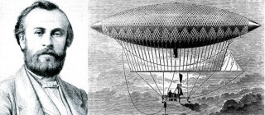
Pioneering Innovations:
The first practical steps toward airship innovation can be traced to the 19th century. The French engineer Henri Giffard made history in 1852 with the creation of the first powered and steerable airship. Fueled by a steam engine, Giffard's airship marked the beginning of controlled flight and paved the way for further developments in airship technology.

Slide 4
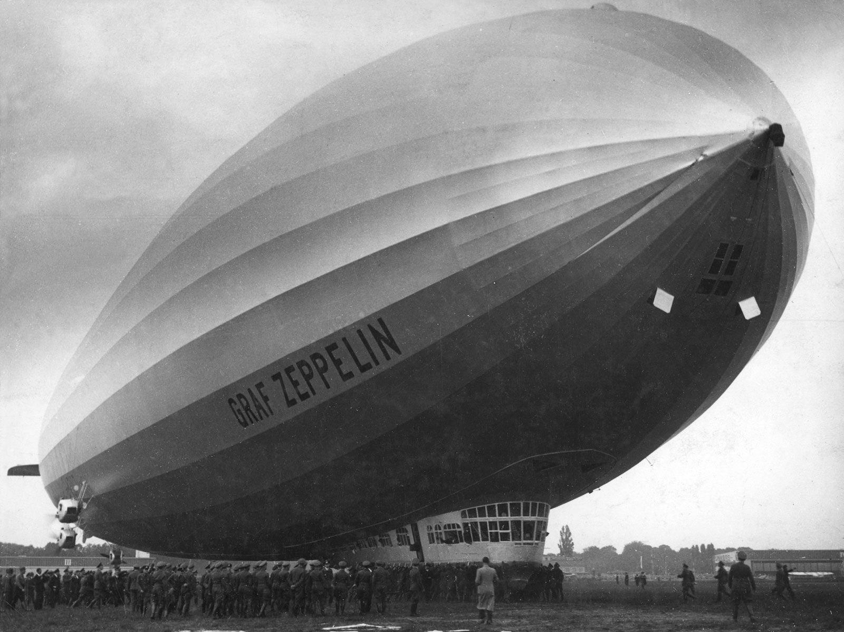
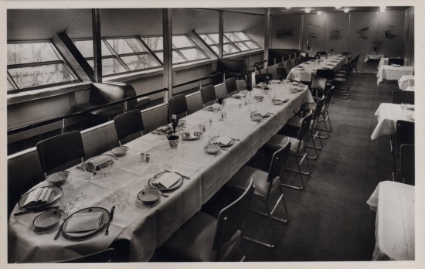
The Golden Age of Airships:
The turn of the 20th century witnessed the golden age of airships, with the emergence of iconic dirigibles like the Zeppelin. These colossal vessels, filled with hydrogen or helium, graced the skies with their majestic presence. The luxurious interiors of passenger airships offered a unique and glamorous mode of long-distance travel.

Slide 5
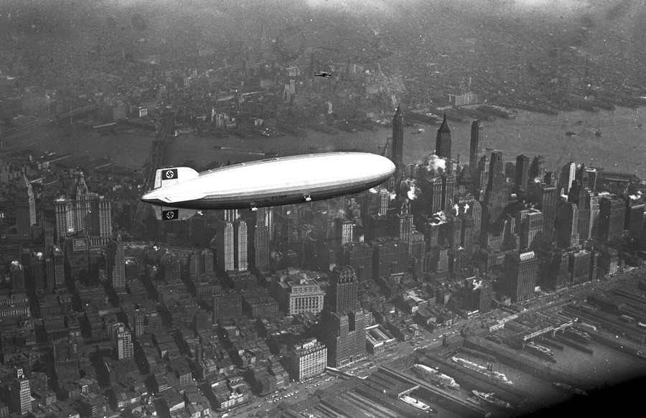
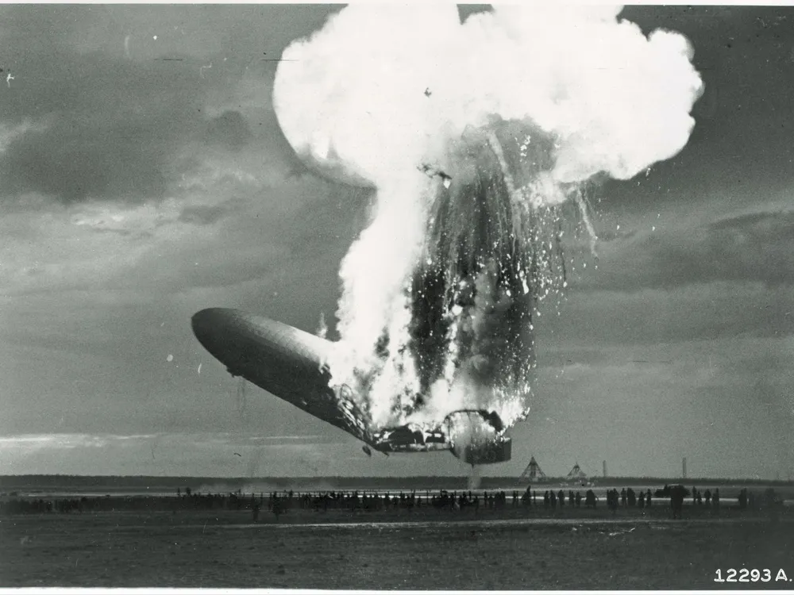
Challenges and Tragedies:
However, the era of airships was not without challenges. The use of highly flammable hydrogen gas led to tragic incidents, most notably the Hindenburg disaster in 1937. This catastrophic event marked a turning point in the public perception of airships and contributed to their decline in favor of more conventional aircraft.

Slide 6
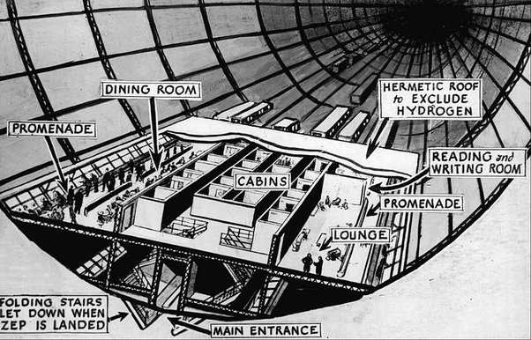
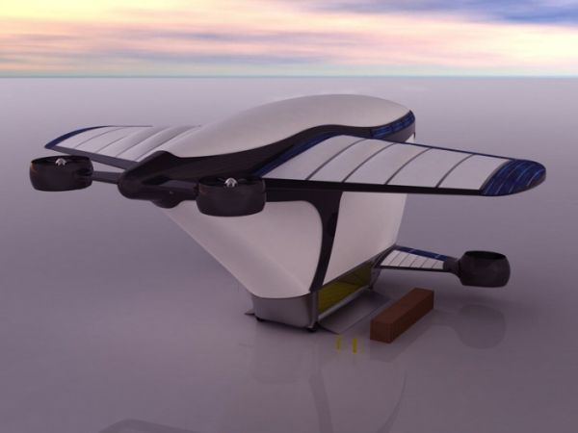
Environmental Advantages:
Airships present a promising alternative in terms of environmental impact. Their lower fuel consumption, reduced noise levels, and ability to stay aloft for extended periods make them an eco-friendly option in comparison to traditional aircraft. The potential for harnessing solar or electric power further adds to their appeal.

