Slide 1
Airplanes and Jet engines
Краев Степан
Серебряков Григорий
ИУ9-31Б

Slide 2
Questions about the presentation
What does the afterburner of an airplane engine mechanically mean?
Why is it not profitable to constantly boost the engine?
What can the afterburner be used for?

Slide 3
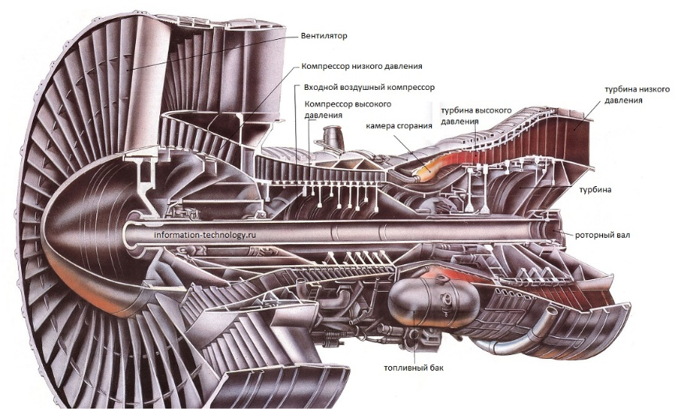
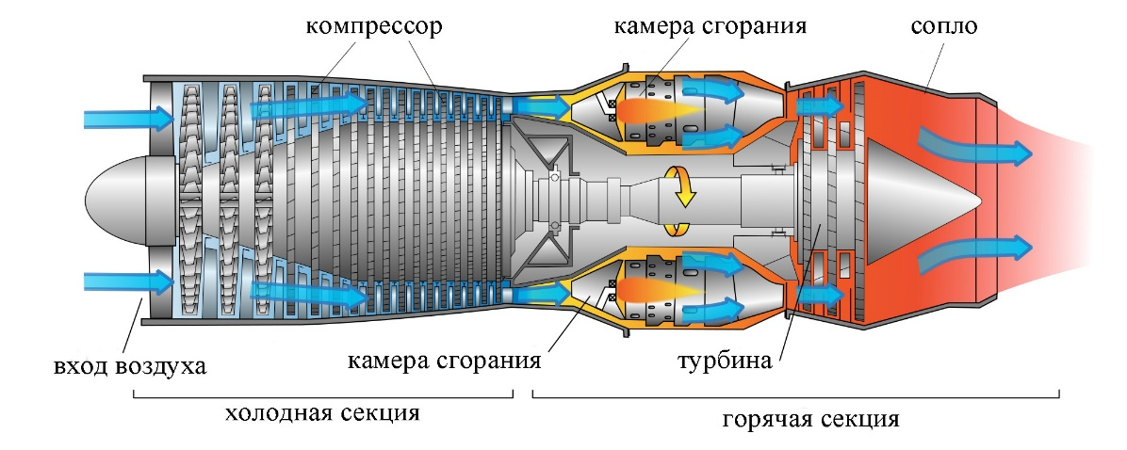
Types of Jet Engines:
There are various types of jet engines, but let's focus on two main categories: turbojet and turbofan engines. Turbojet engines are known for their high-speed capabilities, often used in military aircraft. Turbofan engines, on the other hand, are commonly found in commercial airplanes, providing a balance between speed and fuel efficiency.

Slide 4
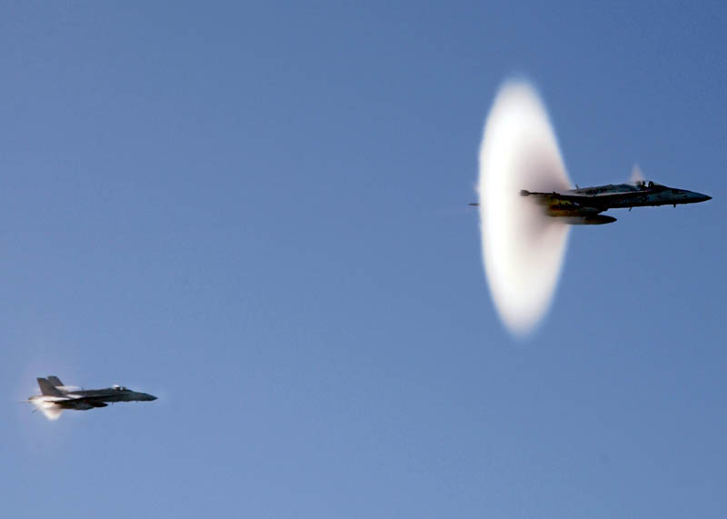
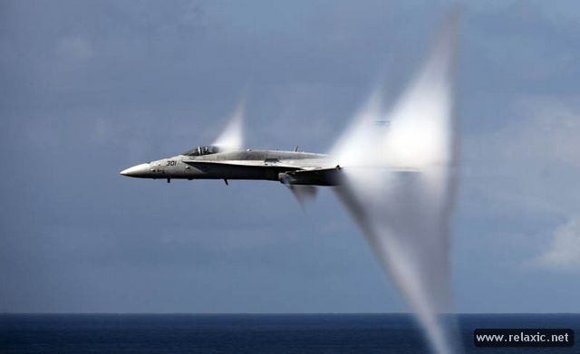
The Afterburner Phenomenon:
Now, let's delve into the heart of the matter – the afterburner. The afterburner is a fascinating component found in some jet engines, particularly in military aircraft. It's essentially an additional combustion chamber that ignites fuel after the initial combustion, dramatically increasing thrust.

Slide 5
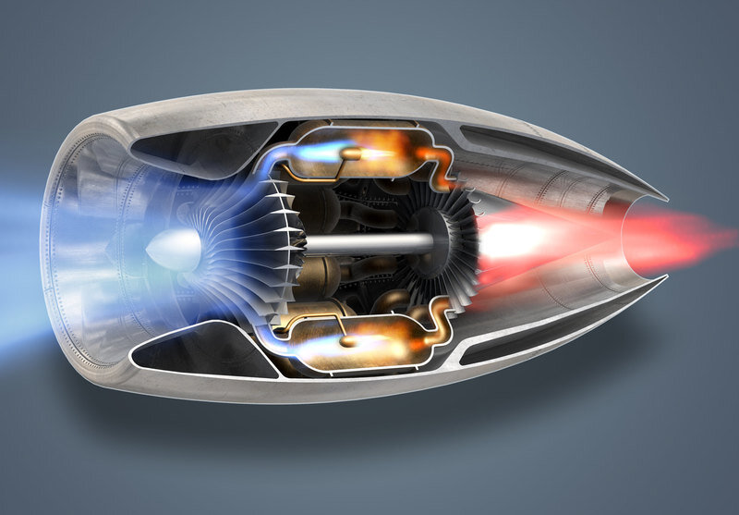
How Afterburners Work:
When engaged, the afterburner injects fuel directly into the exhaust stream, where it ignites and produces a powerful jet of hot gases. This intensified stream of gases exiting the engine generates an extraordinary boost in thrust, allowing the aircraft to achieve unparalleled speed and agility.

Slide 6
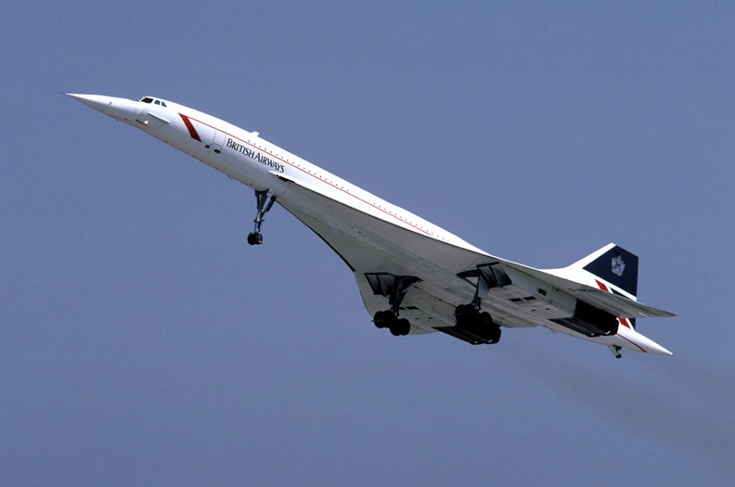
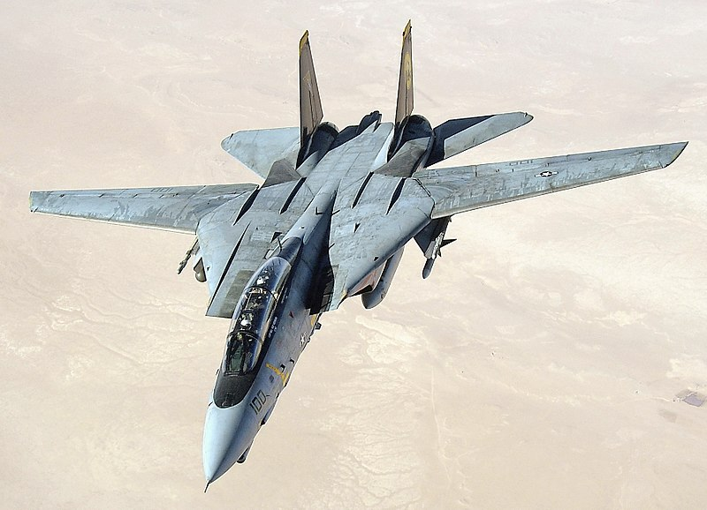
Notable Aircraft with Afterburners:
Some iconic aircraft equipped with afterburners include the legendary F-14 Tomcat and the supersonic Concorde. These aircraft harnessed the power of afterburners to break speed records and achieve unparalleled maneuverability.

Slide 7
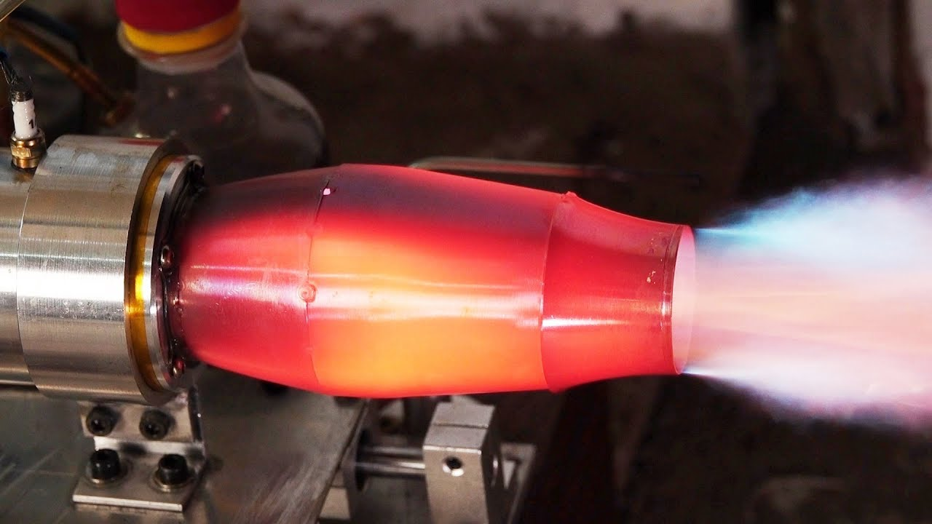
Challenges and Trade-offs:
While afterburners offer exceptional performance, they come with trade-offs. Increased fuel consumption and higher temperatures can limit their usage, making them more suitable for short bursts of intense speed rather than prolonged flights.

