Slide 1
Boston Dynamics

Slide 2
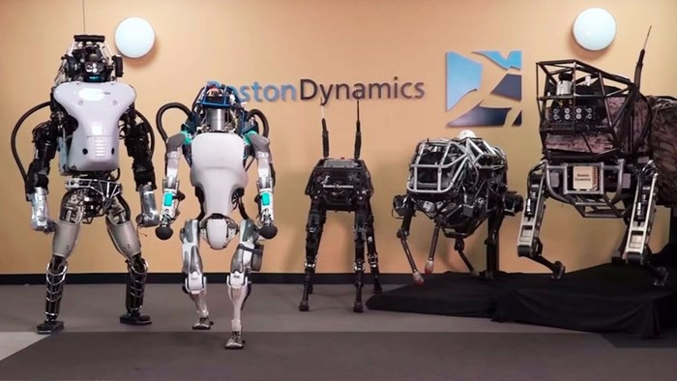

Slide 3
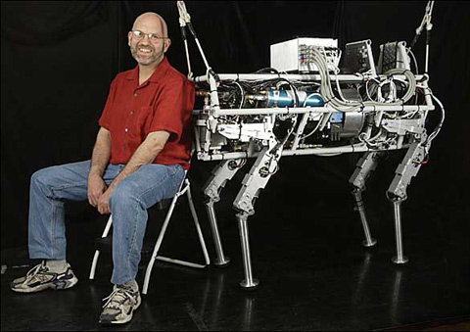
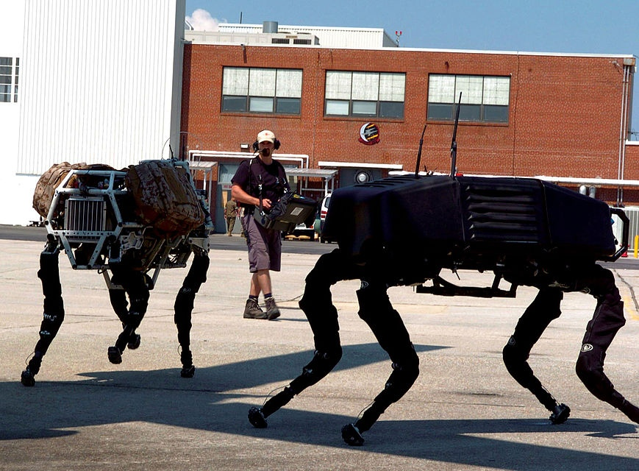
Today, Boston Dynamics is known all over the world through to the company videos on YouTube, in which they robots climb on the mountains, try to stand on the ice, pass through barriers and suffer from beatings of developers.

Slide 4
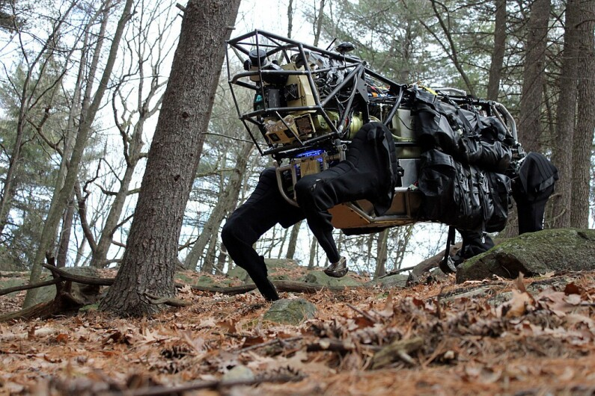
Big dog is adaptive-controlled four-legged walking robot created in 2005 by Boston Dynamics.
Big dog

Slide 5
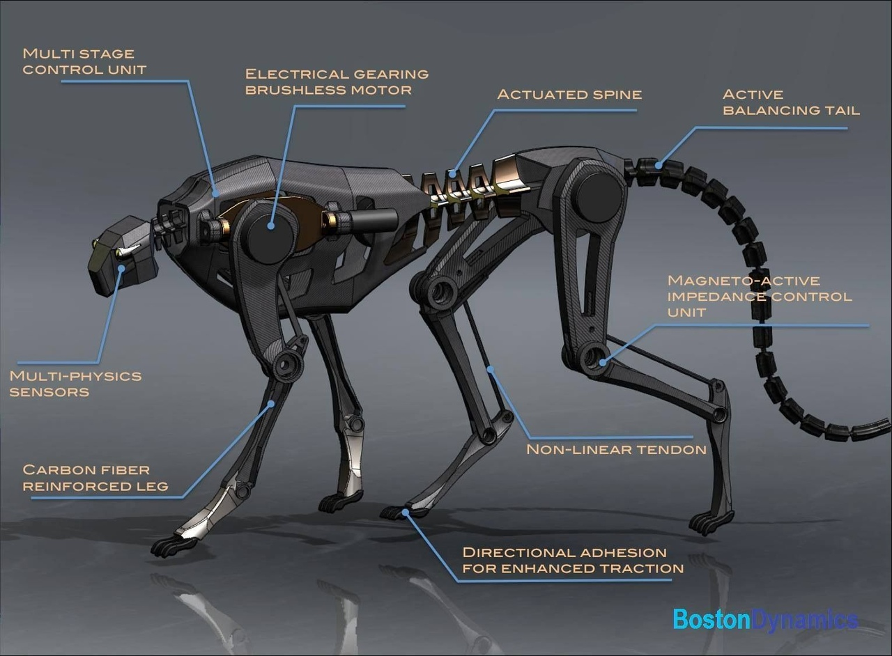
Cheetah

Slide 6
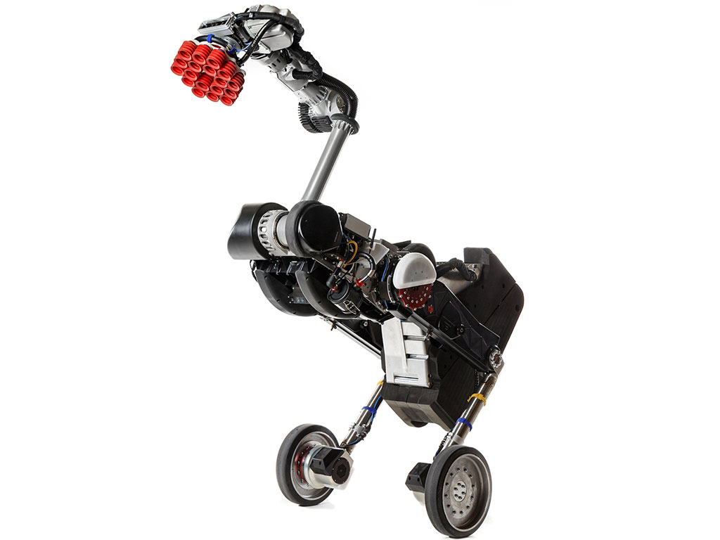
Handle

Slide 7
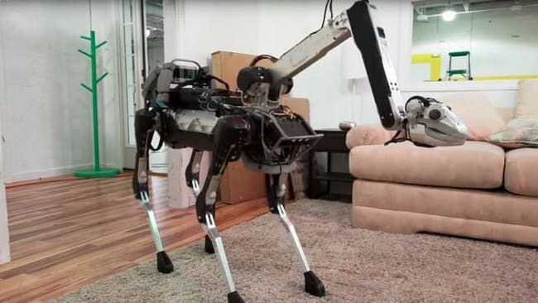
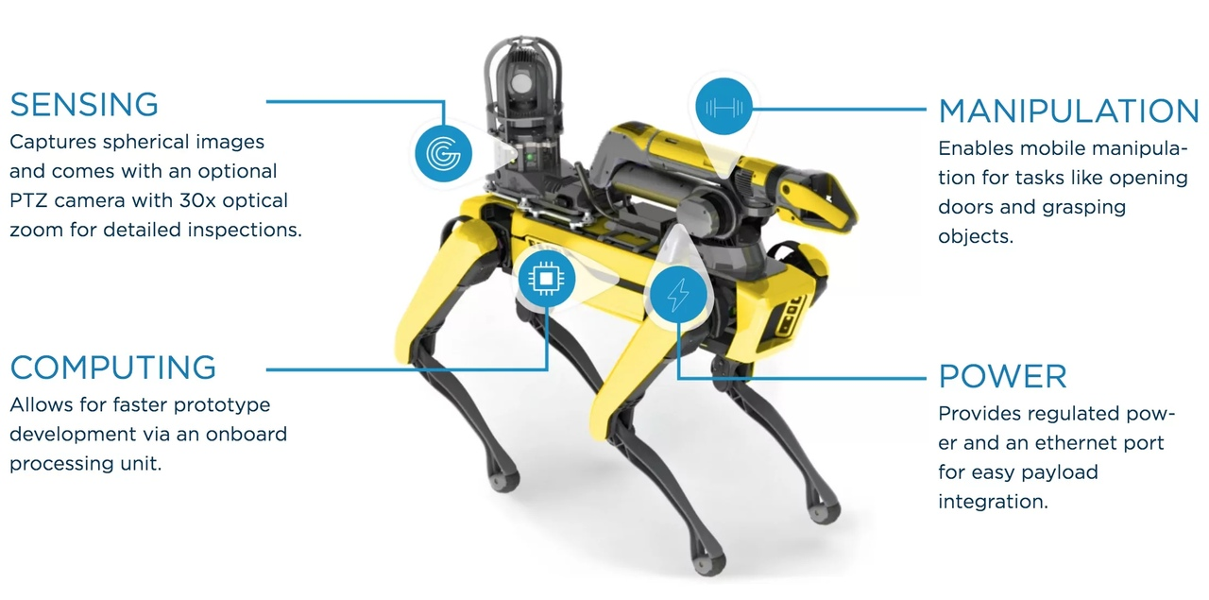
Spot Mini

