Slide 1

Iris
A python package for the analysis and visualisation of gridded Met/Ocean data
Philip Elson
9th Dec 2016

Slide 2

Who am I?
Scientific Python technical lead in the Met Office's analysis, visualisation and data (AVD) team
Seconded to the Bureau for 6 months – primary focus is the Model Data Services project which aims to deliver standard APIs for model data access
Contributor to many open source Scientific Python packages, including:
    Member of the matplotlib executive committee & core contributor for several years – led on the “notebook” backend
    Creator of conda-forge & cartopy
    Co-creator of Iris & biggus

Slide 3
Outline
What is Iris?
Iris demo
Using Iris for novel analysis
Opportunities for combining Iris with other tools
Audience of this talk:
Those who do data analysis and visualisation of Met/Ocean gridded data

Slide 4
The problem space (circa 2010)
UM Fieldsfile
UM Fieldsfile
GRIB
NetCDF
(Downstreaming data)
Notes:
Iris is a python package rather than a system, so we simply “import iris” in our usual python interpreter.
We can load data with Iris using the “load_cube” function. In this case we are asking of air_temperature from the file.
The string representation of a cube, as seen when printing it, is a short summary of some of the key metadata.

Slide 5
The problem space (circa 2010)
UM Fieldsfile
UM Fieldsfile
GRIB
NetCDF
(Data assimilation / Ancillary production)
Notes:
Iris is a python package rather than a system, so we simply “import iris” in our usual python interpreter.
We can load data with Iris using the “load_cube” function. In this case we are asking of air_temperature from the file.
The string representation of a cube, as seen when printing it, is a short summary of some of the key metadata.

Slide 6
The problem space (circa 2010)
UM Fieldsfile
UM Fieldsfile
GRIB
NetCDF
GRIB 2
(GRIB 2 is now widespread)
Notes:
Iris is a python package rather than a system, so we simply “import iris” in our usual python interpreter.
We can load data with Iris using the “load_cube” function. In this case we are asking of air_temperature from the file.
The string representation of a cube, as seen when printing it, is a short summary of some of the key metadata.

Slide 7
The problem space (circa 2010)
UM Fieldsfile
UM Fieldsfile
GRIB
NetCDF
GRIB 2
GeoTiff
(GeoTiff as a GIS product &
incoming GeoTiff for model ancil)
Notes:
Iris is a python package rather than a system, so we simply “import iris” in our usual python interpreter.
We can load data with Iris using the “load_cube” function. In this case we are asking of air_temperature from the file.
The string representation of a cube, as seen when printing it, is a short summary of some of the key metadata.

Slide 8
The problem space (circa 2010)
UM Fieldsfile
UM Fieldsfile
GRIB
NetCDF
GRIB 2
GeoTiff
UKMO IDL PP format
(Met Office's IDL UKMO library
for pre/post-processing,
designed for PP files)
Notes:
Iris is a python package rather than a system, so we simply “import iris” in our usual python interpreter.
We can load data with Iris using the “load_cube” function. In this case we are asking of air_temperature from the file.
The string representation of a cube, as seen when printing it, is a short summary of some of the key metadata.

Slide 9
The problem space (circa 2010)
UM Fieldsfile
UM Fieldsfile
GRIB
NetCDF
GRIB 2
GeoTiff
UKMO IDL PP format
Notes:
Iris is a python package rather than a system, so we simply “import iris” in our usual python interpreter.
We can load data with Iris using the “load_cube” function. In this case we are asking of air_temperature from the file.
The string representation of a cube, as seen when printing it, is a short summary of some of the key metadata.

Slide 10

The problem space (circa 2010)
UM Fieldsfile
UM Fieldsfile
GRIB
NetCDF
GRIB 2
GeoTiff
UKMO IDL PP format
Notes:
Iris is a python package rather than a system, so we simply “import iris” in our usual python interpreter.
We can load data with Iris using the “load_cube” function. In this case we are asking of air_temperature from the file.
The string representation of a cube, as seen when printing it, is a short summary of some of the key metadata.

Slide 11

A solution
Notes:
Iris is a python package rather than a system, so we simply “import iris” in our usual python interpreter.
We can load data with Iris using the “load_cube” function. In this case we are asking of air_temperature from the file.
The string representation of a cube, as seen when printing it, is a short summary of some of the key metadata.

Slide 12
A solution
UM Fieldsfile
GRIB
NetCDF
GRIB 2
GeoTiff
UKMO
PP format
???
Notes:
Iris is a python package rather than a system, so we simply “import iris” in our usual python interpreter.
We can load data with Iris using the “load_cube” function. In this case we are asking of air_temperature from the file.
The string representation of a cube, as seen when printing it, is a short summary of some of the key metadata.

Slide 13
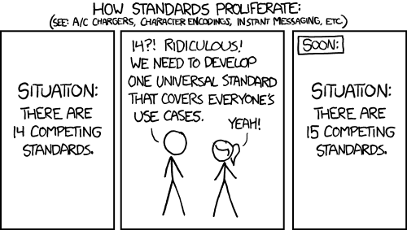
Caution
https://xkcd.com/927/
Notes:
Iris is a python package rather than a system, so we simply “import iris” in our usual python interpreter.
We can load data with Iris using the “load_cube” function. In this case we are asking of air_temperature from the file.
The string representation of a cube, as seen when printing it, is a short summary of some of the key metadata.

Slide 14



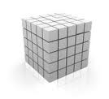

What is
Iris
?
Notes:
Iris is an open source Python package, at the core of which is Iris’ data model – the cube.
A cube is an interpretation of the CF Metadata conventions implemented as an in-memory data model with a Pythonic interface.
Despite the name, the cube is really a hyperrectangle – it can have an arbitrarily large number of dimensions, each of different length.
Attached to each cube is extensible metadata which describes the phenomenon it represents, as well as coordinates which describe the dimensions of the data.

Slide 15
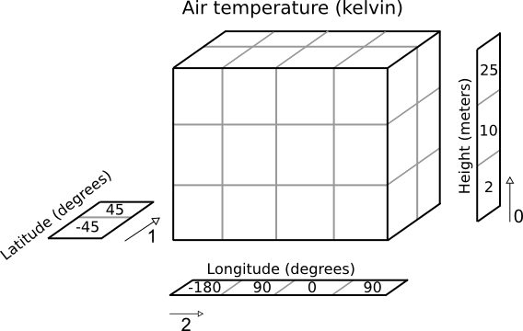
Notes:
Iris is an open source Python package, at the core of which is Iris’ data model – the cube.
A cube is an interpretation of the CF Metadata conventions implemented as an in-memory data model with a Pythonic interface.
Despite the name, the cube is really a hyperrectangle – it can have an arbitrarily large number of dimensions, each of different length.
Attached to each cube is extensible metadata which describes the phenomenon it represents, as well as coordinates which describe the dimensions of the data.

Slide 16


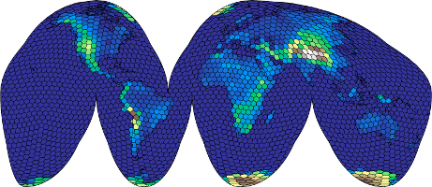
What is
Iris
?
Iris
netCDF
GRIB
PP
…
SciPy
Notes:
Iris’s cubes aren’t bound to specific input fileformats – provided it could be stored as a CF-1.5 compliant NetCDF file, it can be represented as a cube. (e.g. ORCA data)
We already have import support for commonly seen files, such as NetCDF, GRIB and UM PP and Fieldsfiles, and it is relatively simple to add new loading capabilities, or to just create a cube by hand.
Once you have a cube, there are common built-in operations, such as interpolation, aggregations, rolling windows, as well as a matplotlib plotting interface. Critically, it is easy to get access to your data, so if you want to do some novel analysis that Iris doesn't have, you can just call out to the amazing Python ecosystem.

Slide 17
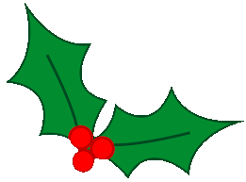
A simple example
Notes:
To best demonstrate some of Iris capabilities, let's look at a simple worked example.

Slide 18
Loading a cube
>>> import iris
>>> air_temp = iris.load_cube(filename,
'air_temperature')
>>> print(air_temp)
air_temperature / (K) (latitude: 73; longitude: 96)
Scalar coordinates:
pressure: 1000.0 hPa
time: 1998-12-01 00:00:00, bound=(1994-12-01 00:00:00,
1998-12-01 00:00:00)
Attributes:
STASH: m01s16i203
source: Data from Met Office Unified Model
Notes:
Iris is a python package rather than a system, so we simply “import iris” in our usual python interpreter.
We can load data with Iris using the “load_cube” function. In this case we are asking of air_temperature from the file.
The string representation of a cube, as seen when printing it, is a short summary of some of the key metadata.

Slide 19
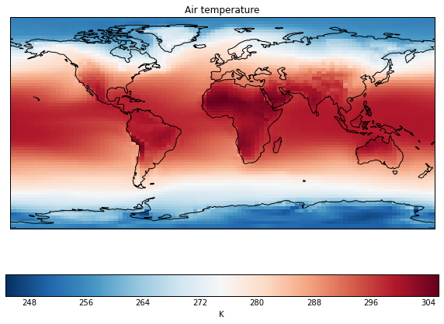
Plotting with matplotlib
>>> import matplotlib.pyplot as plt
>>> import iris.quickplot as qplt
>>> qplt.pcolormesh(air_temp, cmap='RdBu_r')
>>> plt.gca().coastlines()
Output:
PNG
PDF
PS
...
Notes:
The visualisation layer in iris is a very thin wrapper on matplotlib. Essentially, our wrappers understand cubes, and pass the appropriate information on to matplotlib to do the visualisation itself. This includes things such as the title, the x and y coordinate values as well as the coordinate system of those coordinates, and the data itself.
In this case we have used matplotlib's pcolormesh, which is essentially a block plot, but we could equally have asked for filled contours using the contourf function.

Slide 20
Regridding and interpolation
>>> from iris.analysis import Linear
>>> exeter = [('longitude', [-3.5]),
('latitude', [50.7])]
>>> exeter_temp = air_temp.interpolate(exeter,
Linear())
>>> mslp_euro = iris.load_cube(filename2)
>>> air_temp_euro = air_temp.regrid(mslp_euro,
Linear())
Typically, Iris functions take cubes as input, and return cubes as output.
Notes:
Iris has interpolation options built-in, simple interpolation to do flat-surface interpolation (point, line, plane, etc.), as well as regridding interpolation where one cube defines the grid for another to be interpolated onto.
In this case, initially we compute the temperature data at a single point.
In the other case, we regrid our temperature data onto the grid of another variable (mslp_euro – which is on a limited area model European domain with a rotated pole).

Slide 21
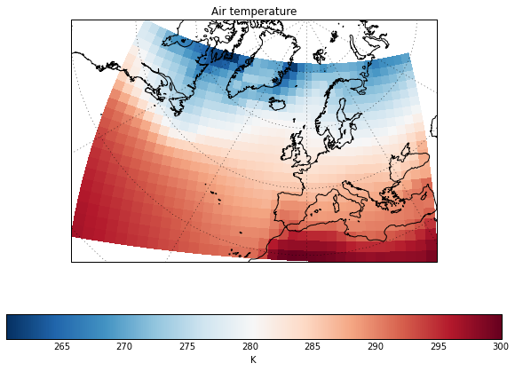
Maps with cartopy
Maps in Iris are drawn by cartopy, a python package developed to solve common dateline and pole problems seen with traditional mapping libraries.
>>> from cartopy.crs as ccrs
>>> ax = plt.axes(projection=ccrs.NorthPolarStereo())
>>> qplt.pcolormesh(air_temp_euro, cmap='RdBu_r')
>>> ax.coastlines('50m')
>>> ax.gridlines()
Notes:
Iris' mapping capabilities come from cartopy – a spin off python package which solves the dateline and pole problems seen with traditional mapping libraries.
In this case, we tell matplotlib that we want to produce a north polar stereographic map, and then use Iris to put our data (which has now been regridded onto a rotated pole) on the map.

Slide 22

A real-life example

Slide 23
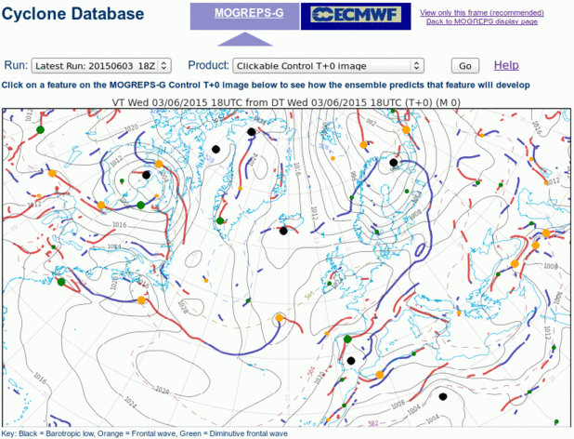
MOGREPS-G Cyclone Database
An algorithm to identify and track fronts and cyclonic features, based on:
Hewson, T.D. & H.A. Titley, 2010: Objective identification, typing and tracking of the complete life-cycles of cyclonic features at high spatial resolution. Meteorol. Appl., 17, 355-381.
Notes:
In practice, for novel product generation, we want to implement algorithms which don't belong in Iris' core.
As an example, I worked with Helen Titley to implement the “Objective identification, typing and tracking of the complete life-cycles of cyclonic features” algorithm described in this 2010 publication.

Slide 24

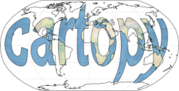

Implementing the algorithm
Load the phenomenon
Regrid and interpolate data to specific to vertical levels
Compute isolines for locating phenomenon + isosurfaces
for masking phenomenon, based on thresholds from paper
Compute intersection of isosurfaces and isolines to
identify cyclonic features
Iris
Iris
Notes:
The algorithm has several steps, each of which benefited from having powerful tools already available within Python:
Roughly, we start by loading the algorithm inputs straight from model output.
Next we put the diagnostics onto the desired grid and vertical levels.
We then used matplotlib in conjunction with cartopy to compute geolocated isolines and isosurfaces.
Using shapely, we compute the intersection of these surfaces to identify fronts, and cyclonic centers.

Slide 25
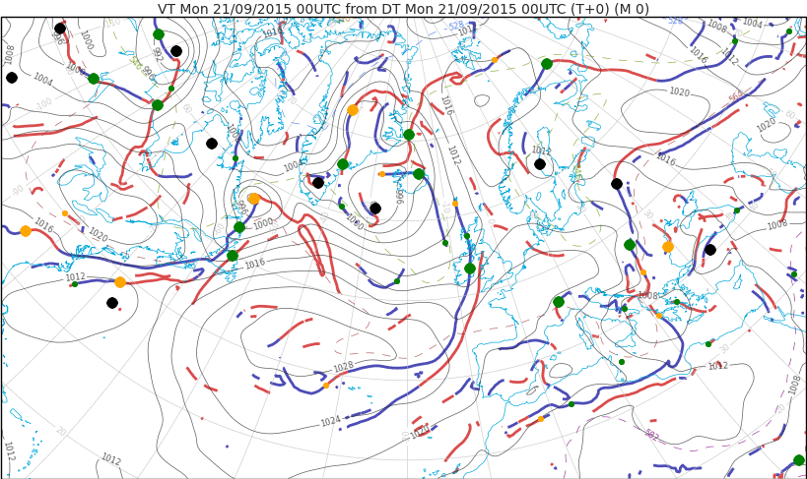
Classify cyclonic features based on phenomenon values
Visualise cyclonic features and the underlying diagnostics
Iris
Iris
Barotropic Lows Frontal Waves Diminutive Waves
Notes:
Using Iris, we then interpolate the diagnostics for these locations, to classify warm/cold fronts, and the type of cyclonic feature identified.
Finally, we visualise the fronts and cyclonic features, along with some of the diagnosics, to produce a web based animation. On the web page, each of the cyclonic features are clickable to give detailed diagnostic information and trends.

Slide 26
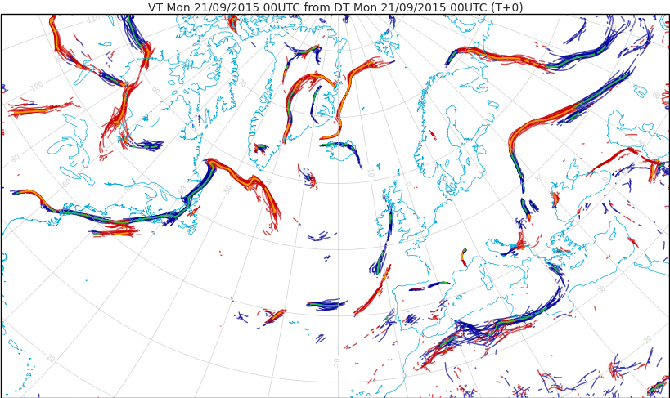

Visualise fronts as a spaghetti plot
Notes:
Because we had saved each of the geometries of the identified fronts, we were also able to compose the fronts into a multi-ensemble animation, which gives a nice indication of the spread of frontal development.

Slide 27
The Python ecosystem
Notes:
The most powerful part of Iris is the communities it plugs into.
Beyond the Iris basics there is a whole world of cross-domain packages which can be leveraged.
I will highlight just a few of these opportunities which represent possibilities in delivering novel science, or simply more effective calculation of ever increasing data payloads.

Slide 28
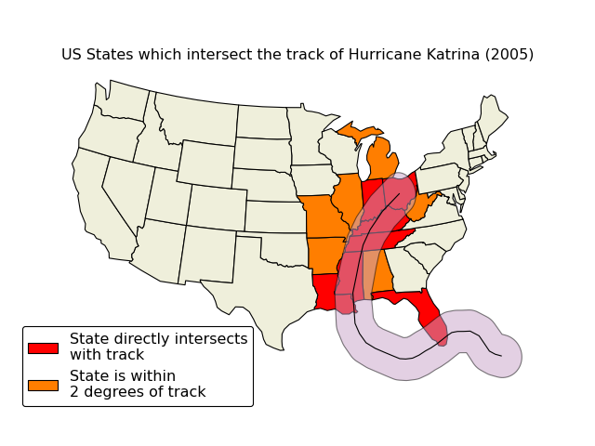
Opportunities within Python
GIS tools:
Shapely
Cartopy
Fiona
RasterIO
QGIS
http://scitools.org.uk/cartopy/docs/latest/examples/hurricane_katrina.html
Notes:
The geographic information system (GIS) world has long been a place for scientists skilled with GIS (desktop) tools to do novel temporal and spatial analyses, but the evolution of these algorithms into user-friendly Python packages has opened up a whole field of opportunity.
This toy example from the cartopy gallery highlights the US states which were within a distance from the track of hurricane Katrina. Although this is just a toy example, a similar technique is being used by Joanne Camp et al. to produce a seasonal forecast for land-falling Hurricane frequencies.

Slide 29
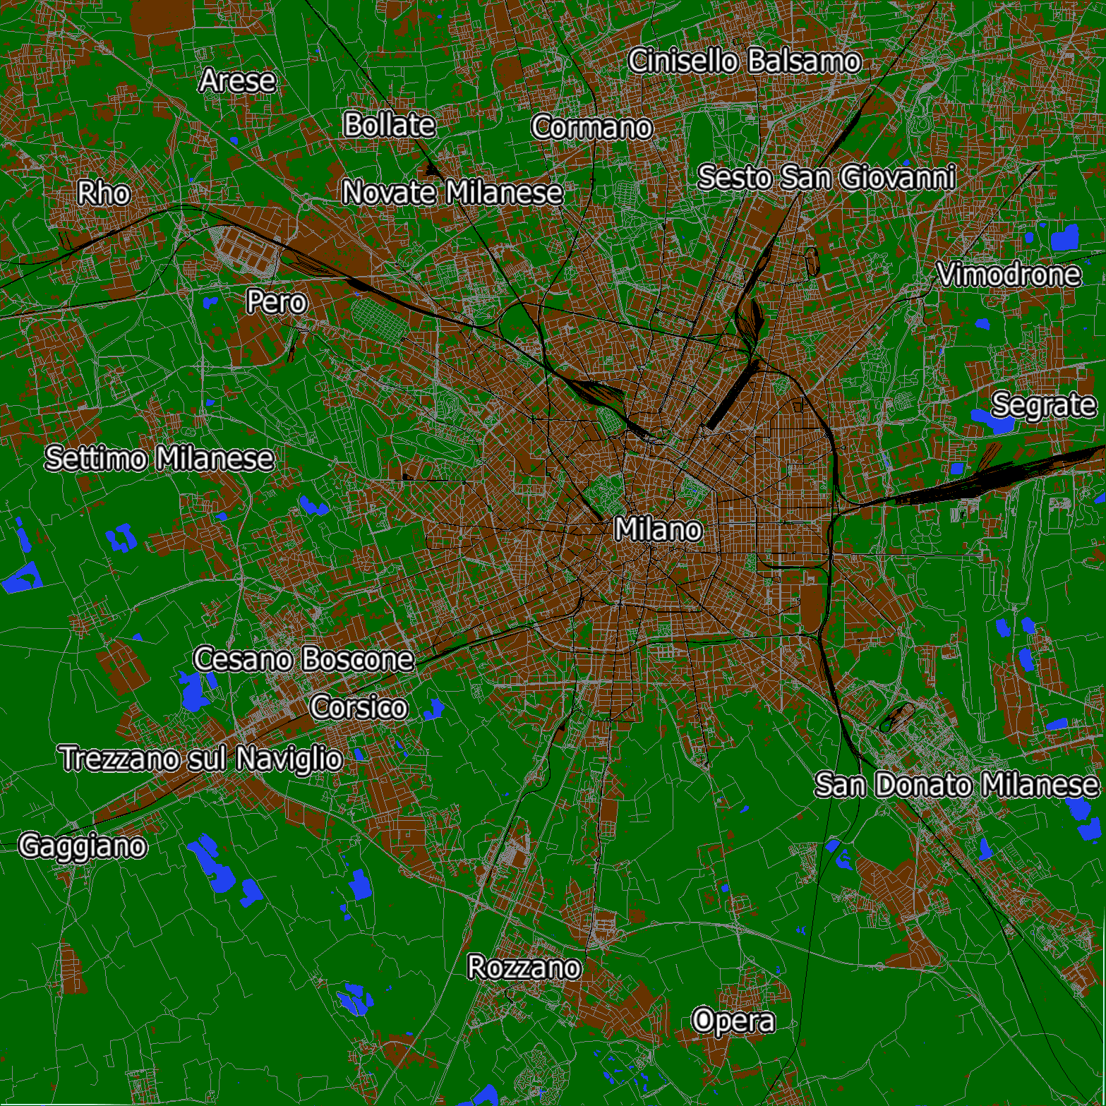
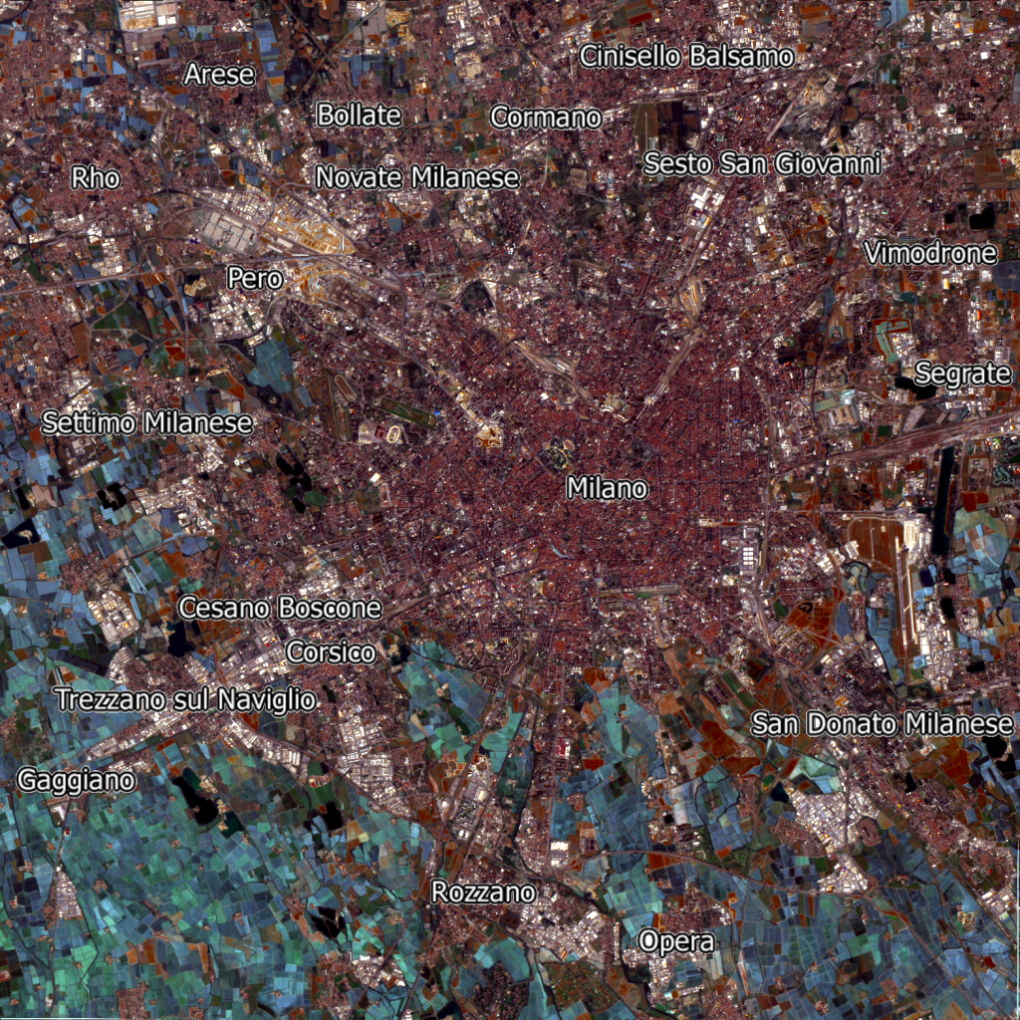
Opportunities within Python
Intelligent algorithms:
scikit-learn
scikit-image
http://rexdouglass.com/quick-and-dirty-land-cover-estimates-from-landsat-satellite-imagery-and-openstreetmap/
Notes:
One very exciting area of development in the Python world is that of machine learning and image processing.
Scikit-learn, in particular, has a broad range of classification algorithms. A simple example of using scikit-learn's random forest estimator to predict land usage based on satellite imagery was presented in this blog. It wouldn't take much effort to do similar analyses using data loaded with Iris.

Slide 30
Opportunities within Python
Large data manipulation:
Cython
Numba
Biggus
Dask
Tools to optimise slow for-loops using static typing and JIT compilation for C-like performance
Notes:
With ever increasing HPC comes ever increasing model output.
Numpy has long been the array language of choice within Python, however as a languague Python remains relatively slow - recently though, there has been work to improve the performance of Python in tight for-loop optimisation, Cython and Numba allow optimisations, such as static typing, to give C-like performance in certain situations.
Increasingly there is work going on to extend the numpy interface to deal with arrays beyond that which can realistically be fit into memory. Biggus and dask share a common goal of delivering “out-of-core” computation to stream through data quickly and efficiently.
The following example shows a biggus array of 32GiB, over which we want to compute the mean, max and min on the first dimension (time in this case). It is easy to imagine the algorithm to compute these values without ever needing to look at all of the data in one go. The computation of these values is not only achievable, it is fast and lean on memory, with the overall execution time being overwhelmingly slowed by disk I/O rather than CPU.
Iris makes use of biggus under the hood, allowing cubes to be loaded and processed, which are far beyond what is allocatable in memory.
We are IO bound, as is shown by cat-ing the file to /dev/null
$> time cat the_big_file > /dev/null
4m19.61s

Slide 31
Opportunities within Python
Large data manipulation:
Cython
Numba
Biggus
Dask
Biggus example:
>>> print(data)
<Array shape=(80640, 4, 144, 192)
dtype=dtype('float32') size=33.22 GiB>
>>> stats = [biggus.mean(data, axis=0),
biggus.max(data, axis=0),
biggus.min(data, axis=0)]
>>> biggus.ndarrays(stats)
Result in ~4m45s on an Intel Xeon E5520 with 8GiB memory, bound by I/O not CPU.
Iris is using Biggus for many of it operations. This means that we can load, analyse and save cubes way beyond the available system memory.
Notes:
With ever increasing HPC comes ever increasing model output.
Numpy has long been the array language of choice within Python, however as a languague Python remains relatively slow - recently though, there has been work to improve the performance of Python in tight for-loop optimisation, Cython and Numba allow optimisations, such as static typing, to give C-like performance in certain situations.
Increasingly there is work going on to extend the numpy interface to deal with arrays beyond that which can realistically be fit into memory. Biggus and dask share a common goal of delivering “out-of-core” computation to stream through data quickly and efficiently.
The following example shows a biggus array of 32GiB, over which we want to compute the mean, max and min on the first dimension (time in this case). It is easy to imagine the algorithm to compute these values without ever needing to look at all of the data in one go. The computation of these values is not only achievable, it is fast and lean on memory, with the overall execution time being overwhelmingly slowed by disk I/O rather than CPU.
Iris makes use of biggus under the hood, allowing cubes to be loaded and processed, which are far beyond what is allocatable in memory.
We are IO bound, as is shown by cat-ing the file to /dev/null
$> time cat the_big_file > /dev/null
4m19.61s

Slide 32

Next steps
Notes:
The most powerful part of Iris is the communities it plugs into.
Beyond the Iris basics there is a whole world of cross-domain packages which can be leveraged.
I will highlight just a few of these opportunities which represent possibilities in delivering novel science, or simply more effective calculation of ever increasing data payloads.

Slide 33
How does it perform?
Already does out-of-core for many operations (though not yet interpolations) and is becoming lazier and lazier...
Iris' UM Fieldsfile loading (python) was benchmarked in a like-for-like comparison with UM utils (modern Fortran) and found to be 4x faster. New UM utils to be based off of Iris' fieldsfile code (extended and packaged as “mule”). For heavy I/O good algorithms are king.
Interpretation of metadata is a bottleneck within Iris (particularly FF/GRIB → cube) – many opportunities for optimisation, including loading concurrently across a cluster
For cases that work out-of-core on data from a network mounted disk (e.g. GPFS, NFS), a proof-of-concept exists to distribute the processing across many nodes with no change needed to user code
Notes:
Do not read this as Python >> Fortran in terms of performance. It is simply easier to write good algorithms in an interpreted language.

Slide 34
What about xarray?
xarray is an Nd datamodel for netCDF files, written in Python
Superbly written, naturally extends Pandas to Nd
Developed by Stephan Hoyer from Iris concept¹
Target's a wider audience – more community buy-in, less domain specific utilities (e.g. no interpolation, no masked array out-of-core, limited interpretation of common standards such as CF)
Long term aim is looking to Iris using the underlying xarray data structures, with Iris providing the bells and whistles of domain specific functionality.
1. http://xarray.pydata.org/en/stable/faq.html#what-other-netcdf-related-python-libraries-should-i-know-about
Notes:
With ever increasing HPC comes ever increasing model output.
Numpy has long been the array language of choice within Python, however as a languague Python remains relatively slow - recently though, there has been work to improve the performance of Python in tight for-loop optimisation, Cython and Numba allow optimisations, such as static typing, to give C-like performance in certain situations.
Increasingly there is work going on to extend the numpy interface to deal with arrays beyond that which can realistically be fit into memory. Biggus and dask share a common goal of delivering “out-of-core” computation to stream through data quickly and efficiently.
The following example shows a biggus array of 32GiB, over which we want to compute the mean, max and min on the first dimension (time in this case). It is easy to imagine the algorithm to compute these values without ever needing to look at all of the data in one go. The computation of these values is not only achievable, it is fast and lean on memory, with the overall execution time being overwhelmingly slowed by disk I/O rather than CPU.
Iris makes use of biggus under the hood, allowing cubes to be loaded and processed, which are far beyond what is allocatable in memory.
We are IO bound, as is shown by cat-ing the file to /dev/null
$> time cat the_big_file > /dev/null
4m19.61s

Slide 35
Installing Iris
On a non-BoM machine:
conda install -c conda-forge iris
Iris installation in /apps anticipated as part of MDS project, already available on some systems (e.g. Raijin).
Notes:
Iris is reasonably well established in the community, and although traditionally it was difficult to install with all of its dependencies, the conda package manger has made the installation trivial on all major platforms (Linux, OSX, Windows).

Slide 36

Questions
Further reading:
github.com/scitools/courses
Slides from presentation:
github.com/pelson/BoM-Iris-presentation
Email: philip.elson@bom.gov.au
Github: github.com/pelson
Twitter: @pypelson

