Slide 1
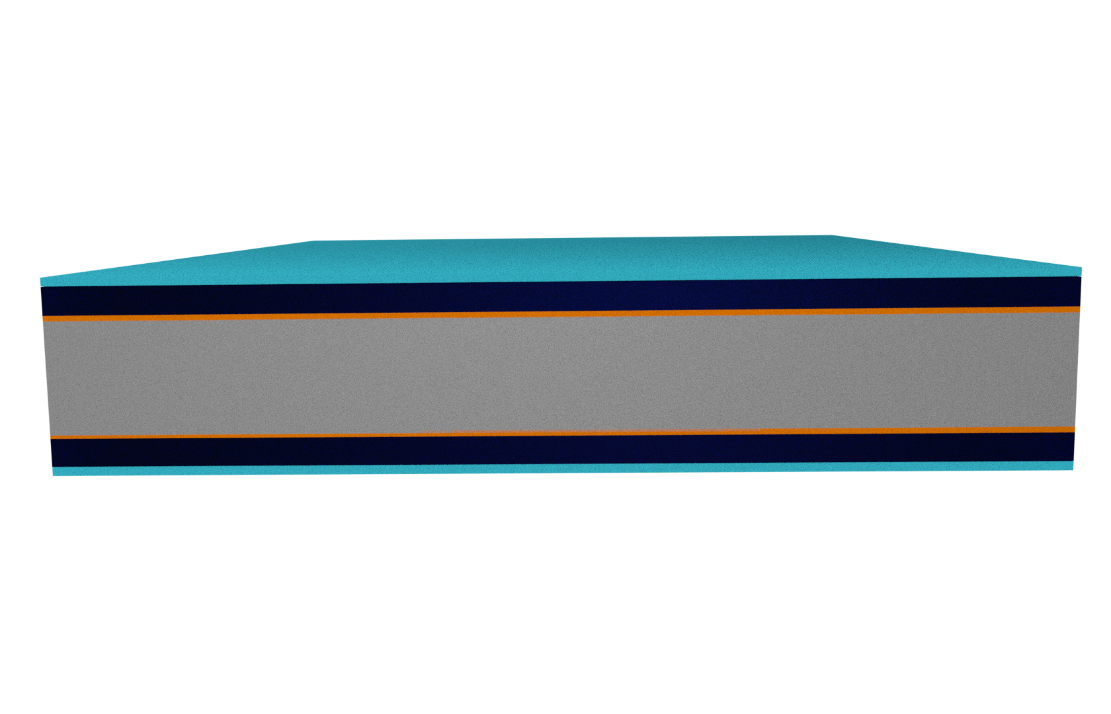
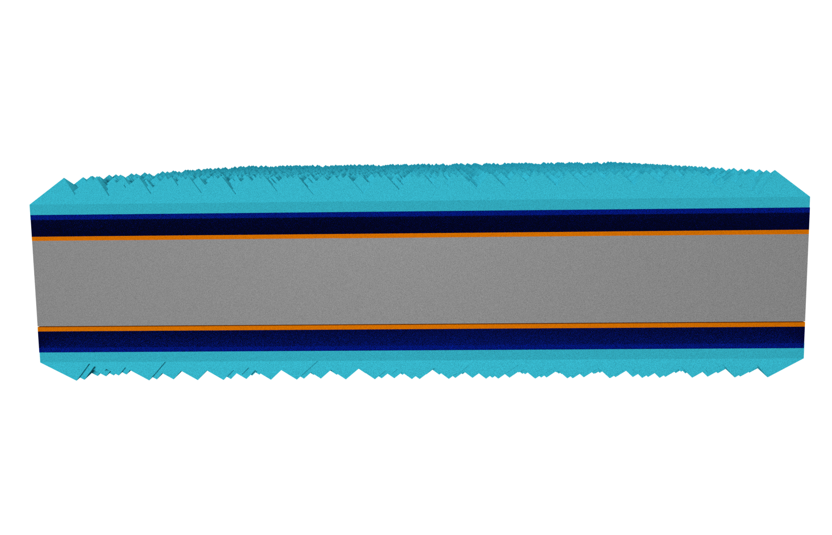
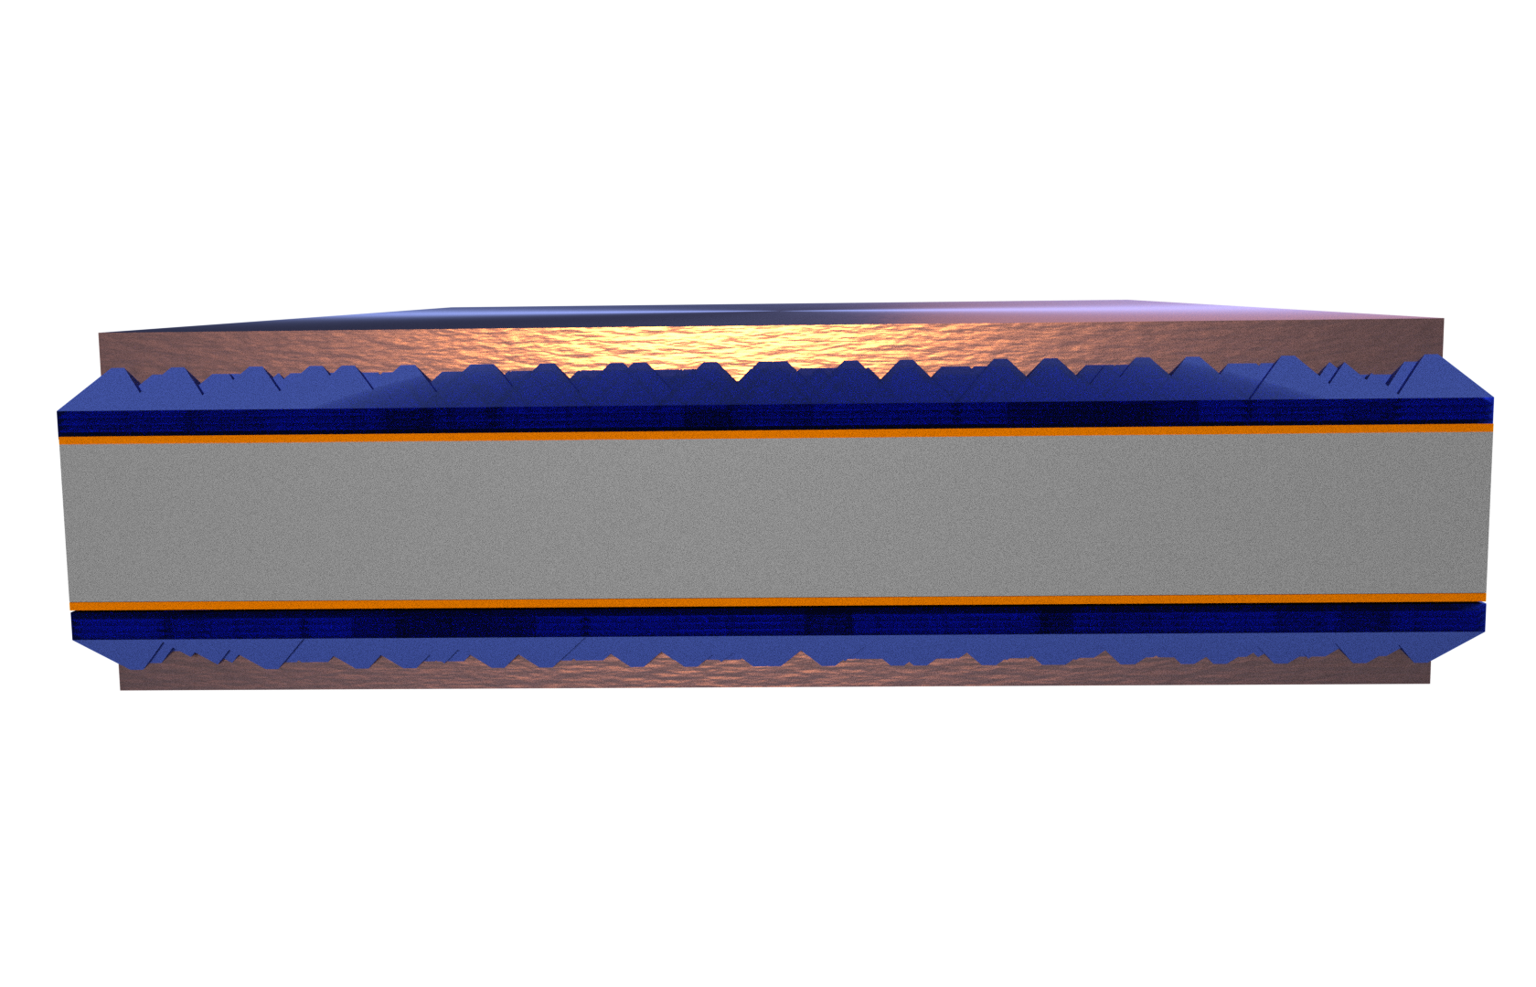
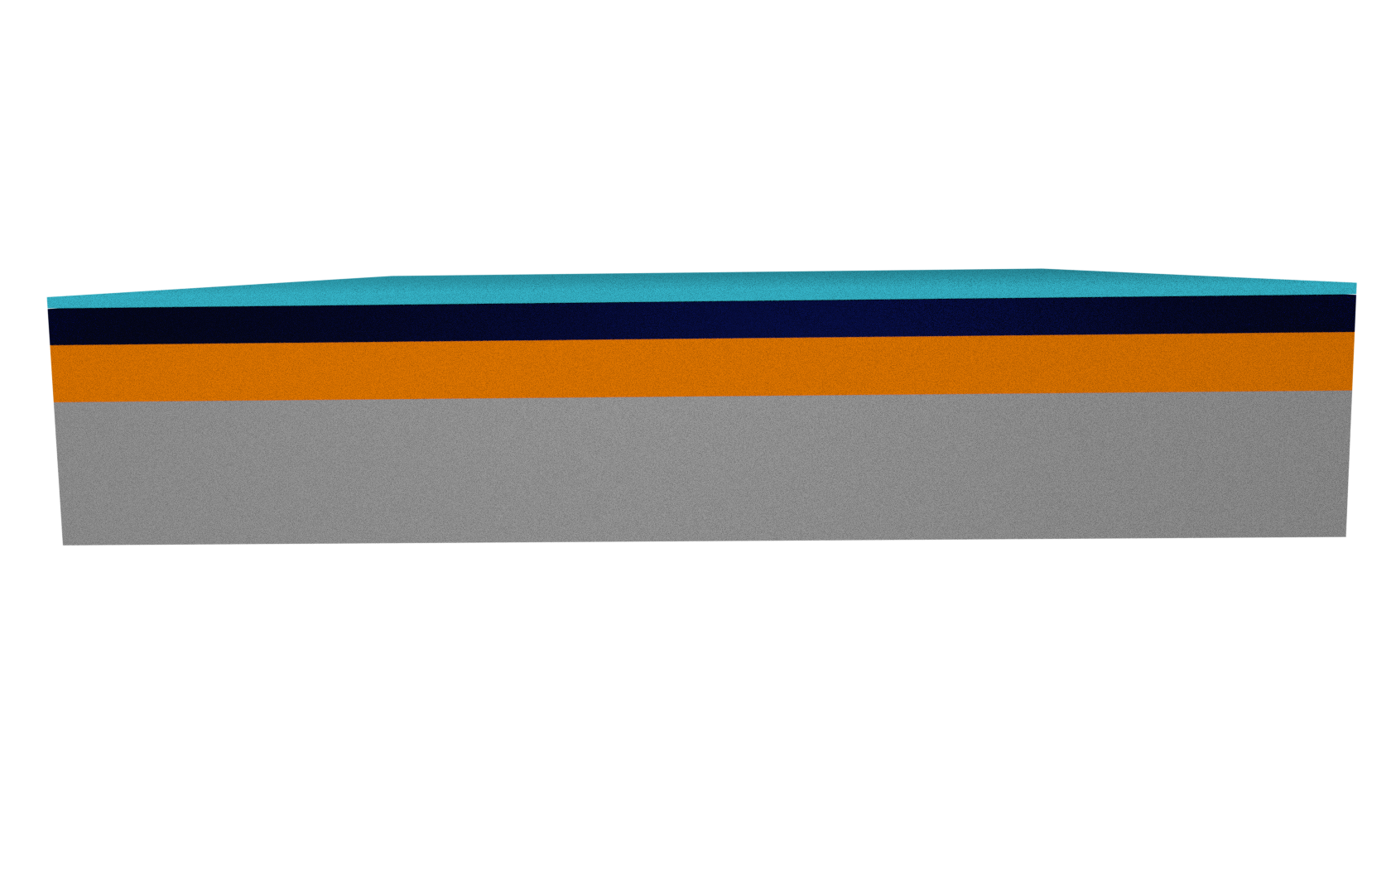
Type A: Passivation studies
ALD Al₂O₃
ALD ZnO
SiO_{x}
RCA, NAOS, LTO, UV/O₃
FZ c-Si(n), 285 μm, 3 Ωcm
Type B: Passivation studies
ALD Al₂O₃
ALD ZnO
with or w/o Al-doping
UV/O₃ SiO_{x}
Textured CZ c-Si(n), 185 μm, 3 Ωcm
with or w/o
n⁺ diffusion
PVD Ag
Type C: Contact resistivity studies
Sacrificial ALD Al₂O₃
etched after anneal
ALD ZnO
with or w/o Al-doping
CZ c-Si(n), 185 μm, 3 Ωcm
UV/O₃ SiO_{x}
n⁺ diffusion
with or w/o
ALD Al₂O₃
Type D: ZnO:Al characterization
ALD ZnO
with or w/o Al-doping
450 nm thermal SiO₂
CZ c-Si(p), 500 μm, 3 Ωcm

