Slide 1
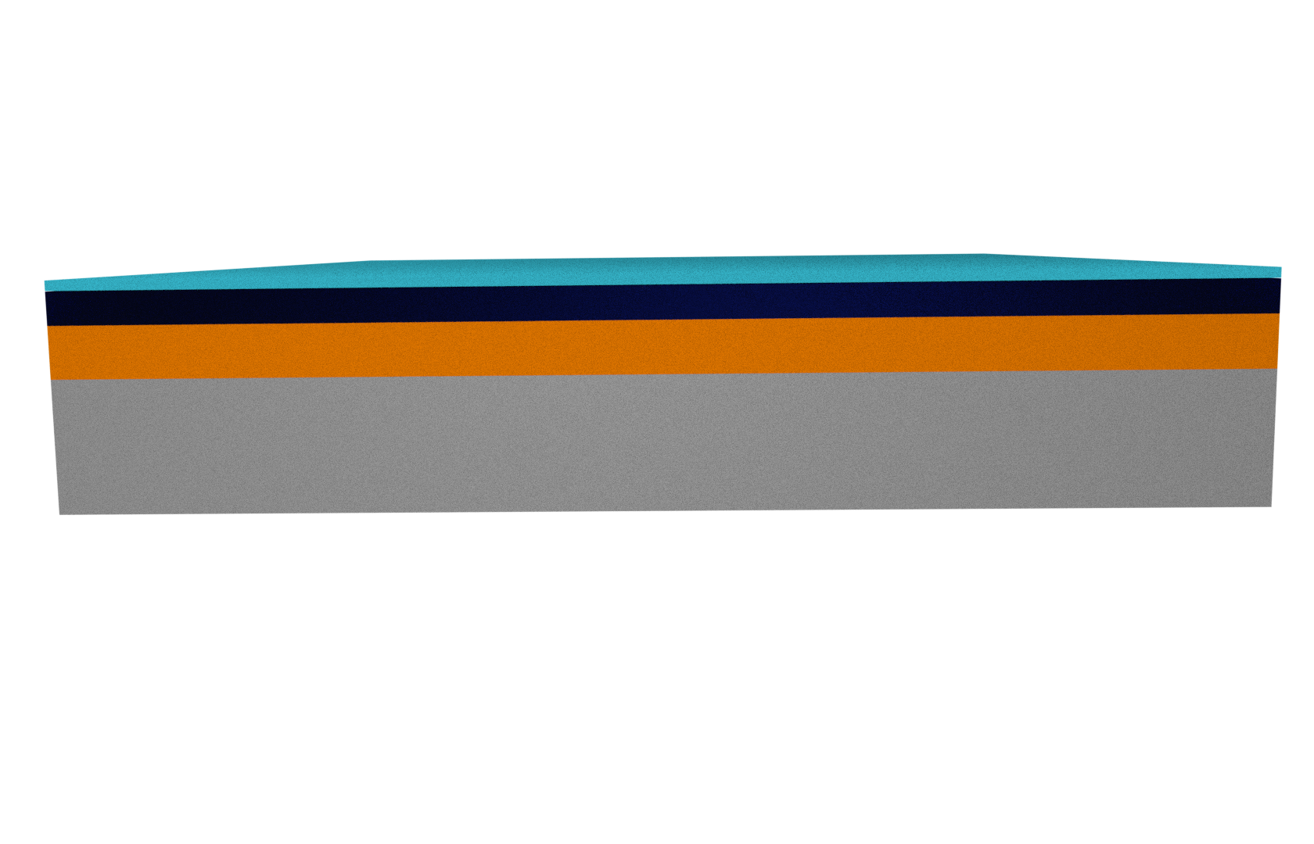
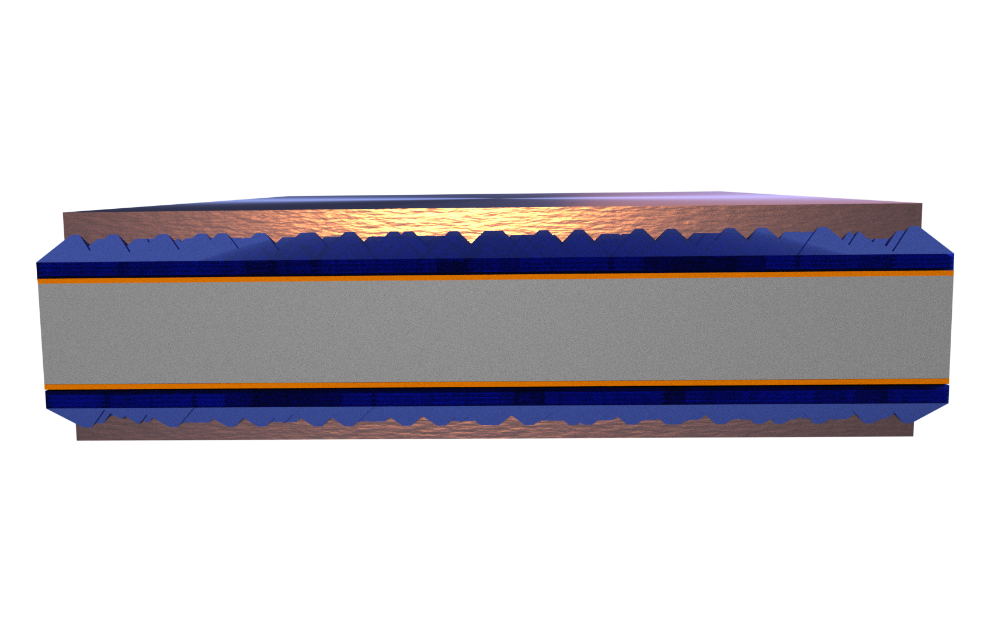
Type A: ZnO:Al characterization
with or w/o
ALD Al₂O₃
ALD ZnO
with or w/o Al-doping
CZ c-Si(p), 500 μm, 3 Ωcm
450 nm
thermal SiO₂
PVD Ag
Type B: Contact resistivity studies
Sacrificial ALD Al₂O₃
etched after anneal
ALD ZnO
with or w/o Al-doping
CZ c-Si(n), 185 μm, 3 Ωcm
UV/O₃ SiO_{x}
n⁺ diffusion

