Slide 1
zooplus
Senior AI Engineer take-home
15-minute walkthrough · see slide 2 for FR1–FR5
peluzzza/PoCAssistantZooplus · releases · v0.1.0
Async RAG · agentic lanes · catalog-only
Assistant
Notes:
30s: PoC scope from Coding Task.docx — five functional requirements.

Slide 2
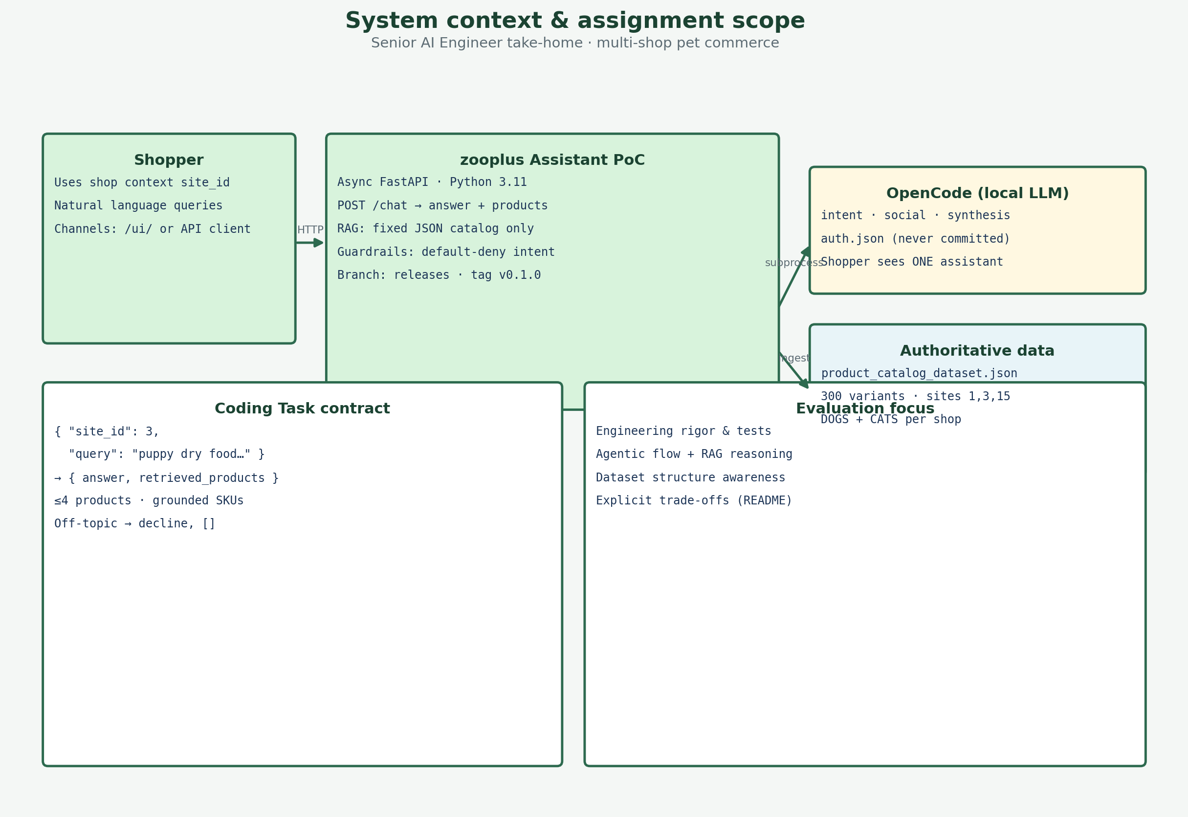
Coding Task overview
§1–§5
FR = Functional Requirement from Coding Task.docx
FR1 — Functional Requirement 1: Async FastAPI POST /chat (site_id + query)
FR2 — Functional Requirement 2: answer + retrieved_products (grounded)
FR3 — Functional Requirement 3: RAG only from product_catalog_dataset.json
FR4 — Functional Requirement 4: pet products only; off-topic decline
FR5 — Functional Requirement 5: production-oriented repo + README
Plus: agentic architecture (slides 5–6) — evaluation story, not an FR number
zooplus Assistant · Coding Task PoC v0.1
2
Notes:
45s: Explain FR acronym once. Point to docx sections 1-5. Then walk FR1 on next slide.

Slide 3
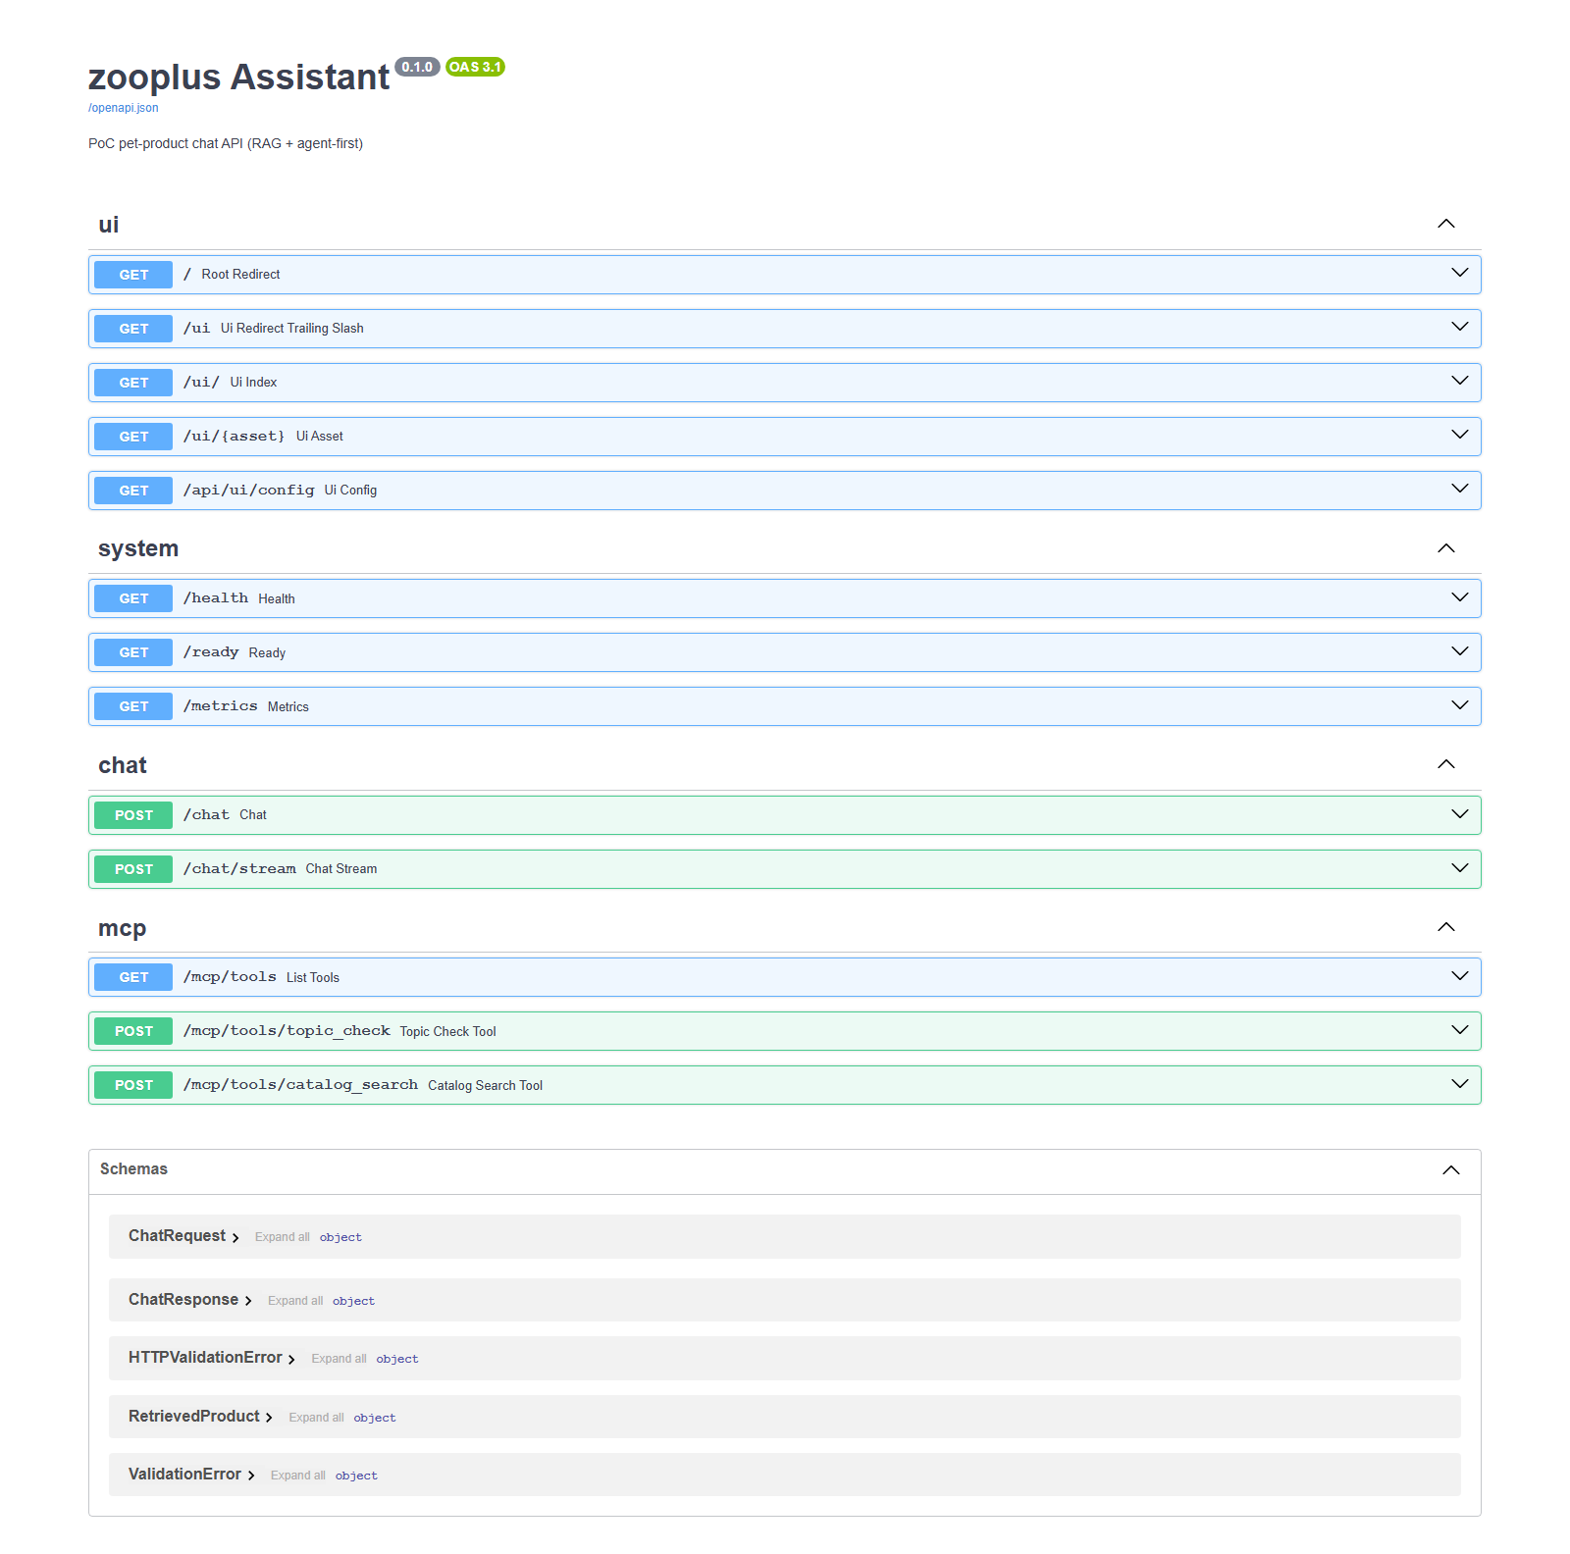
API endpoint
FR1
FR1 — Functional Requirement 1: async FastAPI + POST /chat
FR1 — Async FastAPI · POST /chat { site_id, query }
async def chat() → await handle_chat() (routes/chat.py)
Orchestrator async; Chroma/intent via asyncio.to_thread
Deploy: uvicorn ASGI · Test B1: iscoroutinefunction(chat)
{
"site_id": 3,
"query": "What's the best dry food for a puppy with a sensitive stomach?"
}
Async evidence (source) — B1 PASS
@router.post("/chat") async def chat(body: ChatRequest): return await handle_chat(body) # B1 tests/acceptance/test_coding_task_brief.py assert inspect.iscoroutinefunction(chat)
Live proof: /docs — Try it out with the mandatory brief query above
zooplus Assistant · Coding Task PoC v0.1
3
Notes:
60s: Show Swagger /docs (screenshot). Expand POST /chat. Run docx JSON.

Slide 4
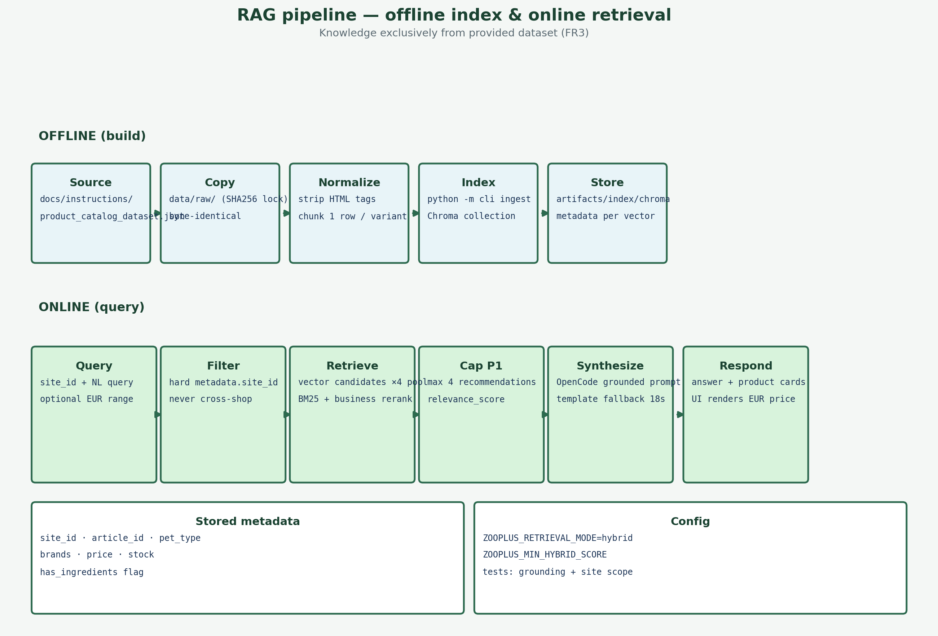
Response & RAG
FR2·FR3
FR2 (§2 response) + FR3 (§3 catalog-only RAG)
FR2 = Structured response: answer + retrieved_products[]
answer must be conversational and grounded in hits
each product: article_id, names, price, pet_type, brands
FR3 = Knowledge ONLY from product_catalog_dataset.json
ingest → Chroma → hybrid retrieve → synthesize · no web/APIs
300 variants · shops 1/3/15 · max 4 SKUs per turn
zooplus Assistant · Coding Task PoC v0.1
4
Notes:
2 min: Map each bullet to Coding Task §2 and §3.

Slide 5
Why hybrid retrieval?
RAG · Hybrid
Chroma vectors + BM25 lexical + business rerank — not vector-only
Problem we saw in the catalog
• Vector search alone misses exact tokens (brands, SKUs, “grain-free”).
• Pure keyword search misses intent (“puppy sensitive stomach”).
Why this hybrid design
• Chroma: semantic candidates from embedded product text (local, no API key).
• BM25 on the same candidate pool: lexical match without a second DB.
• Fuse 50% vector + 35% BM25 + 15% rating/sales/stock.
PoC trade-off
• Zero extra infra vs hosted vector DB; A/B via ZOOPLUS_RETRIEVAL_MODE=vector.
Query path (hybrid default)
1. Hard filter site_id in Chroma metadata
2. Pull ≥24 vector candidates
3. Score BM25 on candidate documents
4. Rerank → top 4 for API + UI cards
When vector-only is enough
• Short brand lookups or regression tests
• Hybrid wins on natural-language shopper queries
zooplus Assistant — Coding Task PoC v0.1
5

Slide 6
RAG strategy — end to end
FR3 · RAG
Ingest → retrieve → ground → synthesize (catalog-only, site-scoped)
Grounding & answer
• retrieved_products[] from same site_id hits only.
• Off-topic → empty list + polite decline (FR4).
• Synthesis: per-agent OpenCode LLM — never invent SKUs.
• Stream: /chat/stream → status* → products → done
• UI: one transient status bubble (agent shopper_status).
Production path
• routing_lexicon.json at ingest; optional Redis mirror.
• Managed vector DB + scheduled re-ingest (roadmap P1).
Grounding & answer
• retrieved_products[] from same site_id hits only.
• Off-topic → empty list + polite decline (FR4).
• Synthesis: per-agent OpenCode LLM — never invent SKUs.
• Stream: /chat/stream → status → products → done.
• UI: one transient status bubble (agent shopper_status).
Production path
• routing_lexicon.json at ingest; optional Redis mirror.
• Managed vector DB + scheduled re-ingest (roadmap P1).
zooplus Assistant — Coding Task PoC v0.1
6

Slide 7
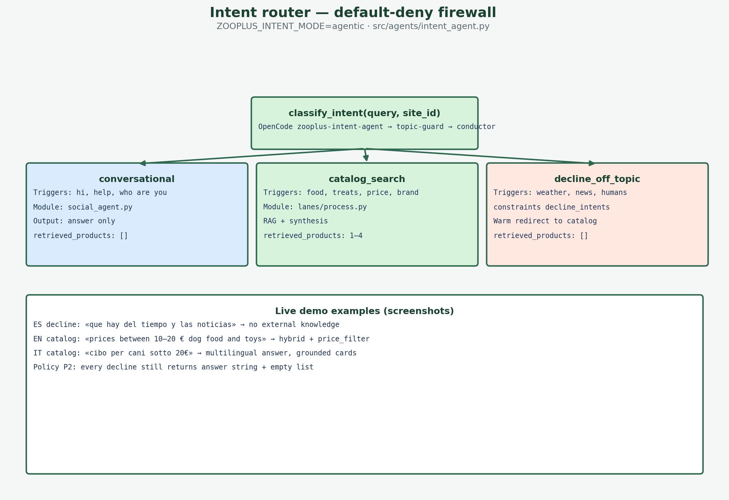
Agentic
Agentic routing (v0.1.3)
• Conductor-first: classify TOPIC before catalog search.
• Social greeting → social agent only (no Chroma).
• Catalog lane → prefetch → process → synthesis.
• Catalog lexicon in prompt (brands/tokens from ingest).
Latency & cache
• TTL cache: intent · chat · retrieval.
• Optional Redis: shared cache + lexicon.
• Fast social: hola que tal in seconds, not 30s+.
7
Notes:
90s: Walk diagram. Default-deny before Chroma.

Slide 8
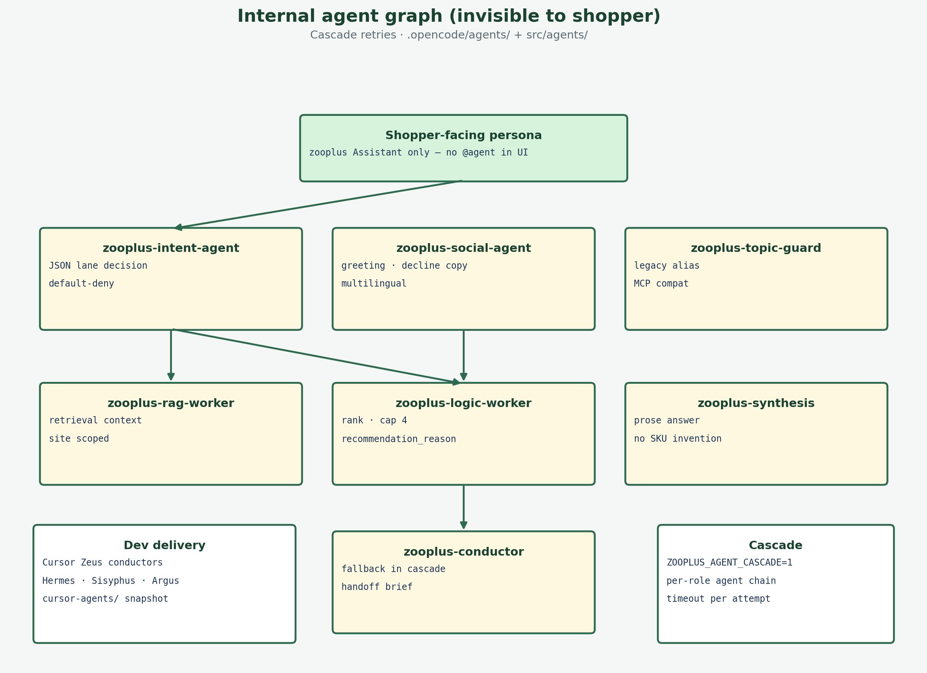
Agents
OpenCode specialists
• conductor → lane + shopper_status (JSON).
• social-agent → multilingual social / decline.
• intent-agent → fallback cascade.
• rag + logic workers → hybrid retrieve, cap 4.
• synthesis → grounded prose from hits only.
Per-agent LLMs (opencode.json)
• Conductor / social: mimo-v2.5-free.
• Intent / RAG: deepseek-v4-flash.
• Logic: qwen3.6-plus · Topic-guard: minimax-m2.5.
• Synthesis: deepseek-v4-flash-free.
• UI badge shows real model from response meta.
8
Notes:
90s: Name each agent and allowed output.

Slide 9
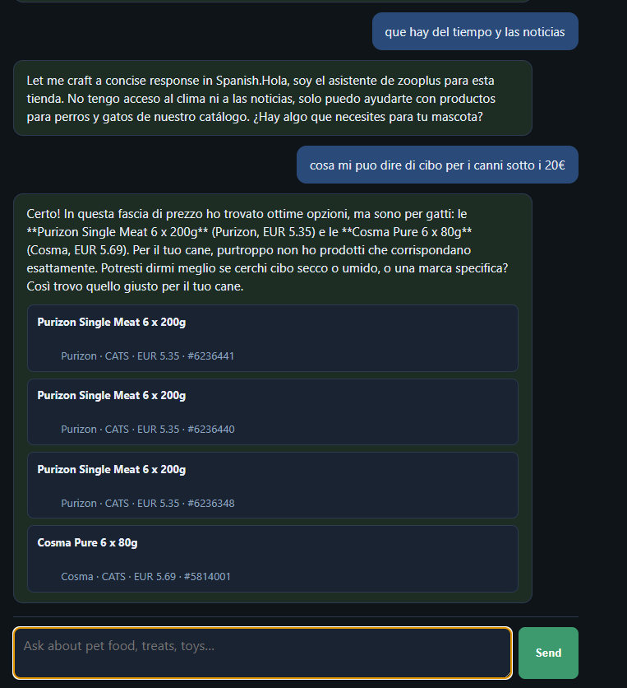
FR4
FR4 guardrails + live demo
• Pet catalog only · default-deny off-topic.
• constraints.yaml + agentic intent + social decline.
Demo (http://127.0.0.1:8090/ui/)
• A: hola que tal → fast social (no RAG).
• B: cat food 40–60 EUR → stream status → products.
• C: weather / news → polite decline.
• Pick shop 1, 3, or 15 before sending.
9
Notes:
5 min demo — tie steps to intent lanes (agentic slides).

Slide 10
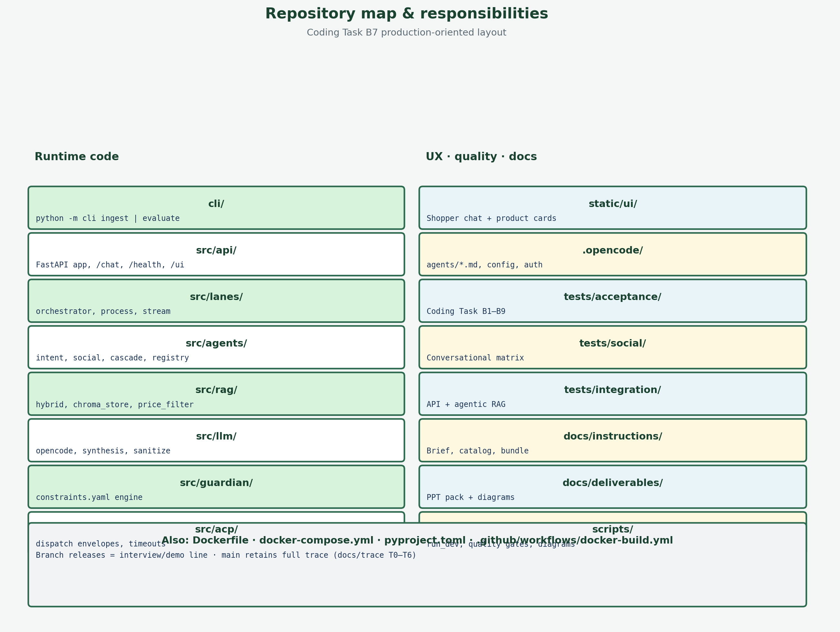
Production layout
FR5
FR5 — Functional Requirement 5: Production design (Coding Task §5)
FR5 = Production-oriented PoC: cli/ · src/ · tests/ · Docker
README submission: Design · Setup · Trade-offs · Roadmap
OpenCode agents internal — not in shopper API contract
Verify: scripts/run_release_verify.ps1
zooplus Assistant · Coding Task PoC v0.1
10
Notes:
1.5 min: FR5 + README four blocks.

Slide 11
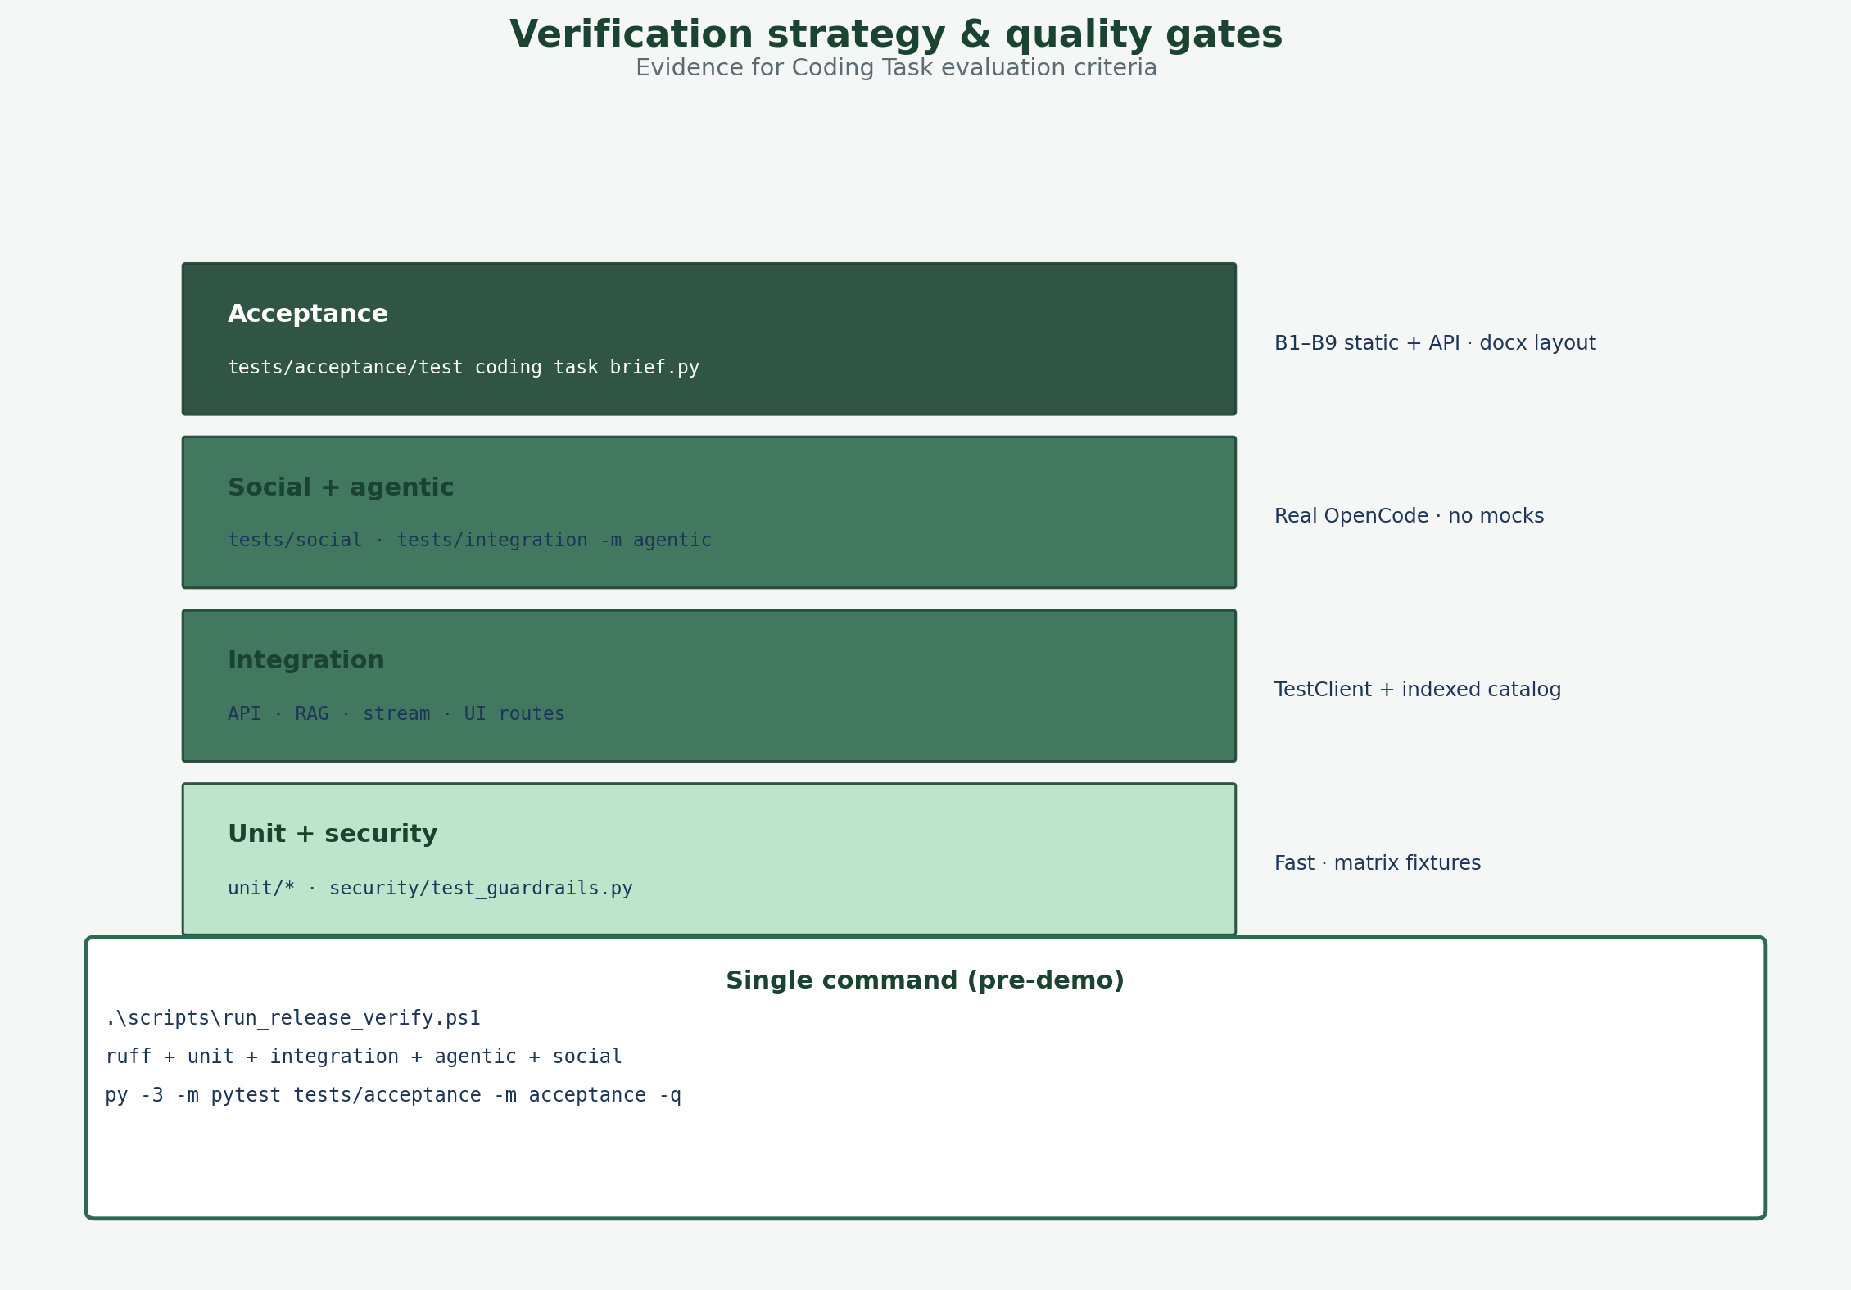
Roadmap — trust & quality
P0
Phase 1 · P0 — security and better filters (items 2–3)
Why first: FR4 guardrails must survive prompt injection and policy drift
Constraints v2: versioned YAML + injection scanner + security CI gate
Intent facets: pet_type, price band, category in JSON → deterministic RAG
Fixes real gaps (e.g. wrong species in results) before more traffic
Detail: docs/FUTURE_IMPROVEMENTS.md §2–§3
zooplus Assistant · Coding Task PoC v0.1
11
Notes:
45s: Tie to FR4 and evaluation criteria.

Slide 12
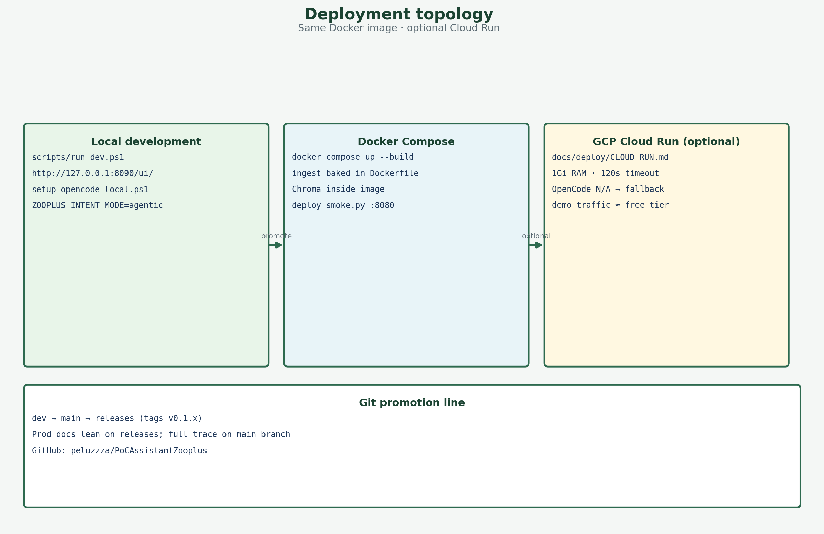
Roadmap — scale & fresh catalog
P1
Phase 2 · P1 — operations (items 8–9–4–5)
Why: stale vectors = wrong prices; single node cannot serve many users
RAG re-ingest: scheduled catalog sync → blue/green vector index swap
Concurrency: stateless API replicas · queue for process lane · rate limits
LLM: HTTP provider in workers (OpenCode stays for local dev/demo)
MCP server for external agents · ACP bus for internal agent choreography
zooplus Assistant · Coding Task PoC v0.1
12
Notes:
45s: Managed Chroma/Pinecone + Cloud Run mental model.

Slide 13
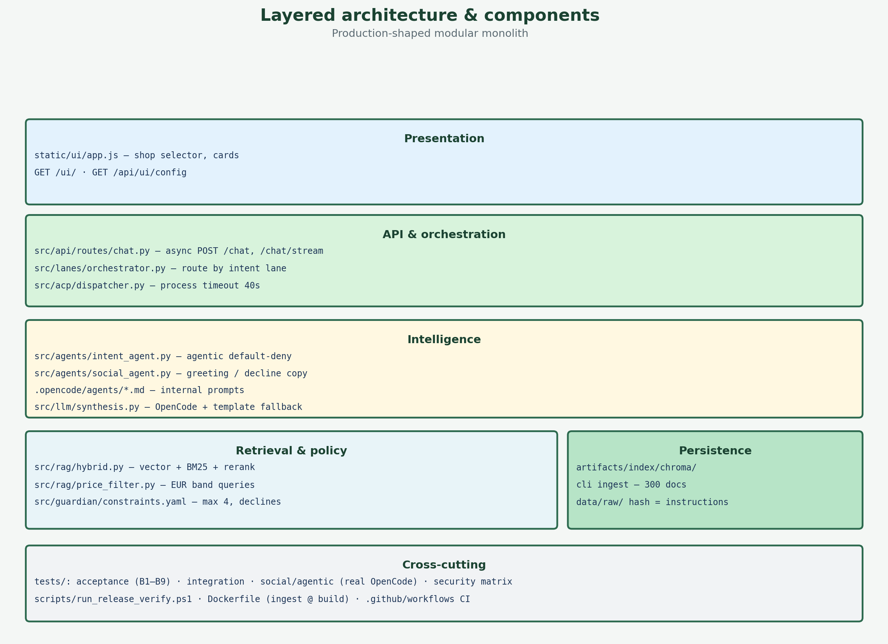
Roadmap — product channels
Later
Phase 3 · P2–P3 — after core is stable (items 7–1–6)
Image search: user photo → vision embedding → catalog-only RAG (no web)
Promo slots on /chat/stream while long RAG runs (feature-flagged ads)
Voice: STT/TTS wrapper — same POST /chat contract, new UI channel
Priority order: 2→3→8→9→4→5→7→1→6
Q&A — full doc: docs/FUTURE_IMPROVEMENTS.md
zooplus Assistant · Coding Task PoC v0.1
13
Notes:
45s + Q&A. Emphasize same API contract for voice and photo.

