Slide 1
zooplus
Senior AI Engineer take-home
15-minute walkthrough · see slide 2 for FR1–FR5
peluzzza/PoCAssistantZooplus · releases · v0.1.0
Async RAG · agentic lanes · catalog-only
Assistant
Notes:
30s: PoC scope from Coding Task.docx — five functional requirements.

Slide 2
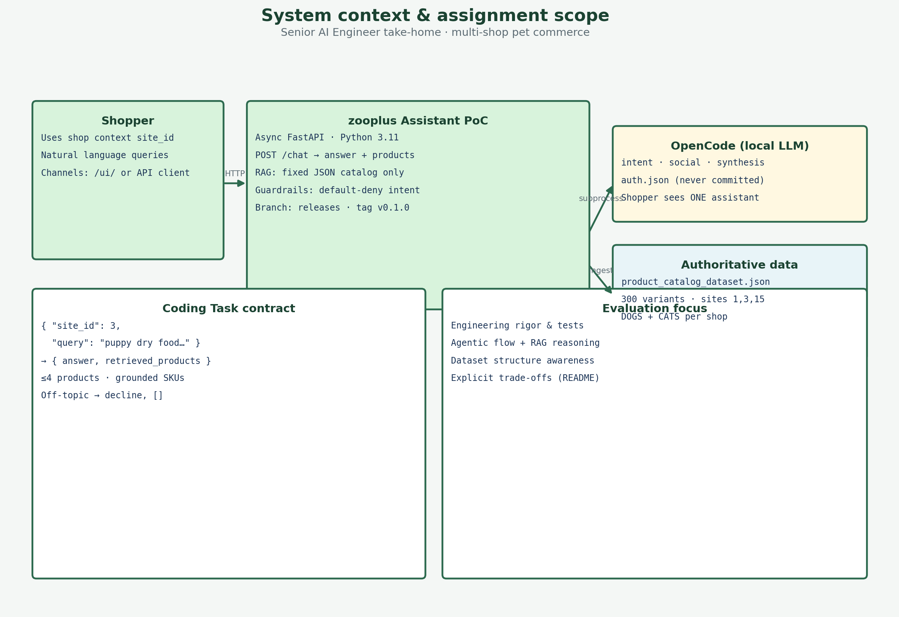
Coding Task overview
§1–§5
FR = Functional Requirement from Coding Task.docx
FR1 — Functional Requirement 1: Async FastAPI POST /chat (site_id + query)
FR2 — Functional Requirement 2: answer + retrieved_products (grounded)
FR3 — Functional Requirement 3: RAG only from product_catalog_dataset.json
FR4 — Functional Requirement 4: pet products only; off-topic decline
FR5 — Functional Requirement 5: production-oriented repo + README
Plus: agentic architecture (slides 5–6) — evaluation story, not an FR number
zooplus Assistant · Coding Task PoC v0.1
2
Notes:
45s: Explain FR acronym once. Point to docx sections 1-5. Then walk FR1 on next slide.

Slide 3
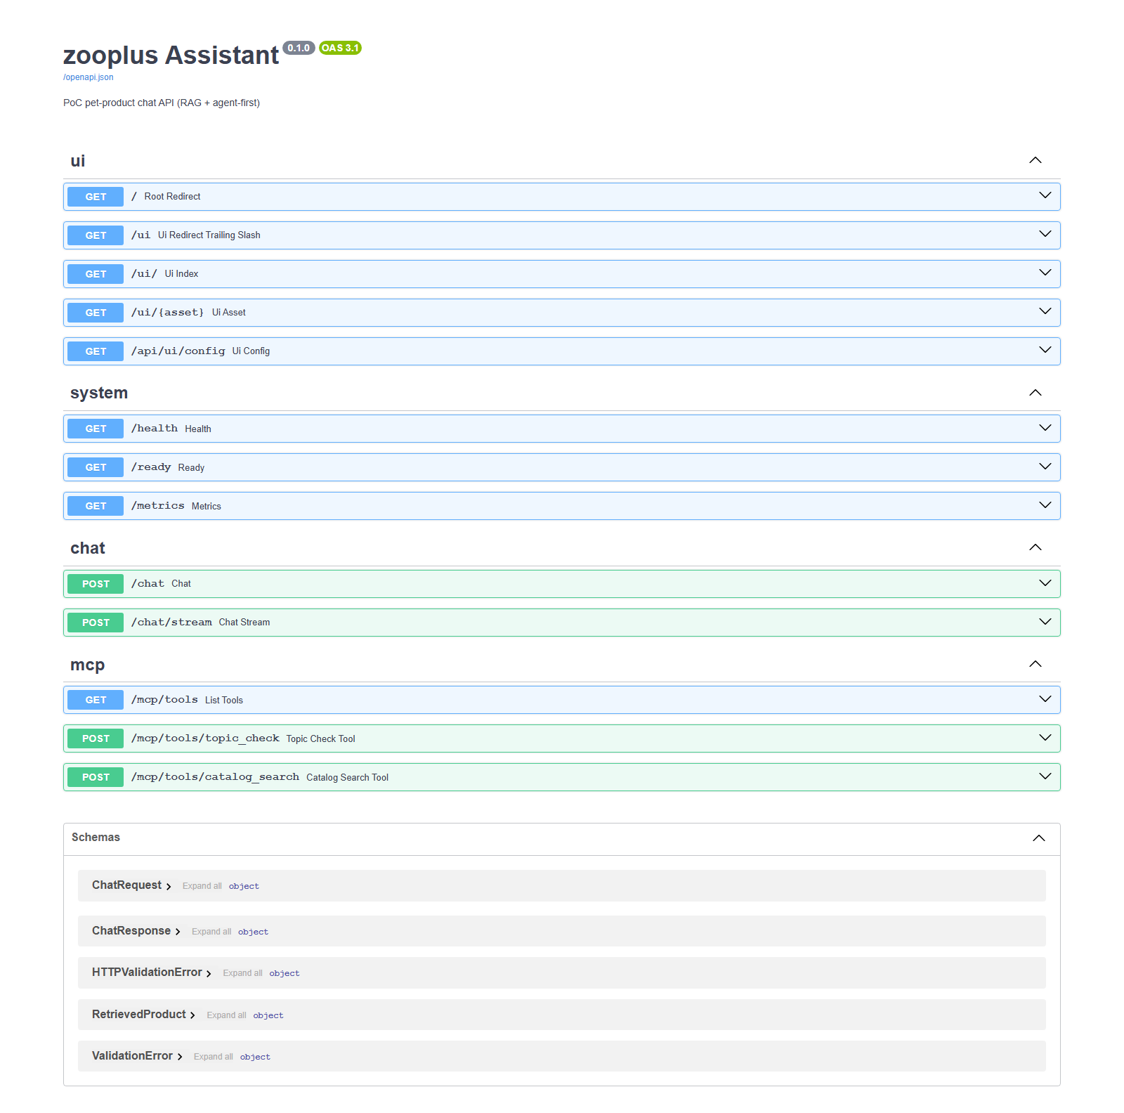
API endpoint
FR1
FR1 — Functional Requirement 1: async FastAPI + POST /chat
FR1 — Async FastAPI · POST /chat { site_id, query }
async def chat() → await handle_chat() (routes/chat.py)
Orchestrator async; Chroma/intent via asyncio.to_thread
Deploy: uvicorn ASGI · Test B1: iscoroutinefunction(chat)
{
"site_id": 3,
"query": "What's the best dry food for a puppy with a sensitive stomach?"
}
Async evidence (source) — B1 PASS
@router.post("/chat") async def chat(body: ChatRequest): return await handle_chat(body) # B1 tests/acceptance/test_coding_task_brief.py assert inspect.iscoroutinefunction(chat)
Live proof: /docs — Try it out with the mandatory brief query above
zooplus Assistant · Coding Task PoC v0.1
3
Notes:
60s: Show Swagger /docs (screenshot). Expand POST /chat. Run docx JSON.

Slide 4
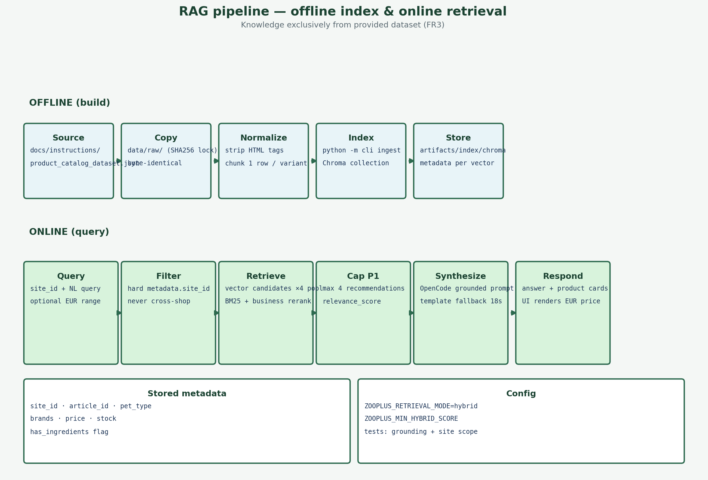
Response & RAG
FR2·FR3
FR2 (§2 response) + FR3 (§3 catalog-only RAG)
FR2 = Structured response: answer + retrieved_products[]
answer must be conversational and grounded in hits
each product: article_id, names, price, pet_type, brands
FR3 = Knowledge ONLY from product_catalog_dataset.json
ingest → Chroma → hybrid retrieve → synthesize · no web/APIs
300 variants · shops 1/3/15 · max 4 SKUs per turn
zooplus Assistant · Coding Task PoC v0.1
4
Notes:
2 min: Map each bullet to Coding Task §2 and §3.

Slide 5
Why hybrid retrieval?
RAG · Hybrid
Chroma vectors + BM25 lexical + business rerank — not vector-only
Problem we saw in the catalog
• Vector search alone misses exact tokens (brands, SKUs, “grain-free”).
• Pure keyword search misses intent (“puppy sensitive stomach”).
Why this hybrid design
• Chroma: semantic candidates from embedded product text (local, no API key).
• BM25 on the same candidate pool: lexical match without a second DB.
• Fuse 50% vector + 35% BM25 + 15% rating/sales/stock.
PoC trade-off
• Zero extra infra vs hosted vector DB; A/B via ZOOPLUS_RETRIEVAL_MODE=vector.
Query path (hybrid default)
1. Hard filter site_id in Chroma metadata
2. Pull ≥24 vector candidates
3. Score BM25 on candidate documents
4. Rerank → top 4 for API + UI cards
When vector-only is enough
• Short brand lookups or regression tests
• Hybrid wins on natural-language shopper queries
zooplus Assistant — Coding Task PoC v0.1
5

Slide 6
RAG strategy — end to end
FR3 · RAG
Ingest → retrieve → ground → synthesize (catalog-only, site-scoped)
Grounding & answer
• retrieved_products[] from same site_id hits only.
• Off-topic → empty list + polite decline (FR4).
• Synthesis: per-agent OpenCode LLM — never invent SKUs.
• Stream: /chat/stream → status* → products → done
• UI: one transient status bubble (agent shopper_status).
Production path
• routing_lexicon.json at ingest; optional Redis mirror.
• Managed vector DB + scheduled re-ingest (roadmap P1).
Grounding & answer
• retrieved_products[] from same site_id hits only.
• Off-topic → empty list + polite decline (FR4).
• Synthesis: per-agent OpenCode LLM — never invent SKUs.
v2.1.6 — playbook + smart limits
• 4 picks default · shopper can ask for more (e.g. 10 opciones, cap 20).
• product_batch stream — cards arrive in chunks of 4 in the UI.
• social_phrases.yaml index + playbook auto-learn (help/greeting).
• Dynamic species inference (iguana, capibara…) — not a fixed list.
zooplus Assistant — Coding Task PoC v0.1
6

Slide 7
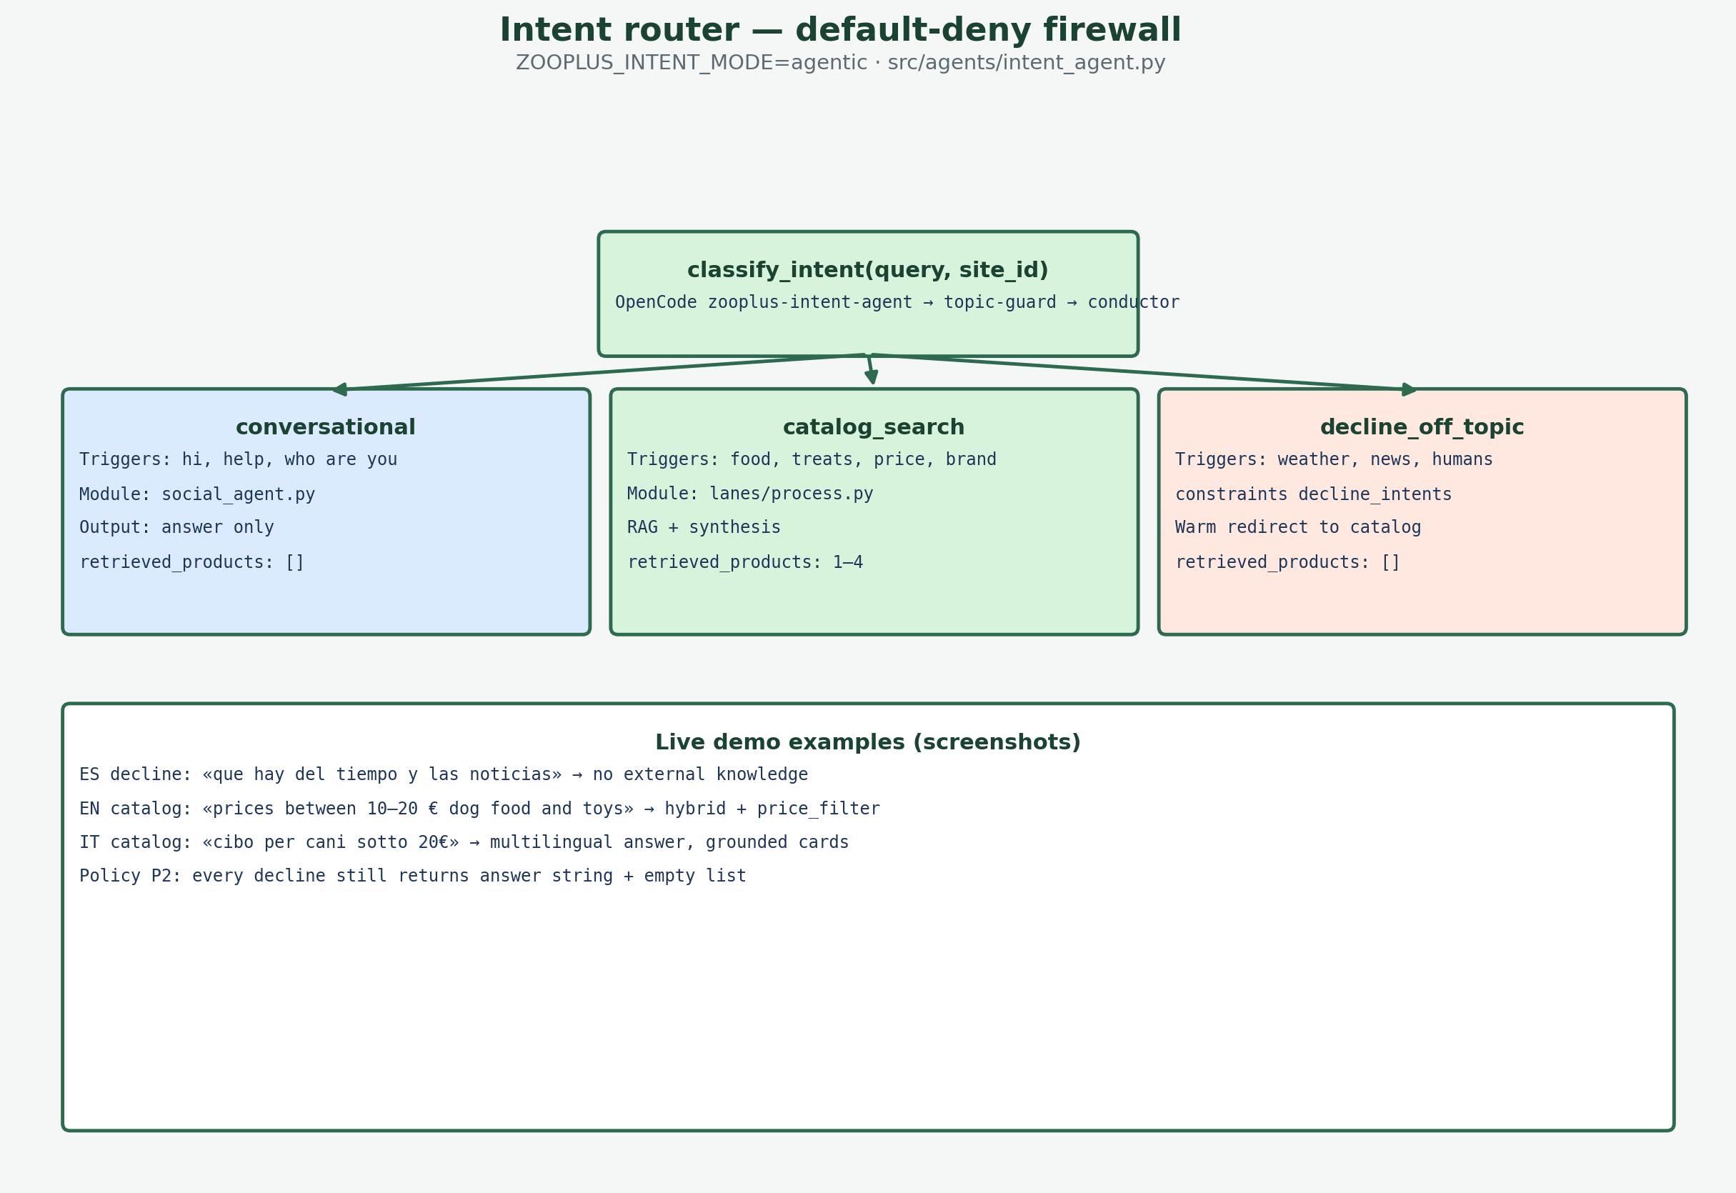
Agentic architecture
Agentic
Conductor-first · catalog lexicon · stream status — fast multilingual UX
Invisible conductor (releases v2.0+)
• Internal MD playbook — conductor maintains silently.
• Social turn → one bubble; help asks never hit catalog progress.
• Catalog turn → ack from query (species, price, lang, count).
• Dedupe: no re-greeting / no repeated scope in final answer.
Stream + fast intent (v2.1.3+)
• Policy + intent-agent first; conductor opt-in (lower latency).
• Parallel social/catalog · ZOOPLUS_STREAM_MODE=conductor.
zooplus Assistant · Coding Task PoC v0.1
7
Notes:
90s: Walk diagram. Default-deny before Chroma.

Slide 8
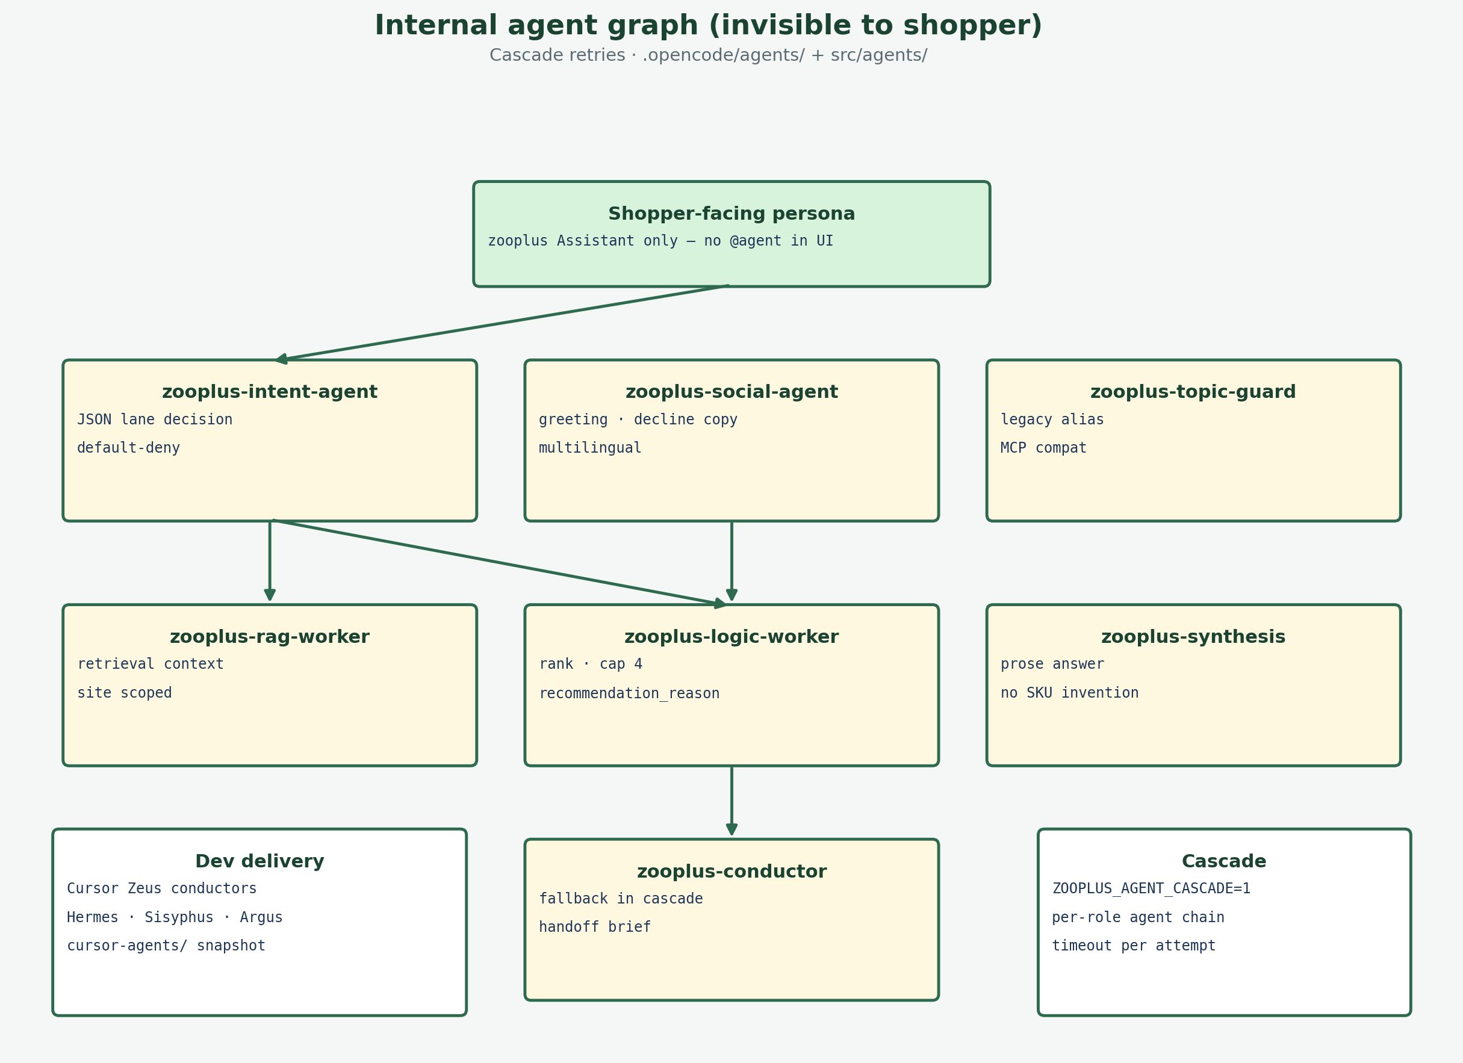
Agents — who responds
Agents
OpenCode specialists: role, output, and cascade
OpenCode specialists
• zooplus-conductor → playbook + stream orchestration (invisible).
• social-agent → shopper voice; mid-session help without re-intro.
• intent / topic-guard → scope filter.
• rag + logic + synthesis → grounded catalog answer.
Phrase index + language
• ~90 curated social phrases (ES/EN/DE/FR) — fast in-memory match.
• Agent mirrors shopper language; playbook learns novel phrases.
zooplus Assistant · Coding Task PoC v0.1
8
Notes:
90s: Name each agent and allowed output.

Slide 9
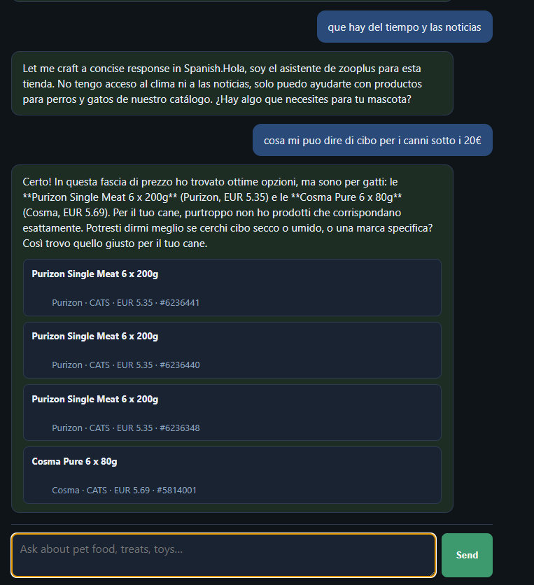
Guardrails + demo
FR4
FR4 — Functional Requirement 4: Pet-only scope (Coding Task §4)
FR4 guardrails + live demo
• Pet catalog only · default-deny off-topic.
Demo — v2.1.6 smart loop
• A: me puedes ayudar → social help, no catalog progress.
• B: y para iguanas → scope reply, no duplicate Hola intro.
• C: dame 10 opciones perros → up to 10 cards in batches.
• http://127.0.0.1:8090/ui/ — shop Spain (15).
zooplus Assistant · Coding Task PoC v0.1
9
Notes:
5 min demo — tie steps to intent lanes (agentic slides).

Slide 10
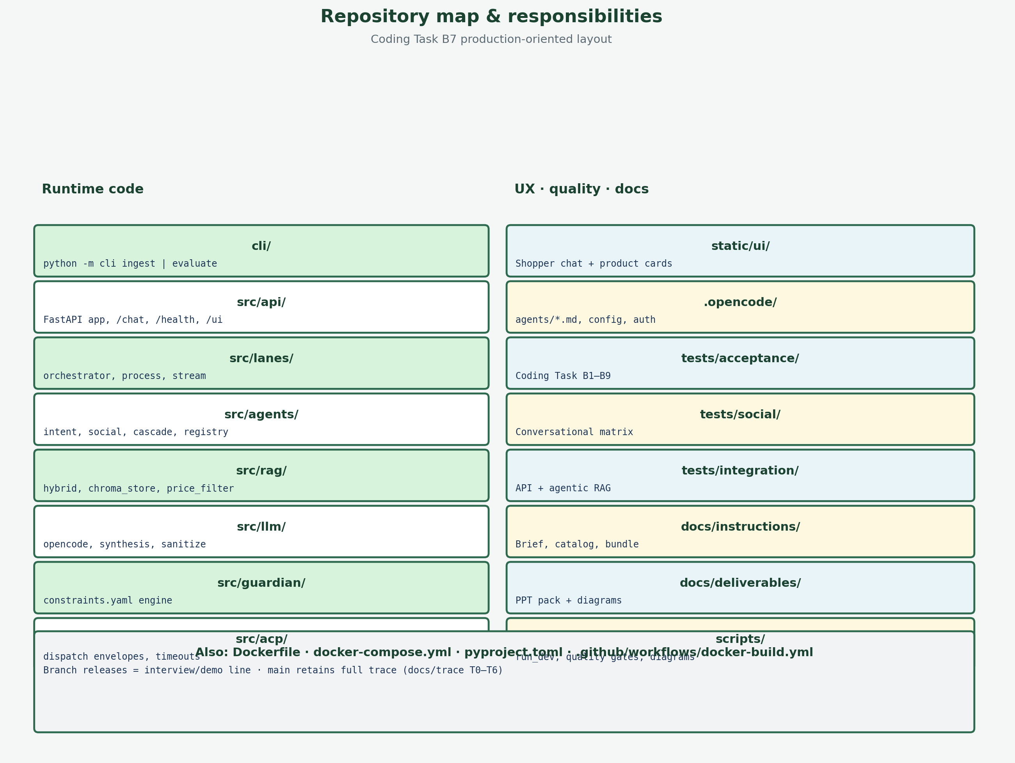
Production layout
FR5
FR5 — Functional Requirement 5: Production design (Coding Task §5)
FR5 = Production-oriented PoC: cli/ · src/ · tests/ · Docker
README submission: Design · Setup · Trade-offs · Roadmap
OpenCode agents internal — not in shopper API contract
Verify: scripts/run_release_verify.ps1
Also explored for FR5: would an explicit state graph beat nested Python branches? (next 3 slides)
zooplus Assistant · Coding Task PoC v0.1
10
Notes:
1.5 min: FR5 + README four blocks.

Slide 11
LangGraph 1/3 — explicit graph vs Python branches
Architecture · LG · #0
Same agentic core, new explicit state graph
The problem this explores
• Legacy: one async function with nested if/elif per lane —
retry/fallback chains hidden inside helper functions.
• Hard to unit-test one decision in isolation (e.g. "what happens
on an intent timeout?") without exercising the whole function.
Same agentic core, explicit shape
• Every node calls THIS repo's own functions verbatim — zero
re-implemented logic, nothing invented.
• 4 typed routing functions, independently unit-tested.
• All 7 nodes async — graph.ainvoke(), not graph.invoke().
START
cache_check
hit
END (cached answer)
miss
classify_intent
social
catalog
social
prefetch
process_lane
cache_store
END
cache
intent
social
catalog
zooplus Assistant — Coding Task PoC v0.1
11

Slide 12
LangGraph 2/3 — every node, what it calls
Architecture · LG · #0
Every node is a verbatim call into this repo's own functions
rag_node + synthesis_node deleted — process_lane replaces both with one call into the existing ACP dispatch.
Node | Calls (verbatim) | Purpose
cache_check | chat_cache.get(key) | Same singleton + key format as the legacy orchestrator
classify_intent | orchestrator._classify_intent_bounded() | Same 22s timeout, same _fallback_intent_decision() on timeout
prefetch | resolve_recommendation_count + price_band + search_catalog | Catalog hits fetched once — orchestrator.py step 3
social | social_agent.social_reply() | Unchanged behaviour, only made async
process_lane | dispatch_process(run_process_lane, timeout=<constraints.yaml>) | Real nested 40s outer / 18s inner timeout — replaces rag_node + synthesis_node
cache_store | chat_cache.set(key, response) | Same singleton as the legacy orchestrator
zooplus Assistant — Coding Task PoC v0.1
12

Slide 13
LangGraph 3/3 — audit findings & verified results
Architecture · LG · #0
What a faithful audit found, and how it was verified
1
preferred_model silently ignored
UI's model override stored in state but no node read it. Fixed via ContextVar set for the whole graph run.
2
No chat-level cache existed
cache_check_node / cache_store_node now share the legacy orchestrator's own chat_cache singleton.
3
Catalog path bypassed dispatch_process
Single 18s timeout, no outer-timeout cancellation. process_lane_node now calls the real ACP dispatch.
~960x faster — same answer, identical bytes.
179/180
unit tests
206/206
acceptance tests
33/33
integration tests
Explored & validated on feature/lg-catalog-probe-intent (not yet adopted) — recommended as item #0, ahead of the roadmap below.
zooplus Assistant — Coding Task PoC v0.1
13

Slide 14
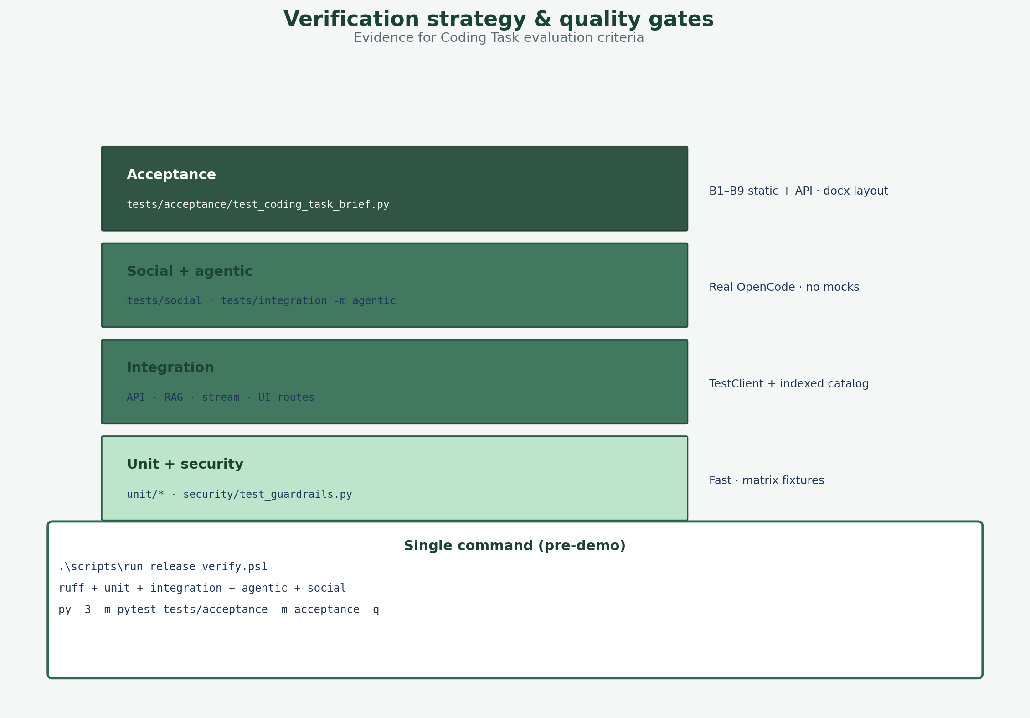
Roadmap — trust & quality
P0
Item #0 explored · Phase 1 P0 next — LangGraph foundation, then security (items 0, 2–3)
Item #0 — explored & validated (not yet adopted)
feature/lg-catalog-probe-intent — faithful redesign, audited live (see previous slides)
Why first: FR4 guardrails must survive prompt injection and policy drift
Constraints v2: versioned YAML + injection scanner + security CI gate
Intent facets: pet_type, price band, category in JSON → deterministic RAG
Fixes real gaps (e.g. wrong species in results) before more traffic
Detail: docs/FUTURE_IMPROVEMENTS.md §2–§3
If adopted: item 2 (intent facets) -> new conditional edge; item 5 (MCP/ACP bus) -> new node types
zooplus Assistant · Coding Task PoC v0.1
14
Notes:
45s: Tie to FR4 and evaluation criteria.

Slide 15
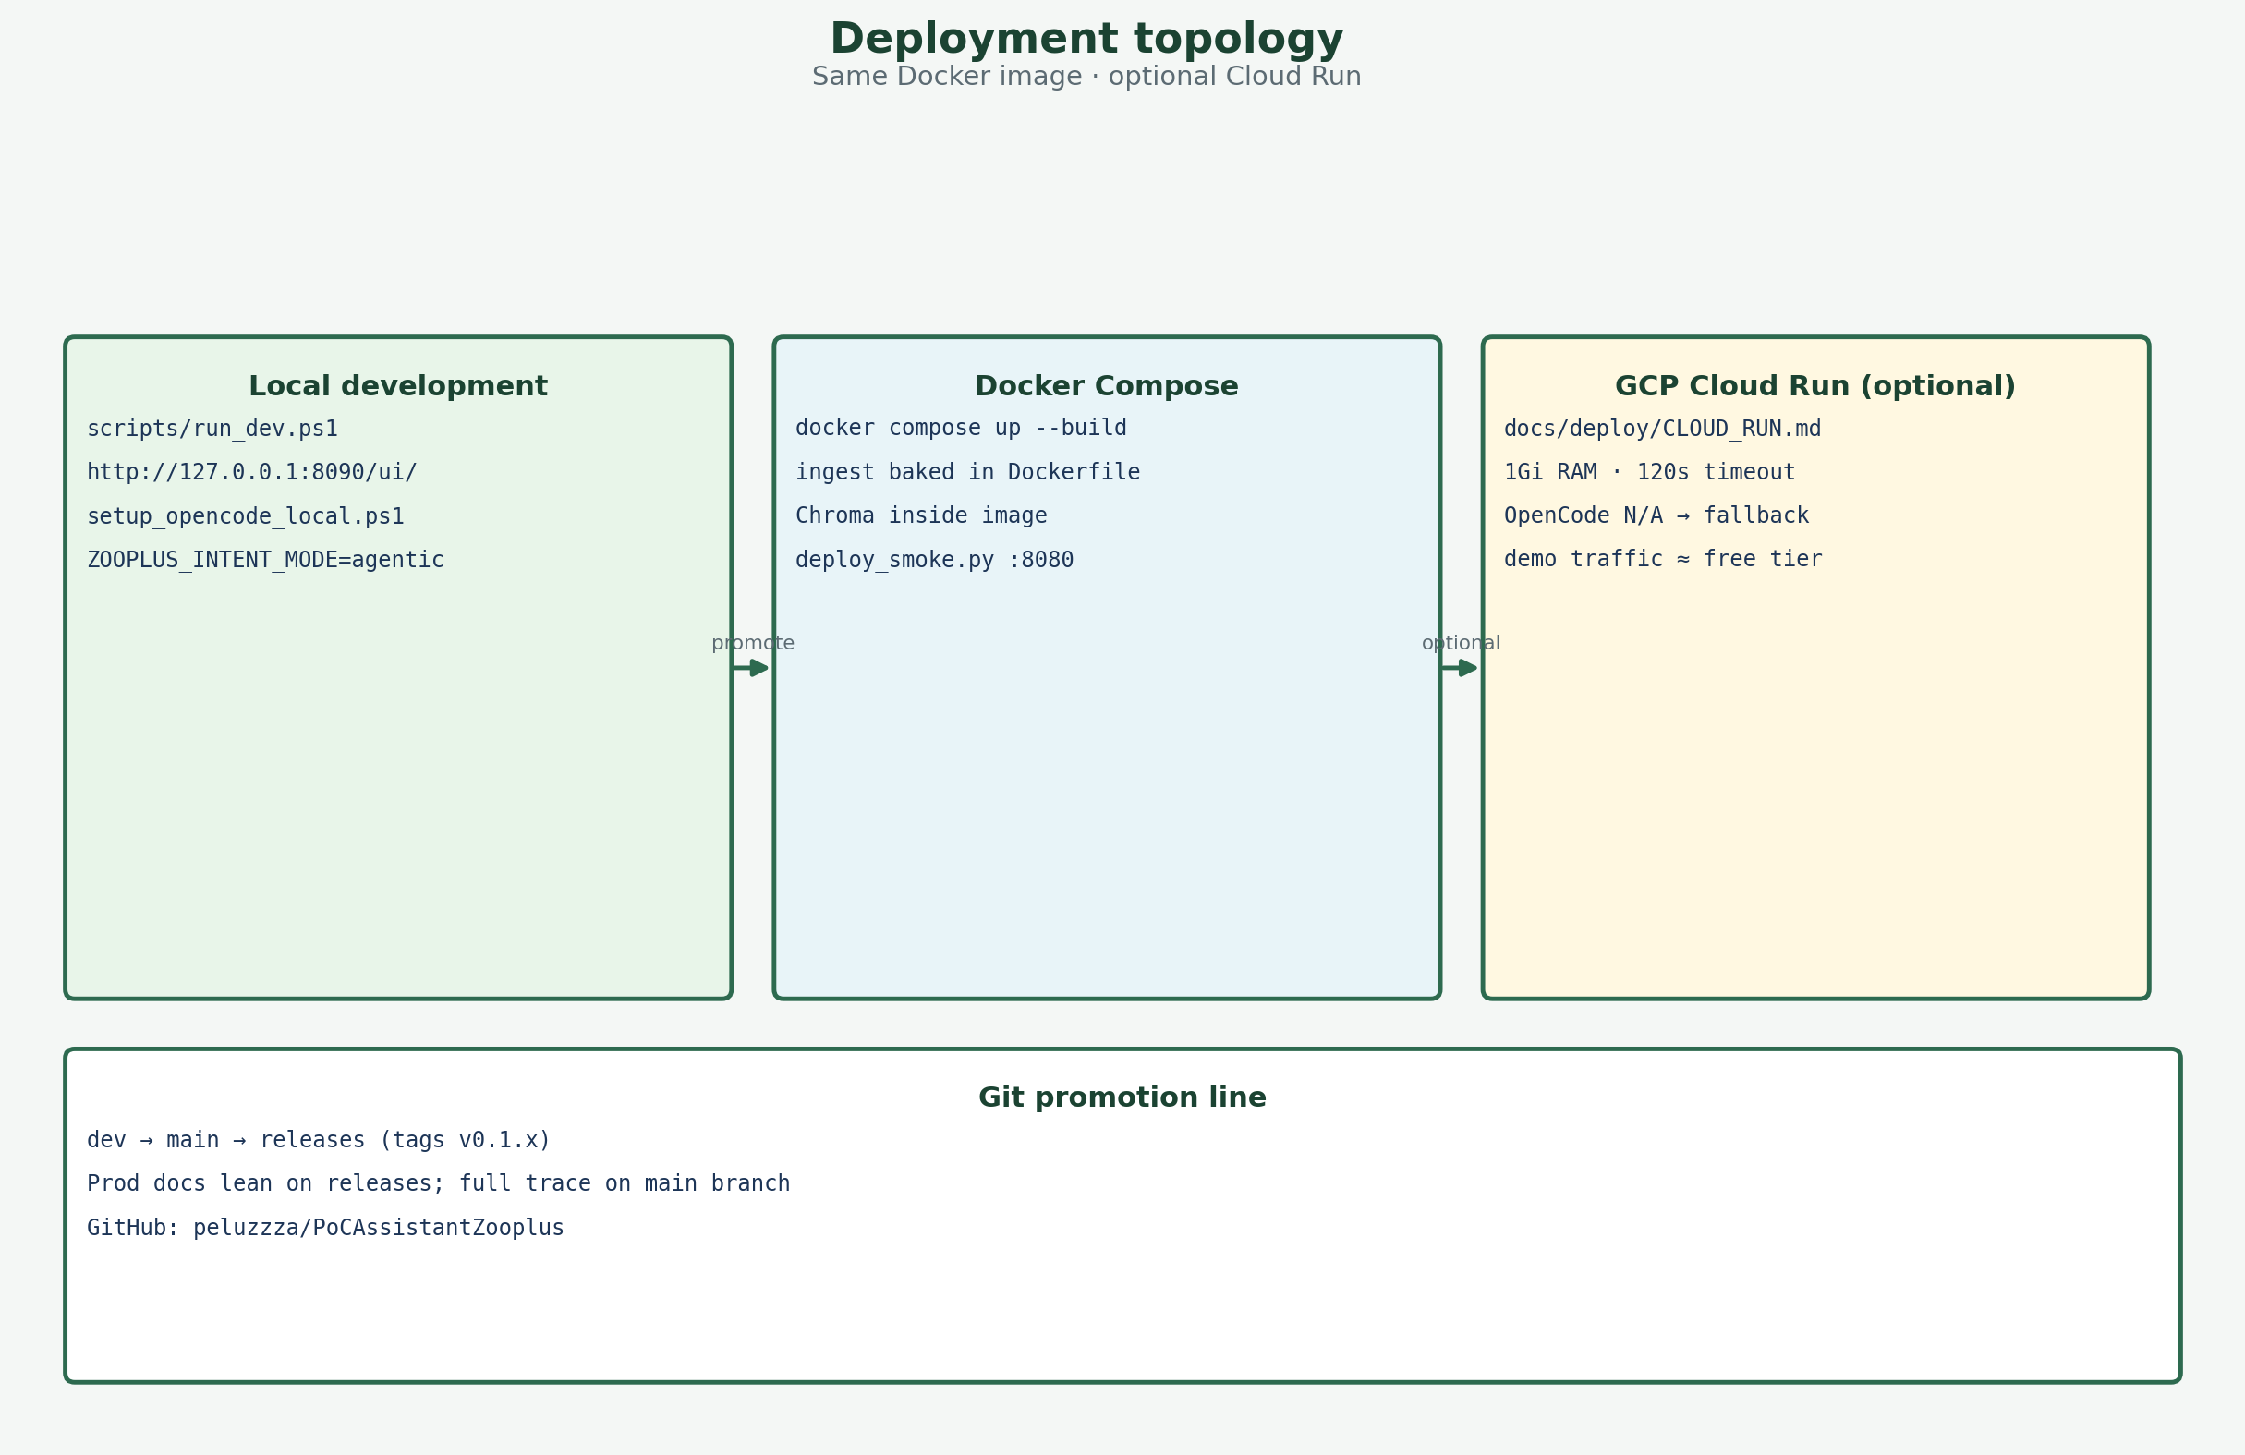
Roadmap — scale & fresh catalog
P1
Phase 2 · P1 — operations (items 8–9–4–5)
Why: stale vectors = wrong prices; single node cannot serve many users
RAG re-ingest: scheduled catalog sync → blue/green vector index swap
Concurrency: stateless API replicas · queue for process lane · rate limits
LLM: HTTP provider in workers (OpenCode stays for local dev/demo)
MCP server for external agents · ACP bus for internal agent choreography
zooplus Assistant · Coding Task PoC v0.1
15
Notes:
45s: Managed Chroma/Pinecone + Cloud Run mental model.

Slide 16
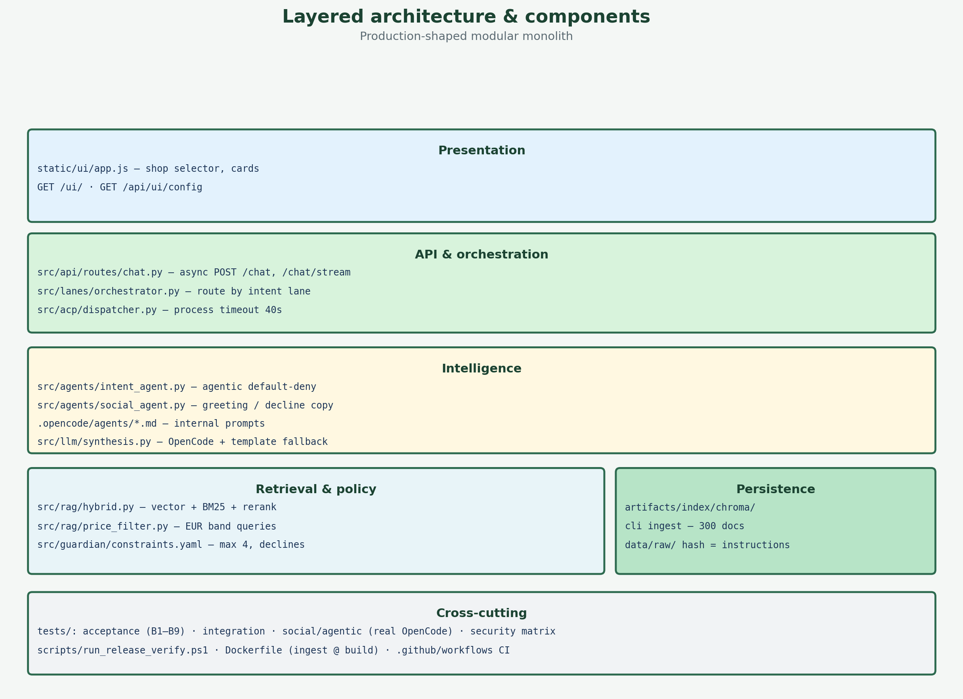
Roadmap — product channels
Later
Phase 3 · P2–P3 — after core is stable (items 7–1–6)
Image search: user photo → vision embedding → catalog-only RAG (no web)
Promo slots on /chat/stream while long RAG runs (feature-flagged ads)
Voice: STT/TTS wrapper — same POST /chat contract, new UI channel
Priority order: 0→2→3→8→9→4→5→7→1→6
Q&A — full doc: docs/FUTURE_IMPROVEMENTS.md
zooplus Assistant · Coding Task PoC v0.1
16
Notes:
45s + Q&A. Emphasize same API contract for voice and photo.

Slide 17
Release progress — v0.1.0 → v2.1.6
Progress · releases
Same five FRs · smarter social routing, flexible picks, chunked UX
Foundation — v0.1.0 → v1.0
v0.1.0 — Coding Task PoC: FR1–5, hybrid RAG, FR4 guardrails.
v0.1.3 — Conductor-first routing; /chat/stream; per-agent OpenCode.
v1.0 — Stable tag: catalog lexicon at ingest, cache, multilingual.
Shopper experience — v1.4 → v2.1.6 (now)
v2.1 — Playbook MD; social/catalog probe; agent-multilingual.
v2.1.3 — Fast intent-first stream; conductor intent opt-in.
v2.1.4–5 — Species inference; help/saludo detect + dedupe.
v2.1.6 — Dynamic count (4→20); phrase index; product_batch UI.
zooplus Assistant — releases v2.1.6 · progress since v0.1.0
17

