Slide 1
Bad Drivers
Which states have the worst drivers?
Avie Timby, Chloe Burgess, William Parsley, Phoebe Miller

Slide 2
Table of Contents
01
02
03
04
The Data
Central Question
Looking into the initial
dataset
What we hoped to find from the raw data
Analysis
Visuals
Analysis and exploration of data
What trends we noticed from visuals and the conclusions from analysis

Slide 3

01
The Data

Slide 4
The Data
Our project is based off of the bad drivers dataset in the GitHub. It includes statistics about driving collisions, and why they occurred. Some examples of why they occurred are speeding, drinking, or distractions.
We chose to focus on “Fatal Collisions per Billion Miles” and “Insurance Losses Incurred per Insured Driver” categories for our analysis.

Slide 5
The Data
We also used census data that contains the number of licensed drivers in each state. This was obtained from the Federal Highway Administration.
We used this data to normalize the data from our Bad Drivers data set, in order to take into account population of drivers in each state.

Slide 6

02
Central Questions

Slide 7
Which State Has the Most Fatal Collisions?
Our hypothesis is that Texas will have the most fatal collisions of the continental US, based on our own background knowledge.

Slide 8
Which State Incurs the Most Monetary Insurance Losses?
Our hypothesis is that California will have the most losses as they have the most insured drivers out of the lower forty-eight states.

Slide 9

03
Analysis

Slide 10
The first step of our analysis was to format the data
We had to read in the csv files and strip the columns to remove leading and trailing spaces

Slide 11
From there, we had to format the data types because total licensed drivers was a string, and not a integer

Slide 12
Next, we had to create a ratio that allowed us to compare the number of people involved in fatal collisions between different states, using the total driver population as the common factor

Slide 13
Finally, we normalized the data by making the lowest ratio one
This allows us to make quick observations because all the other states are on the lowest states scale

Slide 14
To test our hypotheses, we used the scipy.stats package to run a one sample t-test

Slide 15
For our first hypothesis, we determined that another state has a higher standardized ratio than Texas
Our p-value was 3.21e-07, which allowed us to further conclude that a state has a significantly higher standardized ratio than Texas as it was less than our significance level of .05.

Slide 16
For the second hypothesis, we were unable to conclude that another state has a significantly greater average insurance loss than California
The p-value for our hypothesis test was .99 which is greater than the significance level of .05, so we could not reject that California has the highest average insurance losses.

Slide 17
Key Takeaways - Analysis
1st
2nd
At least one state has a significantly greater standardized ratio of fatal collisions than Texas.
No state has a significantly greater average of insurance losses than California.

Slide 18
04 Visuals & Trends

Slide 19
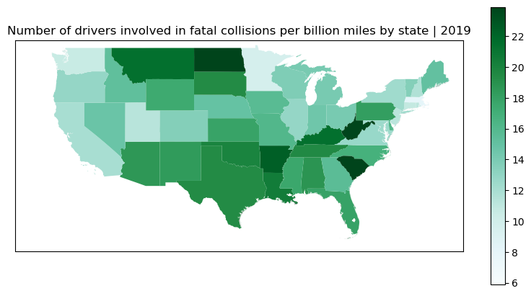

Slide 20
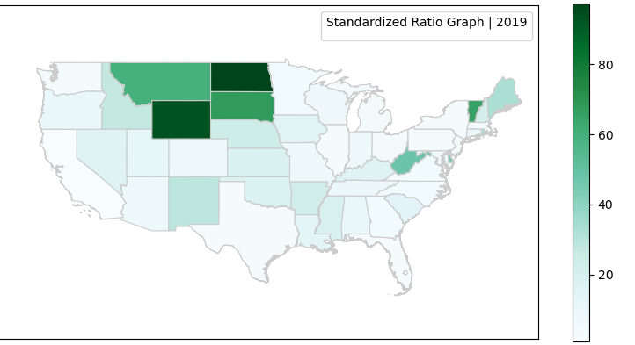

Slide 21
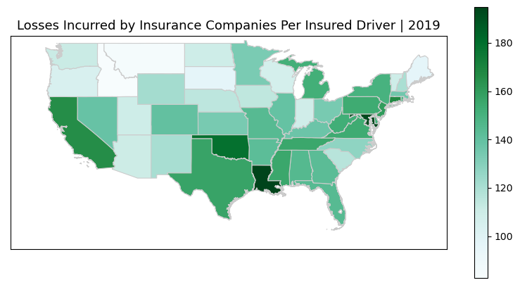

Slide 22
Key Takeaways - Visuals
3rd
1st
2nd
Louisiana and Maryland have the most insurance losses per insured drivers
The data needs to be standardized to account for state populations
North Dakota and Wyoming have the most fatal collisions per licensed driver

Slide 23
Reconciling the Hypothesis Tests and Visuals
Texas has the most fatal collisions?
California Continued
Both the visuals and hypothesis test confirmed that Texas did not have the most fatal collisions
Neither conclusion is necessarily incorrect, as the test concluded that there was no state significantly greater than California
California has the most insurance losses?
The hypothesis test concluded that it did;
the visuals concluded it did not

Slide 24
Sources
National Highway Traffic Safety Administration
https://www.nhtsa.gov/file-downloads?p=nhtsa/downloads/FARS/
U.S. Federal Highway Administration
https://www.fhwa.dot.gov/policyinformation/statistics/2019/dl1c.cfm#foot1
Github Dataset
https://github.com/jstrother123/dasc2103-dataset/tree/main/bad-drivers

