Slide 1
Fayetteville Middle School Zoning
Avie Timby, Phoebe Miller, Alicia Gallemore
April 30th 2024

Slide 2
Motivation
Goal:
Optimize the zoning for the three Fayetteville middle schools.
Ensure students were zoned for the school closest to their residence to limit time spent traveling to school
Enforce school capacities to create an effective learning environment
Why:
McNair Middle School is currently operating at 110% capacity
John L. Colbert Middle School is operating at 55% capacity
Long bus rides for students
Rezoning has been an ongoing school discussion for the past year
Notes:
McNair has 761 enrolled with capacity of 698
Colbert has enrollment of about 440, but capacity is 800 (according to 4029)
Holt is about right at capacity with ~440 enrolled and capacity at 460

Slide 3
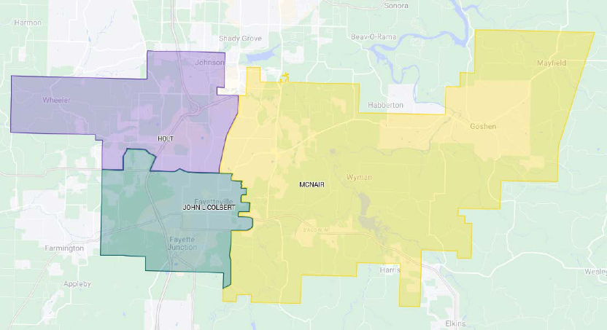
Current Middle School Zoning

Slide 4
Data Collection
What:
Residential Occupant Address GIS data
Contains over 50,000 addresses in the Fayetteville area
School Attendance Zones GIS layer
Has the boundaries for each school zone in the Fayetteville and Springdale school districts
How:
Collected the data we needed from ArcGIS and created 3 initial excel files
Notes:
The GIS data came from the city of fayettevilles GIS files on their website
The city’s GIS dept. actually just received the 2024 GIS innovation award at the MidAmerica GIS Consortium last week ☺

Slide 5
Data Usage
Data Preparation:
Created a data frame with only addresses in district
Selected all points that fell outside of the district line from the school district map layer
Formed an inner join on the address ID's & filtered out non-Fayetteville zoned points from previously created excel files
Prepared data for geopy and OSMnx
Sampled 4000 rows from the ~50,000 to simplify coordinate generation
Converted the addresses to geopy's preferred format and created columns containing latitude and longitude for each address
Used OSMnx to create a dictionary containing the shortest driving distance from each address to each school
Notes:
Being in that CSV meant it was outside of the district and would not help with optimization
There are a little less than 2000 MS students in fay, so we doubled the number to increase accuracy
used nomatim and ratelimiter from geopy, added a column to the df that converted the full address to geopy's favored format, then used that to create both a column for the latitude and longitude for each address (homes and middle schools) to be able to calculate route distances

Slide 6
Optimization Model
Decision Variables
Objective
Constraints
Each student-school pair has a binary decision variable that indicates whether the student is assigned to that particular school
(1 if assigned, 0 otherwise).
Minimize the total distance traveled by all students.
Capacity
Address Assignment

Slide 7
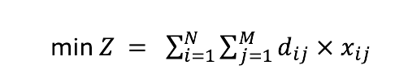
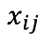
Objective
N = Total number of students
M = Total number of schools
= Distance from student address i to school j
= Binary decision variable that is 1 if student i is assigned to school j, and 0 otherwise
The objective was to minimize the total distance students would have to travel to get to their assigned schools.

Slide 8
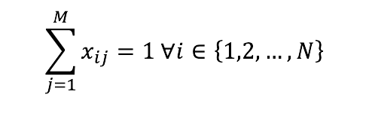
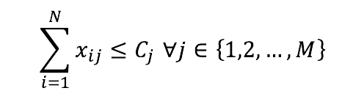

Constraints
Assignment Constraint (Each student is assigned to exactly one school):
Capacity Constraint (The number of students assigned to each school must not exceed its capacity):
Where:

Slide 9
Results
Current Student Body:
McNair: 761/698
Holt: 449/460
John L. Colbert: 442/800
Total: 1652
Our Model:
McNair: 1396/1396
Holt: 920/920
John L. Colbert: 1542/1600
Total: 3858

Slide 10
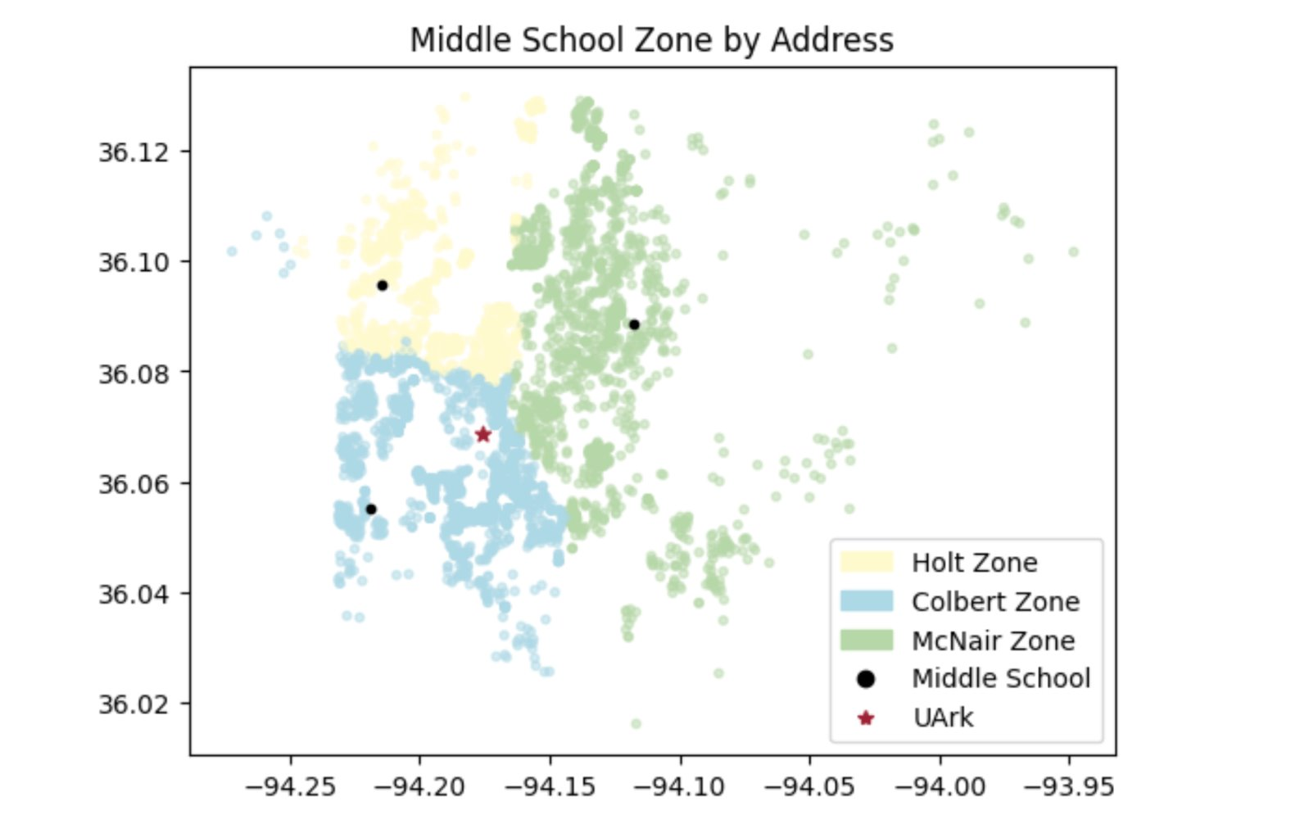
Results

Slide 11
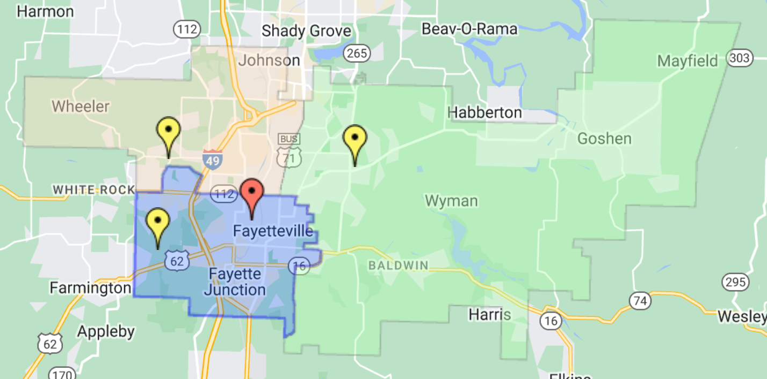
Results

Slide 12
Future Work
What we would do differently if we had the ability:
Run every address in Fayetteville through the model (~50,000 points) instead of sampling, which introduces inherent bias and unrefined zones
Add another middle school, find the best placement with available plots of land, and investigate zoning changes without Colbert
See how the rezoning process affects different schools' demographics and ensure the zoning changes promote inclusivity and quality education for all
Notes:
Sampling introduces some inherent bias and wont fully capture the city's intricacies, using all addresses would refine the opt and considers special characteristics and distributions of locations.
The district is considering adding another middle school, as well as turning colbert into a jr high, which would make this addition even more important. This would include figuring out the best placement of the school and finding plots of land it could potentially be built on. While the district is doing its best, the placement of the newest middle school wasn't the best choice.
Want to ensure that the changes promote inclusivity, would allow for better tailoring of support programs and allocation of resources – overall would help the district make more informed decisions

Slide 13
Key Takeaways
John L. Colbert could have been placed more centrally.
Our model is very similar to the current zoning.
01
02
03
04
A more central
John L. Colbert would help
balance McNair.
The district is operating as optimally as it can.

Slide 14
References
https://fayettevilleflyer.com/2023/01/23/fayetteville-school-board-holds-middle-school-rezoning-discussion-until-august/
https://www.4029tv.com/article/fayettevilles-john-l-colbert-middle-school-honors-superintendent-with-47-years-in-the-district/44207655#:~:text=Fayetteville%20Public%20Schools%20said%20about,L%20Colbert%20Middle%20School%20home.
https://www.usnews.com/education/k12/arkansas/holt-middle-school-275105#:~:text=The%20student%20population%20of%20Holt,the%20school%20serves%205%2D6.
https://adedata.arkansas.gov/statewide/ReportList/Schools/EnrollmentCount.aspx?year=34&search=&pagesize=10
https://www.fayetteville-ar.gov/384/GIS-Interactive-Maps
https://district.fayar.net/page/school-locator

