Slide 1

Data Analysis & Insights On Clients Mortgage Data
Candidate Name: Pema Singye

Slide 2

Contents
Objectives
Methodology
Data Manipulation Queries
Business Case (Analysis)
Recommendations
1
2
3
4
5

Slide 3
Objectives
To manipulate the data in SQL Server and provide the analysis
To do comparative analysis of the mortgage portfolio by region.
To find out the analysis of delinquent mortgages by client segment (Age).
Final recommendations for the regional managers from the findings
To come up comparative analysis between the mortgage delinquent vs Advisors.

Slide 4



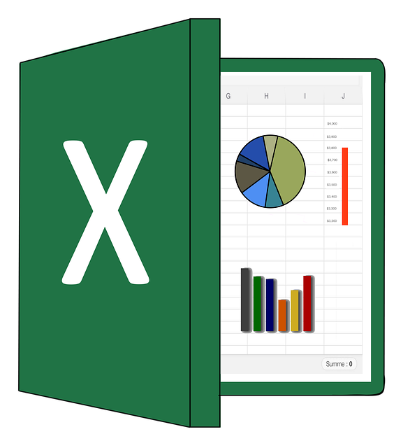
Methodology
Data is manipulated in SQL Server.
Tableau is used for analysis & visualization.
Output of Queries from SQL Server is stored in Excel & used in Tableau.
This Photo by Unknown Author is licensed under CC BY-NC
Notes:
Data is cleaned and analyzed in MS Excel using Pivot tables since this job requires experience in MS Excel
For data cleaning, I have removed the duplicates and also removed the French section since there was no data.

Slide 5
1
Data Manipulation Questions

Slide 6
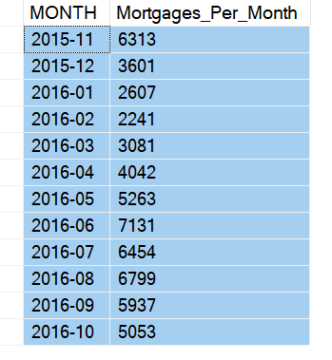
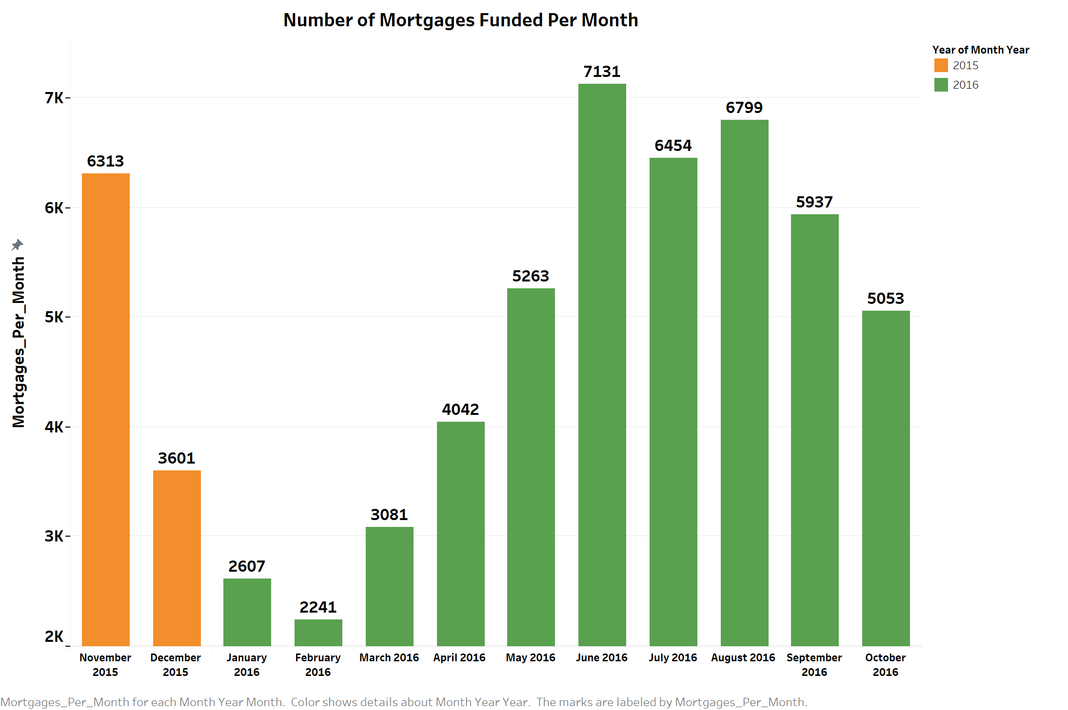
Data Manipulation Query 1-4
1. How many mortgages per month were funded from 2015-11 to 2016-10 ?
SELECT MONTH, COUNT(*) as Mortgages_Per_Month
FROM [SQL Mortgages]..MTG_CUST$
GROUP BY MONTH
--The data is in String format and to split the year and month separately:
SELECT MONTH, COUNT(*) as Mortgages_Per_Month,
CONCAT(SUBSTRING(CAST(MONTH as varchar), 1, 4), '-’,
SUBSTRING(CAST(MONTH as varchar), 5, 2)) as MonthYear
FROM [SQL Mortgages]..MTG_CUST$
WHERE MONTH >= 201511 AND MONTH <= 201610
GROUP BY MONTH
ORDER BY MONTH ASC
-- To remove the MONTH column and replace with MonthYear column
SELECT
CONCAT(SUBSTRING(CAST(MONTH as varchar), 1, 4), '-', SUBSTRING(CAST(MONTH as varchar), 5, 2)) as MONTH,
COUNT(*) as Mortgages_Per_Month
FROM [SQL Mortgages]..MTG_CUST$
WHERE MONTH >= 201511 AND MONTH <= 201610
GROUP BY MONTH
ORDER BY MONTH ASC

Slide 7


Data Manipulation Query 1-4
2. How many mortgages are assigned to Advisor FA500_ON in 201604
SELECT COUNT(*) as Number_of_Mortgages_Assigned_to_Advisor_FA500
FROM [SQL Mortgages]..MTG_CUST$
WHERE Finadvisor = 'FA500_ON' AND DATEPART(yy, MONTH) = 2016 AND DATEPART(mm, MONTH) = 4
3. How many new mortgages in segment “4-Accumulators[45-54]” only in 2016
SELECT COUNT(*) as Num_of_New_Mortgages
FROM [SQL Mortgages]..MTG_CUST$
WHERE age_segment = '4-Accumulators[45-54]'
AND MONTH >= 201601 AND MONTH <= 201612

Slide 8
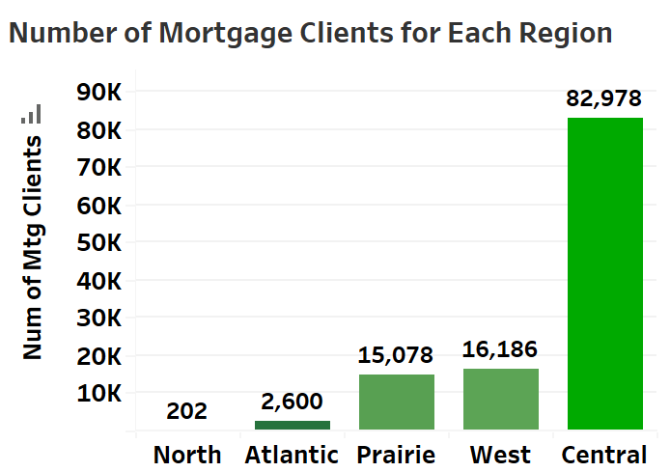
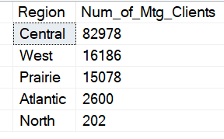
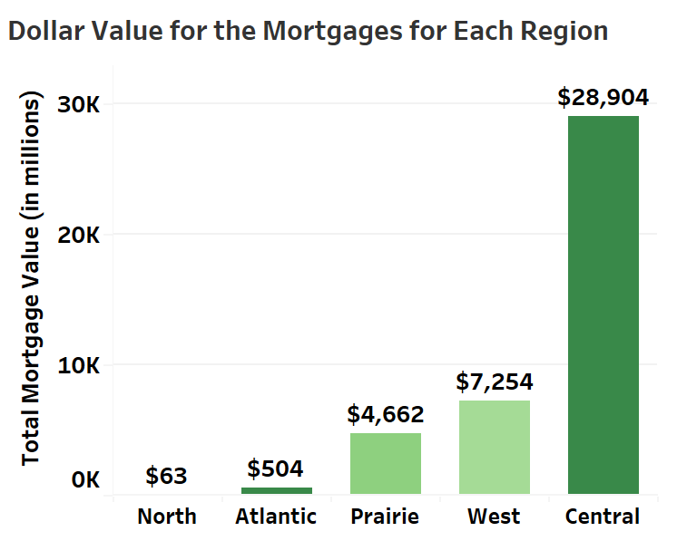
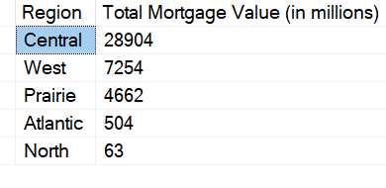
Data Manipulation Query 1-4
4. Build one or more queries to retrieve all mortgage clients grouped by region
Number of mortgage clients for each region
SELECT Region, COUNT(*) as Num_of_Mtg_Clients
FROM [SQL Mortgages]..MTG_CUST$ m
JOIN [SQL Mortgages]..FinAdvMaster$ f
ON m.Finadvisor = f.FinAdvID
JOIN [SQL Mortgages]..Region$ r
ON f.Province = r.Province
GROUP BY Region
ORDER BY Num_of_Mtg_Clients DESC
Dollar value for the mortgages for each region
SELECT region, SUM(AMT_OF_LOAN) AS Total_Mortgage_Value
FROM [SQL Mortgages]..MTG_CUST$ m
INNER JOIN [SQL Mortgages]..FinAdvMaster$ f
ON m.Finadvisor = f.FinAdvID
INNER JOIN [SQL Mortgages]..Region$ r
ON f.Province = r.Province
GROUP BY region
--To convert into millions & remove the number after the decimals
SELECT region, CAST(ROUND(SUM(AMT_OF_LOAN)/1000000, 2) AS INT) AS 'Total Mortgage Value (in millions)'
FROM [SQL Mortgages]..MTG_CUST$ m
INNER JOIN [SQL Mortgages]..FinAdvMaster$ f
ON m.Finadvisor = f.FinAdvID
INNER JOIN [SQL Mortgages]..Region$ r
ON f.Province = r.Province
GROUP BY region
ORDER BY 'Total Mortgage Value (in millions)' DESC

Slide 9
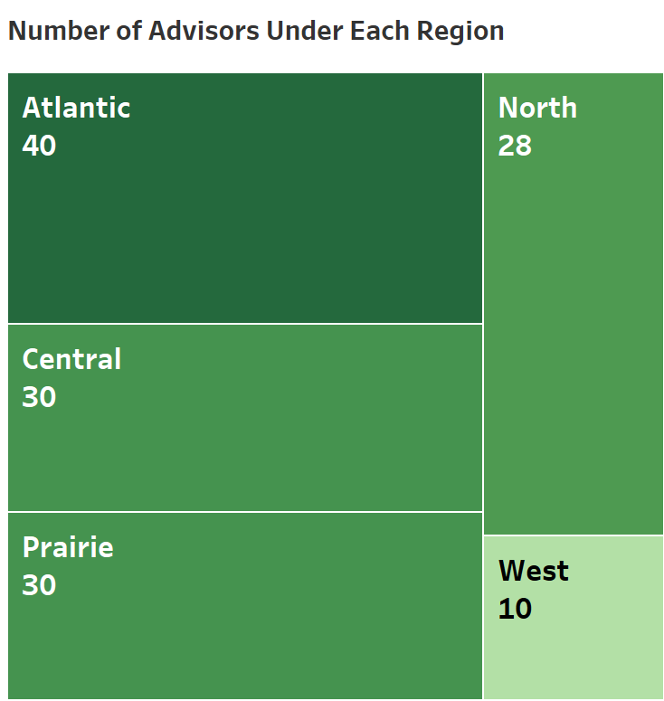
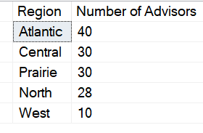
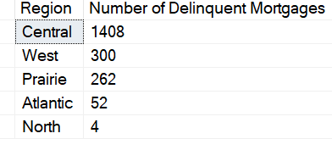
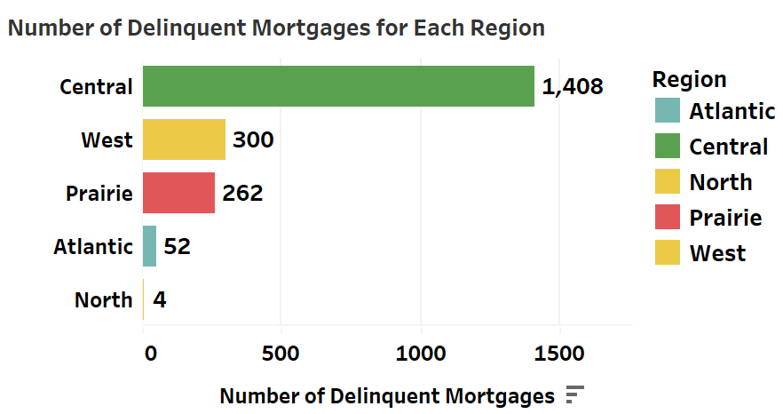
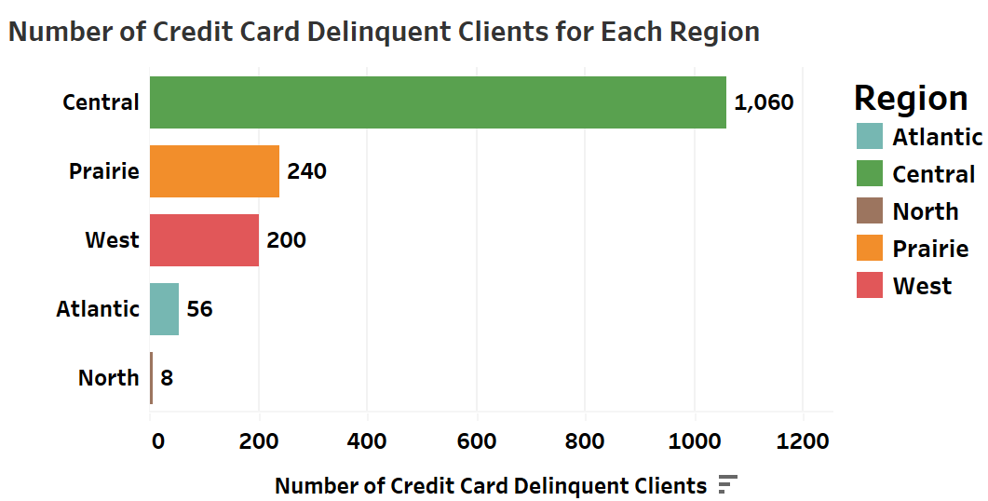
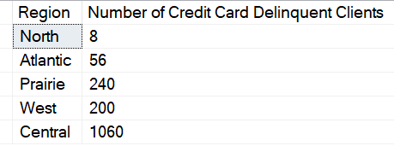
Data Manipulation Query 1-4
4. Build one or more queries to retrieve all mortgage clients grouped by region
Number of Advisors under each region
SELECT Region, COUNT(*) AS 'Number of Advisors'
FROM [SQL Mortgages]..FinAdvMaster$ f
INNER JOIN [SQL Mortgages]..Region$ r
ON f.Province = r.Province
GROUP BY Region
ORDER BY [Number of Advisors] DESC
Number of delinquent mortgages for each region
SELECT r.Region, COUNT(*) AS 'Number of Delinquent Mortgages'
FROM [SQL Mortgages]..MTG_DELINQ_DEC2017$ d
INNER JOIN [SQL Mortgages]..MTG_CUST$ m
ON d.CUST_Id = m.CUST_Id
INNER JOIN [SQL Mortgages]..FinAdvMaster$ f
ON m.Finadvisor = f.FinAdvID
INNER JOIN [SQL Mortgages]..Region$ r
ON f.Province = r.Province
GROUP BY r.Region
ORDER BY 'Number of Delinquent Mortgages' DESC
Number of credit card delinquent clients for each region
SELECT r.Region, COUNT(c.CUST_Id)
AS 'Number of Credit Card Delinquent Clients'
FROM [SQL Mortgages]..CC_DEL_DEC_2017$ c
INNER JOIN [SQL Mortgages]..MTG_CUST$ m
ON c.CUST_Id = m.CUST_Id
INNER JOIN [SQL Mortgages]..FinAdvMaster$ f
ON m.Finadvisor = f.FinAdvID
INNER JOIN [SQL Mortgages]..Region$ r
ON f.Province = r.Province
GROUP BY r.Region

Slide 10
2
Business case

Slide 11
Your Task
Business Case
Use the data provided to answer the following questions:
Situation
You are the new Analyst and have received the datasets related to mortgages originated from 2015-10 to 2016-10. You are being asked to use your analytical skills to answer some questions and provide some recommendations based on your findings as you explored the data presented to you.
Ask
Descriptive metrics: Define at least two metrics that will help Regional Managers monitor their mortgage portfolio, in your presentation we will discuss your findings. For example:
Metrics that Regional managers could use to understand/monitor their mortgage portfolio by region, client segment, total $ portfolio, Advisors delinquent portfolio ($ and number of mortgages)
Findings: Facts based on the metrics you developed
Recommendations: Based on your understanding the business case, what would you recommend to the regional managers (region level metrics) and National Office (National level metrics)
Interview
During the interview you will be invited to:
Show how the metrics can help managers monitor their mortgage portfolio and the rationale of your metrics
Please place your ETL process you built to create the metrics in References section, we will discuss this item in the technical portion of the interview
Tools: Use your preferred programming and visualization tool for this section
Note: No extra research needed.

Slide 12
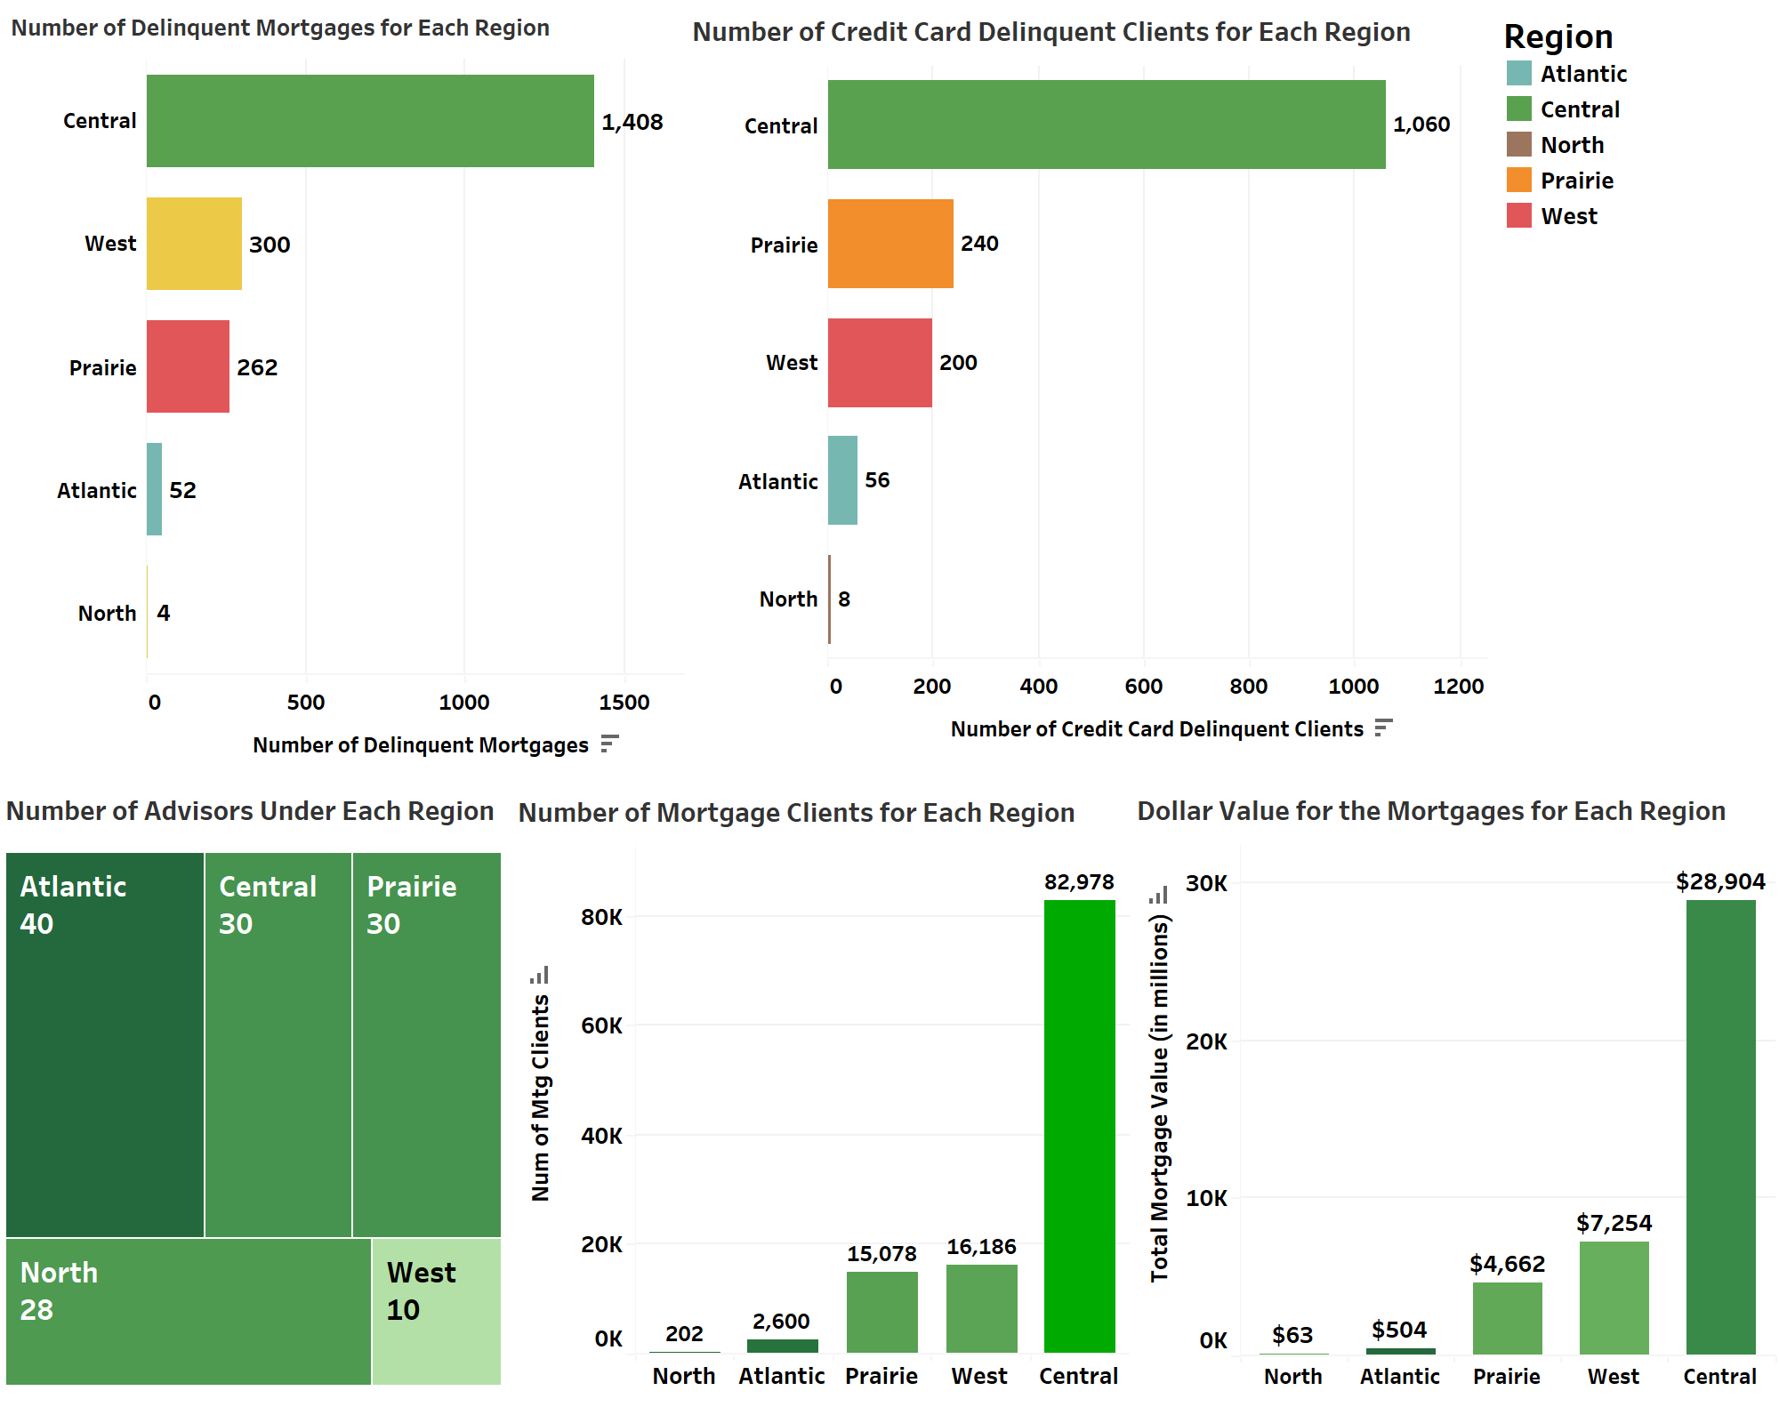
Descriptive Metrics- Analysis & Insights
Mortgage Portfolio by Region
Findings
The central region has the highest number of Mortgage clients & dollar value of mortgages while the North and Atlantic has the lowest.
Contrary the number of advisors is low in the central region.
Similarly, the number of delinquents for both mortgage and credit card has highest in Central.
Number of mortgage delinquents in the West with 300 while Prairie has a higher number of credit card mortgage delinquents with 240 compared to the West with 200.

Slide 13
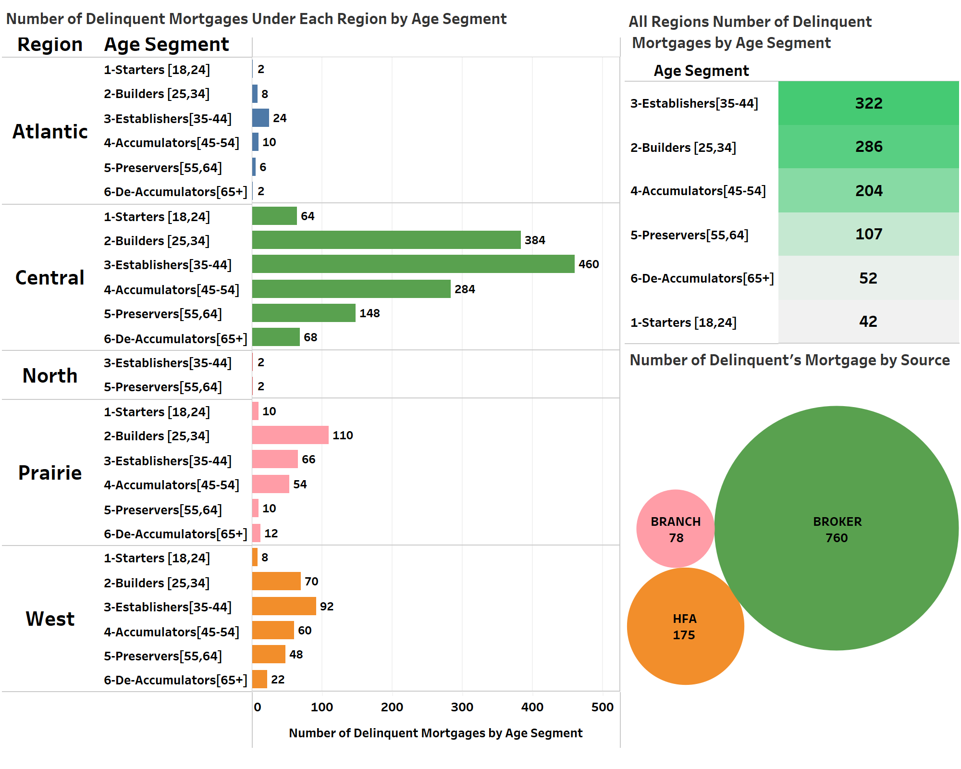
Descriptive Metrics- Analysis & Insights
Delinquent Mortgages by Client Segment (Age)
Findings
At the national level, clients with age 35-44 have the highest number of mortgages delinquent followed by those aged 25-34.
Age 65+ and 18-24 have the lowest number.
The central region has the highest number of mortgage delinquents while the North and Atlantic have the lowest.
Broker has the highest number of mortgage delinquents followed by HFA.

Slide 14
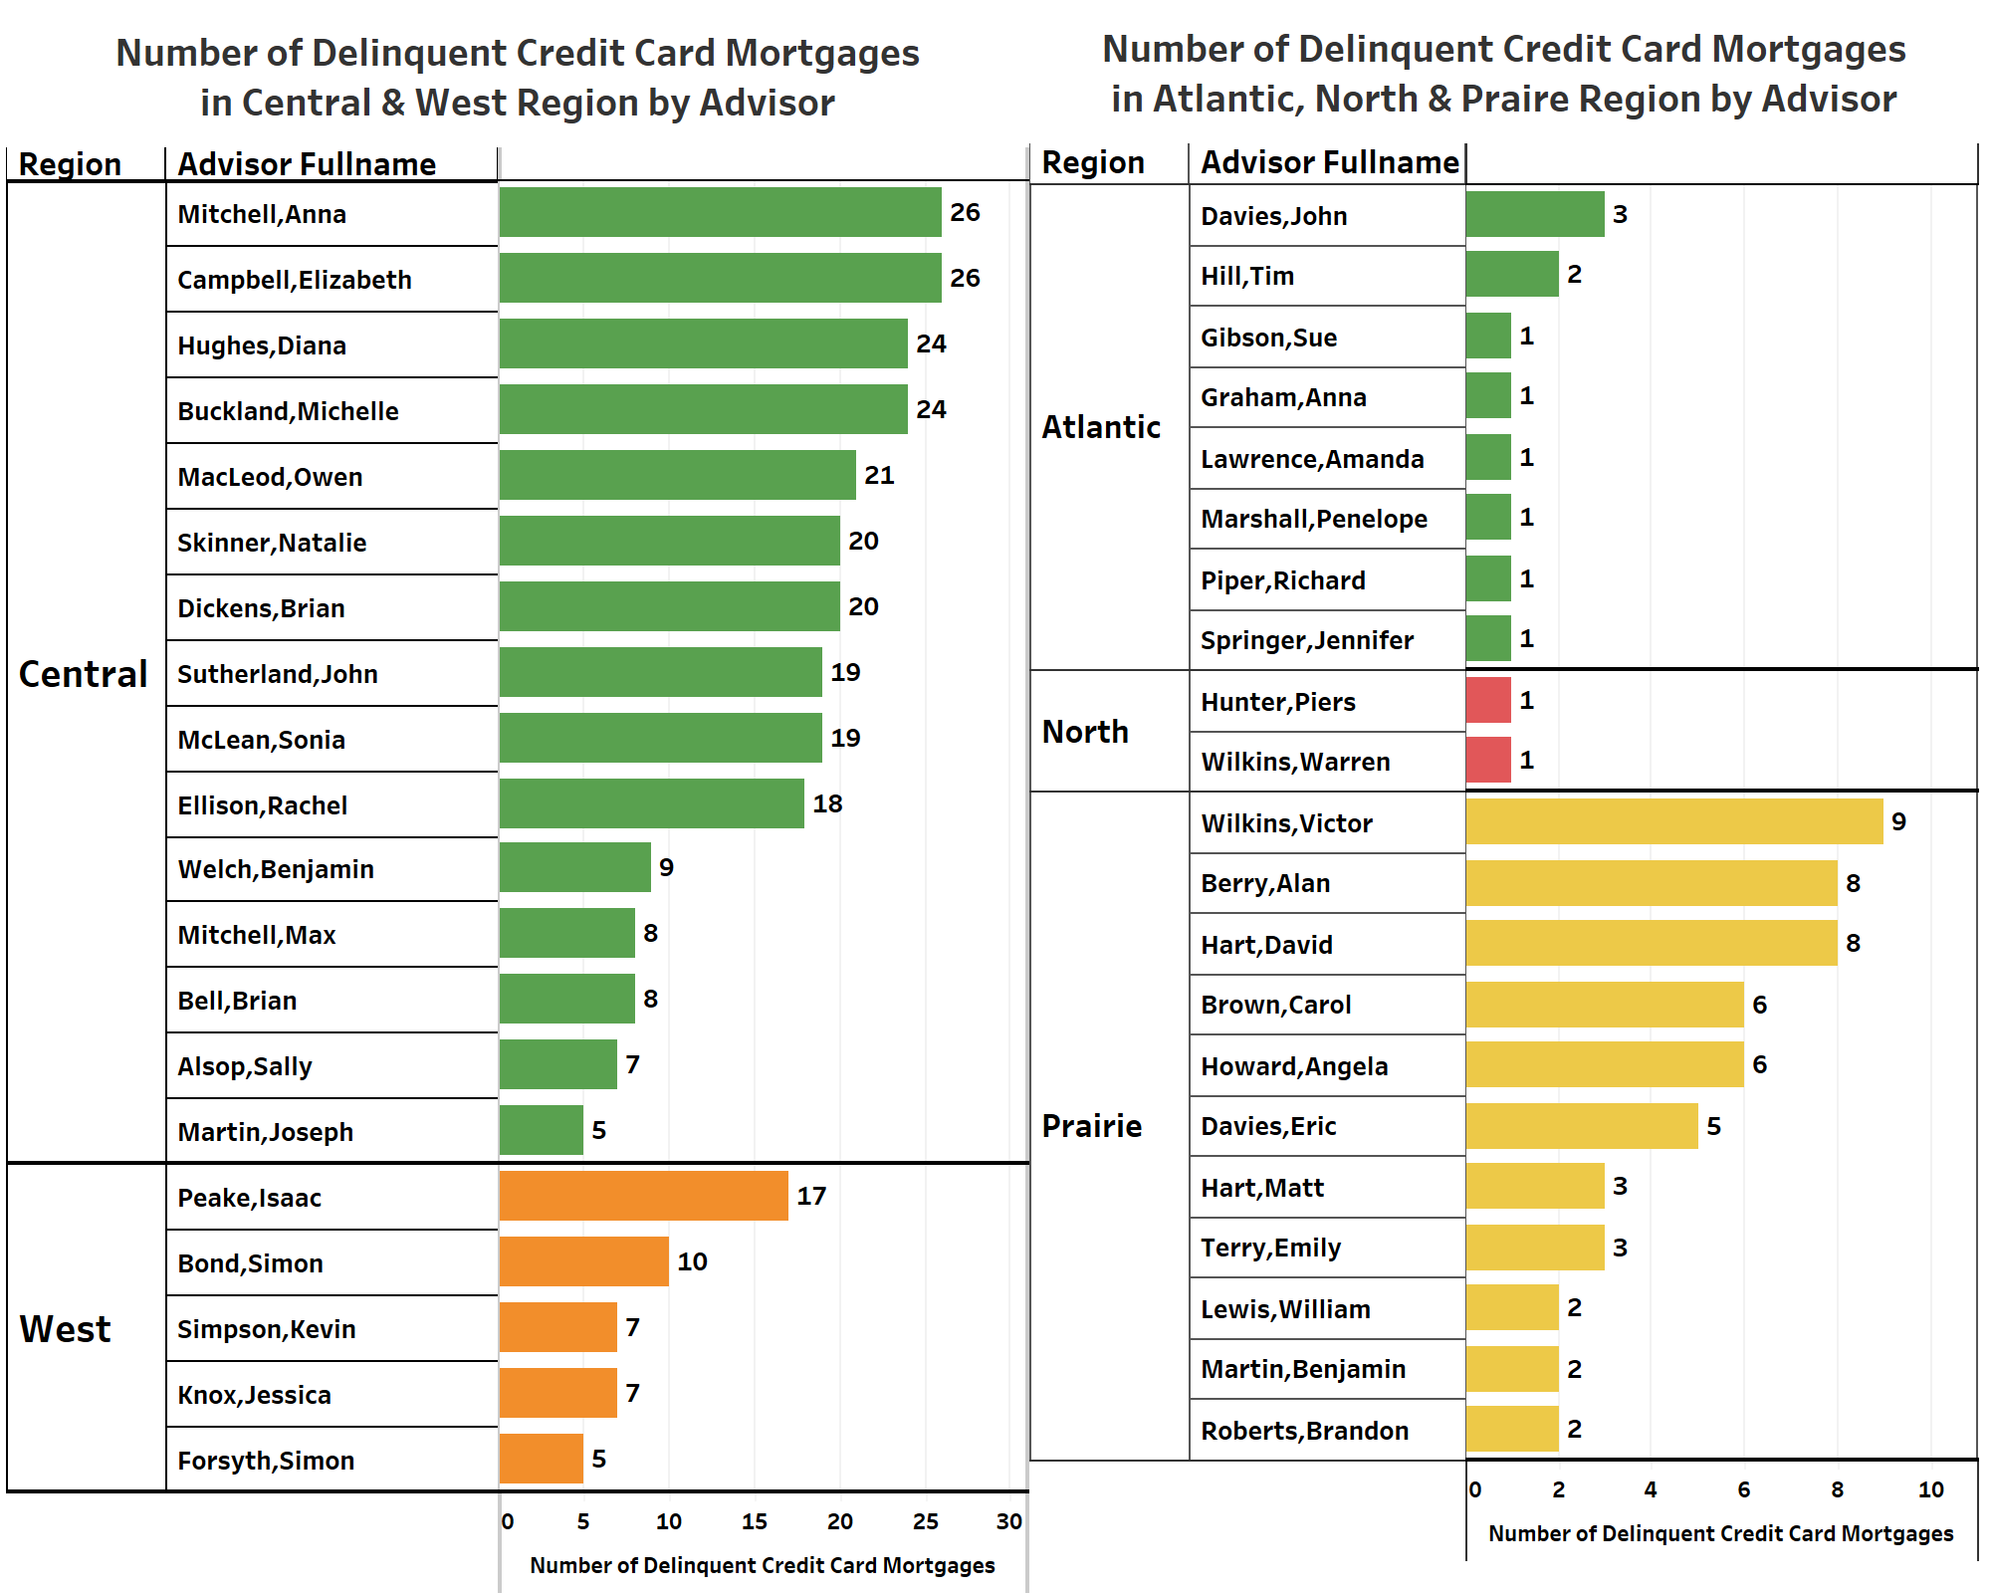
Descriptive Metrics- Analysis & Insights
Delinquent Mortgages With Respect to Advisors
Findings
Under the central region, the advisor Anna and Elizabeth has the highest number of CC mortgage delinquencies while Sally and Joseph have the lowest.
Similarly, Issac and Simon have high in the West.
Victor has the highest in the Prairie region.

Slide 15
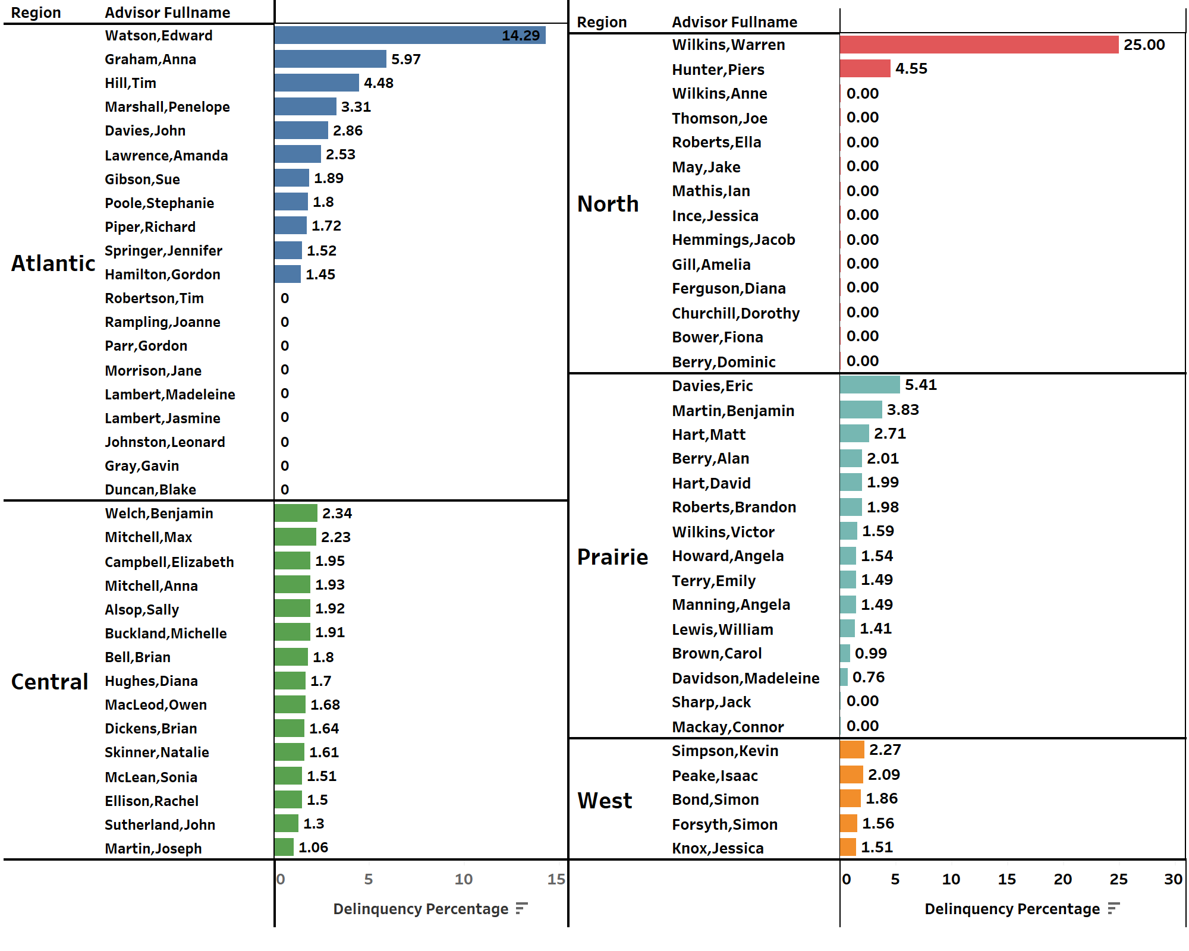
Descriptive Metrics- Analysis & Insights
% of Mortgage Delinquent Between Number of Clients & Delinquent w.r.t Region & Advisors
Findings
No of Client/ No of Delinquent *100
Under the Atlantic, the Edward has the highest number of delinquents while there are 9 advisors with zero
Central region has a low number of delinquents % compared with other regions.

Slide 16
Recommendations (Regional)
Focus on improving the performance of the advisors within their region to reduce delinquency & increasing the total value.
Also consider providing additional training or support to the advisors to help them improve their performance(higher delinquency rate advisors).
To identify and target specific client segments within their region that may be at higher risk of delinquency.
Regional managers in the central region have to hire more advisors to reduce delinquencies and give better customer service.
Notes:
This could be done by setting specific targets for the advisors, such as reducing the number of delinquent mortgages and increasing the total value of the mortgage portfolio within the region. The regional managers could also consider providing additional training or support to the advisors to help them improve their performance.

Slide 17
Recommendations (National)
Implement a system for tracking and monitoring the performance & workload of advisors across the country.
Consider implementing additional risk management strategies to help reduce the overall number of delinquent mortgages.
There is a huge correlation between the number of mortgages funded and delinquencies in certain months.
To develop a system to find out the number of clients with respect to the workload of advisors in each region.
Notes:
This could be done by setting specific targets for the advisors, such as reducing the number of delinquent mortgages and increasing the total value of the mortgage portfolio within the region. The regional managers could also consider providing additional training or support to the advisors to help them improve their performance.
For example, this could include clients with a lower credit score or clients with a higher debt-to-income ratio. By focusing on these high-risk segments, the regional managers could potentially reduce the overall number of delinquent mortgages within their region.

Slide 18
References
https://www.w3schools.com/sql/
https://stackoverflow.com/
SQL Data camp
Data Analyst Portfolio Project | Tableau Visualization from YouTube by Alex

Slide 19
Business Case Queries
Delinquent Mortgages by Client Segment (Age)
-To find the number of delinquent mortgages under each region by age_segment
SELECT r.Region, m.age_segment, COUNT(d.CUST_ID) AS 'Number of Delinquent Mortgages'
FROM [SQL Mortgages]..MTG_DELINQ_DEC2017$ d
INNER JOIN [SQL Mortgages]..MTG_CUST$ m
ON d.CUST_ID = m.CUST_ID
INNER JOIN [SQL Mortgages]..FinAdvMaster$ f
ON m.Finadvisor = f.FinAdvID
INNER JOIN [SQL Mortgages]..Region$ r
ON f.Province = r.Province
GROUP BY r.Region, m.age_segment
--To find the number of delinquent mortgage by Source
SELECT Source, Count(*) as 'Number of Delinquent Mortgages by Source'
FROM [SQL Mortgages]..MTG_CUST$ m
INNER JOIN [SQL Mortgages]..MTG_DELINQ_DEC2017$ d
ON m.CUST_ID = d.CUST_ID
GROUP BY Source
--Number of Credit Card Delinquent Mortgages by Age Segment
SELECT age_segment, COUNT(*) AS 'Number of Delinquent Mortgages'
FROM [SQL Mortgages]..CC_DEL_DEC_2017$ d
INNER JOIN [SQL Mortgages]..MTG_CUST$ c
ON d.CUST_Id = c.CUST_ID
GROUP BY age_segment
ORDER BY 'Number of Delinquent Mortgages' DESC

Slide 20
Business Case Queries
Delinquent Mortgages With Respect to Advisors
--To find the number of delinquent credit card mortgages in each region by the advisor and also the balance amount
--Advisors delinquent portfolio ($ and number of mortgages)
SELECT r.Region, f.AdvisorFullname, COUNT(c.CUST_ID) AS 'Number of Delinquent Credit Card Mortgages', SUM(c.balance) AS 'Total Balance'
FROM [SQL Mortgages]..CC_DEL_DEC_2017$ c
INNER JOIN [SQL Mortgages]..MTG_CUST$ m
ON c.CUST_ID = m.CUST_ID
INNER JOIN [SQL Mortgages]..FinAdvMaster$ f
ON m.Finadvisor = f.FinAdvID
INNER JOIN [SQL Mortgages]..Region$ r
ON f.Province = r.Province
GROUP BY r.Region, f.AdvisorFullname
ORDER BY r.Region

Slide 21
Business Case Queries
% of Mortgage Delinquent Between Number of Clients & Delinquent w.r.t Region & Advisors
SELECT r.Region, f.AdvisorFullname, COUNT(m.CUST_ID) AS 'Total Number of Clients',
COUNT(d.CUST_ID) AS 'Number of Delinquent Mortgages',
ROUND((COUNT(d.CUST_ID) * 100.0) / COUNT(m.CUST_ID), 2) AS 'Delinquency Percentage'
FROM [SQL Mortgages]..MTG_CUST$ m
LEFT JOIN [SQL Mortgages]..MTG_DELINQ_DEC2017$ d
ON m.CUST_ID = d.CUST_ID
INNER JOIN [SQL Mortgages]..FinAdvMaster$ f
ON m.Finadvisor = f.FinAdvID
INNER JOIN [SQL Mortgages]..Region$ r
ON f.Province = r.Province
GROUP BY r.Region, f.AdvisorFullname
ORDER BY r.Region, f.AdvisorFullname

