Slide 1

JCUSI
CDT Bucher
CDT Fernandes CDT Liu
CDT Lough CDT Nelson

Slide 2
Problem Statement
Develop a system capable of autonomous point recon.

Slide 3
GUI Flow Chart
JCC
Add Robot
Ability to edit the state of robot and its target
Add Target
Remove Robot from environment
Edit
Delete
Add a target to the environment and assign robots to target
Add a Robot to the environment and give it state and target
http://www-internal.eecs.usma.edu/courses/cs401/Resources/References/lsn14.pdf
Lough
Notes:
Direction of arrows

Slide 4
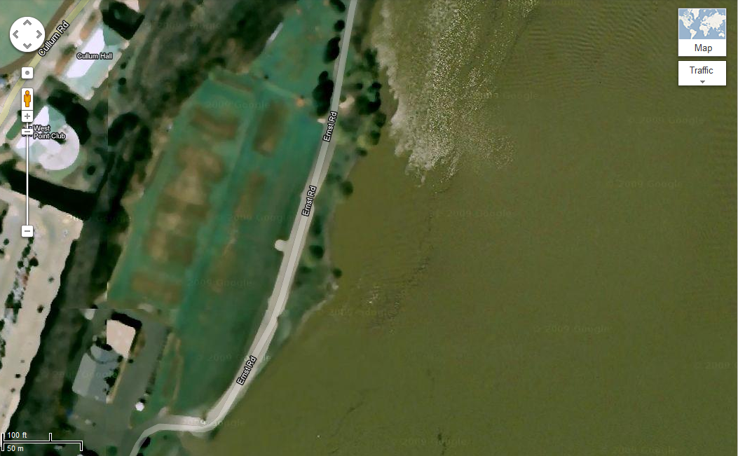
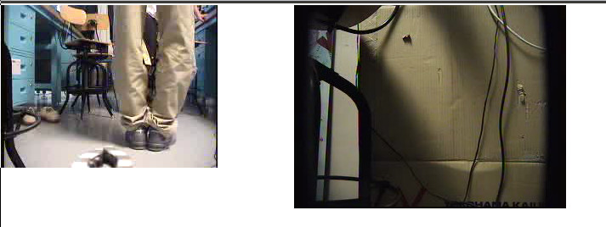
JCC
x
Front and Rear Video Feed
Robot ID: 1234
ID: 7890
ID: 1234
Robot Table
Robot ID | Robot Class | Latitude | Longitude | Elevation | Heading | State | Target ID
1234 | PackBot | 41.566 | -73.95 | 5.66 | 15.64 | Scanning | 7890
Target Table
Target | Identified By | Latitude | Longitude
7890 | PackBot | 41.58 | -73.94
Add Robot
Edit
Add Target
Delete
Lough

Slide 5
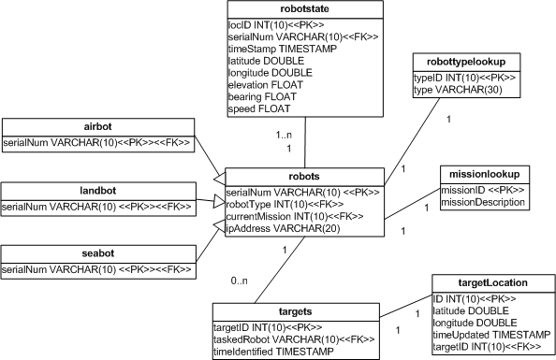
Database Schema Bucher
Bucher

Slide 6
Mapping Fernandes
Map world based off LIDAR
Determine if goal is achievable
Reduce getting stuck
Fernandes

Slide 7
Mapping: Complex World Fernandes
Fernandes

Slide 8
Mapping: No Path Fernandes
Fernandes

Slide 9
Mapping Fernandes
Determining Obstacle location
loc= Robot loc + Lidar beam
Vectors, include robot attitude
Flexibility of environment
dynamic, noise, errors
Memory size
Shadows
Fernandes

Slide 10
Mapping Fernandes
Flat ground assumption (intially)
Weighting function: [0,1]
Sparse matrix
Shape recognition/pattern matching
Smoothing function
Active Portion
Fernandes

Slide 11
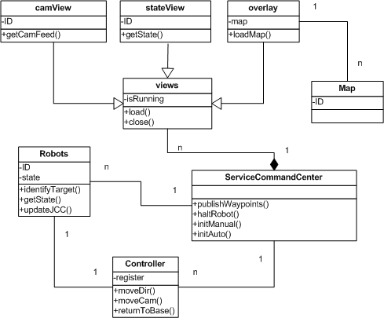
Operator Override
Liu
Notes:
Overlay and map might not be implemented on SCC

Slide 12
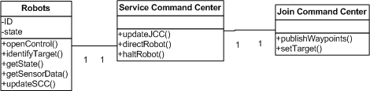
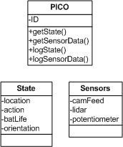
Sensor Data Capture, Storage and Retrieval
Nelson

Slide 13
Sensor Data Capture, Storage and Retrieval
Most data will be saved to a .txt file
Time stamps must be included
Data will be either divided into separate files based on type or 1 file with specific time stamp
Python scripts will be used to read data
TCP packets will be used to send data
Nelson

