Slide 1

JCUSI 1.1
CDT Bucher
CDT Fernandes CDT Liu
CDT Lough CDT Nelson

Slide 2

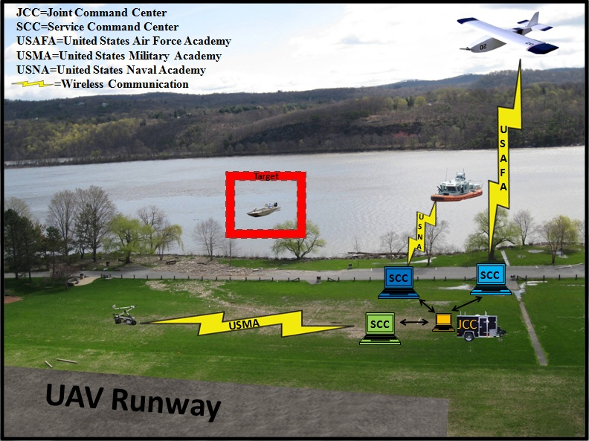
System Block Diagram
Overall Problem Statement:
Develop a network of aerial (USAFA), naval (USNA), and land (USMA) semi-autonomous robots that share operational data through a Joint Command Center (JCC) to collectively reconnoiter a region and/or track a designated target.
West Point Specific Problem Statement:
Develop two ground robots that will be able to detect, locate, and advance on a designated target as directed by a Service Command Center (SCC) and provide current status information to a Joint Command Center in order to provide a joint service common operating picture.

Slide 3
Agenda
Version 1.0 Recap
Version 1.1
Video of Demo
Overall Project
Way Forward
  Before Projects Day
  Next Year
Live Demo

Slide 4
Version 1.0
Communication:
Introduction of SCC
OCU and onboard radio
Message formats
Robot to JCC messages
SCC to Robot messages: unsuccessful demo

Slide 5
Version 1.1: Goal
Integration with previous code instead of building on top of previous code.
SCC Video
SCC Manual Control
Improved SCC→ PICO communication
Additional Message Definitions
Notes:
Last slide of version 1.0 brief

Slide 6
Version 1.1: End State
SCC GUI
Robot command specification
Robot command execution
  Autonomous Control Loop (Command Publisher)
  Peripheral Sensor Integration
  Integrator Update
Additional Work Required
  Manual Control
  Video

Slide 7
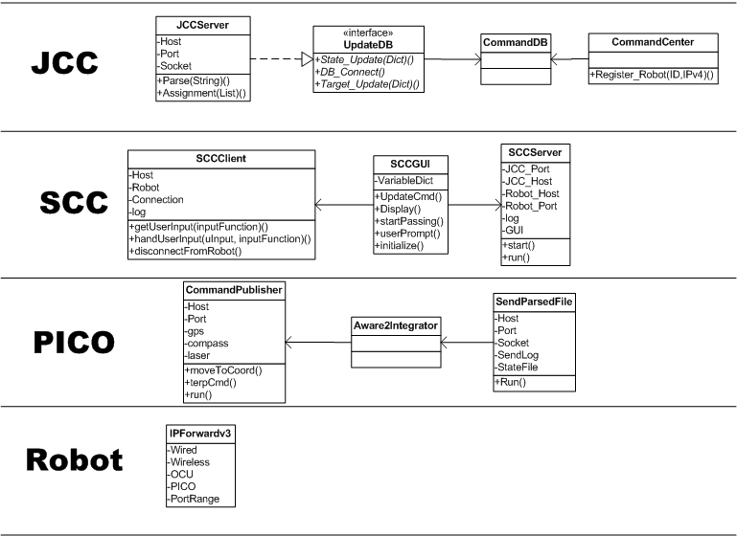
Class Diagram

Slide 8
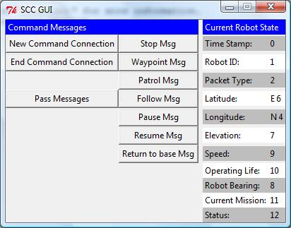
Version 1.1: SCC GUI

Slide 9
Version 1.1: Commands
Header + Command ID + Body
Header: time, robot, message ID,
Command | ID | Body | Example
Stop | 00 | None | 12:00, AR10, 99, 00
Waypoint | 01 | List of points | …,…,99,01 (, x₁,y₁, x₂,y₂, …)
Patrol | 02 | List of Points | …,…,99,02 (,x₁,y₁, x₂,y₂, …)
Follow | 03 | Optional Location | …,…,99,03 (,x₁,y₁)
Pause | 04 | Time to pause | …,…,99,04, T
Resume | 05 | None | …,…,99,05
Return | 06 | Optional Location | …,…,99,03 (,x₁,y₁)

Slide 10

Version 1.1: Execution
User Input
SCC Gui
SCC Client
ROBOT
SCC/OCU
Command Message
TCP Packet
Laser
ROS TOPIC
Command Publisher
Aware 2 Integrator
GPS
ROS TOPIC
ROS TOPIC
Publish
Subscribe
Compass
ROS TOPIC:
Chassis Command
PICO
Notes:
Testing: well duh

Slide 11
Demo Video

Slide 12
Before Projects Day
Video
  Stream to SCC/OCU
Robustness
  Robot multithreading: allow override commands
  State updates: remove file I/O
Tweaks
  SCC GUI: display refresh, user input
  Navigation Algorithm: buffer size
Manual Control
  Expand command instruction set
  Add GUI buttons

Slide 13
Value Added
Communications Architecture
Service Command Center
OCU and Radio integration
Weatherized platform
Arm
Manual Control*
Video Using new model*

Slide 14
Legacy/Supporting Work
Autonomy
  Navigation Code
  Obstacle Avoidance
Joint Command Center
  GUI
  Database
ROS
  Open source software
  Robot publishers/subscribers

Slide 15
Next Year: General
Project scope
  Isolate components
  Smaller teams
Research and integrate other work
  Common algorithms and open source
    Navigation
    Image processing
  Government owned software
    SPAWAR: retro traverse/autonomy box
    Multiple Robot Host Architecture (MRHA)
    Multi-Robot Operator Control Unit (MOCU)
    Joint Battlespace Command and Control System (JBCCS)

Slide 16
Next Year: Specific
Multi Robot Control: Multiple robots using 1 OCU
  x2 CS/IT: python, TCP/UDP, IP tables
Autonomous Navigation: Improve navigation algorithms
  x2 CS: python, math, research/integration
Target Discrimination
  CS (EE?): image processing, math, research/integration
Additional Platforms
  x1 EE (peripherals), x1 CS (chassis control), x1 IT (communications)
Improvements
  JCC functionality, add directives
  SCC interface: include higher level perspective
  Video to JCC
  Stand alone map: DTED, Buckeye (LIDAR/Imagery)
  Expanded SCC command set/functionality

Slide 17
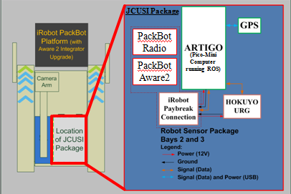
PackBot System Diagram

Slide 18
EE Work Completed
Goals | Complete?
Upgraded Hardware
-water resistant packaging | Yes
-upgraded laser | Yes
-elimination of microcontrollers | Yes
-upgraded GPS (waterproof) | Yes
-upgraded compass | Yes

Slide 19


Slide 20
Live Demo

Slide 21
JCUSI 1.0
CDT Bucher
CDT Fernandes CDT Liu
CDT Lough CDT Nelson

Slide 22
Agenda
Overview
Requirements
Design
Implementation
  Subsystems
Testing
Demo

Slide 23
Project Goal
Bring fight to enemy while mitigating risk to field soldiers:
  Decrease risk in battle for soldiers
  Combat multiplier
  Perform unmanned reconnaissance in high-risk areas
  Facilitate information gather for all units

Slide 24
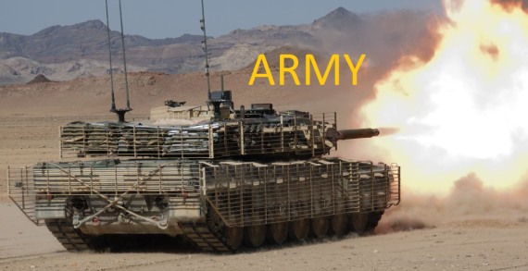


System Overview
JCC
SCC (AR)
SCC (NA)
SCC (AF)

Slide 25
Problem Statement
Develop a system capable of autonomous point recon.

Slide 26
Project Specifications
Interface Requirements
JCC
  Establish network communication with Service Command Centers (SCC)
SCC
  Establish wireless communication with the Packbot using protocols from the OCU
Robotic Platform (Packbot)
  Hokuyo laser interface with PICO through ROS module , CAT5 cable, and serial connection
  GPS interface with PICO through ROS module and serial connection

Slide 27
Project Specifications
JCC Functional Requirements
Receive the robots’ state and sensor data from the SCC’s (USMA, USAFA, and USNA)
Track the robots’ states and JCC state
Publish data/information to SCC’s
Display system state and appropriate information to the user
Common Operating Picture at JCC

Slide 28
Project Specifications
Robot Functional Requirements
Autonomous and teleoperations modes
Communicate state to Command Center
Communicate sensor data to Command Center
Provide video feed of environment
Target identification

Slide 29
Primary Functional Requirements
3.1 Manual Control (E)
3.2 System Display (E)
3.3 Navigate To Target (E)

Slide 30
Initial Plan

Slide 31
Refined Plan

Slide 32
Version 1.0
Network communications
  Packet forwarding
  Robot→PICO→SCC→JCC
Update Messages
  Database updates
  GUI updates
SCC Command Messages
PICO Manual Control

Slide 33
Network Diagram

Slide 34
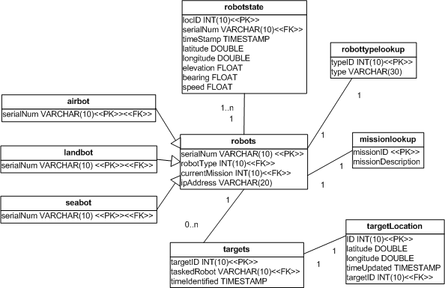
Database Schema

Slide 35
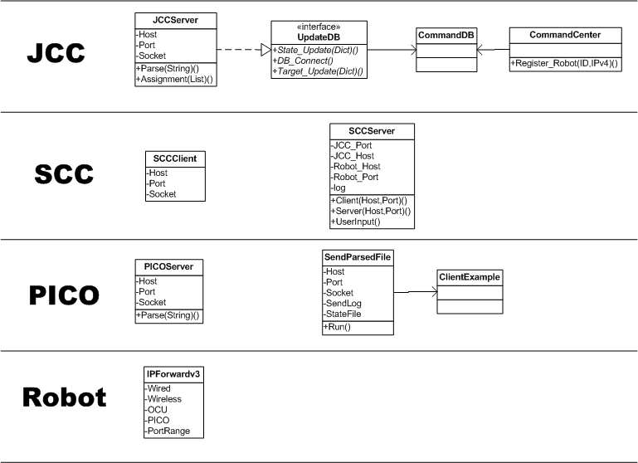
Class Diagram

Slide 36
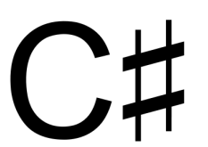
Data Flow
Primary Contribution
New Communication Model
More robust
Defined Messages
Sensor Data
TCP Packet
SCC
TCP Packet
JCC Server
Parsed Sensor Data
JCC GUI
PICO

Slide 37
Robot
The platform
Improvements:
  Use of onboard radio
  Arm and onboard camera
  Two connections
  Packet forwarding

Slide 38
PICO
Control of the Platform
Improvements:
  Message reception
  Message creationg

Slide 39
SCC
Local Operating Picture
Control of the platforms
Improvements:
  New to this year
  Use of OCU
  Use of onboard radio

Slide 40
JCC
Common Operating Picture
Improvements:
  Defined message formats
  Network communications (not database)

Slide 41
Legacy Work
GUI
Database
Navigation
ROS

Slide 42
Testing
INTEGRATION
UNIT

Slide 43
Testing
Unit
  DB: updateDB.py
  SCC Server (2 parts): SCCserver.py
  JCC Server: JCCserver.py
Integration
  JCC → GUI
  PICO → SCC
  Robot → SCC
  Robot → JCC
  PICO → GUI

Slide 44
Testing
Test Messages
Simple Clients/Servers
Log files

Slide 45
Unit Test
testMsg.txt
testMsgClient.py
TCC Packet
SCCserver.py
msgLog.txt
TCP Packet
messagesRecieved.txt
testMsgServer.py

Slide 46

Integration Test
testMsg.txt
testMsgClient.py
TCC Packet
SCCserver.py
JCCserver.py
msgLog.txt
TCP Packet
GUI
Database

Slide 47
Data Flow
Sensor Data
TCC Packet
SCC
TCP Packet
JCC Server
Parsed Sensor Data
JCC GUI
PICO

Slide 48
Demo

Slide 49
Lessons Learned
Scoping of problem space
Difficulty in working with propriety software
Difficulty in multidisciplinary groups
Test your tester
Document code
Delete old code (version control)

Slide 50
Version 1.1
Integration with previous code instead of building on top of previous code.
SCC Video
SCC Manual Control
Improved SCC→ PICO communication
Additional Message Definitions

