Slide 1


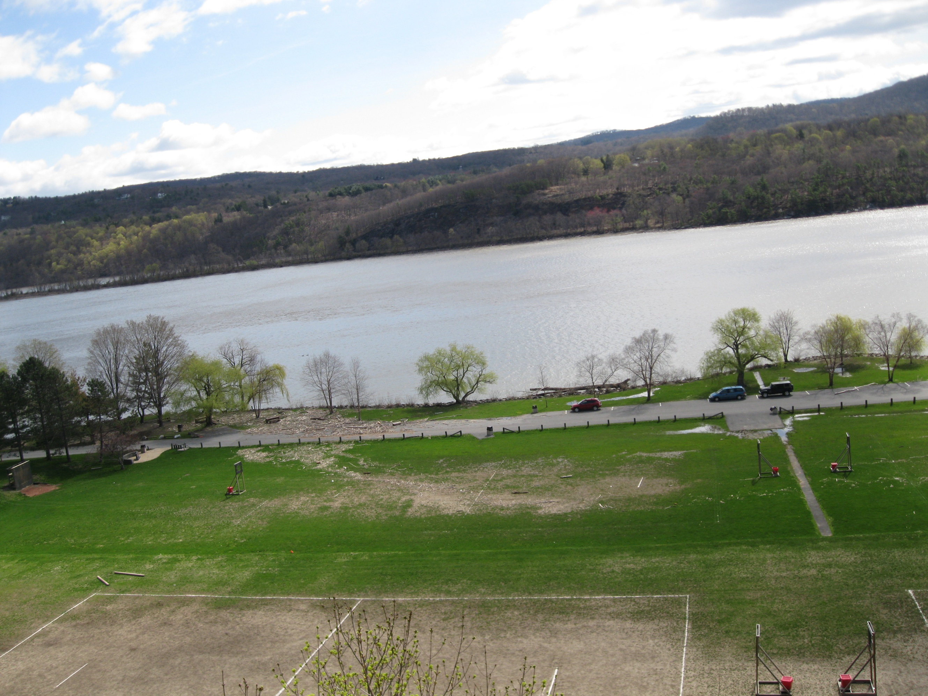
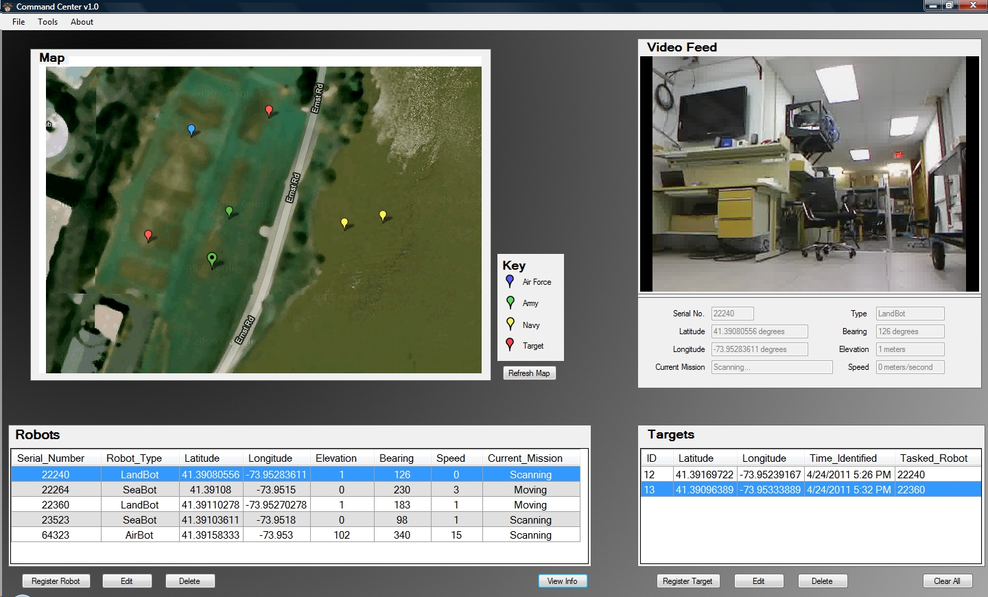
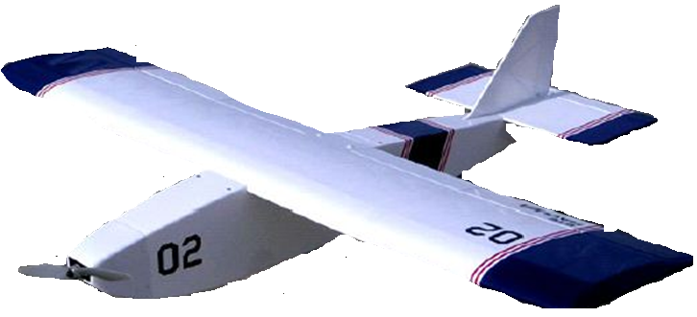

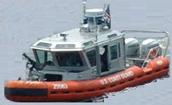
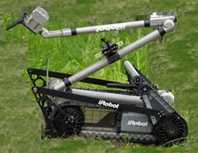
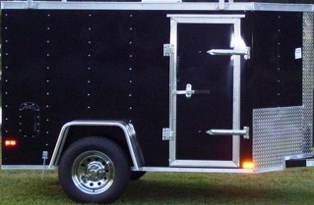
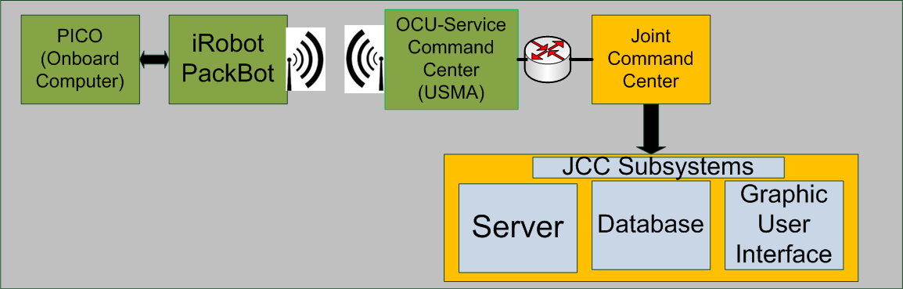
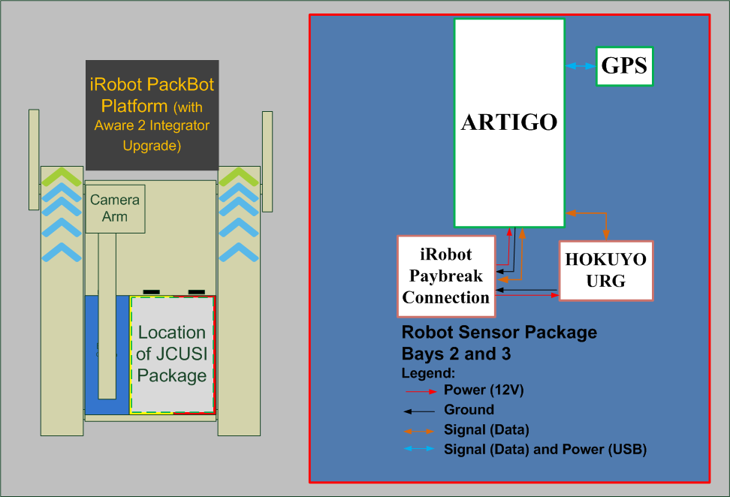
JCUSI (Joint Cooperative Unmanned Systems Initiative)
Overall Problem Statement: Develop a network of aerial (USAFA), naval (USNA), and land (USMA) semi-autonomous robots that share operational data through a Joint Command Center (JCC) to collectively reconnoiter a region and/or track a designated target.
West Point Specific Problem Statement: Develop two ground robots that will be able to detect, locate, and advance on a designated target as directed by a Service Command Center (SCC) and provide current status information to a Joint Command Center (JCC) in order to contribute to a joint service Common Operating Picture (COP).
Problem Scenario
JCC Interface
JCC = Joint Command Center
SCC = Service Command Center
USAFA = U.S. Air Force Academy
USMA = U.S. Military Academy
USNA = U.S. Naval Academy
= Wireless Communication
SCC
(USAFA)
SCC
(USNA)
JCC
UAV Runway
SCC
(USMA)
USMA Platform Specific Diagram
JCUSI Package
PackBot Radio
PackBot Aware2
(Pico-Mini Computer running ROS)
Major Milestones
Complete- 23 January 2012: Service meeting (USAFA,USNA, and USMA) to finalize specifications for JCUSI project
Complete- 08 March 2012: All subsystems complete and ready for integration (Laser, Packaging, Controls/Camera, GPS, Packet Forwarding, Threading, Communications, SCC GUI)
23-27 April 2012: Final Testing (Demo runs, Final Film and presentation materials complete)
03 May 2012: Projects Day (Final Product Presentation and Live Demonstration for stakeholders by USA FA, USMA, and USNA)
Project POC: Major Christopher Lowrance (christopher.lowrance@usma.edu, 845-938-3127)
OSR Number: 12-S-1340

