Slide 1

Blood Donation Management System
(BloodBridge)
By:
Lakmaya Tamang
Pemba Chhumu Sherpa
BCA 8th semester

Slide 2
Overview
Introduction
Problem Statement
Objectives
Literature review
System Design
Algorithm
Gantt Chart
Implementation
Testing
Conclusion
Future Improvement

Slide 3
Introduction
BloodBridge is a web-based blood donation management system developed to connect blood recipients with eligible donors efficiently. The platform simplifies donor discovery, registration, and management through a user-friendly interface and a robust backend built with Laravel PHP.

Slide 4
Problem Statement
Lack of a centralized system for accessing eligible blood donors.
Difficulty in manually tracking donor eligibility (3-month donation rule).
Inability to quickly connect recipients with donors in the same geographic region.
Existing platforms either lack admin features, mobile responsiveness, or eligibility validation.
Inefficient record-keeping and absence of donor engagement mechanisms.

Slide 5
Objectives
General objectives
To develop an efficient and user-friendly web-based platform named BloodBridge that connects blood donors with recipients, ensuring quick access to eligible donors based on location and donation history.
Specific objectives
To enable users to request blood donor information filtered by eligibility and geographic location.
To allow donors to register, manage their profiles, and view their donation history.
To notify donors when they become eligible to donate again (after a 3-month interval).

Slide 6
Literature Review
BloodBridge is designed to address these challenges by digitizing and automating the blood donation management process. It connects donors, recipients, and administrators through a unified interface while ensuring that only eligible donors (those who haven’t donated in the past 3 months) are listed. The system also simplifies record-keeping for both public users and administrators.

Slide 7
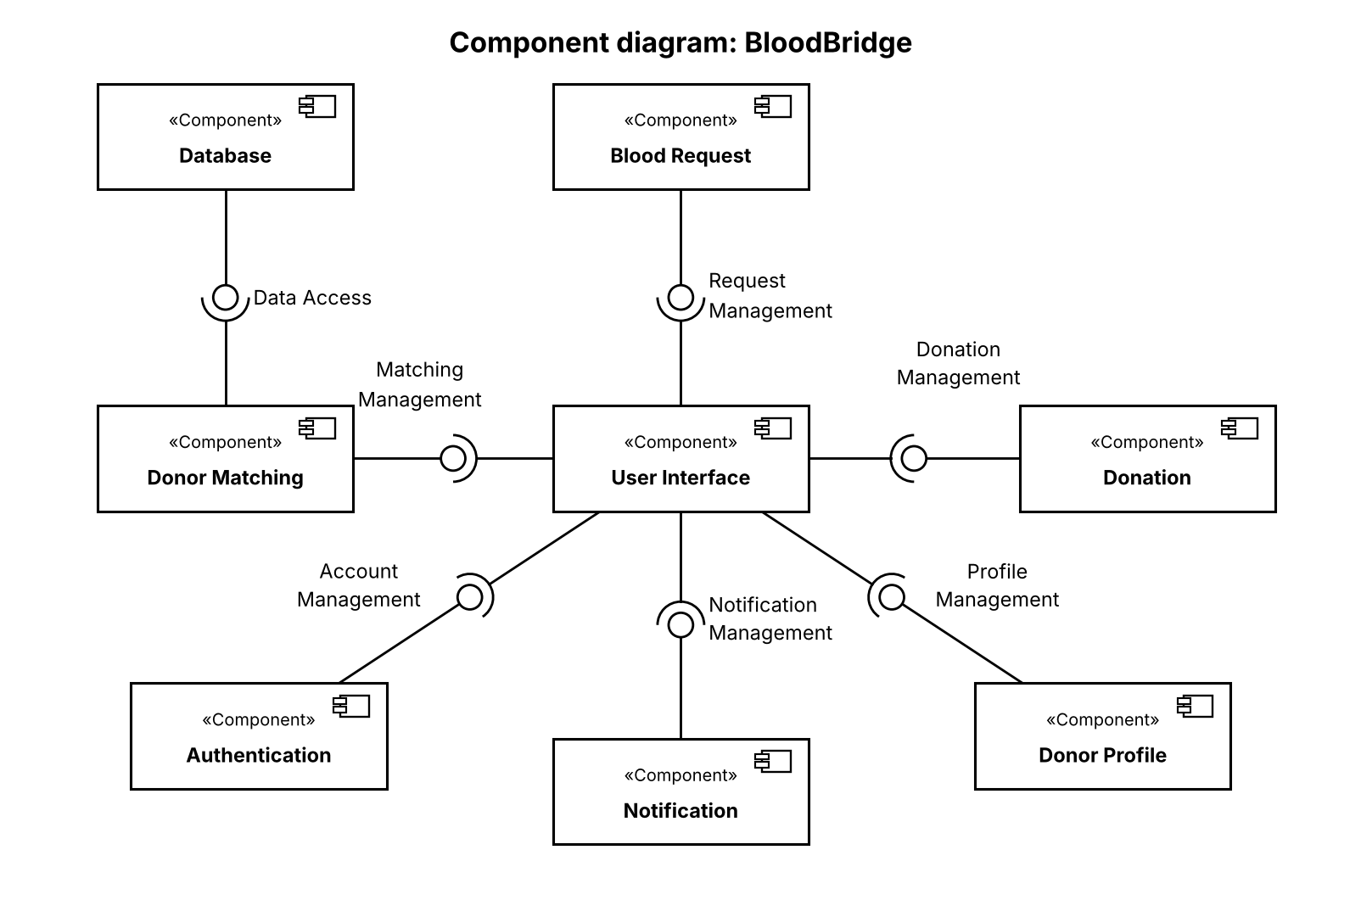
System Design
1)Component diagram

Slide 8
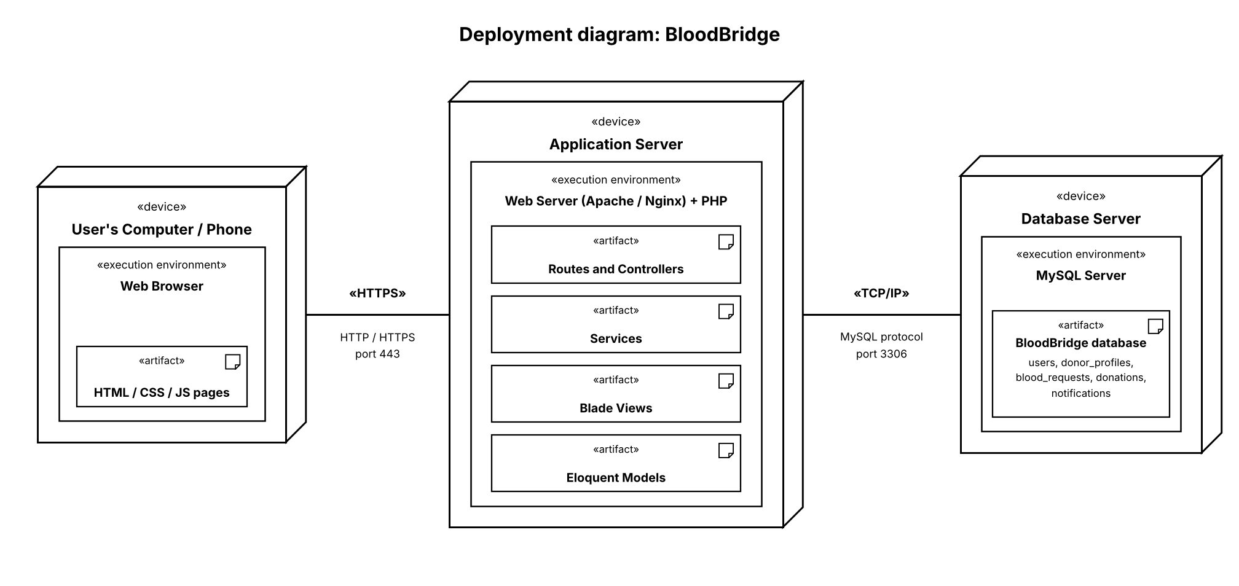
2)Deployment Diagram

Slide 9
Algorithm
To improve the accuracy and relevance of donor search results, the system implements a weighted scoring algorithm.
Key Scoring Criteria:
Location Proximity (Weight: 35%)
Eligibility (Weight: 25%)
Blood Compatibility (Weight: 20%)
Donor Regularity (Weight: 10%)
Availability (Weight: 5%)
Health Status (Weight: 5%)

Slide 10
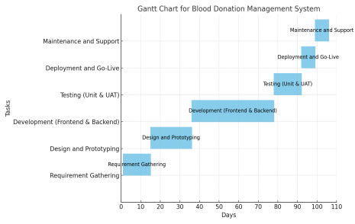
Gant Chart

Slide 11
Implementation
Implementation details of modules:
User Registration and Authentication Module
Donor Profile Management
Donation Request System
Admin Panel
Donor History Tracking
Search and Filter Functionality
Validation and Security

Slide 12
Testing
Unit testing
Unit testing focused on testing individual functions, controller methods, and logical conditions within the system.
System testing
System testing evaluated the entire system as a whole, ensuring all modules interacted correctly and the platform behaved as expected in real-world scenarios.

Slide 13
Conclusion
By implementing a weighted scoring algorithm, the system ensures that the most suitable donors are prioritized, improving the likelihood of timely donations. The use of Laravel PHP framework and modern web development practices contributed to a robust, secure, and maintainable solution.

Slide 14
Future Improvement
Mobile app development for easier access and better user engagement.
Support for multiple languages to cater to a broader user base.
Implementation of a more detailed health check reporting system for donors.
Integration with national or regional blood bank databases for wider coverage and data sharing.
Integration of SMS or email notifications to alert donors of new requests and remind them when they become eligible again.

Slide 15
References
Laravel Documentation
PHP Official Website
Blood Donation Guidelines
Geographical Distance Calculation
Laravel Eloquent ORM
Web Accessibility Guidelines

