Slide 1

LAB 1: Using Testbenches More Effectively
Nate Lannan
Oklahoma State University
Electrical and Computer Engineering Department
Stillwater, OK 74078 USA nate.lannan@okstate.edu

Slide 2
Objective
This lab has one main objective:
Learn how powerful testbenches are and how they are constructed
You cannot complete any lab overnight, be forewarned.
Don’t wait for your lab partner to start. Jump in and compare your work.

Slide 3
Testbenches
Always use a testbench to simulate your design
A DO or Tcl file will help run the simulation through MGC ModelSim.
vsim –do file.do
vsim –do file.do –c (runs without GUI)
Response
HDL or Device
Under Test
(DUT)
Testbench
Vectors

Slide 4
DO File
TCL script that runs 4 things that you could run from the cmd prompt but is much more tedious since you will be doing them each time you want to simulate
Sets up your work environment: if [file exists work] { vdel -all } vlib work
Compiles all of your .sv files: vlog rca4.sv fulladder.sv test_rca4.sv
Runs a simulation and verifies with a test bench: vsim -voptargs=+acc work.stimulus
Configures your GUI environment view list view wave add wave -hex -r /stimulus/* add list -hex -r /stimulus/* add log -r /*

Slide 5
Basic structure of testbench
module tb ();
logic a,b,c,y; logic clk;
logic [31:0] errors;
logic [31:0] vectornum;
silly dut1 (a,b,c,y);
initial begin
clk = 1'b1;
forever #5 clk = ~clk;
end
initial begin
#0 a = $random;
#0 b = $random;
#0 c = $random;
end
endmodule
Testbenches have 3 main elements
Internal declarations (no inputs and outputs)
Instantiation of the Device Under Test
Generation of test vectors

Slide 6
Clock
What is a clock?
A clock is used to synchronize signals.
It is basically a digital signal that goes up to Logic 1, down to Logic 0, and repeats.
Most digital systems have external clocks that provides accurate sunchronization
Testbenches can use clocks to synchronize when devices are tested even if they do not use a clock.

Slide 7
Example Code
integer handle3;
integer desc3;
integer i;
initial
begin
handle3 = $fopen("rca.out");
desc3 = handle3;
#1250 $finish;
end
initial
begin
for (i=0; i < 128; i=i+1)
begin
// Put vectors before beginning of clk
@(posedge clk)
begin
A = $random;
B = $random;
end
@(negedge clk)
begin
$fdisplay(desc3, "%h %h || %h | %h | %b", A, B, Sum, Sum_correct, (Sum == Sum_corr));
end
end // @(negedge clk)
end
This testbench outputs data to a file called rca.out
The output file will be created in your directory after you run your DO file

Slide 8
Self Validating Testbench
Almost all testbenches verify against “known” results (golden vectors)
Golden vectors can be generated or imported via a file
Generating golden vectors using common coding constructs within the testbench is common practice assign sum_correct = A+B+Cin (this generates the sum of 3 values A,B, and Cin)
Another common practice is to create an alert when there is an error so that you don’t need to sift through all of your vectors. assign error = Y_out != Y_correct;

Slide 9
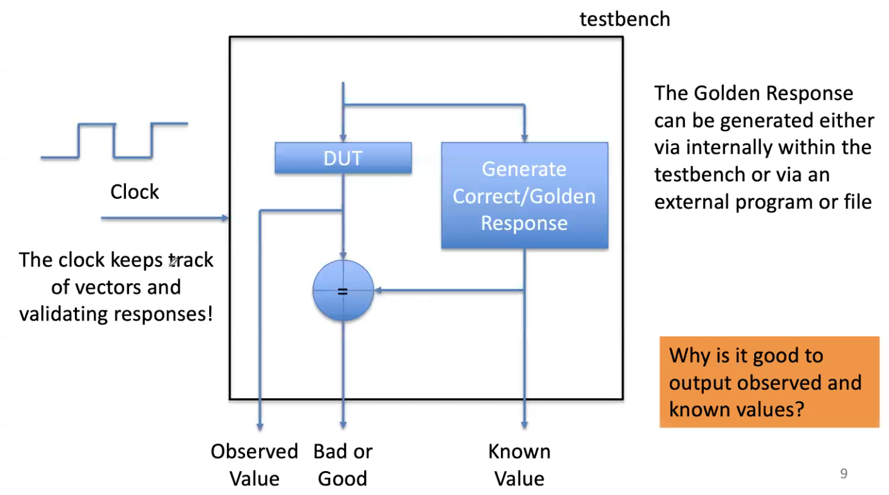
Idea of Self –Validating TB

Slide 10
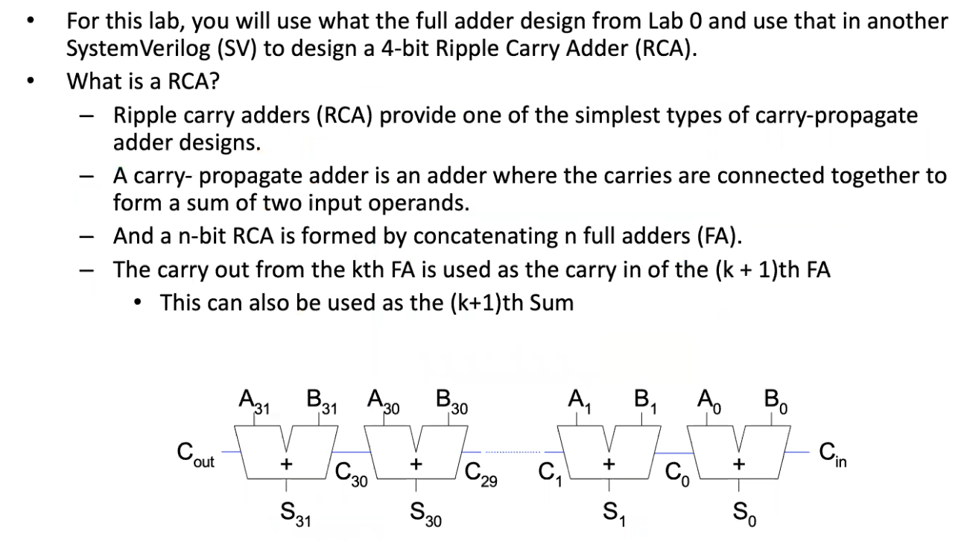
Tasks: Ripple Carry Adder

Slide 11
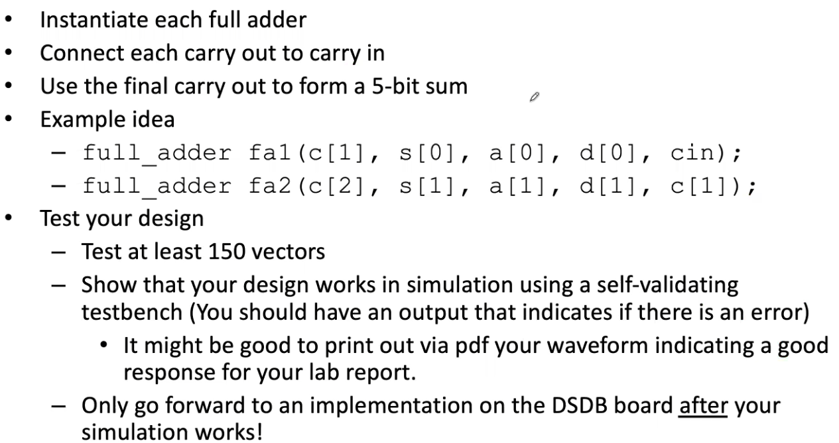
Creating a 4-bit RCA

Slide 12
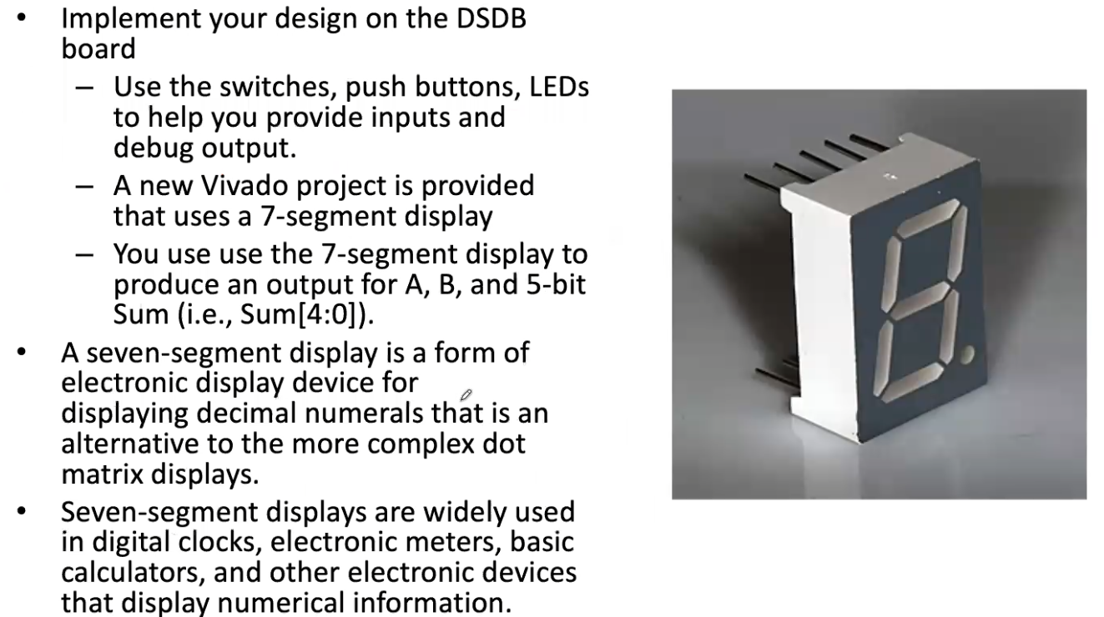
Implementation on DSDB
13

Slide 13
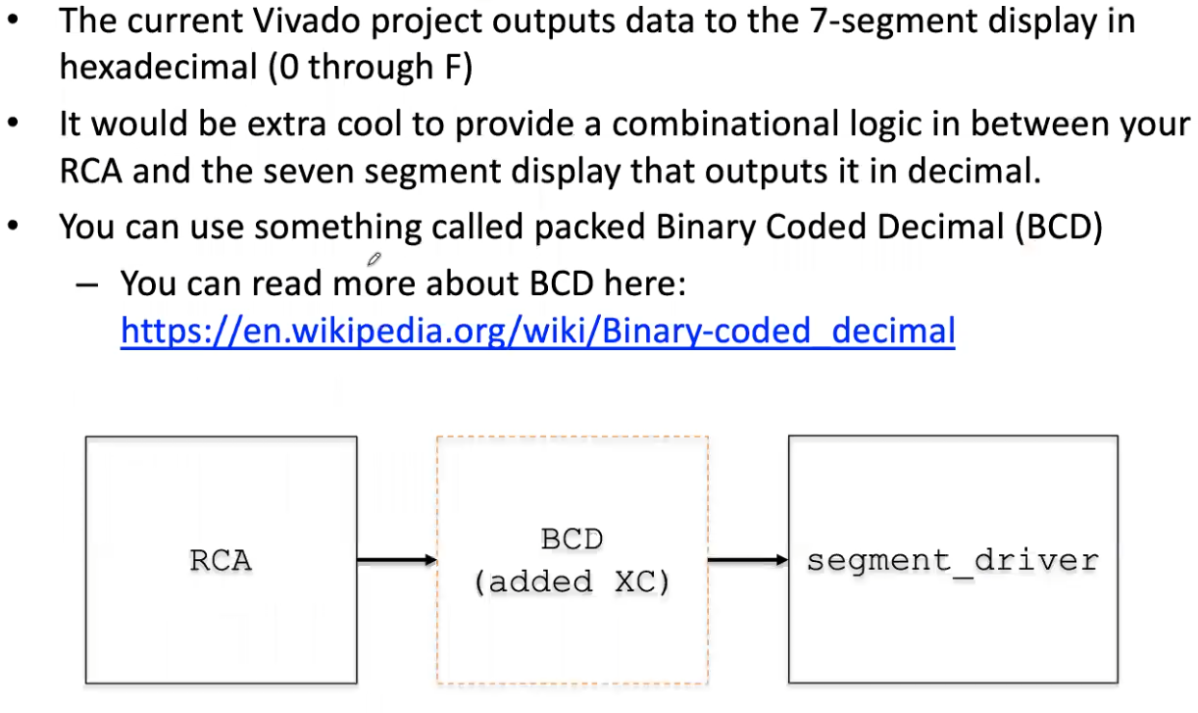
Extra Credit

