Slide 1

VoltEdge
SOUND REACTIVE DISCO LIGHT BOX
Samarasekara S.M.R.P. 230564L
Jayakody J.A.C.P. 230268H Kaushalya R.G.S.P. 230327N Jayasinghe J.A.P.R. 230280L

Slide 2

Introduction
The Sound Reactive Light System is an analog electronic project designed to create dynamic lighting effects that respond directly to audio signals.
By analyzing different frequency bands of background music, the system drives a set of LEDs to change patterns in real time, enhancing the ambiance and visual appeal at parties or events.
Using analog circuits such as band-pass filters, amplifiers and a regulator, the design processes sound frequencies will cove the concepts in signal processing and circuit design while delivering an engaging interactive experience.
3

Slide 3
Methodology
1. Sound Capture and Amplification
Music is captured via a “Electret Microphone”
Preamplification and amplification using “NE5532P , LM358N” OpAmp ICs
x11 times amplification
3

Slide 4
2. Frequency band seperation
1. Low Pass Active Filter
“NE5532P” OpAmp 2nd order filtering
267Hz cutoff
2.Bandpass
“NE5532P” OpAmp 2nd order filtering
328Hz and 2411Hz cutoff
3. Highpass Active Filter
“NE5532P” OpAmp 2nd order fltering
3386Hz cutoff
3

Slide 5
4.Amplification and Driving LEDs
All the three bands are amplified and used for LED driving
Low Pass by x7.8
Bandpass by x11
High pass by x11
3

Slide 6
3.Power Supply
1. 9V battery will be used as power source
LT1086 - 5V model with 10uF capacitances
MAX1044 switched capacitor convertor or
a voltage divider circuit.
3

Slide 7
Functionality
MICROPHONE
AMPLIFIER
FREQUENCY FILTERS
LED ARRAYS
LED DRIVE
AMPLIFIER
3

Slide 8
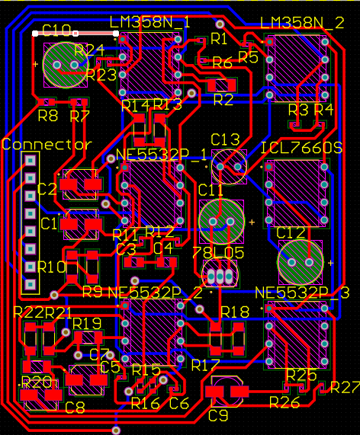
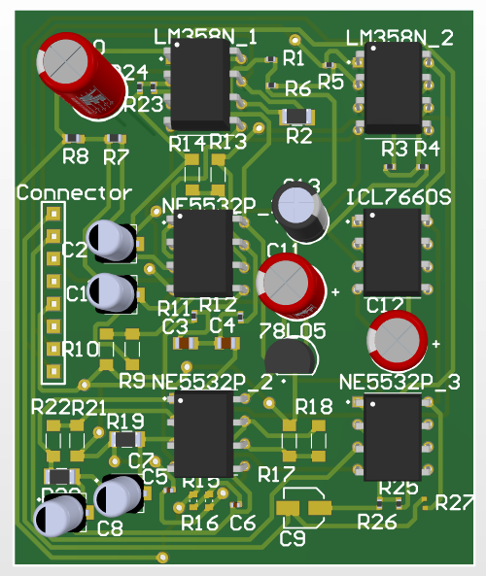
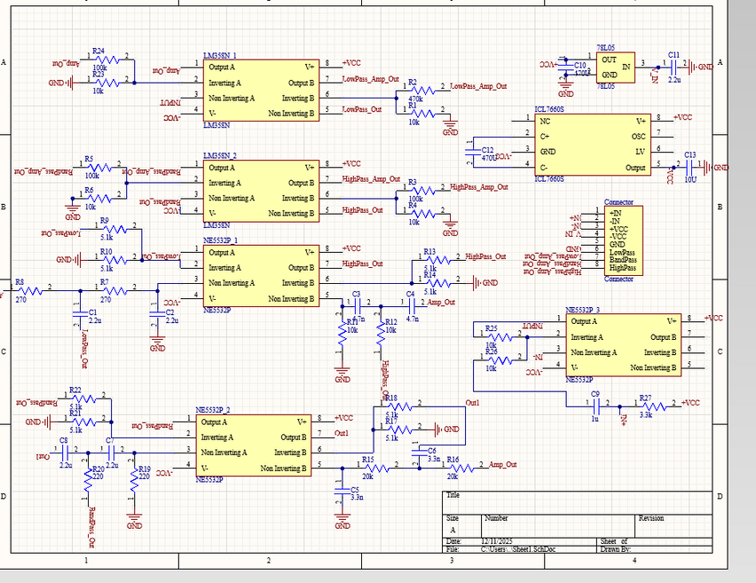
PCB design
The pcb was created to organize the entire circuit in a clean compact and relaible way.
3

Slide 9
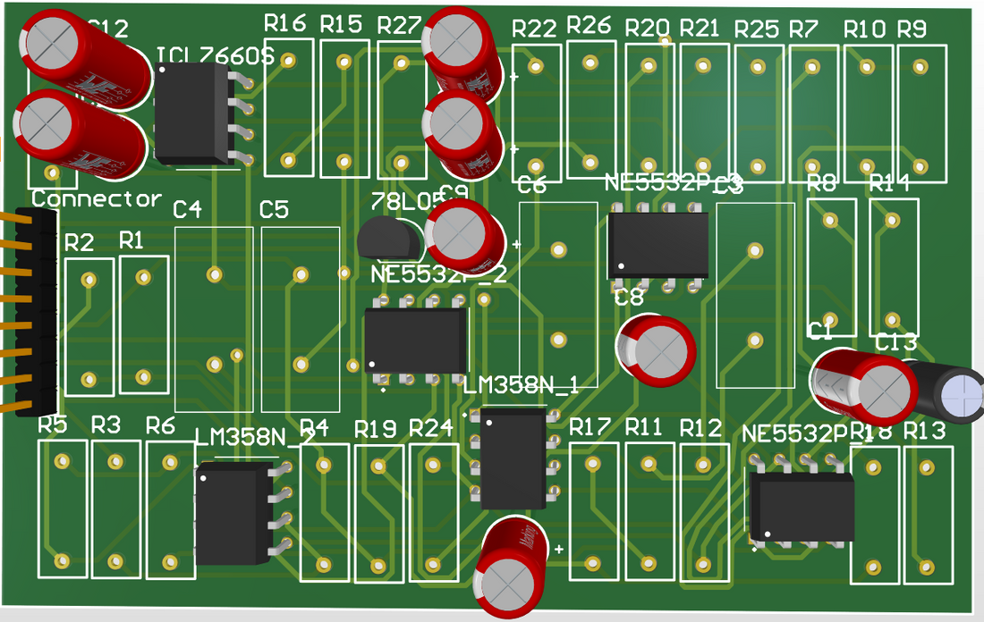
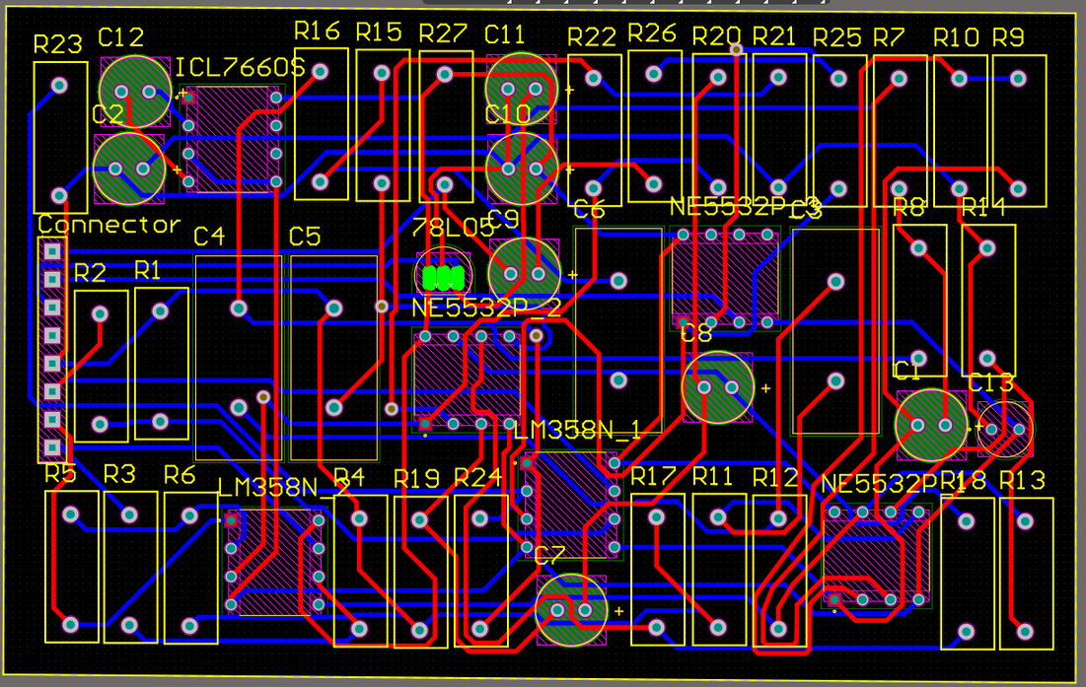
PCB design
3

Slide 10
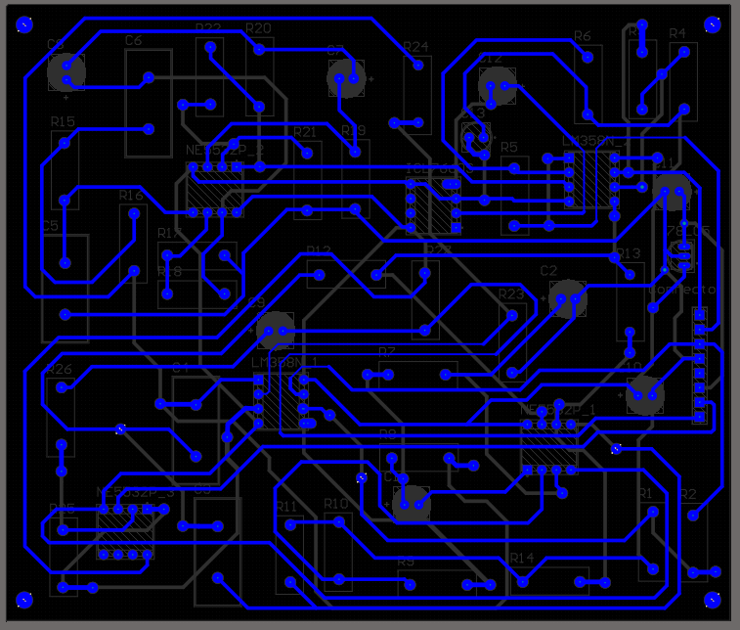
PCB design
3

Slide 11
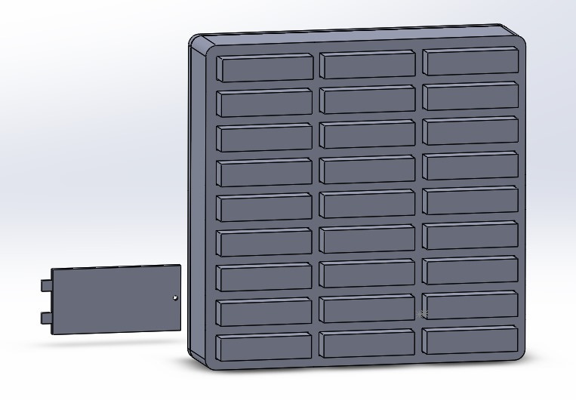
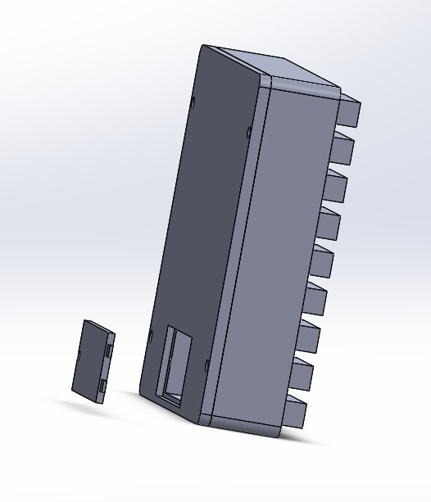
To protect the circuitry while giving the project a clean, professional appearence.
Enclosure design
Enhances the aesthetics of the light box making it suitable for display during events or as part of the room
3

Slide 12
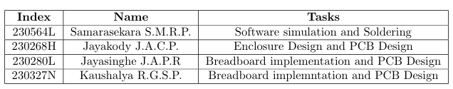
Task Allocation
3

