Slide 1

Inferring Information and Classifying Structure of a Distinct Online Social Network
Peter McKay

Slide 2

tumblr is an online social network with
  A different demographic from other OSNs
  A different topology from other OSNs
  A different set of functionality from other OSNs
tumblr has been analyzed by
  Newspaper reporters
  Sociologists
  People who aren't really sure what the cloud is

Slide 3

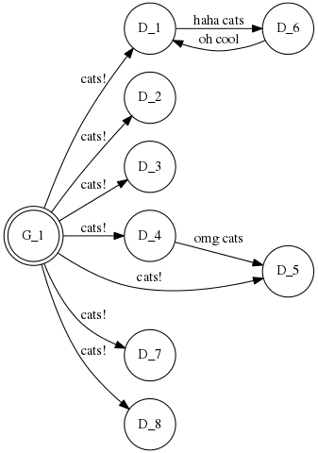
Twitter is a different beast
  Degree input != degree output
  Messages up to 144 characters, or a photo
  Context (#'s and @'s)
  Generators/producers, Distributors/consumers
  Used primarily by adults of age 18-29, African-Americans, people from urban centers
Twitter has been analyzed by
  Computer scientists
  People who write papers with two thousand citations on Google Scholar.

Slide 4

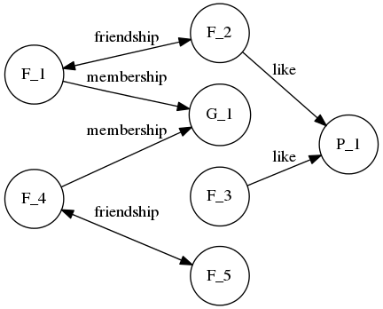
Facebook is also quite different
  Bidirectional and directed links
  Users, groups, pages, posts, messages, apps, events, photo albums, videos
  Similar context
  Used primarily by women, and adults ages 18-29
Facebook has also seen academic analysis

Slide 5

How do tumblr's structural/functional differences translate to usage and demographic patterns?
  tumblr users have unidirectional links, like twitter
    (but they're invisible to other users)
  tumblr facilitates preservation of context

Slide 6

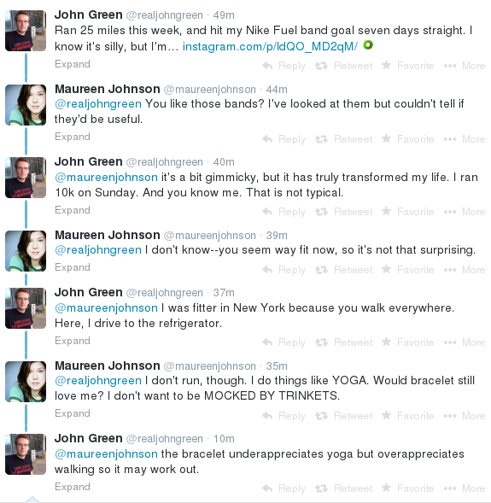
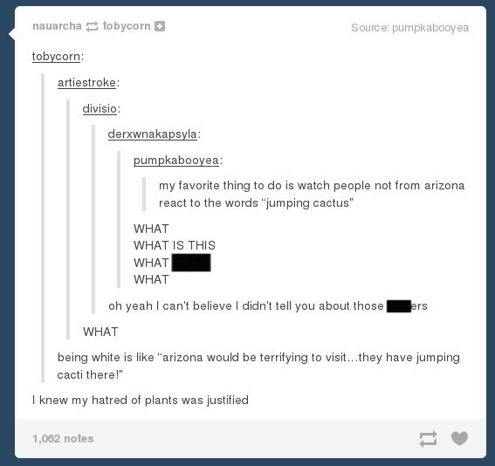
vs.

Slide 7


Users may have thousands of posts,
  Many may be reblogs, but we have conservation of notes
    This means we have ~ten notes or ~ten-million notes
  Each post may be associated with an arbitrary number of tags
    Many-to-many post/tag relationship makes tag processing computationally expensive
Users have no externally available unique identifier other than their username
  No namespace-oriented traversals

Slide 8

Let's use the Python library!
  Oh wait it's awful
  Doesn't handle Unicode
    (nearly every tumblr blog features copious amounts of Unicode)
Let's use the API!
  Oh wait it's awful
  Contains only a subset of useful data
  Responses to requests are not always compliant with supplied standards
  Returns JSON with improperly escaped Unicode
    Requires custom-built regexes to parse
  The tumblr API does not allow access to “user follows user” links
    We have to infer that on our own
  The tumblr API does not reliably differentiate between reblogs and original posts
  The tumblr API does not retain dates for “user likes post” records
  The tumblr API does selective parsing of corrupt requests

Slide 9
Okay, we'll just crawl the pages and parse the HTML.
  Beautiful Soup
    “You didn't write that awful page. You're just trying to get some data out of it.”
  Custom themes make for heterogeneous web layouts
Hybrid approach.
  Do depth-first web-parsing for some parts, API-access for other parts.

Slide 10

For some username:
  Store user data
  Look at all of their posts
    For each post:
      Store post data
      Look at all their notes
        For each note:
          Store note data
Repeat, with new usernames sourced from posts and notes.

Slide 11

We toss the previous algorithm into a process
  Offload the storage part to a database process
    One database per database worker
Load it all onto a long-term ACISS node
  We run roughly 500 crawlers and 200 database workers
    ~4gb of useful data per 24-hr period
We stitch together the databases
  Then operate a series of queries to acquire useful data

Slide 12

A user looks like this:
  (username, time since joined, post count)
A post looks like this:
  (source username, post ID, post type, date posted, note count)
A note looks like this:
  (username, reblogged from, post ID, type{like|reblog})
Of the 4gb from a 24hour period, we might expect
  100 users
  50,000 posts
  75,000,000 notes

Slide 13

Most of our data is in the notes
  The queries will be designed to take that into account
  So, what do we want?
Who follows whom?
Are following relationships often bidirectional?
What does the content distribution network look like?
How much original content / re-posted content?
What kind of posts are more popular?

Slide 14

Photos and quotes are by far the most popular type of post.
  Context + gifsets
Reblogs outnumber original posts
  Sometimes by a few, sometimes by an order of magnitude or more.
    Users usually fall into one of two camps: content generators, and content redistributors.
Following is a bit trickier
  With a large dataset, the queries themselves can take days
  Sanity-checking is difficult
  Results only somewhat promising.

Slide 15
Conclusion
I now believe I understand why I found no computer science papers on tumblr
Nevertheless, some promising results were had
User relationship queries require O(n^2) on number of notes
  Some of which are still running
  Impossible without ACISS

Slide 16
Future Work
Explore the tag-space
Isolate API corner cases
  spend more time reading small JSON responses and less time reading large HTML documents
  Reliable collection of reblog information
Restructure parser for complete user interactions
Reach out to Ethnic Studies, Women's Studies, and Media Studies departments

