Slide 1
Chapter 2
Simulation Examples
Banks, Carson, Nelson & Nicol
Discrete-Event System Simulation

Slide 2
Purpose
To present several examples of simulations that can be performed by devising a simulation table either manually or with a spreadsheet.
The simulation table provides a systematic method for tracking the system state over time.
To provide insight into the methodology of discrete-system simulation and the descriptive statistics used for predicting system performance.

Slide 3
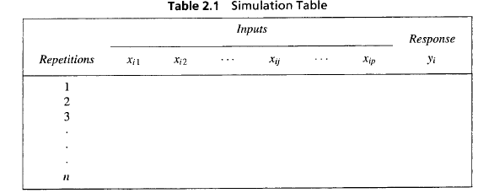
Outline
The simulations are carried out by following steps:
  Determine the input characteristics.
  Construct a simulation table.
  For each repetition i, generate a value for each input, evaluate the function, and calculate the value of the response y_{i}.
Simulation examples are in queueing, inventory, reliability and network analysis.

Slide 4
Simulation of Queueing Systems
A queueing system is described by its calling population, nature of arrivals, service mechanism, system capacity and the queueing discipline (details in Chapter 6.)
In a single-channel queue:
  The calling population is infinite.
  Arrivals for service occur one at a time in a random fashion, once they join the waiting line, they are eventually served.
Arrivals and services are defined by the distribution of the time between arrivals and service times.
Key concepts:
  The system state is the number of units in the system and the status of the server (busy or idle).
  An event is a set of circumstances that causes an instantaneous change in the system state, e.g., arrival and departure events.
  The simulation clock is used to track simulated time.

Slide 5
Simulation of Queueing Systems
Event list: to help determine what happens next.
  Tracks the future times at which different types of events occur. (this chapter simplifies the simulation by tracking each unit explicitly.)
  Events usually occur at random times.
The randomness needed to imitate real life is made possible through the use of random numbers, they can be generated using:
  Random digits tables: form random numbers by selecting the proper number of digits and placing a decimal point to the left of the value selected, e.g., Table A.1 in book.
  Simulation packages and spreadsheets.
  Details in chapter 7.

Slide 6
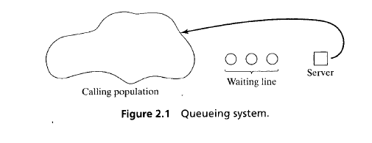
Simulation of Queueing Systems

Slide 7
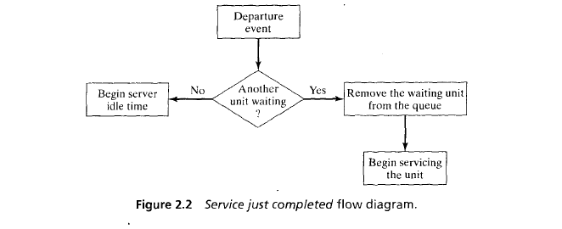
Simulation of Queueing Systems

Slide 8
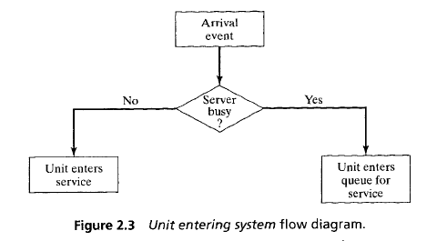
Simulation of Queueing Systems

Slide 9
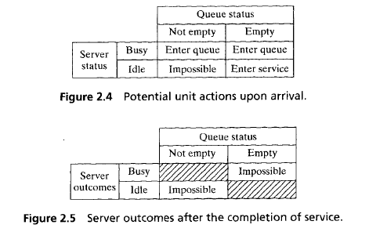
Simulation of Queueing Systems

Slide 10
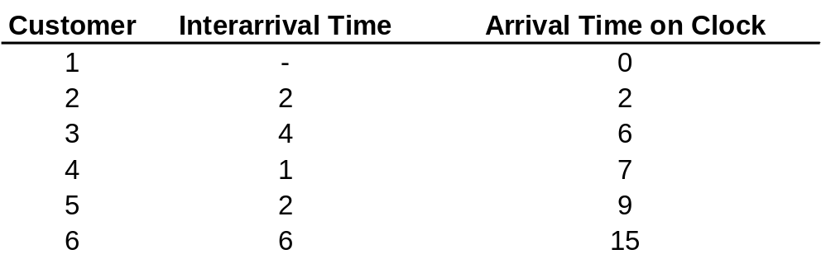
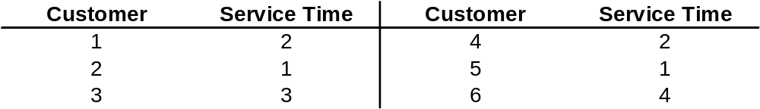
Simulation of Queueing Systems
Single-channel queue illustration:
  Assume that the times between arrivals were generated by rolling a die 5 times and recording the up face. Input generated:
    The 1st customer is assumed to arrive at clock time 0. 2nd customer arrives two time units later (at clock time 2), and so on.
  Assume the only possible service times are 1,2,3 and 4 time units and they are equally likely to occur. Input generated:

Slide 11
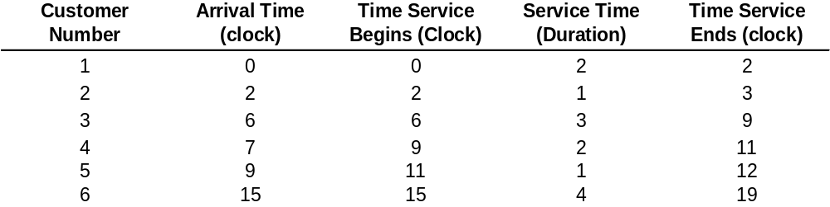
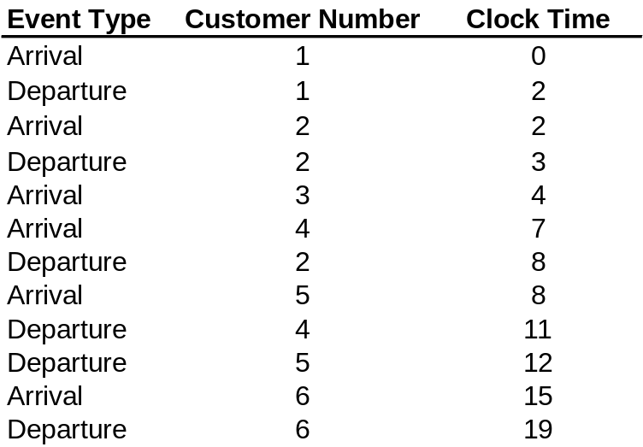
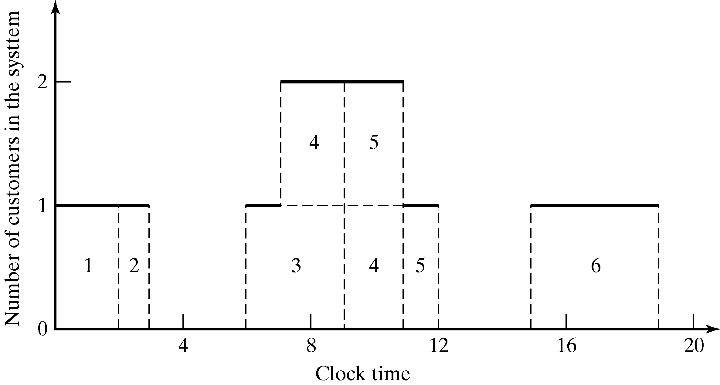
Simulation of Queueing Systems
  Resulting simulation table emphasizing clock times:
  Another presentation method, by chronological ordering of events:

Slide 12
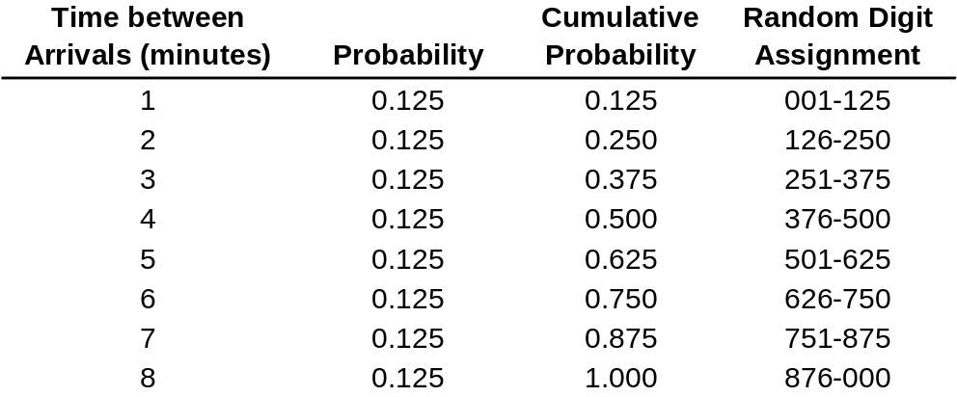
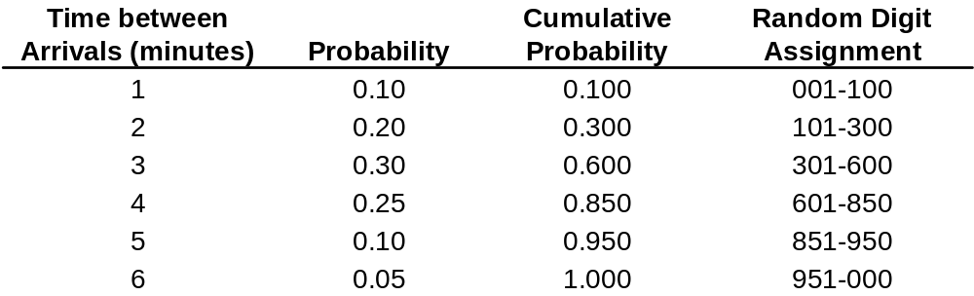
Simulation of Queueing Systems
Grocery store example: with only one checkout counter.
  Customers arrive at random times from 1 to 8 minutes apart, with equal probability of occurrence:
  The service times vary from 1 to 6 minutes, with probabilities:

Slide 13
Grocery Store Example
[Simulation of Queueing Systems]
To analyze the system by simulating arrival and service of 100 customers.
  Chosen for illustration purpose, in actuality, 100 customers is too small a sample size to draw any reliable conclusions.
  Initial conditions are overlooked to keep calculations simple.
A set of uniformly distributed random numbers is needed to generate the arrivals at the checkout counter:
  Should be uniformly distributed between 0 and 1.
  Successive random numbers are independent.
With tabular simulations, random digits can be converted to random numbers.
  List 99 random numbers to generate the times between arrivals.
  Good practice to start at a random position in the random digit table and proceed in a systematic direction (never re-use the same stream of digits in a given problem.

Slide 14
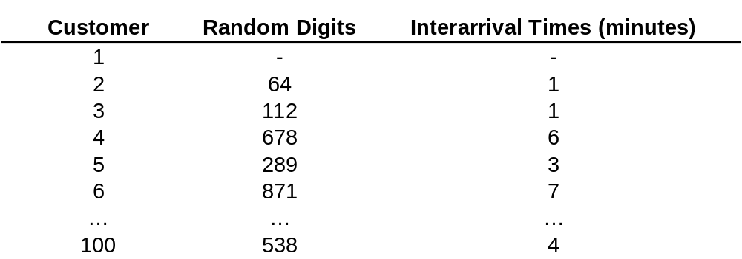
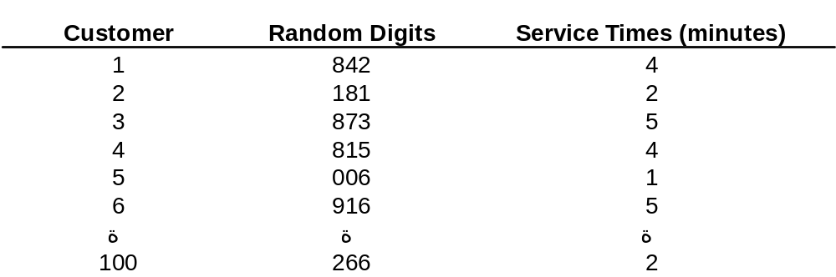
Grocery Store Example
[Simulation of Queueing Systems]
Generated time-between-arrivals:
Using the same methodology, service times are generated:

Slide 15
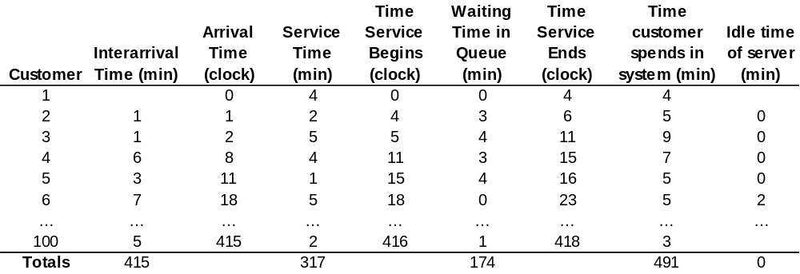
Grocery Store Example
[Simulation of Queueing Systems]
2nd customer was in the system for 5 minutes.
For manual simulation, Simulation tables are designed for the problem at hand, with columns added to answer questions posed:
Service ends at time 16, but the 6th customer did not arrival until time 18. Hence, server was idle for 2 minutes
Service could not begin until time 4 (server was busy until that time)

Slide 16
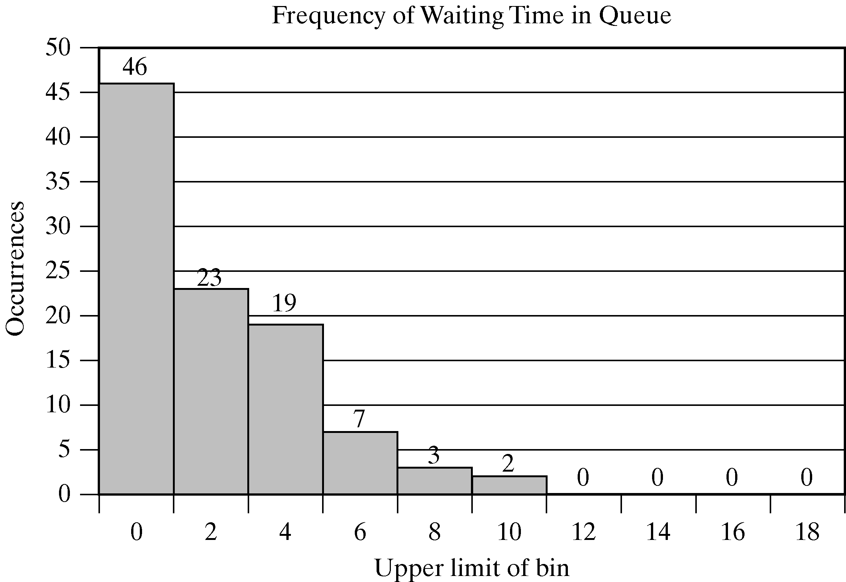
Grocery Store Example
[Simulation of Queueing Systems]
Tentative inferences:
  About half of the customers have to wait, however, the average waiting time is not excessive.
  The server does not have an undue amount of idle time.
Longer simulation would increase the accuracy of findings.
Note: The entire table can be generated using the Excel spreadsheet for Example 2.1 at www.bcnn.net

Slide 17
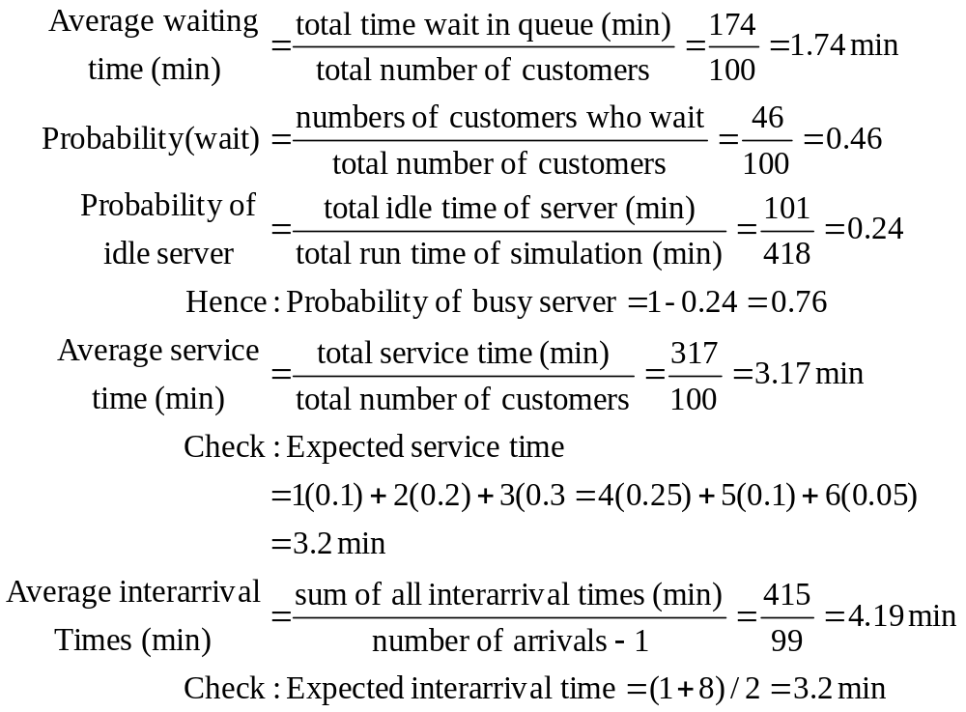
Grocery Store Example
[Simulation of Queueing Systems]
Key findings from the simulation table:

Slide 18
Able-Baker Call Center Example
[Simulation of Queueing Systems]
A computer technical support center with two personnel taking calls and provide service.
  Two support staff: Able and Baker (multiple support channel).
  A simplifying rule: Able gets the call if both staff are idle.
  Goal: to find how well the current arrangement works.
  Random variable:
    Arrival time between calls
    Service times (different distributions for Able and Baker).
  A simulation of the first 100 callers are made
    More callers would yield more reliable results, 100 is chosen for purposes of illustration.

Slide 19
(1/6)Example 2: Abel-Baker Call Center
Interarrival distribution of calls for technical support
Times between arrivals | Probability | Cumulative Probability | Random Number Assignment
1 2 3 4 | 0.25 0.40 0.20 0.15 | 0. 25 0.65 0.85 1.00 | 0.000-0. 250 0.251-0.650 0.651-0.850 0.851-1.000

Slide 20
(2/6)Example 2: Abel-Baker Call Center
Service times Distribution of Abel
Service Times | Probability | Cumulative Probability | Random Number Assignment
2 3 4 5 | 0.30 0.28 0.25 0.17 | 0.3 0.58 0.83 1.00 | 0.000-0.300 0.301-0.580 0.581-0.830 0.831-1.000

Slide 21
(3/6)Example 2: Abel-Baker Call Center
  Service Time Distribution of Baker
Service Times | Probability | Cumulative Probability | Random Number Assignment
3 4 5 6 | 0.35 0.25 0.20 0.20 | 0.35 0.60 0.80 1.00 | 0.000-0.350 0.351-0.600 0.601-0.800 0.801-1.000

Slide 22
(4/6)Example 2: Abel-Baker Call Center
Simulation Table
 |  |  |  |  | Abel |  |  | Baker
Customer Number | arrival Random Number | Time Between Arrivals | Clock time of arrivals | Services Random Number | Service time start | Service time | Service time ends | Service time start | S. T. | S. T. Ends | Time in Queue
1 2 3 4 5 6 7 8 9 10 11 12 13 14 15 | 0.99284 0.46349 0.65493 0.00801 0.01753 0.02711 0.29430 0.70327 0.30517 0.02915 0.29487 0.84654 0.99127 0.68425 0.64327 | 4 2 3 1 1 1 2 3 2 1 2 3 4 3 2 | 4 6 9 10 11 12 14 17 19 20 22 25 29 32 34 | 0.39824 0.48585 0.01847 0.37545 0.38022 0.07169 0.79473 0.04861 0.74483 0.08278 0.91326 0.62540 0.98713 0.64157 0.41684 | 4 - 9 - 11 14 - 17 19 - 23 - 29 - 34 | 3 - 2 - 3 2 - 2 4 - 5 - 5 - 3 | 7 - 11 - 14 16 - 19 23 - 28 - 34 - 37 | - 6 - 10 - - 14 - - 20 - 25 - 32 - | - 4 - 4 - - 5 - - 3 - 5 - 5 - | - 10 - 14 - - 19 - - 23 - 30 - 37 - | 0 0 0 0 0 2 0 0 0 0 1 0 0 0 0

Slide 23
(5/6)Example 2: Abel-Baker Call Center
 |  |  |  |  | Abel |  |  | Baker
Customer Number | arrival Random Number | Time Between Arrivals | Clock time of arrivals | Services Random Number | Service time start | Service time | Service time ends | Service time start | S. T. | S. T. Ends | Time in Queue
16 17 18 19 20 21 22 23 24 25 26 27 28 29 30 | 0.36920 022224 0.43799 0.11914 0.66299 0.28891 0.90375 0.94859 0.37528 0.27395 0.66487 0.12508 0.80400 0.43157 0.78568 | 2 1 2 1 3 2 4 4 2 2 3 1 3 2 3 | 36 37 39 40 43 45 49 53 55 57 60 61 64 66 69 | 0.91637 0.71243 0.77096 0.06115 0.93464 0.92325 0.35555 0.68290 0.37974 0.27307 0.35881 0.83147 0.73653 0.75574 0.38987 | 37 - 42 - - 46 51 - 55 58 60 - 64 - 69 | 5 - 4 - - 5 3 - 3 2 3 - 4 - 3 | 42 - 46 - - 51 54 - 58 60 63 - 68 - 72 | - 37 - 42 45 - - 53 - - - 61 - 67 - | - 5 - 3 6 - - 5 - - - 6 - 5 - | - 42 - 45 51 - - 58 - - - 67 - 72 - | 1 0 3 2 2 1 2 0 0 1 0 0 0 1 0
Total |  | 69 |  |  |  | 61 |  |  | 56 |  | 16

Slide 24
(6/6)Example 2: Abel-Baker Call Center
Key findings from the simulation table:
  Abel utilization= (Abel Service Time /Simulation Time)=(61/72)=0.847 %
  Baker utilization=(Baker Service Time / Simulation Time)=(56/72)=0.777%
  Number of customer serviced by Abel=18 from (30 customers) i.e., 60%
  Number of customer serviced by Baker=12 from (30 customers) i.e., 40%
  Abel average service time=(Number of customer serviced by Abel)/Abel service time =61/18=3.39 min
  Baker average service time=(Number of customer serviced by Baker)/Baker service time =56/12=4.46 min
  Average waiting time for all= (waiting time/number of customer)=(16/30)=0.53min
  Average waiting time for customers who wait= (Waiting time/ number of customer who wait)= 16/10=1.6 min
  Average interarrival times=(Sum of all interarrival times)/number of customers -1= 69/29=2.379 min
  Average system service time= (Sum of all service times/number of customers)=72/30=2.4 min

Slide 25
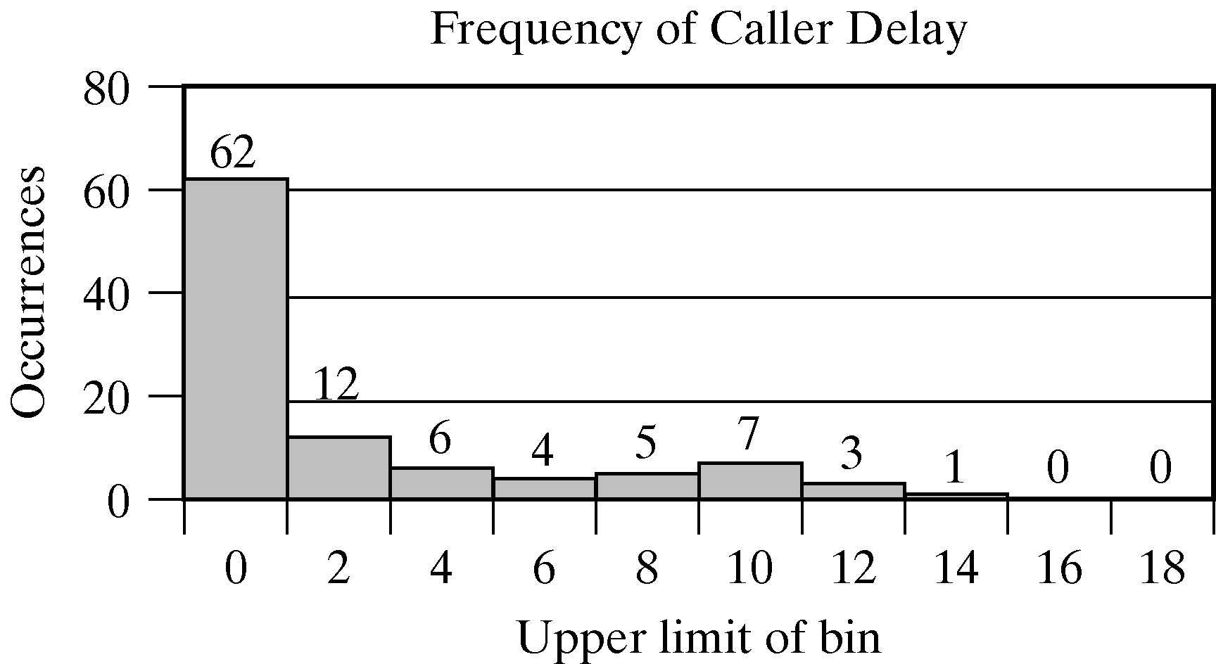
Able-Baker Call Center Example
[Simulation of Queueing Systems]
The steps of simulation are implemented in a spreadsheet available on the website (www.bcnn.net).
  In the first spreadsheet, we found the result from the trial:
    62% of the callers had no delay
    12% had a delay of one or two minutes.

Slide 26
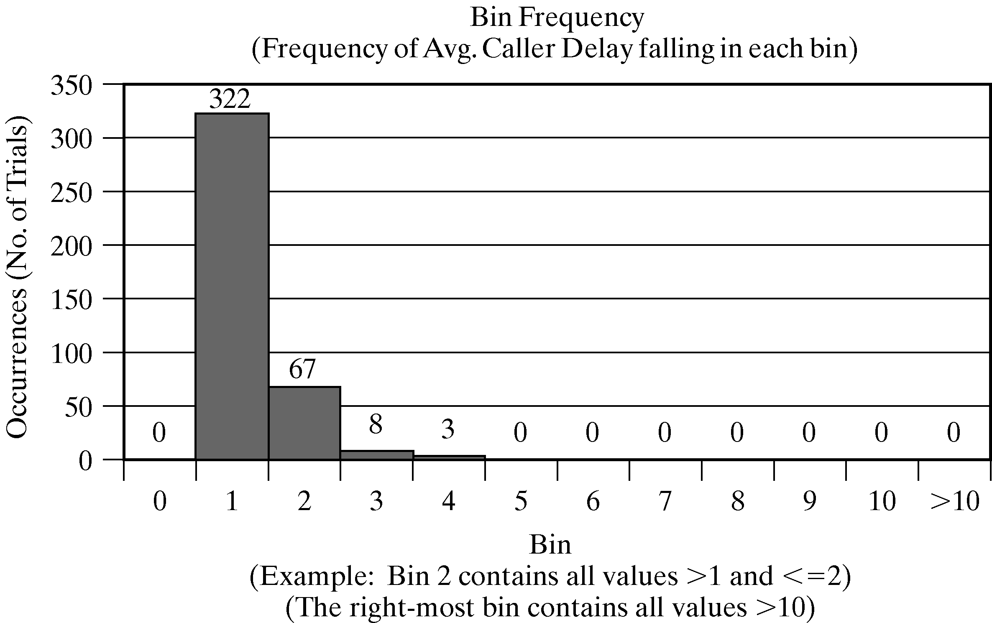
Able-Baker Call Center Example
[Simulation of Queueing Systems]
  In the second spreadsheet, we run an experiment with 400 trials (each consisting of the simulation of 100 callers) and found the following:
    19% of the average delays are longer than two minutes.
    Only 2.75% are longer than 3 minutes.

Slide 27
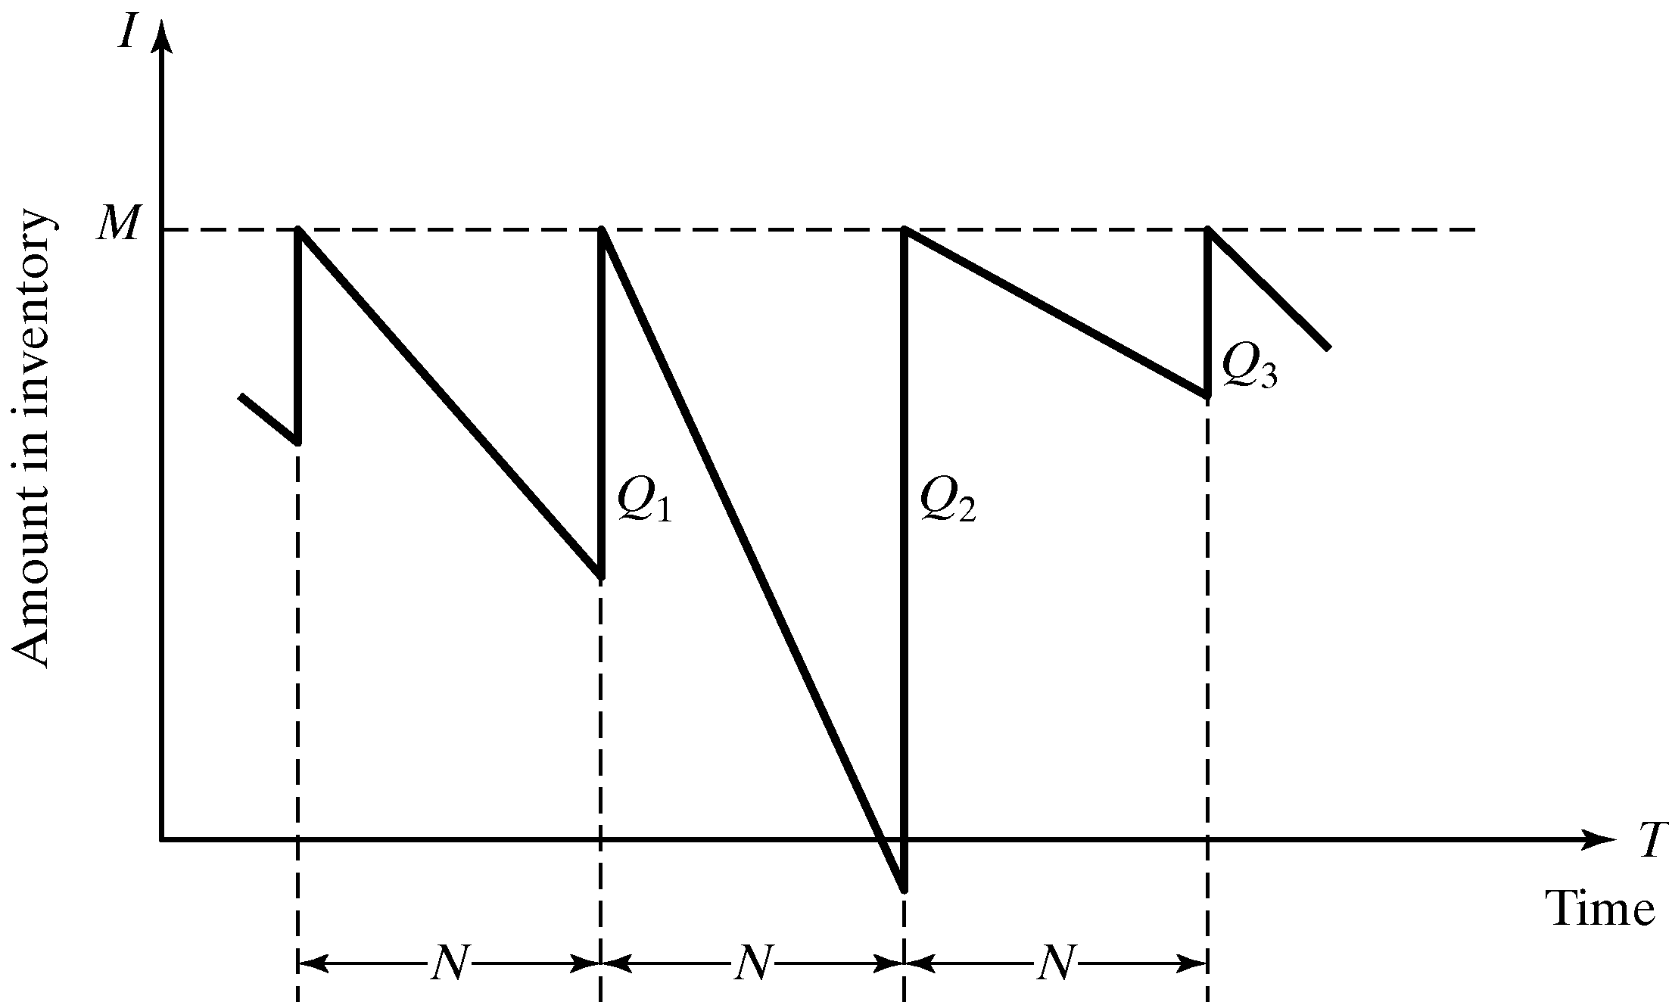
Simulation of Inventory Systems
A simple inventory system, an (M, N) inventory system:
  Periodic review of length, N, at which time the inventory level is checked.
  An order is made to bring the inventory up to the level M.
  At the end of the i^{th} review period, an order quantity, Q_{i}, is placed.
  Demand is shown to be uniform over time. However, in general, demands are not usually known with certainty.

Slide 28
Simulation of Inventory Systems
A simple inventory system (cont.):
  Total cost (or profit) of an inventory system is the performance measure.
    Carrying stock in inventory has associated cost.
    Purchase/replenishment has order cost.
    Not fulfilling order has shortage cost.

Slide 29
Simulation of Inventory Systems
The News Dealer’s Example: A classical inventory problem concerns the purchase and sale of newspapers.
  News stand buys papers for 33 cents each and sells them for 50 cents each.
  Newspaper not sold at the end of the day are sold as scrap for 5 cents each.
  Newspaper can be purchased in bundles of 10 (can only buy 10, 20,… 50, 60…)
  Random Variables:
    Types of newsdays.
    Demand.
  Profits = (revenue from sales) – (cost of newspaper)
  – (lost profit form excess demand)
  + (salvage from sale of scrap papers)

Slide 30
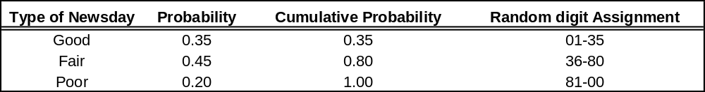
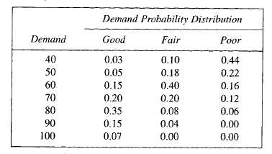
News Dealer’s Example
[Simulation of Inventory Systems]
Three types of newsdays: “good”; “fair”; “poor”; with probabilities of 0.35, 0.45 and 0.20, respectively.
Distribution of newspaper demand

Slide 31
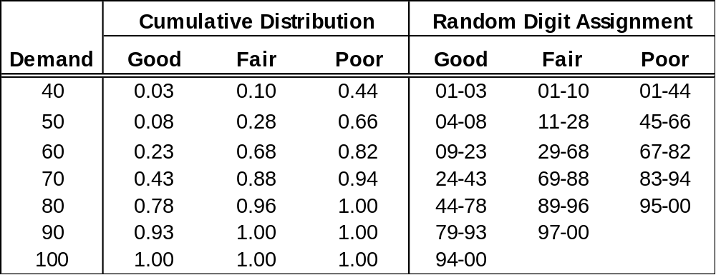
News Dealer’s Example
[Simulation of Inventory Systems]
Demand and the random digit assignment is as follow:

Slide 32
News Dealer’s Example
[Simulation of Inventory Systems]
Simulate the demands for papers over 20-day time period to determine the total profit under a certain policy, e.g. purchase 70 newspaper
The policy is changed to other values and the simulation is repeated until the best value is found.

Slide 33
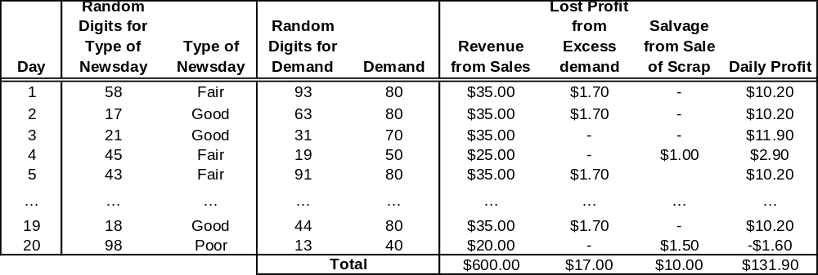
News Dealer’s Example
[Simulation of Inventory Systems]
From the manual solution
  The simulation table for the decision to purchase 70 newspapers is for 20 days:

Slide 34
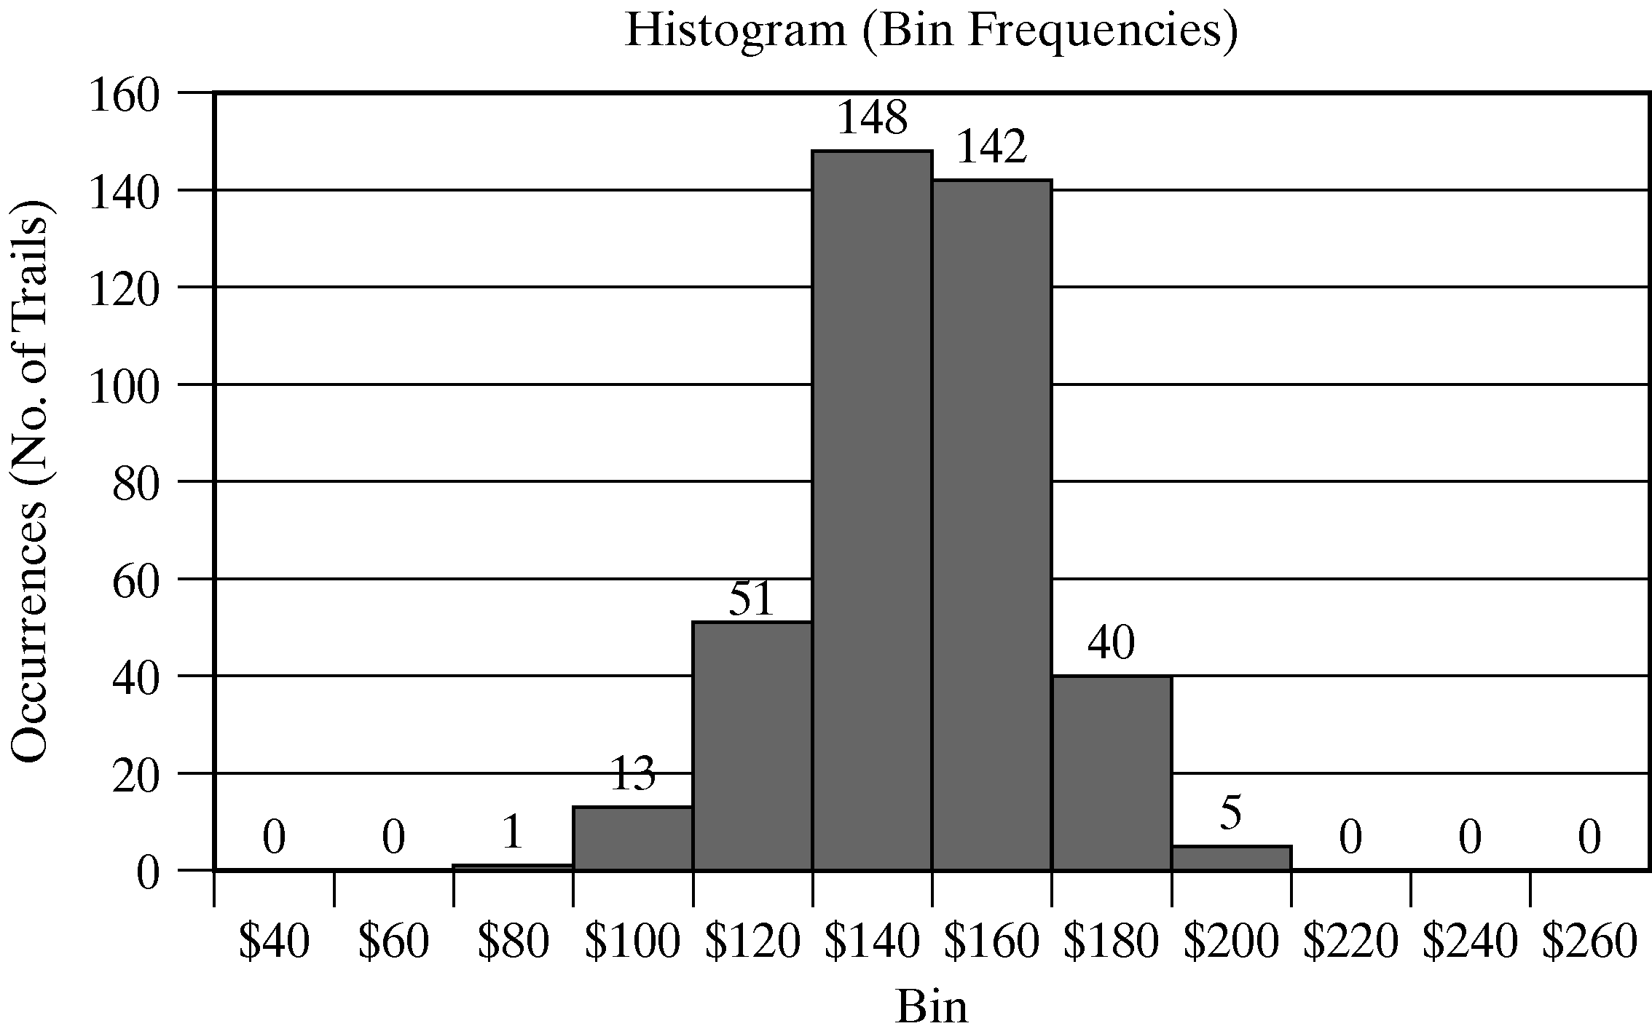
News Dealer’s Example
[Simulation of Inventory Systems]
From Excel: running the simulation for 400 trials (each for 20 days)
  Average total profit = $137.61.
  Only 45 of the 400 results in a total profit of more than $160.

Slide 35
News Dealer’s Example
[Simulation of Inventory Systems]
The manual solution had a profit of $131.00, not far from the average over 400 days, $137.61.
But the result for a one-day simulation could have been the minimum value or the maximum value.
Hence, it is useful to conduct many trials.
On the “One Trial” sheet in Excel spreadsheet of Example 2.3.
  Observe the results by clicking the button ‘Generate New Trail.’
  Notice that the results vary quite a bit in the profit frequency graph and in the total profit.

Slide 36
Order-Up-To Level Inventory Example
[Simulation of Inventory Systems]
A company sells refrigerators with an inventory system that:
  Review the inventory situation after a fixed number of days (say N) and order up to a level (say M).
  Order quantity = (Order-up-to level) - (Ending inventory)
  + (Shortage quantity)
  Random variables:
    Number of refrigerators ordered each day.
    Lead time: the number of days after the order is placed with the supplier before its arrival.
  See Excel solution for Example 2.4 for details.

Slide 37
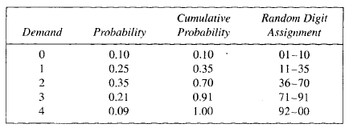
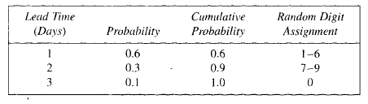
Order-Up-To Level Inventory Example
[Simulation of Inventory Systems]
Set M (order up to level) =11 items
Set the review period n= 5 days
Random digit assignments for lead time
Random digit assignments for daily demand

Slide 38
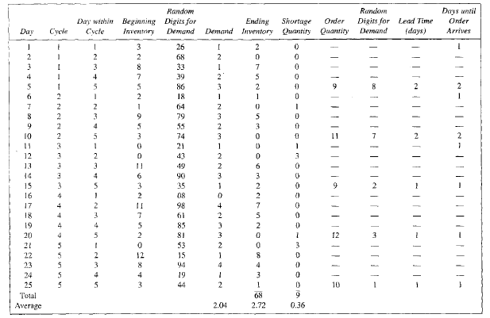
Order-Up-To Level Inventory Example
[Simulation of Inventory Systems]
Simulation table for (M=11, N=5) inventory System

Slide 39
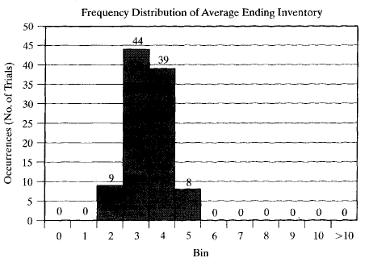
Order-Up-To Level Inventory Example
[Simulation of Inventory Systems]
Frequency distribution of average ending inventory for 100 trials (each 25 days)

Slide 40

Order-Up-To Level Inventory Example
[Simulation of Inventory Systems]

Slide 41
Other Examples of Simulation
Reliability problem:
  A machine with different failure types of which repairman is called to install or repair the part.
  Possible random variables: time to failure, time to service.
  Possible decision variables: decide strategy of repair verses replace, number of repairman to hire.
Random normal numbers:
  e.g. a bomber problem – where the point of impact is normally distributed around the aim point.
  Possible decision variables: number of bombs to drop for a certain level of damage.

Slide 42
Other Examples of Simulation
Lead-time demand:
  Lead time is the random variable: the time from placement of an order until the order is received.
  Other possible random variable: demand.
  Possible decision variables: how much and how often to order.
Project simulation:
  A project can be represented as a network of activities: some activities must be carried out sequentially, others can be done in parallel.
  Possible random variables: times to complete the activities.
  Possible decision variables: sequencing of activities, number of workers to hire.

Slide 43
Summary
Introduced simulation concepts by means of examples, illustrated general areas of application, and motivated the remaining chapters.
Ad-hoc simulation tables were used:
  Events in tables were generated by using uniformly distributed random numbers, and resulting responses were analyzed.
  Ac-hoc simulation table may fail due to system complexities. More systematic methodology, e.g., event scheduling approach, is described in Chapter 3.
Key takeaways:
  A simulation is a statistical experiment and results have variation.
  As the number of replications increases, there is an increased opportunity for greater variation.

