Slide 1
Chapter 4
Simulation Software
Banks, Carson, Nelson & Nicol
Discrete-Event System Simulation

Slide 2
Outline and Purpose
Discuss the history of simulation software.
Discuss features and attributes of simulation software, organized into three categories:
  General-purpose programming languages, e.g., C, C++, and Java.
  Simulation programming language, e.g., GPSS/HTM, SIMAN V® and SLAM II®.
  Simulation environment
    Such as graphical interface and an environment that supports all (or most) aspects of a simulation study.

Slide 3
History of Simulation Software
1995 - 60 The Period of Search
  Search for unifying concepts and the development of reusable routines to facilitate simulation.
  Mostly conducted in FORTRAN
1961 - 75 The Advent
  Appearance of the forerunners of simulation programming languages (SPLs.)
  The first process interaction SPL, GPSS was developed at IBM
1966 - 70 The Formative Period
  Concepts were reviewed and refined to promote a more consistent representation of each language’s worldview
Sources: Nance (1995) and panel discussion at the 1992 Winter Simulation conference (Wilson, 1992).

Slide 4
History of Simulation Software
1971 - 78 The Expansion Period
  Major advances in GPSS came from outside IBM
  GPSS/NORDEN, a pioneering effort that offered an interactive, visual online environment (in Norden Systems.)
  GASP added support for the activity-scanning worldview and event-scheduling worldview (at Purdue.)
1979 - 86 The Period of Consolidation and Regeneration
  Beginnings of PSLs written for, or adapted to, desktop computers and microcomputers.
  Two major descendants of GASP appeared: SLAM II and SIMAN (provide multiple modeling perspectives and combined modeling capabilities).
1987 – Now The Period of Integrated Environments
  Growth of SPLs on the personal computer and the emergence of simulation environments with graphical user interfaces, animation and other visualization tools.
  Recent advancements have been made in web-based simulation.
Sources: Nance (1995) and panel discussion at the 1992 Winter Simulation conference (Wilson, 1992).

Slide 5
Selection of Simulation Software
Advice when evaluating and selecting simulation software:
  Consider the accuracy and level of detail obtainable, ease of learning, vendor support, and applicability to your applications.
  Execution speed is important.
  Beware of advertising claims and demonstrations.
  Ask the vendor to solve a small version of your problem.

Slide 6
Selection of Simulation Software
Advice when evaluating and selecting simulation software:
  Beware of “checklists” with “yes” and “no” as the entries, e.g. many packages claim to have a conveyor entity, however, implementations have considerable variation and level of fidelity ( accuracy).
  Determine whether the simulation package and language are sufficiently powerful to avoid having to write logic in any external language.
  Beware of “no programming required,” unless either the package is a near-perfect fit to your problem domain, or programming is possible with the supplied blocks, nodes, or process-flow diagram.

Slide 7
An Example Simulation
The checkout counter: a typical single-server queue
  The simulation will run until 1000 customers have been served.
  Interarrival times of customers ~ Exp(4.5 min).
  Service times are (approx.) ~ Normal(3.2 min, 0.6 min).
  When the cashier is busy, a queue forms with no customers turned away.
  Manual simulation in Examples 3.3 and 3.4.
  Two events: the arrival and departure events (logic illustrated in Figures 3.5 and 3.6.)
This example is used to illustrate simulations in Java, GPSS/H and SSF in the following slides.

Slide 8
Simulation in Java
Java is widely used programming language that has been used extensively in simulation.
It does not provide any facilities directly aimed at aiding the simulation analyst.
The runtime library provides a random-number generator.
It supports modular construction of large models.
Simulation libraries such as SSG alleviate the development burden.
  Provides access to standardized simulation functionality and hide low-level scheduling minutiae (details).

Slide 9
Simulation in Java
Discrete-event simulation model written in Java contains the following :
  Basic components:
    1. System state 2. Entities and attributes
    3. Sets 3. Events
    5. Activities 6. Delays
  Common components (when organizing model in a modular fashion by using methods):
    Clock : A variable defining simulated time
    Initialization method: A method to define the system state at time 0
    Min-time event method: A method that identifies the iimmnent event, that is, the element of the future event list (FutureEventList) that has the smallest time-stamp
    Event methods: For each event type, a method to update system state (and cumulative statistics) when that event occurs
    Random-variate generators: Methods to generate samples from desired probability distributions
    Main program: To maintain overall control of the event-scheduling algorithm
    Report generator: A method that computes summary statistics from cumulative statistics and prints report at the end of the simulation:

Slide 10
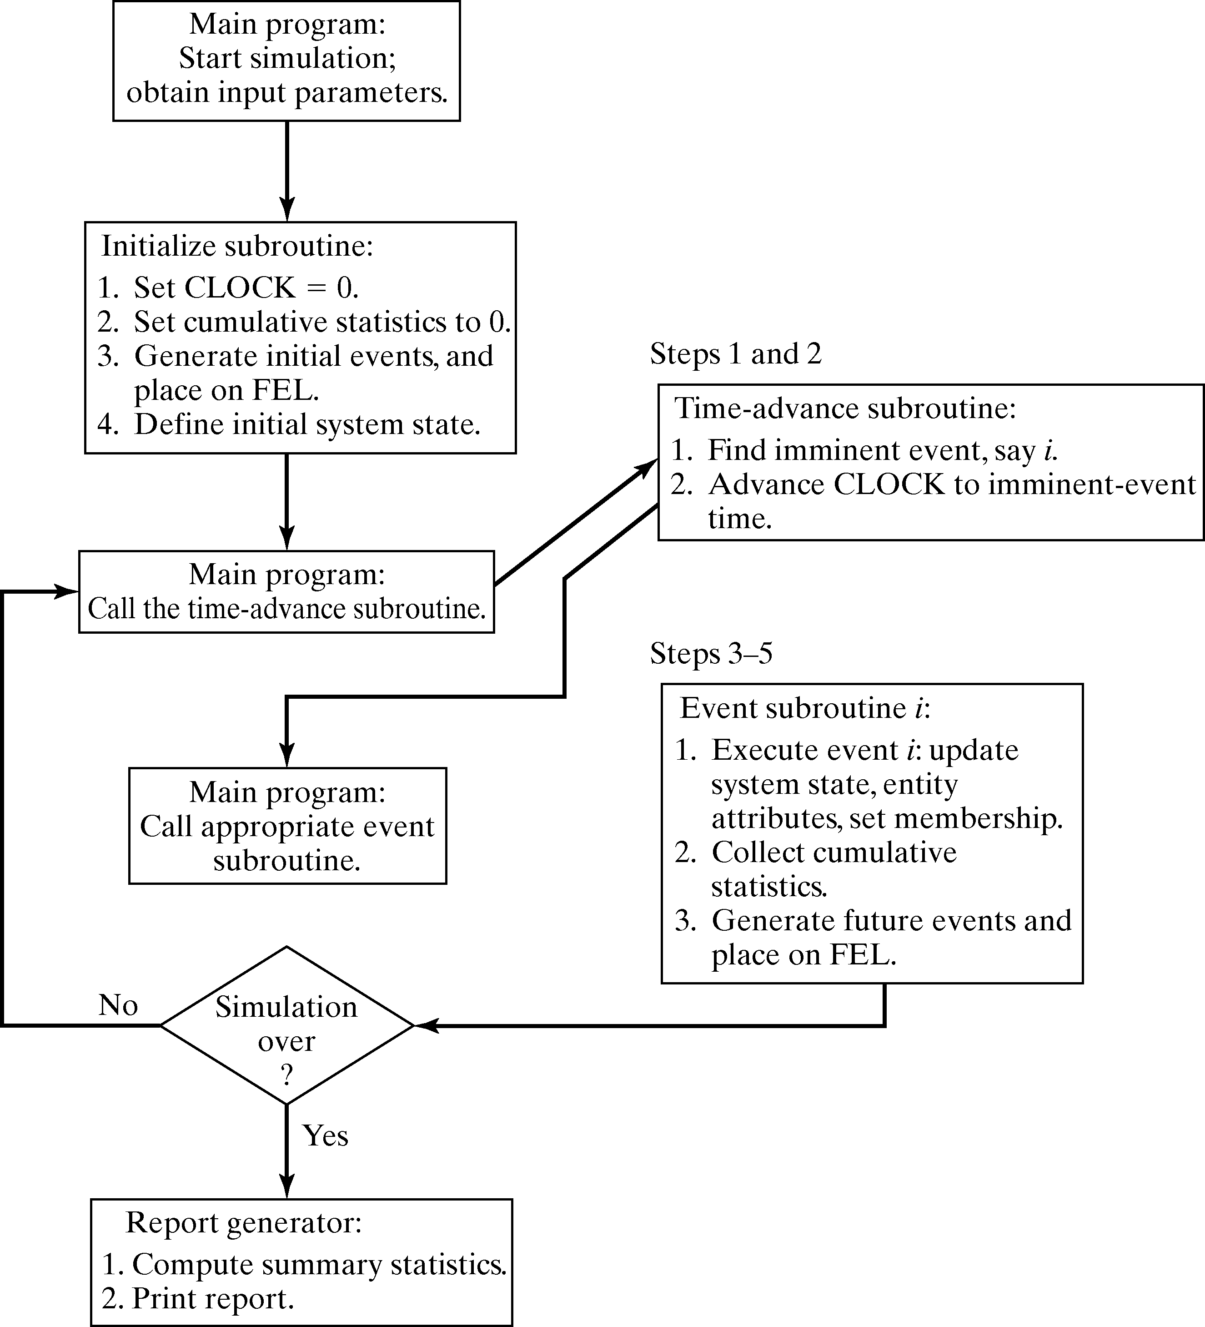

Slide 11
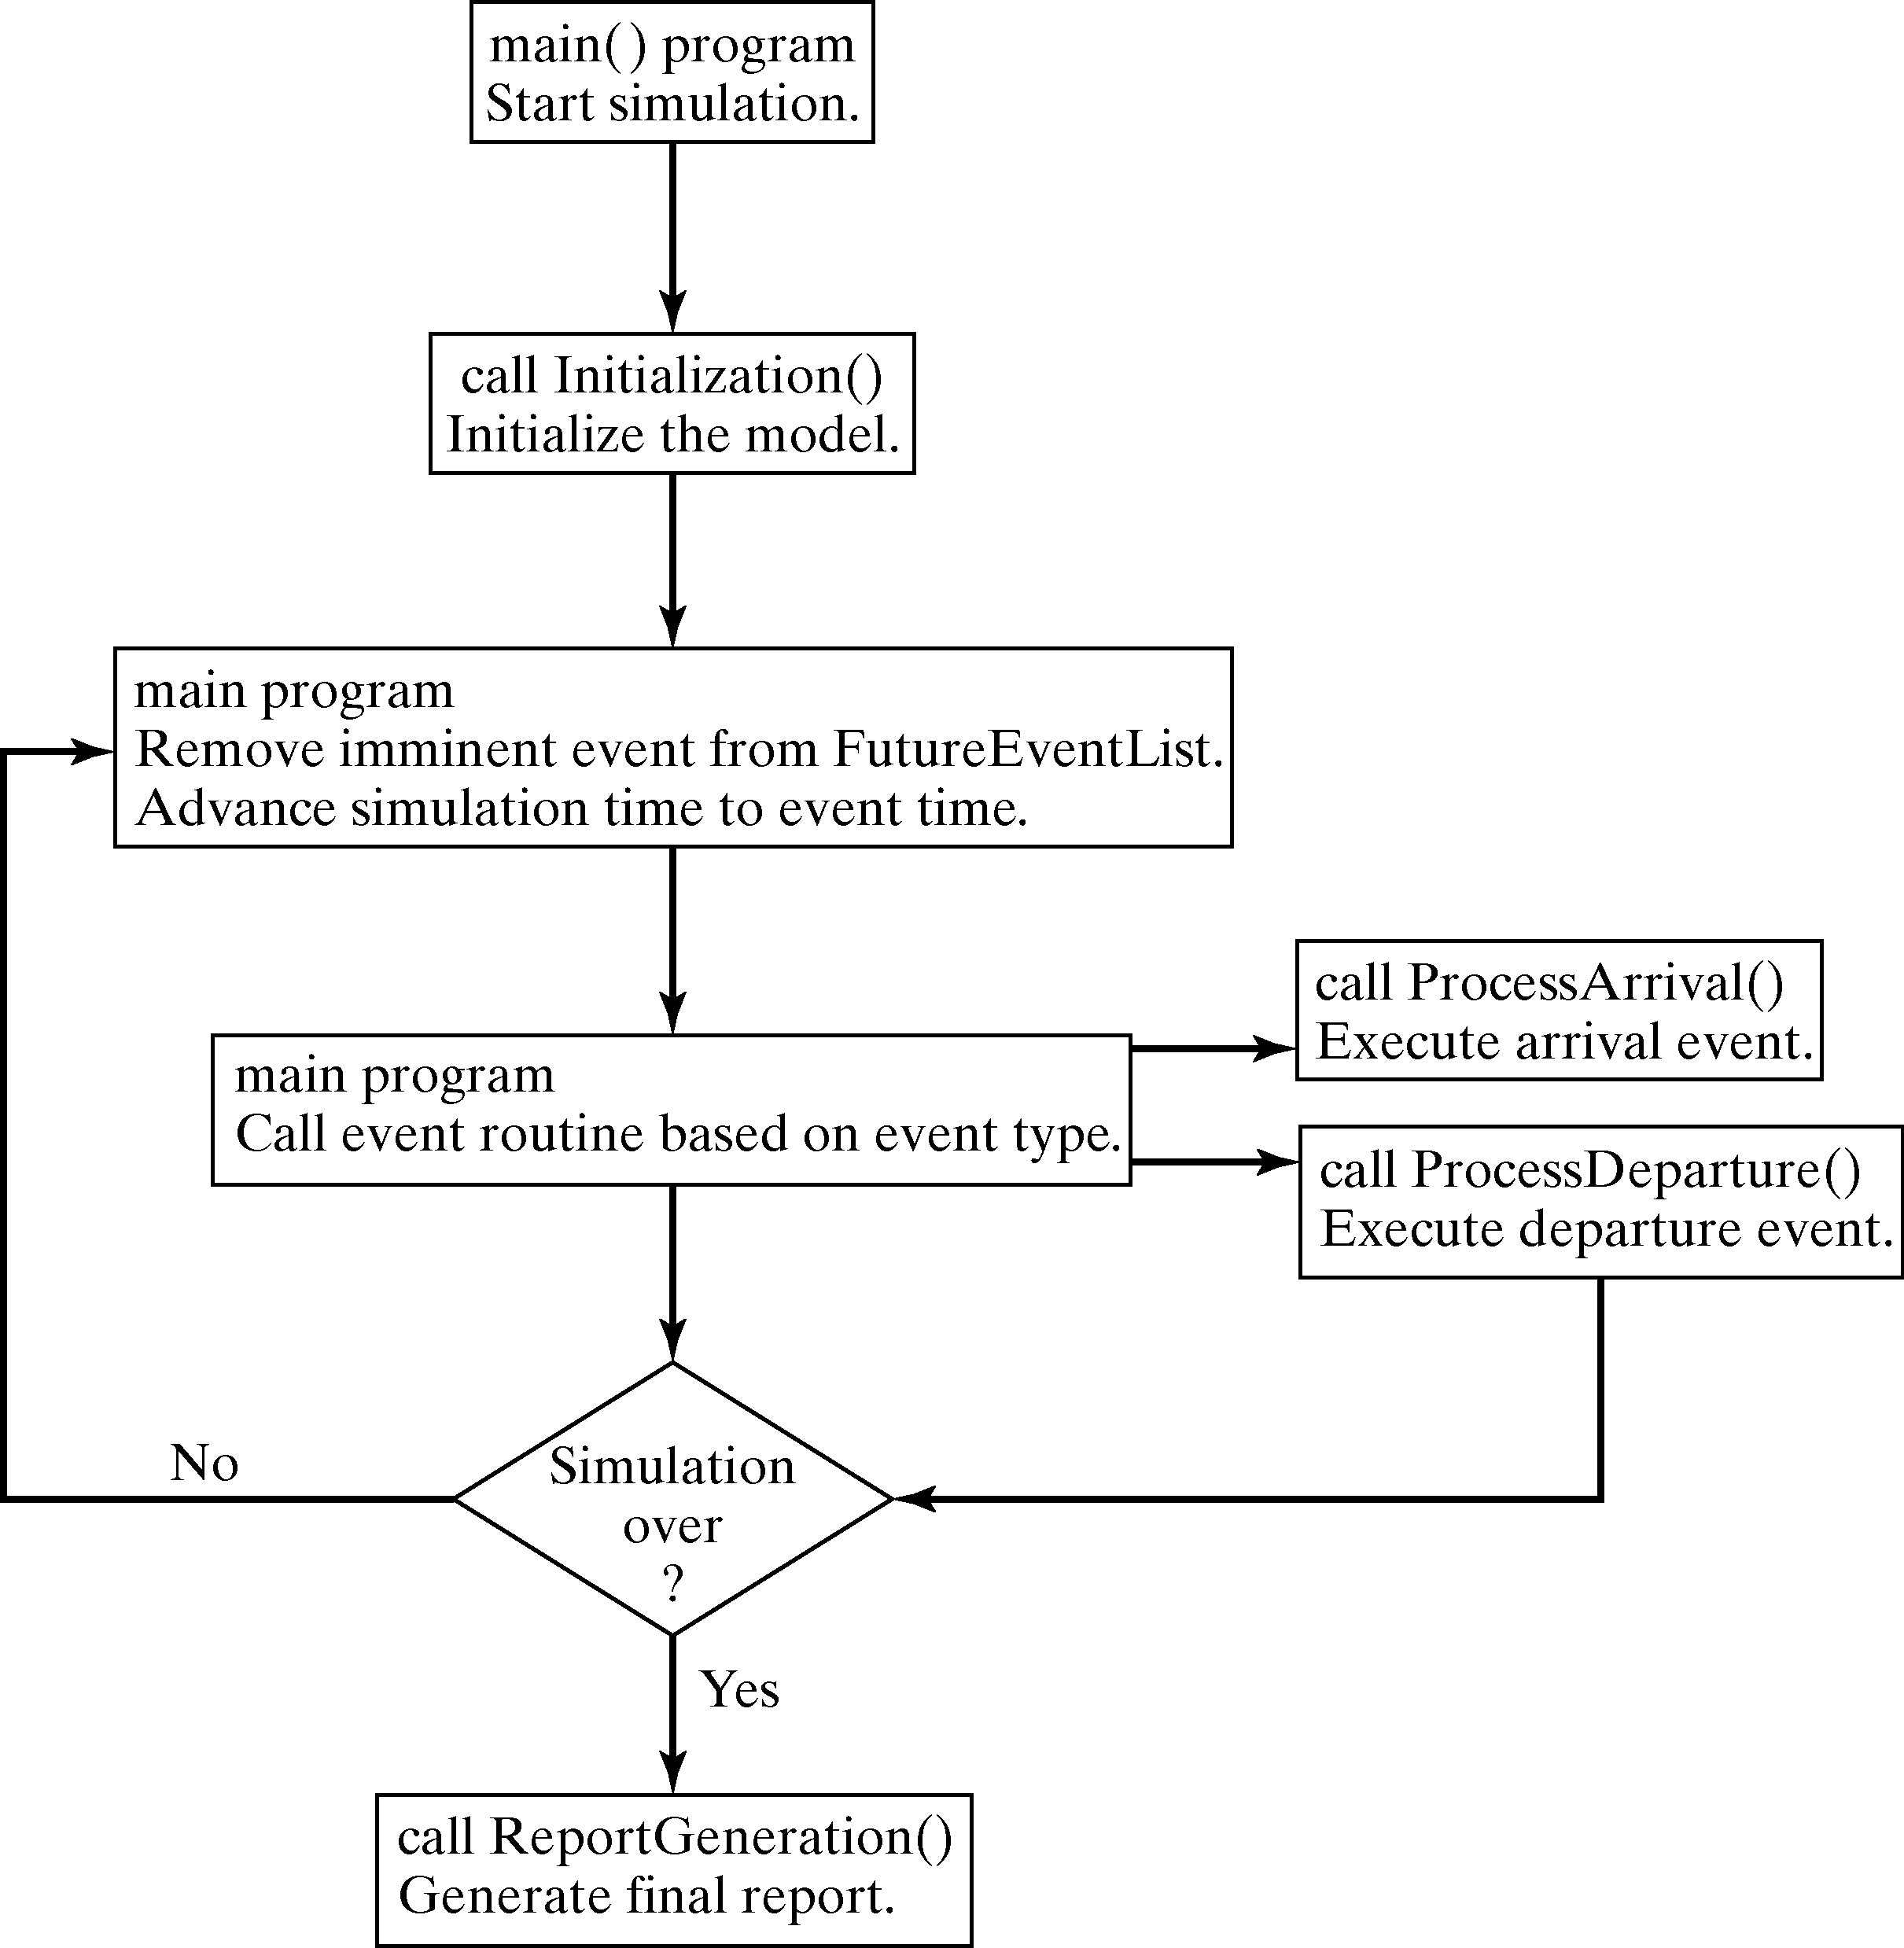
Single-Server Queue Example [Simulation in Java]
The overall structure of Java simulation structure of the grocery checkout counter example:

Slide 12
Single-Server Queue Example [Simulation in Java]
The main program:

Slide 13
Single-Server Queue Example [Simulation in Java]
Structure of the main program:
class Sim {
// Class Sim variables
public static double Clock, MeanInterArrivalTime, MeanServiceTime,
SIGMA, LastEventTime, TotalBusy, MaxQueueLength, SumResponseTime;
public static long NumberOfCustomers, QueueLength, NumberInService,
TotalCustomers, NumberOfDepartures, LongService;
public final static int arrival = 1;
public final static int departure = 2;
public static EventList FutureEventList;
public static Queue Customers;
public static Random stream;
… continued on next slide …

Slide 14
Single-Server Queue Example [Simulation in Java]
Structure of the main program (continued):
… continued from last slide …
public static void main(String argv[]) {
MeanInterArrivalTime = 4.5; MeanServiceTime = 3.2;
SIGMA = 0.6; TotalCustomers = 1000;
long seed = Long.parseLong(argv[0]);
stream = new Random(seed); // initialize rng stream
FutureEventList = new EventList();
Customers = new Queue();
Initialization();
// Loop until first "TotalCustomers" have departed
while(NumberOfDepartures < TotalCustomers ) {
Event evt = (Event)FutureEventList.getMin(); // get imminent event
FutureEventList.dequeue(); // be rid of it
Clock = evt.get_time(); // advance in time
if( evt.get_type() == arrival ) ProcessArrival(evt);
else ProcessDeparture(evt);
}
ReportGeneration();
}

Slide 15
Single-Server Queue Example [Simulation in Java]
The initialization method:

Slide 16
Single-Server Queue Example [Simulation in Java]
Structure of the initialization method:
public static void Initialization() {
Clock = 0.0;
QueueLength = 0;
NumberInService = 0;
LastEventTime = 0.0;
TotalBusy = 0 ;
MaxQueueLength = 0;
SumResponseTime = 0;
NumberOfDepartures = 0;
LongService = 0;
// create first arrival event
Event evt =
new Event(arrival, exponential( stream, MeanInterArrivalTime));
FutureEventList.enqueue( evt );
}

Slide 17
Single-Server Queue Example [Simulation in Java]
The arrival event method:

Slide 18
Single-Server Queue Example [Simulation in Java]
Structure of the arrival event method:
  Update server status
  Collect statistics
  Schedule next arrival
public static void ProcessArrival(Event evt) {
Customers.enqueue(evt);
QueueLength++;
// if the server is idle, fetch the event, do statistics
// and put into service
if( NumberInService == 0) ScheduleDeparture();
else TotalBusy += (Clock - LastEventTime); // server is busy
// adjust max queue length statistics
if (MaxQueueLength < QueueLength) MaxQueueLength = QueueLength;
// schedule the next arrival
Event next_arrival =
new Event(arrival, Clock+exponential(stream,MeanInterArrivalTime));
FutureEventList.enqueue( next_arrival );
LastEventTime = Clock;
}

Slide 19
Single-Server Queue Example [Simulation in Java]
The departure event method:

Slide 20
Single-Server Queue Example [Simulation in Java]
Structure of the departure event method:
  Obtain the job at the head of the queue
public static void ScheduleDeparture() {
double ServiceTime;
// get the job at the head of the queue
while (( ServiceTime = normal(stream,MeanServiceTime, SIGMA)) < 0 );
Event depart = new Event(departure,Clock+ServiceTime);
FutureEventList.enqueue( depart );
NumberInService = 1;
QueueLength--;
}
… continued on next slide …

Slide 21
Single-Server Queue Example [Simulation in Java]
Structure of the departure event method (continued):
  Get the description of finishing customer
  Schedule departure of the next customer if queue is not emptied
  Collect statistics
… continued from last slide …
public static void ProcessDeparture(Event e) {
// get the customer description
Event finished = (Event) Customers.dequeue();
// if there are customers in the queue then schedule the departure of the next one
if( QueueLength > 0 ) ScheduleDeparture();
else NumberInService = 0;
// measure the response time and add to the sum
double response = (Clock - finished.get_time());
SumResponseTime += response;
if( response > 4.0 ) LongService++; // record long service
TotalBusy += (Clock - LastEventTime );
NumberOfDepartures++;
LastEventTime = Clock;
}

Slide 22
Single-Server Queue Example [Simulation in Java]
Report generator:

Slide 23
Single-Server Queue Example [Simulation in Java]
Structure of the report generator:
public static void ReportGeneration() {
double RHO = TotalBusy/Clock;
double AVGR = SumResponseTime/TotalCustomers;
double PC4 = ((double)LongService)/TotalCustomers;
  System.out.print( "SINGLE SERVER QUEUE SIMULATION ");
  System.out.println( "- GROCERY STORE CHECKOUT COUNTER ");
  System.out.println( "\tMEAN INTERARRIVAL TIME "
  + MeanInterArrivalTime );
  System.out.println( "\tMEAN SERVICE TIME "
  + MeanServiceTime );
  System.out.println( "\tSTANDARD DEVIATION OF SERVICE TIMES "
  + SIGMA );
  … continued on next slide …

Slide 24
Single-Server Queue Example [Simulation in Java]
Structure of the report generator (continued):
  … continued from last slide …
  System.out.println( "\tNUMBER OF CUSTOMERS SERVED "
  + TotalCustomers );
  System.out.println();
  System.out.println( "\tSERVER UTILIZATION "
  + RHO );
  System.out.println( "\tMAXIMUM LINE LENGTH "
  + MaxQueueLength );
  System.out.println( "\tAVERAGE RESPONSE TIME "
  + AVGR + " MINUTES" );
  System.out.println( "\tPROPORTION WHO SPEND FOUR ");
  System.out.println( "\t MINUTES OR MORE IN SYSTEM "
  + PC4 );
  System.out.println( "\tSIMULATION RUNLENGTH "
  + Clock + " MINUTES" );
  System.out.println( "\tNUMBER OF DEPARTURES "
  + TotalCustomers );
}

Slide 25
Single-Server Queue Example [Simulation in Java]
Sim class methods to generate exponential and normal random variates:
public static double exponential(Random rng, double mean) {
return -mean*Math.log( rng.nextDouble() );
}
public static double SaveNormal;
public static int NumNormals = 0;
public static final double PI = 3.1415927 ;
public static double normal(Random rng, double mean, double sigma) {
double ReturnNormal;
if(NumNormals == 0 ) { // should we generate two normals?
double r1 = rng.nextDouble();
double r2 = rng.nextDouble();
ReturnNormal = Math.sqrt(-2*Math.log(r1))*Math.cos(2*PI*r2);
SaveNormal = Math.sqrt(-2*Math.log(r1))*Math.sin(2*PI*r2);
NumNormals = 1;
} else {
NumNormals = 0;
ReturnNormal = SaveNormal;
}
return ReturnNormal*sigma + mean ;
}

Slide 26
Single-Server Queue Example [Simulation in Java]
The output:
  Note: Most of the output statistics are estimates that contain random error.
SINGLE SERVER QUEUE SIMULATION - GROCERY STORE CHECKOUT COUNTER
MEAN INTERARRIVAL TIME 4.5
MEAN SERVICE TIME 3.2
STANDARD DEVIATION OF SERVICE TIMES 0.6
NUMBER OF CUSTOMERS SERVED 1000
SERVER UTILIZATION 0.671
MAXIMUM LINE LENGTH 9.0
AVERAGE RESPONSE TIME 6.375 MINUTES
PROPORTION WHO SPEND FOUR
MINUTES OR MORE IN SYSTEM 0.604
SIMULATION RUNLENGTH 4728.936 MINUTES
NUMBER OF DEPARTURES 1000

Slide 27
Simulation in GPSS
GPSS is a highly structured, special-purpose simulation programming language.
  Based on the process-interaction approach.
  Oriented toward queueing systems.
Use of block diagram:
  Provides a convenient way to describe the system.
  With over 40 standard blocks.
  Blocks represents events, delays and other actions that affect transaction flow.
Block diagram is converted to block statements, control statements are added, and result in a GPSS model.

Slide 28
Simulation in GPSS
The 1st version was released by IBM in 1961.
GPSS/H is the most widely used version today.
  Released in 1977
  Flexible yet powerful.
  The animator is Proof AnimationTM.

Slide 29
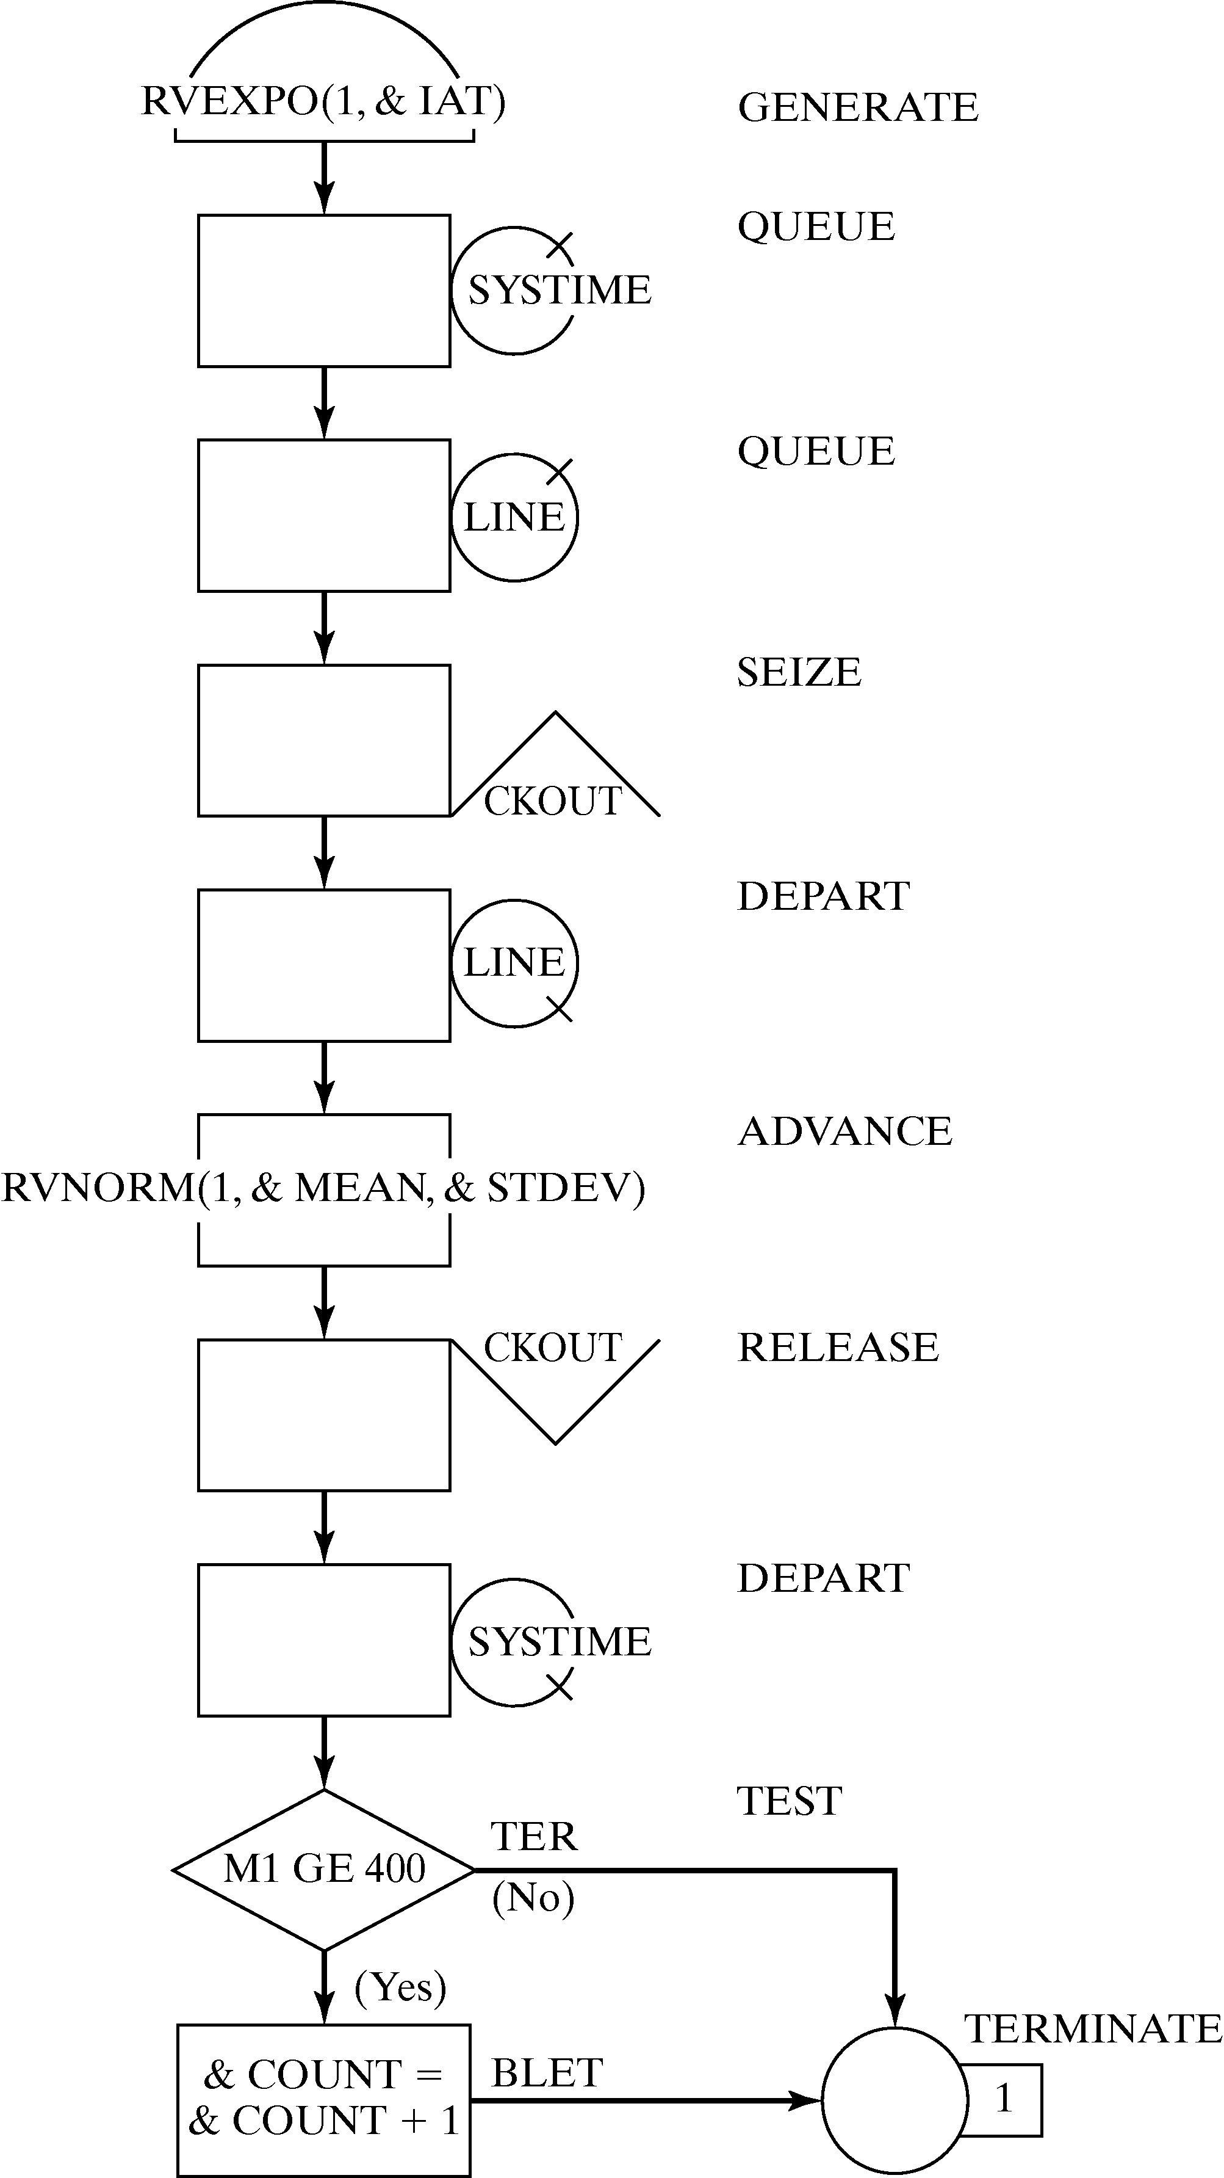
Single-Server Queue Example [Simulation in GPSS/H]
Beginning of data collection
Random variable, exponentially distributed
Customer captures cashier resource
Random variable, normally distributed
Customer gives up the use of the facility

Slide 30
Single-Server Queue Example [Simulation in GPSS/H]
First, define ampervariables.
SIMULATE
*
* Define Ampervariables
*
INTEGER &LIMIT
REAL &IAT,&MEAN,&STDEV,&COUNT
LET &IAT=4.5
LET &MEAN=3.2
LET &STDEV=.6
LET &LIMIT=1000

Slide 31
Single-Server Queue Example [Simulation in GPSS/H]
Write input data to file and provide formatting information.
* Write Input Data to File
*
PUTPIC FILE=OUT,LINES=5,(&IAT,&MEAN,&STDEV,&LIMIT)
Mean interarrival time **.** minutes
Mean service time **.** minutes
Standard deviation of service time **.** minutes
Number of customers to be served *****

Slide 32
Single-Server Queue Example [Simulation in GPSS/H]
GPSS/H block section description and inputs.
START control statement controls simulation execution.
* GPSS/H Block Section
*
GENERATE RVEXPO(1,&IAT) Exponential arrivals
QUEUE SYSTIME Begin response time data collection
QUEUE LINE Customer joins waiting line
SEIZE CHECKOUT Begin checkout at cash register
DEPART LINE Customer starting service leaves queue
ADVANCE RVNORM(1,&MEAN,&STDEV) Customer's service time
RELEASE CHECKOUT Customer leaves checkout area
DEPART SYSTIME End response time data collection
TEST GE M1,4,TER Is response time GE 4 minutes?
BLET &COUNT=&COUNT+1 If so, add 1 to counter
TER TERMINATE 1
*
START &LIMIT Simulate for required number

Slide 33
Single-Server Queue Example [Simulation in GPSS/H]
Write desired output data to file OUT.
* Write Customized Output Data to File
*
PUTPIC FILE=OUT,LINES=7,(FR(CHECKOUT)/1000,QM(LINE),_
QT(SYSTIME),&COUNT/N(TER),AC1,N(TER))
Server utilization .***
Maximum line length **
Average response time **.** minutes
Proportion who spend four minutes .***
or more in the system
Simulation runlength ****.** minutes
Number of departures ****
*
END

Slide 34
Single-Server Queue Example [Simulation in GPSS/H]
Sample output report:
Mean interarrival time 4.50 minutes
Mean service time 3.20 minutes
Standard deviation of service time 0.60 minutes
Number of customers to be served 1000
Server utilization 0.676
Maximum line length 7
Average response time 6.33 minutes
Proportion who spend four minutes 0.646
or more in the system
Simulation runlength 4767.27 minutes
Number of departures 1000

Slide 35
Simulation in SSF
The Scalable Simulation Framework (SSF) is an Application Program Interface (API)
  Describes a set of capabilities for object-oriented, process-view simulation.
  The API is sparse and allows implementations to achieve high performance, e.g. on parallel computers.
  A widely used base, particularly in network simulation by using the add-on framework SSFNet.
SSF API defines 5 base classes:
  Processes: implements threads of control (where the action method contains the execution body of the thread.)
  Entity: describes simulation objects.
  inChannel and outChannel: communication endpoints.
  Event: defines messages sent between entities.

Slide 36
Single-Server Queue Example [Simulation in SSF]
SSQueue is a class that contains the whole simulation experiment:
class SSQueue extends Entity {
private static Random rng;
public static final double MeanServiceTime = 3.2;
public static final double SIGMA = 0.6;
public static final double MeanInterarrivalTime = 4.5;
public static final long ticksPerUnitTime = 1000000000;
public long generated=0;
public Queue Waiting;
outChannel out;
inChannel in;
public static long TotalCustomers=0, MaxQueueLength=0,
TotalServiceTime=0;
public static long LongResponse=0, umResponseTime=0, jobStart;
class arrival {
long id, arrival_time;
public arrival(long num, long a) { id=num; arrival_time = a; }
}
… continued on next slide…
  Defines experimental constants.
  Contains SSF communication endpoints.
  Defines an inner class, arrival.

Slide 37
Single-Server Queue Example [Simulation in SSF]
Arrival is an SSF process:
  Stores the identity of entity
  Creates a random-number generator,
  Generates and enqueues a new arrival, then blocks for an inter-arrival time.
… continued from last slide…
class Arrivals extends process {
private Random rng;
private SSQueue owner;
public Arrivals (SSQueue _owner, long seed) {
super(_owner); owner = _owner;
rng = new Random(seed);
}
public boolean isSimple() { return true; }
public void action() {
if ( generated++ > 0 ) {
// put a new Customer on the queue with the present arrival time
int Size = owner.Waiting.numElements();
owner.Waiting.enqueue( new arrival(generated, now()));
if( Size == 0) owner.out.write( new Event() ); // signal start of burst
}
waitFor(owner.d2t( owner.exponential(rng, owner.MeanInterarrivalTime)) );
}
}
}

Slide 38
Single-Server Queue Example [Simulation in SSF]
Server process:
  This process is called when a job has completed service or by a signal from the arrival process.
  Update statistics.
  Customer is dequeued from the waiting list or the process suspends if no customer was waiting.
class Server extends process {
private Random rng;
private SSQueue owner ;
private arrival in_service;
private long service_time;
public Server(SSQueue _owner, long seed) {
super(_owner);
owner = _owner;
rng = new Random(seed);
}
public boolean isSimple() { return true; }
… continued on next slide…

Slide 39
Single-Server Queue Example [Simulation in SSF]
Server process (continued):
… continued from last slide…
public void action() {
// if in_service is not null, we entered because of a job completion
if( in_service != null ) {
owner.TotalServiceTime += service_time;
long in_system = (now() -in_service.arrival_time);
owner.SumResponseTime += in_system;
if( owner.t2d(in_system) > 4.0 ) owner.LongResponse++;
in_service = null;
if( owner.MaxQueueLength < owner.Waiting.numElements() + 1 )
owner.MaxQueueLength = owner.Waiting.numElements() + 1;
owner.TotalCustomers++;
}
if( owner.Waiting.numElements() > 0 ) {
in_service = (arrival)owner.Waiting.dequeue();
service_time = -1;
while ( service_time < 0.0 )
service_time = owner.d2t(owner.normal( rng, owner.MeanServiceTime, owner.SIGMA));
waitFor( service_time );
} else {
waitOn( owner.in ); // we await a wake-up call
}
} }

Slide 40
Simulation in SSF
SSF bridges the gap between models developed in pure Java and models developed in languages specifically designed for simulation.
It also provides the flexibility offered by a general-programming language, yet has essential support for simulation.

Slide 41
Simulation Software
All the simulation packages described in later subsections run on a PC under Microsoft Windows 2000 or XP.
Common characteristics:
  Graphical user interface, animation
  Automatically collected outputs.
  Most provide statistical analyses, e.g., confidence intervals.
All packages considered in this chapter take the process-interaction worldview, a few also allow event-scheduling models and mixed discrete-continuous models.
For animation, some emphasize scale drawings in 2-D or 3-D; others emphasize iconic-type animation.
Almost all offer dynamic business graphing, e.g., time lines, bar charts and pie charts.

Slide 42
Simulation Software
Software package discussed:
  Arena
  AutoMod
  Delmia/QUEST
  Extend
  Flexsim
  Micro Saint
  ProModel
  Simul8
  WITNESS

Slide 43
Arena [Simulation Software]
Arena can be used for simulating discrete and continuous systems.
At the heart of Arena is the SIMAN simulation language.
The Arena Basic Edition:
  For modeling business processes and other systems in support of high-level analysis needs.
The Arena Standard Edition:
  For modeling more detailed discrete and continuous systems.
  Models are built from graphical objects called modules to define system logic and physical components.
  Includes modules focused on specific aspects of manufacturing and material-handling systems.
The Arena Professional Edition:
  With capability to craft custom simulation objects that mirror components of real system, including terminology, process logic, data, etc.

Slide 44
Arena [Simulation Software]
The Arena family includes:
  OptQuest: an optimization software package.
  Arena Contact Center and Arena Packaging: designed specifically to model call centers and high-speed production lines.
Arena’s Input Analyzer automates the process of selecting the proper distribution and its inputs.
The Output Analyzer and Process Analyzer automate comparison of different design alternatives.

Slide 45
AutoMod [Simulation Software]
AutoMod Product Suite includes:
  AutoMod simulation package, AutoStat for experimentation and analysis, and AutoView for making AVI moves of the built-in 3-D animation.
Main focus: manufacturing and material-handling systems (has built in templates.)
Also contains a full simulation programming language.
Strength: detailed, large models used for planning, operational decision support, and control-system testing.
An AutoMod model consists of one or more systems.
  A system can be either a process system or a movement system.
  A model may contain any number of systems, which can be saved and reused as objects in other models.
AutoStat provides a complete environment for the user to define scenarios, conduct experimentation and perform analysis.
Optimization is based on an evolutionary strategies algorithm.

Slide 46
Extend [Simulation Software]
Extend OR, Industry, and Suite are used for simulating discrete and mixed discrete-continuous systems.
Extend CP is for continuous modeling only.
Extend combines a block diagram approach to model-building with a development environment for creating new blocks.
  Models are built by placing and connecting blocks, and entering the parameters on the block’s dialog window.
  For creating new blocks, Extend comes with a compiled C-like programming environment.
Input parameters can be changed interactively during a model run and can come from external sources.
Provides iconic process-flow animation of the block diagram.
Has an open architecture and also supports linking to and using code written in external languages.

Slide 47
Flexsim [Simulation Software]
Flexsim is a discrete-event, object-oriented simulator developed in C++, using Open GL technology.
Flexsim is commonly used to
  To build models that behave like the actual physical or conceptual systems they represent.
  To improve production efficiencies and reduce operating costs through simulation, experimentation, and optimization of dynamic flow systems.
  Engineers and managers use Flexsim to evaluate plant capacity, balance packaging and manufacturing lines, manage bottlenecks.
The results of each simulation can be analyzed:
  Graphically through 3D animation, and
  Through statistical reports and graphs.

Slide 48
Micro Saint [Simulation Software]
Micro Saint is a general-purpose, discrete-event, network simulation-software package for building models that simulate real-life processes.
It does not use the terminology or graphic representations of a specific industry.
Model can be built for any process that can be represented by a flowchart diagram.
It provides two views of the simulation model:
  Network diagram view: the process flowchart in action.
  Actionview provides a realistic 2-D picture of the process.
OptQuest optimization is included:
  Automatically search for and find optimal or near-optimal solutions.

Slide 49
ProModel [Simulation Software]
A simulation and animation tool designed to model manufacturing systems.
  Has manufacturing-oriented modeling elements and rule-based decision logic.
  The modeling elements in ProModel are parts (entities), locations, resources, path networks, routing and processing logic, and arrivals.
Includes logic for automatically generating cost data associated with a process.
Also comes with an output viewer.
Its runtime interface allows a user to define multiple scenarios for experiments.
It offers 2-D animation with an optional 3-D like perspective view.
The company also offers MedModel for healthcare systems and ServiceModel for service systems.

Slide 50
Delmia/QUEST [Simulation Software]
Delmia/QUEST is a manufacturing-oriented simulation package.
  Combines an object-based, true 3-D simulation environment with a graphical user interface for material-flow modules.
  Incorporates 2-D and 3-D CAD geometry to create a virtual factory environment.
The company also offers a number of workcell simulators:
  IGRIP® for robotic simulation and programming.
  ERGOTM for ergonomic analyses.
  PROCESS ENGINEERTM for process-planning.
Simulation Control Language (SCL): allows expert users to define customer behavior and to gain control over simulation.
Batch Control Language (SCL): open architecture allows the advanced user to perform batch simulation runs to automatically collect and tabulate data.
Output is available both numerically and visually.

Slide 51
SIMUL8 [Simulation Software]
SIMUL8 models are created by drawing the flow of work with the computer mouse, using a series of icons and arrows to represent the resources and queues in the system.
Main focus is service industries where people are processing transactions.
The company’s goal is to spread simulation very widely across businesses.
  Have very different pricing and support policies.
  Contains features that watch how the product is being used.
Simulation models and data are saved in SML format.
SIMUL8 has a VBA interface and supports ActiveX/COM so that external applications can build and control SIMUL8 simulations.
The product is available at two levels: Standard and Professional.

Slide 52
WITNESS [Simulation Software]
WITNESS has separate versions for manufacturing and service industries.
WITNESS models are based on template elements.
  Elements may be customized and combined into module elements and templates for reuse.
  Displayed in a 2-D layout animation with multiple windows and display layers.
WITNESS has object-model and ActiveX control for simulation embedding and includes direct data links to Microsoft Excel, MINITAB and any OLEDB database source.

Slide 53
Experimentation and Statistical-Analysis Tools
Virtually all simulation packages offer support for statistical analysis of simulation output.
In recent years, many packages have added optimization as one of the analysis tools.
  Optimization is used to find a “near-optimal” solution.
  User must define an objective or fitness function, e.g. cost.
  Recent advances in the field of metaheuristics has offered new approaches to simulation optimization.
Products discussed:
  Arena’s Output and Process Analyzer
  AutoStat
  OptQuest
  SimRunner

Slide 54
Arena’s Output and Process Analyzer [Experimental and Analysis Tools]
Output Analyzer
  Provides confidence intervals, comparison of multiple systems, and warm-up determination to reduce initial condition bias.
Process Analyzer
  Adds sophisticated scenario-management capabilities to Arena for comprehensive design of experiments.
  Allows a user to define scenarios, make the desired runs, and analyze the results.
OptQuest is used for optimization.

Slide 55
OptQuest [Experimental and Analysis Tools]
An optimization tool.
OptQuest is based on a combination of methods: scatter search, tabu search, linear-integer programming, and neural networks.
  The combination of methods allows the search process to escape local optimality in the quest for the best solution.

Slide 56
AutoStat [Experimental and Analysis Tools]
AutoStat is the run manager and statistical-analysis product in the AutoMod product family.
It provides a number of analyses
  Including warm-up determination, absolute and comparison confidence intervals, design of experiments, sensitivity analysis.
The evolutionary-strategies algorithm used is well suited to find a near-optimal solution without getting trapped at a local optimum.
An end user can define any number of scenarios by defining factors and their range or values.
AutoStat supports correlated sampling using common random numbers.
AutoStat is capable of distributing simulation runs across a local area network and pulling back all results to the user’s computer.

Slide 57
SimRunner [Experimental and Analysis Tools]
SimRunner was developed by PROMODEL Corporation.
  Available for ProModel, MedModel and ServiceModel.
Uses genetic algorithms and evolutionary strategies.
Manipulates the input factors within boundaries specified by the user seeking to optimize the objective function.
Also has a utility for helping users estimate:
  The end of the warm-up phase
  The number of replications needed to obtain an estimate of the objective function’s mean value to within a specified percentage error and confidence level.

Slide 58
Summary
Three types of software for simulation models developments:
  General-purpose programming languages, e.g., Java, C.
    Not specifically designed for use in simulation.
    Simulation libraries, e.g., SSF, are sometimes available for standardized simulation functionality.
    Helps to understand the basic concepts and algorithms.
  Simulation programming languages, e.g., GPSS/HTM, SIMAN V® and SLAM II®.
    Designed specifically for simulation of certain systems, e.g. queueing systems.
  Simulation environment, e.g., Arena, AutoMod.
    Output analyzer is an important component, e.g. experimental design, statistical analysis.
    Many packages offer optimization tools as well.

