Slide 1
Chapter 8
Random-Variate Generation
Banks, Carson, Nelson & Nicol
Discrete-Event System Simulation

Slide 2
Purpose & Overview
Develop understanding of generating samples from a specified distribution as input to a simulation model.
Illustrate some widely-used techniques for generating random variates.
  Inverse-transform technique
  Acceptance-rejection technique
  Special properties

Slide 3
Inverse-transform Technique
The concept:
  For cdf function: r = F(x)
  Generate r from uniform (0,1)
  Find x:
r = F(x)
x = F⁻¹(r)
r₁
x₁
Notes:
where r is a variate generated from Uniform (0,1)
and F-1(r) is the solution to the equation r = F(X)

Slide 4
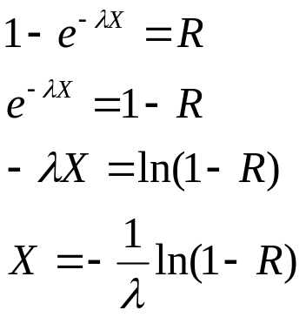
Steps in inverse-transform technique
Step 1. Compute the cdf of the desired random variable X: F(x) = 1 – e^{-λx}
x ≥ 0
Step 2. Set F(X) = R on the range of X
Step 3. Solve the equation F(x) = R for X in terms of R.
Step 4. Generate (as needed) uniform random numbers R₁, R₂, R₃, . . . and compute the desired random variates
See the next slide

Slide 5
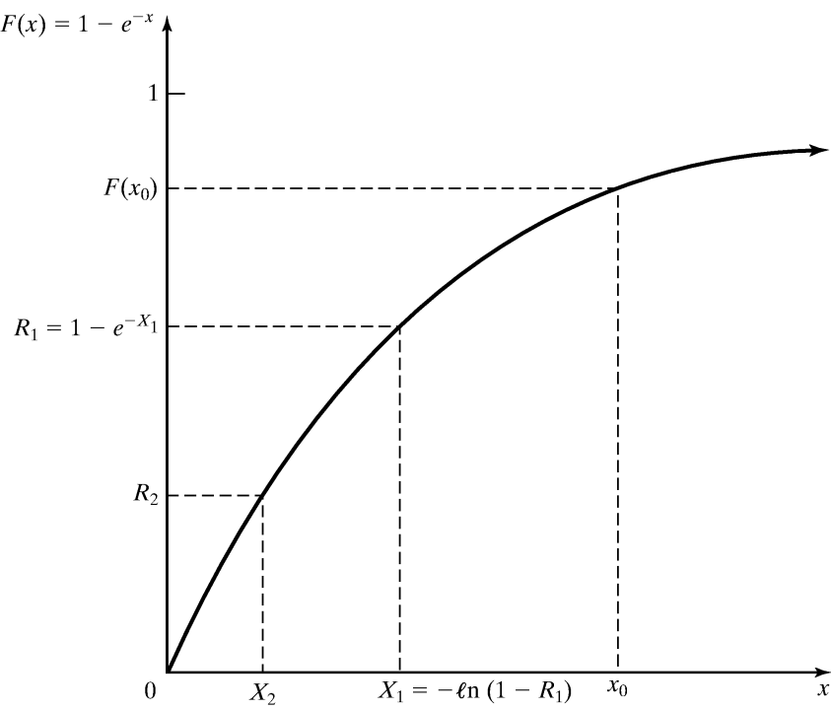
Exponential Distribution [Inverse-transform]
Exponential Distribution:
  Exponential cdf:
  To generate X₁, X₂, X₃ …
r = F(x)
= 1 – e^{-λx} for x ≥ 0
X_{i} = F⁻¹(R_{i})
= -(1/λ) ln(1-R_{i}) [Eq’n 8.3]
Figure: Inverse-transform technique for exp(λ = 1)
Notes:
where r is a variate generated from Uniform (0,1)
and F-1(r) is the solution to the equation r = F(X)

Slide 6
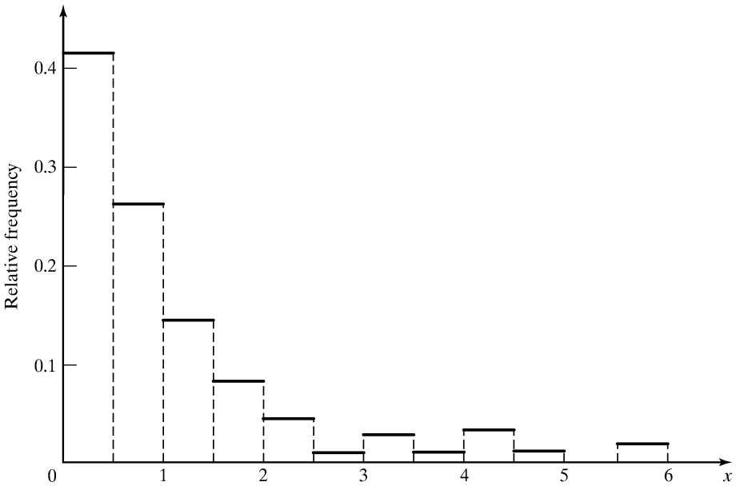

Exponential Distribution [Inverse-transform]
Example: Generate 200 variates X_{i} with distribution exp(λ= 1)
  Generate 200 Rs with U(0,1) and utilize eq’n 8.3, the histogram of Xs become:
  Check: Does the random variable X₁ have the desired distribution?
Notes:
where r is a variate generated from Uniform (0,1)
and F-1(r) is the solution to the equation r = F(X)

Slide 7
Does the random variable X₁ have the desired distribution?
Pick a value of x₀ and compute the cummulative probability.
P(X₁ ≤ x₀) = P(R₁ ≤ F(x₀)) = F(x₀) (8.4)
First equality: See figure 8.2 on slide 5.
It can be seen that X₁ ≤ x₀ when and only when R₁ ≤ F(x₀).
Since 0 ≤ F(x₀) ≤ 1, the second equality in the equation follows immediately from the fact that R₁ is uniformly distributed on [0,1].
The equation shows that the cdf of X₁ is F;
  hence X₁ has the desired distribution

Slide 8
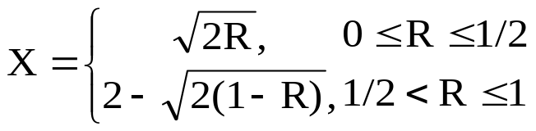
Other Distributions [Inverse-transform]
Examples of other distributions for which inverse cdf works are:
  Uniform distribution
  X = a + (b – a)R
  Weibull distribution – time to failure – see steps on p278
  X = α[- ln(1 - R)]^{1/β}
  Triangular distribution
Notes:
where r is a variate generated from Uniform (0,1)
and F-1(r) is the solution to the equation r = F(X)

Slide 9
Section 8.1.5 Empirical Continuous Distributions
This is a worthwhile read (as is the whole chapter of course)
Works on the question:
  What do you do if you can’t figure out what the distribution of the data is?
The example starting on slide 13 is a good model to work from.

Slide 10


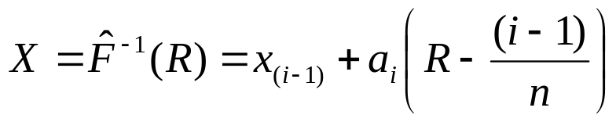
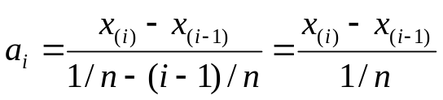
Empirical Continuous Dist’n [Inverse-transform]
When theoretical distribution is not applicable
To collect empirical data:
  Resample the observed data (i.e. use the data for the distribution)
  Interpolate between observed data points to fill in the gaps
For a small sample set (size n):
  Arrange the data from smallest to largest
  Assign the probability 1/n to each interval
  where
Notes:
where r is a variate generated from Uniform (0,1)
and F-1(r) is the solution to the equation r = F(X)

Slide 11
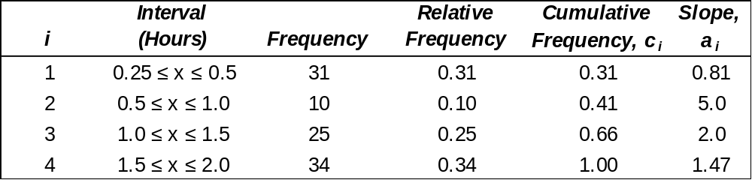
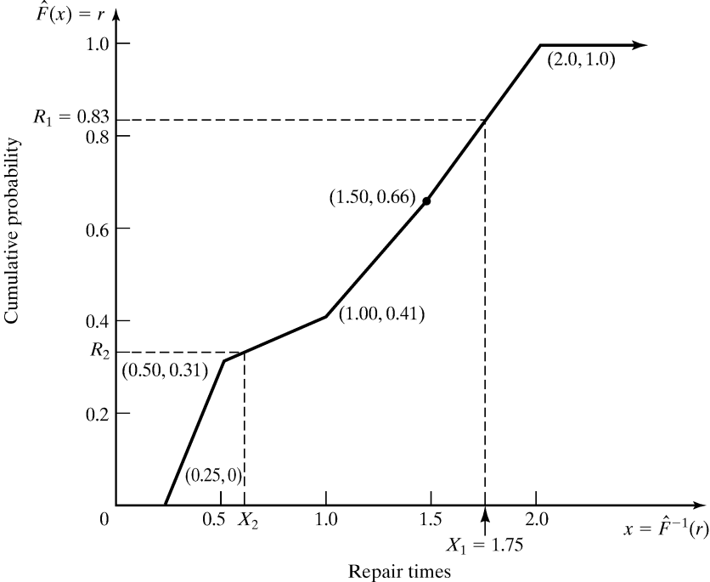
Empirical Continuous Dist’n [Inverse-transform]
Example: Suppose the data collected for100 broken-widget repair times are:
Consider R₁ = 0.83:
c₃ = 0.66 < R₁ < c₄ = 1.00
X₁ = x₍₄₋₁₎ + a₄(R₁ – c₍₄₋₁₎)
= 1.5 + 1.47(0.83-0.66)
= 1.75
Notes:
where r is a variate generated from Uniform (0,1)
and F-1(r) is the solution to the equation r = F(X)

Slide 12
8.1.6
There are continuous distributions without a nice closed-form expression for their cdf or its inverse.
  Normal distribution
  Gamma
  Beta
Must approximate in these cases

Slide 13
Discrete Distribution [Inverse-transform]
All discrete distributions can be generated via inverse-transform technique
Method: numerically, table-lookup procedure, algebraically, or a formula
Examples of application:
  Empirical
  Discrete uniform
  Gamma
Notes:
where r is a variate generated from Uniform (0,1)
and F-1(r) is the solution to the equation r = F(X)

Slide 14
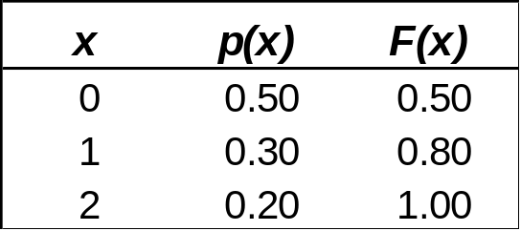
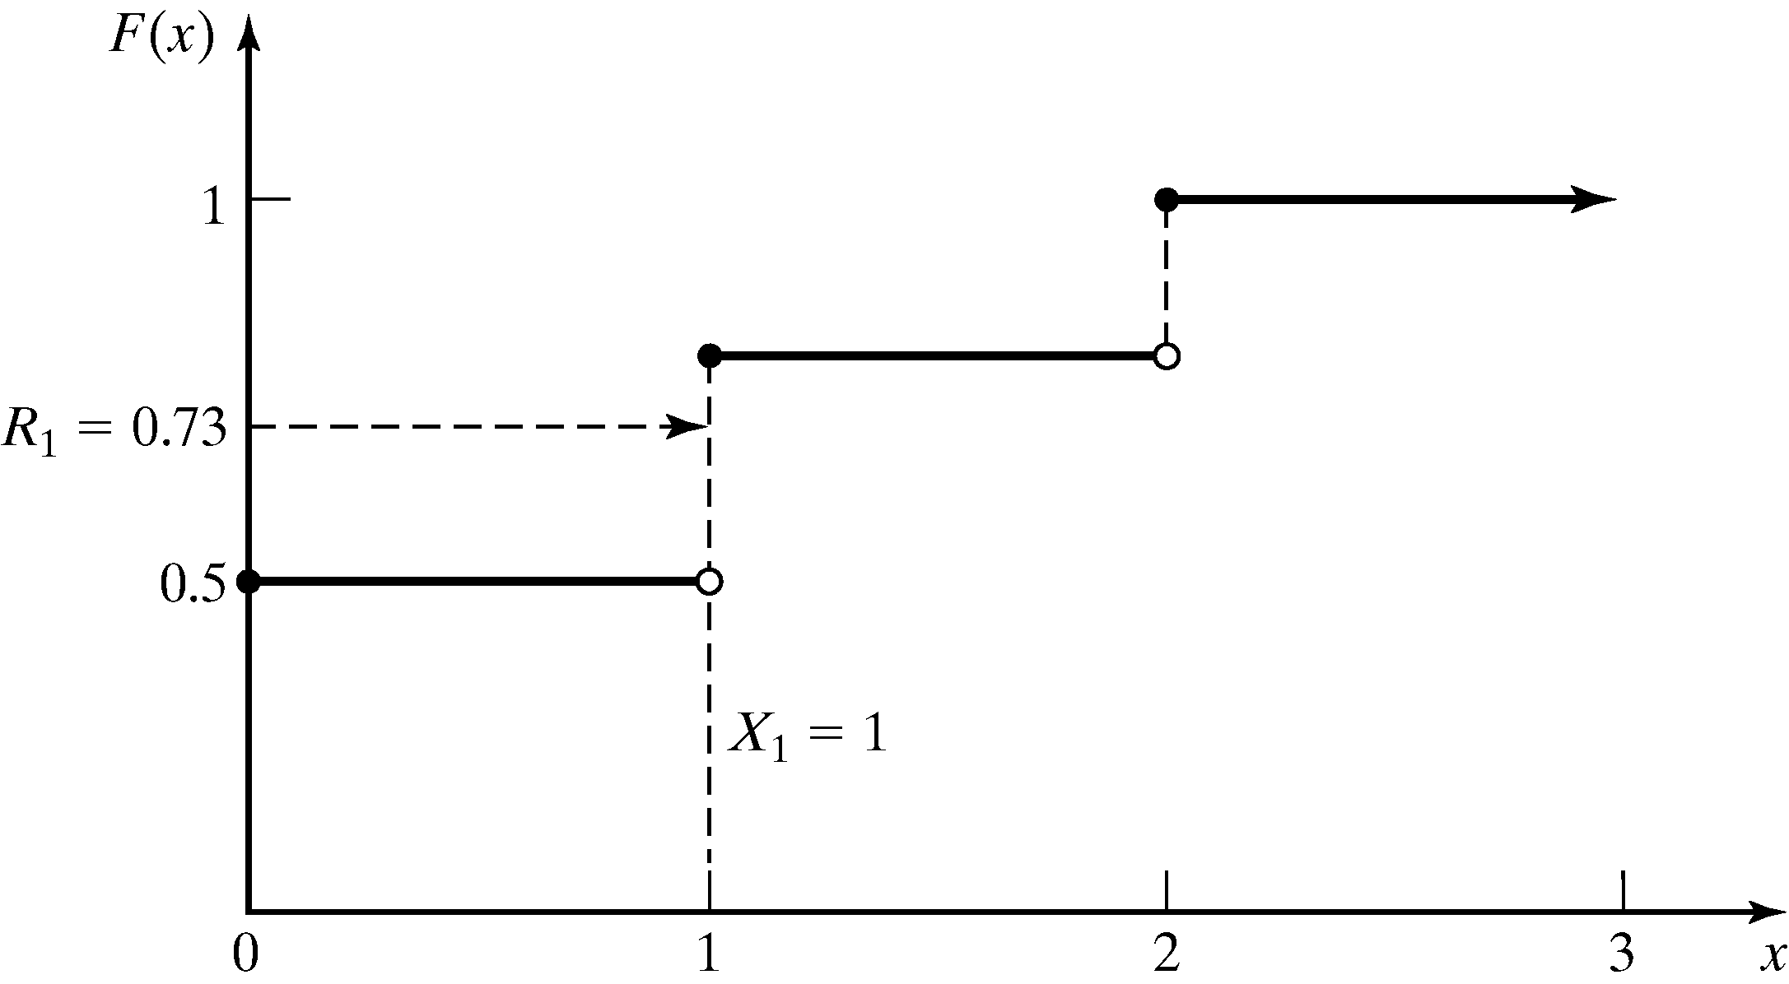
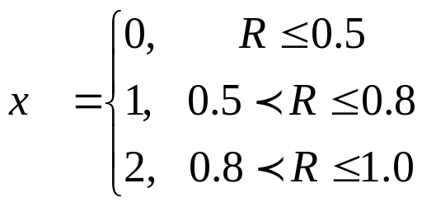
Example 8.4
An Empirical Discrete Distribution [Inverse-transform]
Example: Suppose the number of shipments, x, on the loading dock of IHW company is either 0, 1, or 2
  Data - Probability distribution:
  Method - Given R, the generation
  scheme becomes:
Consider R₁ = 0.73:
F(x_{i-1}) < R <= F(x_{i})
F(x₀) < 0.73 <= F(x₁)
Hence, x₁ = 1
Notes:
where r is a variate generated from Uniform (0,1)
and F-1(r) is the solution to the equation r = F(X)

Slide 15
Discrete distributions continued
Example 8.5 concerns a Discrete Uniform Distribution
Example 8.6 concerns the Geometric Distribution

Slide 16
8.2: Acceptance-Rejection technique
Useful particularly when inverse cdf does not exist in closed form, a.k.a. thinning
Illustration: To generate random variates, X ~ U(1/4, 1)
R does not have the desired distribution, but R conditioned (R’) on the event {R ≥ ¼} does. (8.21, P. 289)
Efficiency: Depends heavily on the ability to minimize the number of rejections.
Generate R
Procedures:
Step 1. Generate R ~ U[0,1]
Step 2a. If R >= ¼, accept X=R.
Step 2b. If R < ¼, reject R, return to Step 1
no
Condition
yes
Output R’

Slide 17
NSPP [Acceptance-Rejection]
Non-stationary Poisson Process (NSPP): a Possion arrival process with an arrival rate that varies with time
Idea behind thinning:
  Generate a stationary Poisson arrival process at the fastest rate, λ* = max λ(t)
  But “accept” only a portion of arrivals, thinning out just enough to get the desired time-varying rate
Generate E ~ Exp(λ*)
t = t + E
no
Condition
R <= λ(t)
yes
Output E ’~ t

Slide 18
8.2 Acceptance – Rejection continued
8.2.1 Poisson Distribution
  Step 1 set n = 0, P =1
  Step 2 generate a random number R_{n+1}
  And replace P by P * R_{n+1}
  Step 3 if P < e^{-λ} , then accept, otherwise, reject the current n, increase n by 1 and return to step 2

Slide 19
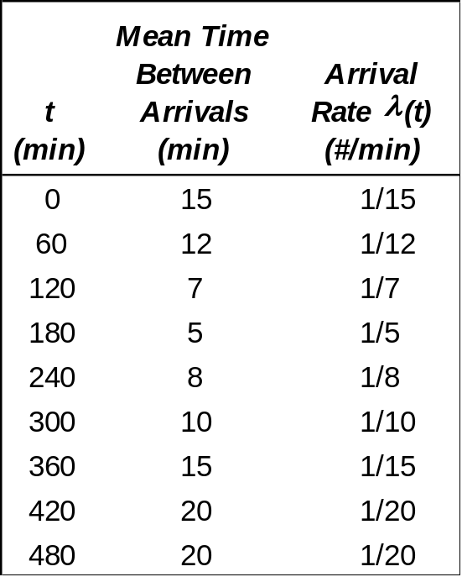
Non-Stationary Poisson Process [Acceptance-Rejection]
Example: Generate a random variate for a NSPP
Data: Arrival Rates
Procedures:
Step 1. λ* = max λ(t) = 1/5, t = 0 and i = 1.
Step 2. For random number R = 0.2130,
E = -5ln(0.213) = 13.13
t = 13.13
Step 3. Generate R = 0.8830
λ(13.13)/λ*=(1/15)/(1/5)=1/3
Since R>1/3, do not generate the arrival
Step 2. For random number R = 0.5530,
E = -5ln(0.553) = 2.96
t = 13.13 + 2.96 = 16.09
Step 3. Generate R = 0.0240
λ(16.09)/λ*=(1/15)/(1/5)=1/3
Since R<1/3, T₁ = t = 16.09,
and i = i + 1 = 2

Slide 20
8.3: Special Properties
Based on features of particular family of probability distributions
For example:
  Direct Transformation for normal and lognormal distributions
  Convolution
  Beta distribution (from gamma distribution)

Slide 21
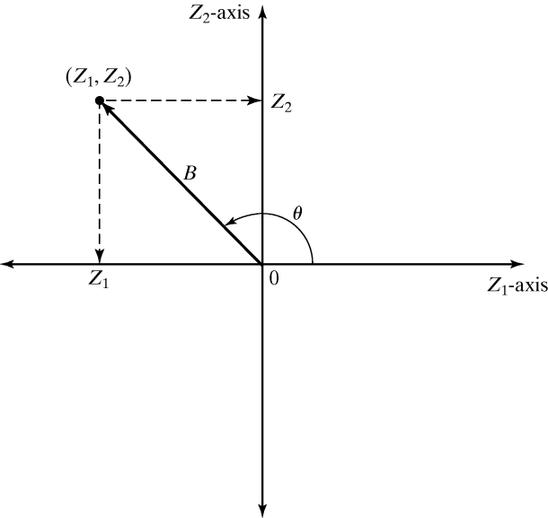

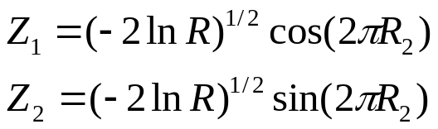
Direct Transformation [Special Properties]
Approach for normal(0,1):
  Consider two standard normal random variables, Z₁ and Z₂, plotted as a point in the plane:
  B² = Z²₁ + Z²₂ ~ chi-square distribution with 2 degrees of freedom = Exp(λ = 2). Hence,
  The radius B and angle φ are mutually independent.
In polar coordinates:
Z₁ = B cos φ
Z₂ = B sin φ

Slide 22
Direct Transformation [Special Properties]
Approach for normal(μ,σ²):
  That is, with mean μ and variance σ²
  Generate Z_{i} ~ N(0,1) as above
Approach for lognormal(μ,σ²):
  Generate X ~ N((μ,σ²)
X_{i} = μ + σ Z_{i}
Y_{i} = e^{Xi}

Slide 23
Summary
Principles of random-variate generate via
  Inverse-transform technique
  Acceptance-rejection technique
  Special properties
Important for generating continuous and discrete distributions

