Slide 1
Chapter 10
Verification and Validation of Simulation Models
Banks, Carson, Nelson & Nicol
Discrete-Event System Simulation

Slide 2
Purpose & Overview
The goal of the validation process is:
  To produce a model that represents true behavior closely enough for decision-making purposes
  To increase the model’s credibility to an acceptable level
Validation is an integral part of model development
  Verification – building the model correctly (correctly implemented with good input and structure)
  Validation – building the correct model (an accurate representation of the real system)
Most methods are informal subjective comparisons while a few are formal statistical procedures

Slide 3
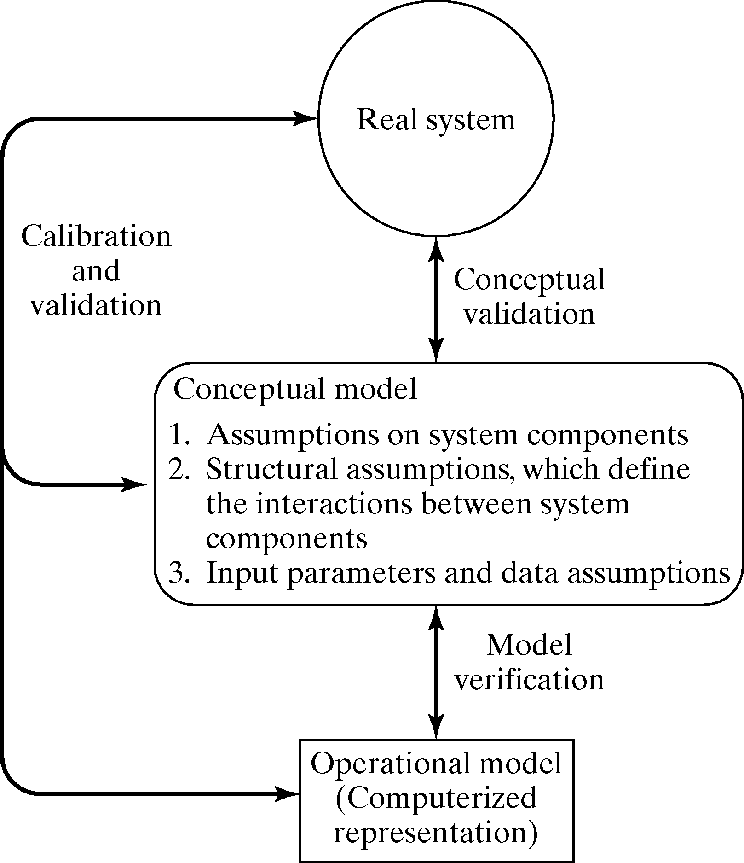
Modeling-Building, Verification & Validation

Slide 4
Verification
Purpose: ensure the conceptual model is reflected accurately in the computerized representation.
Many common-sense suggestions, for example:
  Have someone else check the model.
  Make a flow diagram that includes each logically possible action a system can take when an event occurs.
  Closely examine the model output for reasonableness under a variety of input parameter settings. (Often overlooked!)
  Print the input parameters at the end of the simulation, make sure they have not been changed inadvertently.

Slide 5
Examination of Model Output for Reasonableness [Verification]
Example: A model of a complex network of queues consisting many service centers.
  Response time is the primary interest, however, it is important to collect and print out many statistics in addition to response time.
    Two statistics that give a quick indication of model reasonableness are current contents and total counts, for example:
      If the current content grows in a more or less linear fashion as the simulation run time increases, it is likely that a queue is unstable
      If the total count for some subsystem is zero, indicates no items entered that subsystem, a highly suspect occurrence
      If the total and current count are equal to one, can indicate that an entity has captured a resource but never freed that resource.
    Compute certain long-run measures of performance, e.g. compute the long-run server utilization and compare to simulation results

Slide 6
Other Important Tools [Verification]
Documentation
  A means of clarifying the logic of a model and verifying its completeness
Use of a trace
  A detailed printout of the state of the simulation model over time.

Slide 7
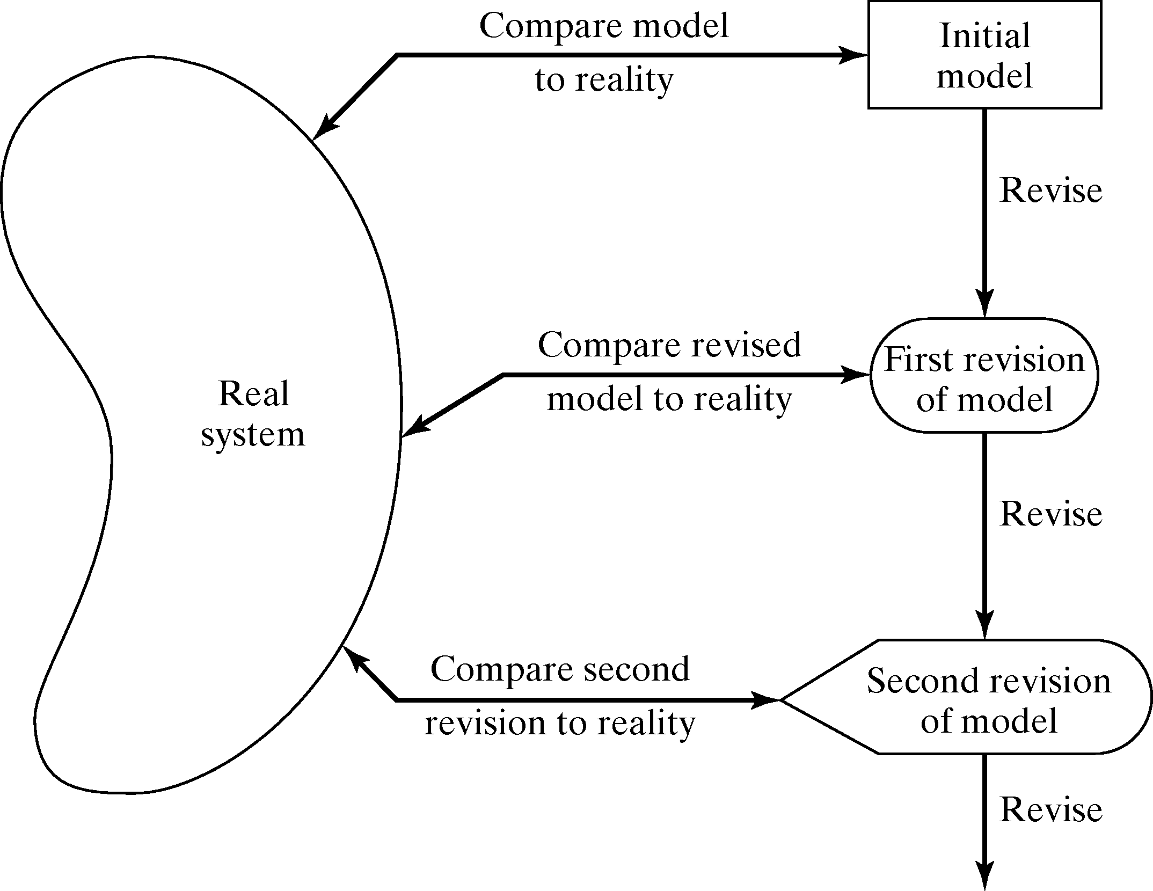
Calibration and Validation
Validation: the overall process of comparing the model and its behavior to the real system.
Calibration: the iterative process of comparing the model to the real system and making adjustments.

Slide 8
Calibration and Validation
No model is ever a perfect representation of the system
  The modeler must weigh the possible, but not guaranteed, increase in model accuracy versus the cost of increased validation effort.
Three-step approach:
  Build a model that has high face validity.
  Validate model assumptions.
  Compare the model input-output transformations with the real system’s data.

Slide 9
High Face Validity [Calibration & Validation]
Ensure a high degree of realism: Potential users should be involved in model construction (from its conceptualization to its implementation).
Sensitivity analysis can also be used to check a model’s face validity.
  Example: In most queueing systems, if the arrival rate of customers were to increase, it would be expected that server utilization, queue length and delays would tend to increase.

Slide 10
Validate Model Assumptions
[Calibration & Validation]
General classes of model assumptions:
  Structural assumptions: how the system operates.
  Data assumptions: reliability of data and its statistical analysis.
Bank example: customer queueing and service facility in a bank.
  Structural assumptions, e.g., customer waiting in one line versus many lines, served FCFS versus priority.
  Data assumptions, e.g., interarrival time of customers, service times for commercial accounts.
    Verify data reliability with bank managers.
    Test correlation and goodness of fit for data (see Chapter 9 for more details).

Slide 11
Validate Model Assumptions
[Calibration & Validation]
General classes of model assumptions:
  Structural assumptions: how the system operates.
  Data assumptions: reliability of data and its statistical analysis.
Bank example: customer queueing and service facility in a bank.
  Structural assumptions, e.g., customer waiting in one line versus many lines, served FCFS verses priority.
  Data assumptions, e.g., interarrival time of customers, service times for commercial accounts.
    Verify data reliability with bank managers.
    Test correlation and goodness of fit for data (see Chapter 9 for more details).

Slide 12
Validate Input-Output Transformation [Calibration & Validation]
Goal: Validate the model’s ability to predict future behavior
  The only objective test of the model.
  The structure of the model should be accurate enough to make good predictions for the range of input data sets of interest.
One possible approach: use historical data that have been reserved for validation purposes only.
Criteria: use the main responses of interest.

Slide 13
Bank Example [Validate I-O Transformation]
Example: One drive-in window serviced by one teller, only one or two transactions are allowed.
  Data collection: 90 customers during 11 am to 1 pm.
    Observed service times {S_{i}, i = 1,2, …, 90}.
    Observed interarrival times {A_{i}, i = 1,2, …, 90}.
  Data analysis let to the conclusion that:
    Interarrival times: exponentially distributed with rate λ = 45
    Service times: N(1.1, 0.2²)

Slide 14
The Black Box
[Bank Example: Validate I-O Transformation]
A model was developed in close consultation with bank management and employees
Model assumptions were validated
Resulting model is now viewed as a “black box”:
Input Variables
Possion arrivals
λ = 45/hr: X₁₁, X₁₂, …
Services times,
N(D₂, 0.22): X₂₁, X_{22, …}
D₁ = 1 (one teller)
D₂ = 1.1 min
(mean service time)
D₃ = 1 (one line)
Model Output Variables, Y
Primary interest:
Y₁ = teller’s utilization
Y₂ = average delay
Y₃ = maximum line length
Secondary interest:
Y₄ = observed arrival rate
Y₅ = average service time
Y₆ = sample std. dev. of
service times
Y₇ = average length of time
Model
“black box”
f(X,D) = Y
Uncontrolled variables, X
Controlled Decision variables, D

Slide 15
Comparison with Real System Data
[Bank Example: Validate I-O Transformation]
Real system data are necessary for validation.
  System responses should have been collected during the same time period (from 11am to 1pm on the same Friday.)
Compare the average delay from the model Y₂ with the actual delay Z₂:
  Average delay observed, Z₂ = 4.3 minutes, consider this to be the true mean value μ₀ = 4.3.
  When the model is run with generated random variates X_{1n} and X_{2n}, Y₂ should be close to Z₂.
  Six statistically independent replications of the model, each of 2-hour duration, are run.

Slide 16
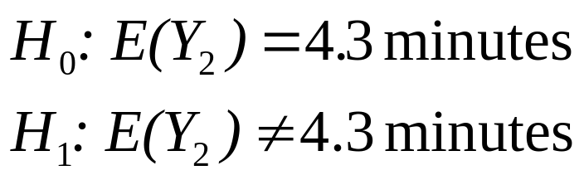
Hypothesis Testing
[Bank Example: Validate I-O Transformation]
Compare the average delay from the model Y₂ with the actual delay Z₂ (continued):
  Null hypothesis testing: evaluate whether the simulation and the real system are the same (w.r.t. output measures):
    If H₀ is not rejected, then, there is no reason to consider the model invalid
    If H₀ is rejected, the current version of the model is rejected, and the modeler needs to improve the model

Slide 17
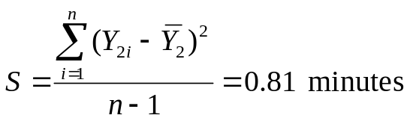
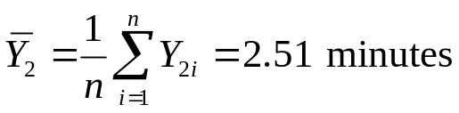
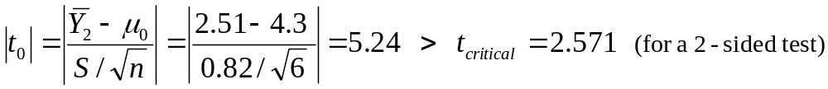
Hypothesis Testing
[Bank Example: Validate I-O Transformation]
  Conduct the t test:
    Chose level of significance (α = 0.5) and sample size (n = 6), see result in Table 10.2.
    Compute the same mean and sample standard deviation over the n replications:
    Compute test statistics:
    Hence, reject H₀. Conclude that the model is inadequate.
    Check: the assumptions justifying a t test, that the observations (Y_{2i}) are normally and independently distributed.

Slide 18
Hypothesis Testing
[Bank Example: Validate I-O Transformation]
Similarly, compare the model output with the observed output for other measures:
Y₄ ↔ Z₄, Y₅ ↔ Z₅, and Y₆ ↔ Z₆

Slide 19
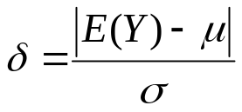
Type II Error [Validate I-O Transformation]
For validation, the power of the test is:
  Probability[ detecting an invalid model ] = 1 – β
  β = P(Type II error) = P(failing to reject H₀|H₁ is true)
  Consider failure to reject H₀ as a strong conclusion, the modeler would want β to be small.
  Value of β depends on:
    Sample size, n
    The true difference, δ, between E(Y) and μ:
In general, the best approach to control β error is:
  Specify the critical difference, δ.
  Choose a sample size, n, by making use of the operating characteristics curve (OC curve).

Slide 20
Type I and II Error
[Validate I-O Transformation]
Type I error (α):
  Error of rejecting a valid model.
  Controlled by specifying a small level of significance α.
Type II error (β):
  Error of accepting a model as valid when it is invalid.
  Controlled by specifying critical difference and find the n.
For a fixed sample size n, increasing α will decrease β.

Slide 21
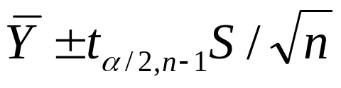
Confidence Interval Testing
[Validate I-O Transformation]
Confidence interval testing: evaluate whether the simulation and the real system are close enough.
If Y is the simulation output, and μ = E(Y), the confidence interval (C.I.) for μ is:
Validating the model:
  Suppose the C.I. does not contain μ₀:
    If the best-case error is > ε, model needs to be refined.
    If the worst-case error is ≤ ε, accept the model.
    If best-case error is ≤ ε, additional replications are necessary.
  Suppose the C.I. contains μ₀:
    If either the best-case or worst-case error is > ε, additional replications are necessary.
    If the worst-case error is ≤ ε, accept the model.

Slide 22
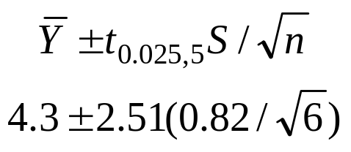
Confidence Interval Testing
[Validate I-O Transformation]
Bank example: μ₀ = 4.3, and “close enough” is ε = 1 minute of expected customer delay.
  A 95% confidence interval, based on the 6 replications is
  [1.65, 3.37] because:
  Falls outside the confidence interval, the best case |3.37 – 4.3| = 0.93 < 1, but the worst case |1.65 – 4.3| = 2.65 > 1, additional replications are needed to reach a decision.

Slide 23
Using Historical Output Data
[Validate I-O Transformation]
An alternative to generating input data:
  Use the actual historical record.
  Drive the simulation model with the historical record and then compare model output to system data.
  In the bank example, use the recorded interarrival and service times for the customers {A_{n}, S_{n}, n = 1,2,…}.
Procedure and validation process: similar to the approach used for system generated input data.

Slide 24
Using a Turing Test
[Validate I-O Transformation]
Use in addition to statistical test, or when no statistical test is readily applicable.
Utilize persons’ knowledge about the system.
For example:
  Present 10 system performance reports to a manager of the system. Five of them are from the real system and the rest are “fake” reports based on simulation output data.
  If the person identifies a substantial number of the fake reports, interview the person to get information for model improvement.
  If the person cannot distinguish between fake and real reports with consistency, conclude that the test gives no evidence of model inadequacy.

Slide 25
Summary
Model validation is essential:
  Model verification
  Calibration and validation
  Conceptual validation
Best to compare system data to model data, and make comparison using a wide variety of techniques.
Some techniques that we covered (in increasing cost-to-value ratios):
  Insure high face validity by consulting knowledgeable persons.
  Conduct simple statistical tests on assumed distributional forms.
  Conduct a Turing test.
  Compare model output to system output by statistical tests.

