Slide 1
Chapter 12
Comparison and Evaluation of Alternative System Designs
Banks, Carson, Nelson & Nicol
Discrete-Event System Simulation

Slide 2
Purpose
Purpose: comparison of alternative system designs.
Approach: discuss a few of many statistical methods that can be used to compare two or more system designs.
Statistical analysis is needed to discover whether observed differences are due to:
  Differences in design or,
  The random fluctuation inherent in the models.

Slide 3
Outline
For two-system comparisons:
  Independent sampling.
  Correlated sampling (common random numbers).
For multiple system comparisons:
  Bonferroni approach: confidence-interval estimation, screening, and selecting the best.
Metamodels

Slide 4
Comparison of Two System Designs
Goal: compare two possible configurations of a system
  e.g., two possible ordering policies in a supply-chain system, two possible scheduling rules in a job shop.
Approach: the method of replications is used to analyze the output data.
The mean performance measure for system i is denoted by θ_{i} (i = 1,2).
To obtain point and interval estimates for the difference in mean performance, namely θ₁ – θ₂.

Slide 5
Comparison of Two System Designs
Vehicle-safety inspection example:
  The station performs 3 jobs: (1) brake check, (2) headlight check, and (3) steering check.
  Vehicles arrival: Possion with rate = 9.5/hour.
  Present system:
    Three stalls in parallel (one attendant makes all 3 inspections at each stall).
    Service times for the 3 jobs: normally distributed with means 6.5, 6.0 and 5.5 minutes, respectively.
  Alternative system:
    Each attendant specializes in a single task, each vehicle will pass through three work stations in series
    Mean service times for each job decreases by 10% (5.85, 5.4, and 4.95 minutes).
  Performance measure: mean response time per vehicle (total time from vehicle arrival to its departure).

Slide 6
Comparison of Two System Designs
  From replication r of system i, the simulation analyst obtains an estimate Y_{ir} of the mean performance measure θ_{i} .
  Assuming that the estimators Y_{ir} are (at least approximately) unbiased:
  θ₁ = E(Y_{1r} ), r = 1, … , R₁; θ₂ = E(Y_{2r} ), r = 1, … , R₂
  Goal: compute a confidence interval for θ₁ – θ₂ to compare the two system designs
  Confidence interval for θ₁ – θ₂ (c.i.):
    If c.i. is totally to the left of 0, strong evidence for the hypothesis that θ₁ – θ₂ < 0 (θ₁ < θ₂ ).
    If c.i. is totally to the right of 0, strong evidence for the hypothesis that θ₁ – θ₂ > 0 (θ₁ > θ₂ ).
    If c.i. is totally contains 0, no strong statistical evidence that one system is better than the other
      If enough additional data were collected (i.e., R_{i} increased), the c.i. would most likely shift, and definitely shrink in length, until conclusion of θ₁ < θ₂ or θ₁ > θ₂ would be drawn.

Slide 7

Comparison of Two System Designs
In this chapter:
  A two-sided 100(1-α)% c.i. for θ₁ – θ₂ always takes the form of:
  3 techniques discussed assume that the basic data Y_{ir} are approximately normally distributed.

Slide 8


Comparison of Two System Designs
Statistically significant versus practically significant
  Statistical significance: is the observed difference larger than the variability in ?
  Practical significance: is the true difference θ₁ – θ₂ large enough to matter for the decision we need to make?
  Confidence intervals do not answer the question of practical significance directly, instead, they bound the true difference within a range.

Slide 9

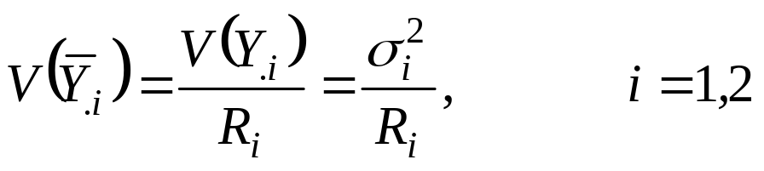
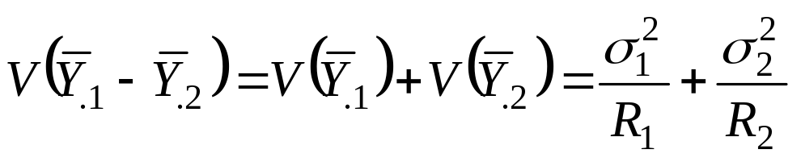
Independent Sampling with Equal Variances
[Comparison of 2 systems]
Different and independent random number streams are used to simulate the two systems
  All observations of simulated system 1 are statistically independent of all the observations of simulated system 2.
The variance of the sample mean, , is:
For independent samples:

Slide 10

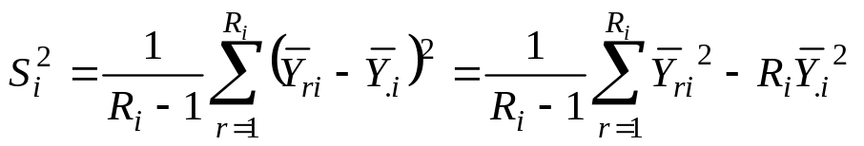
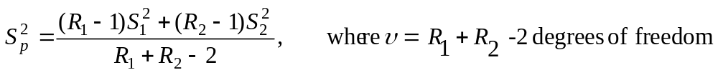
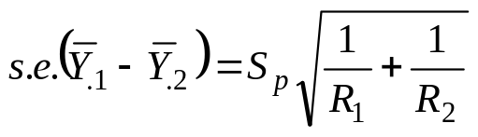
Independent Sampling with Equal Variances
[Comparison of 2 systems]
If it is reasonable to assume that σ²₁ = σ²₂ (approximately) or if R₁ = R₂, a two-sample-t confidence-interval approach can be used:
  The point estimate of the mean performance difference is:
  The sample variance for system i is:
  The pooled estimate of σ² is:
  C.I. is given by:
  Standard error:

Slide 11
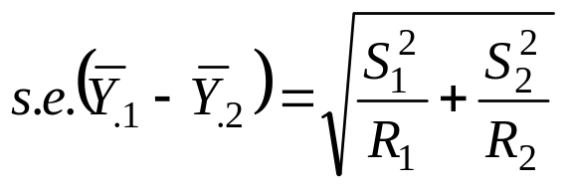
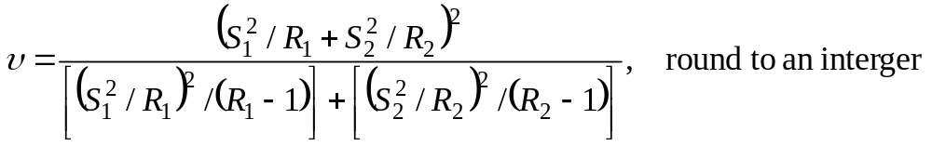
Independent Sampling with Unequal Variances [Comparison of 2 systems]
If the assumption of equal variances cannot safely be made, an approximate 100(1-α)% c.i. for can be computed as:
  With degrees of freedom:
  Minimum number of replications R₁ > 7 and R₂ > 7 is recommended.

Slide 12

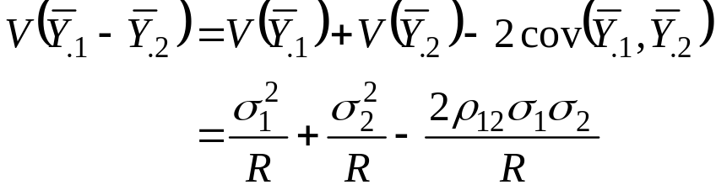
Common Random Numbers (CRN) [Comparison of 2 systems]
For each replication, the same random numbers are used to simulate both systems.
  For each replication r, the two estimates, Y_{r1} and Y_{r2}, are correlated.
  However, independent streams of random numbers are used on different replications, so the pairs (Y_{r1} ,Y_{s2} ) are mutually independent.
Purpose: induce positive correlation between (for each r) to reduce variance in the point estimator of .
  Variance of arising from CRN is less than that of independent sampling (with R₁=R₂).
ρ₁₂ is positive

Slide 13

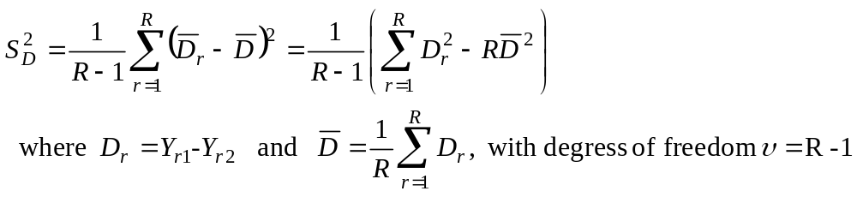
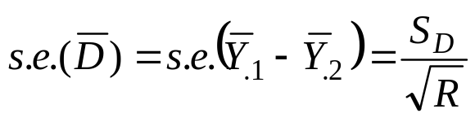
Common Random Numbers (CRN) [Comparison of 2 systems]
The estimator based on CRN is more precise, leading to a shorter confidence interval for the difference.
Sample variance of the differences :
Standard error:

Slide 14
Common Random Numbers (CRN) [Comparison of 2 systems]
It is never enough to simply use the same seed for the random-number generator(s):
  The random numbers must be synchronized: each random number used in one model for some purpose should be used for the same purpose in the other model.
  e.g., if the i^{th} random number is used to generate a service time at work station 2 for the 5th arrival in model 1, the i^{th} random number should be used for the very same purpose in model 2.

Slide 15
Common Random Numbers (CRN) [Comparison of 2 systems]
Vehicle inspection example:
  4 input random variables:
    A_{n}, interarrival time between vehicles n and n+1,
    S_{n}^{(i)}, inspection time for task i for vehicle n in model 1 (i=1,2,3; refers to brake, headlight and steering task, respectively).
  When using CRN:
    Same values should be generated for A₁, A₂, A₃, …in both models.
    Mean service time for model 2 is 10% less. 2 possible approaches to obtain the service times:
      Let S_{n}^{(i)}, be the service times generated for model 1, use: S_{n}^{(i)} - 0.1E[S_{n}^{(i)}]
      Let Z_{n}^{(i)}, as the standard normal variate, σ = 0.5 minutes, use:
      E[S_{n}^{(i)}] + σ Z_{n}^{(i)}
    For synchronized runs: the service times for a vehicle were generated at the instant of arrival and stored as its attribute and used as needed.

Slide 16



Common Random Numbers (CRN) [Comparison of 2 systems]
Vehicle inspection example (cont.): compare the two systems using independent sampling and CRN where R = R₁ = R₂ =10 (see Table 12.2 for results):
  Independent sampling:
  CRN without synchronization:
  CRN with synchronization:
    The upper bound indicates that system 2 is at almost 1.30 minutes faster in expectation. Is such a difference practically significant?

Slide 17



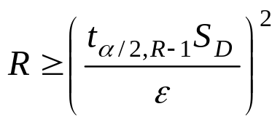

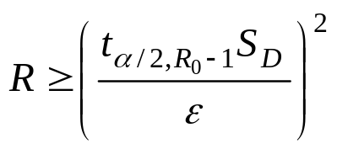
CRN with Specified Precision [Comparison of 2 systems]
Goal: The error in our estimate of θ₁ – θ₂ to be less than .
Approach: determine the number of replications R such that the half-width of c.i.:
Vehicle inspection example (cont.):
  R₀ = 10, complete synchronization of random numbers yield 95% c.i.:
  Suppose ε = 0.5 minutes for practical significance, we know R is the smallest integer satisfying R ≥ R₀ and:
  Since , a conservation estimate of R is:
  Hence, 35 replications are needed (25 additional).

Slide 18
Comparison of Several System Designs
To compare K alternative system designs
  Based on some specific performance measure, θ_{i}, of system i , for i = 1, 2, …, K.
Procedures are classified as:
  Fixed-sample-size procedures: predetermined sample size is used to draw inferences via hypothesis tests of confidence intervals.
  Sequential sampling (multistage): more and more data are collected until an estimator with a prespecified precision is achieved or until one of several alternative hypotheses is selected.
Some goals/approaches of system comparison:
  Estimation of each parameter θ,.
  Comparison of each performance measure θ_{i}, to control θ₁.
  All pairwise comparisons, θ_{i}, - θ_{i}, for all i not equal to j
  Selection of the best θ_{i}.

Slide 19
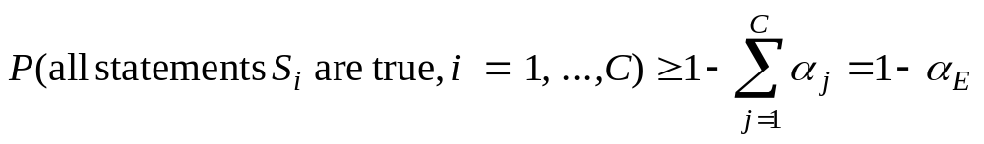
Bonferroni Approach [Multiple Comparisons]
To make statements about several parameters simultaneously, (where all statements are true simultaneously).
Bonferroni inequality:
  The smaller α_{j} is, the wider the j^{th} confidence interval will be.
Major advantage: inequality holds whether models are run with independent sampling or CRN
Major disadvantage: width of each individual interval increases as the number of comparisons increases.
Overall error probability, provides an upper bound on the probability of a false conclusion

Slide 20
Bonferroni Approach [Multiple Comparisons]
Should be used only when a small number of comparisons are made
  Practical upper limit: about 20 comparisons
3 possible applications:
  Individual c.i.’s: Construct a 100(1- α_{j})% c.i. for parameter θ_{i}, where # of comparisons = K.
  Comparison to an existing system: Construct a 100(1- α_{j})% c.i. for parameter θ_{i}- θ₁ (i = 2,3, …K), where # of comparisons = K – 1.
  All pairwise: For any 2 different system designs, construct a 100(1- α_{j})% c.i. for parameter θ_{i}- θ_{j}. Hence, total # of comparisons = K(K – 1)/2.

Slide 21


Bonferroni Approach to Selecting the Best [Multiple Comparisons]
Among K system designs, to find the best system
  “Best” - the maximum expected performance, where the i^{th} design has expected performance θ_{i}.
Focus on parameters:
  If system design i is the best, it is the difference in performance between the best and the second best.
  If system design i is not the best, it is the difference between system i and the best.
Goal: the probability of selecting the best system is at least
1 – α, whenever .
  Hence, both the probability of correct selection 1-α, and the practically significant difference ε, are under our control.
A two-stage procedure.

Slide 22


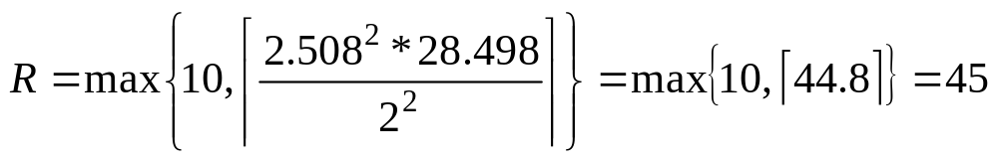
Bonferroni Approach to Selecting the Best [Multiple Comparisons]
Vehicle inspection example (cont.): Consider K = 4 different designs for the inspection station.
  Goal: 95% confidence of selecting the best (with smallest expected response time) where ε = 2 minutes.
  A minimization problem: focus on
  ε = 2, 1-α = 0.95, R₀=10 and t = t_{0.0167,9} = 2.508
  From Table 12.5, we know:
  The largest sample variance , hence,
  Make 45 - 10 = 35 additional replications of each system.

Slide 23
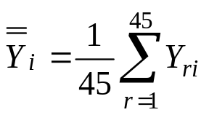


Bonferroni Approach to Selecting the Best [Multiple Comparisons]
Vehicle inspection example (cont.):
  Calculate the overall sample means:
  Select the system with smallest is the best.
  Form the confidence intervals:
  Note, for maximization problem:
    The difference for comparison is:
    The c.i. is:

Slide 24


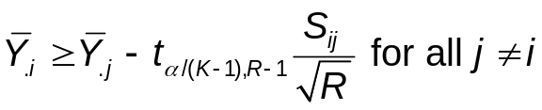

Bonferroni Approach for Screening [Multiple Comparisons]
A screening (subset selection) procedure is useful when a two-stage procedure isn’t possible or when too many systems.
Screening procedure: The retained subset contains the true best system with probability ≥ 1-α when the data are normally distributed (independent sampling or CRN).
  Specify 1-α, common sample size from each system and R≥2.
  Make R replications of system i to obtain Y_{1i}, Y_{2i}, … < Y_{Ri} for system i = 1,2, …, K.
  Calculate the sample means for all systems .
  Calculate sample variance of the difference for every system pair .
  If bigger is better, then retain system i in the selected subset if:
  If smaller is better, then retain system i in the selected subset if:

Slide 25
Metamodeling
Goal: describe the relationship between variables and the output response.
The simulation output response variable, Y, is related to k independent variables x₁, x₂, …, x_{k} (the design variables).
The true relationship between variables Y and x is represented by a (complex) simulation model.
Approximate the relationship by a simpler mathematical function called a metamodel, some metamodel forms:
  Linear regression.
  Multiple linear regression.

Slide 26
Simple Linear Regression [Metamodeling]
Suppose the true relationship between Y and x is suspected to be linear, the expected value of Y for a given x is: E(Y|x) = β₀ + β₁x
where β₀ is the intercept on the Y axis, and β₁ is the slope.
Each observation of Y can be described by the model:
Y = β₀ + β₁x + ε
where ε is the random error with mean zero and constant variance σ²

Slide 27
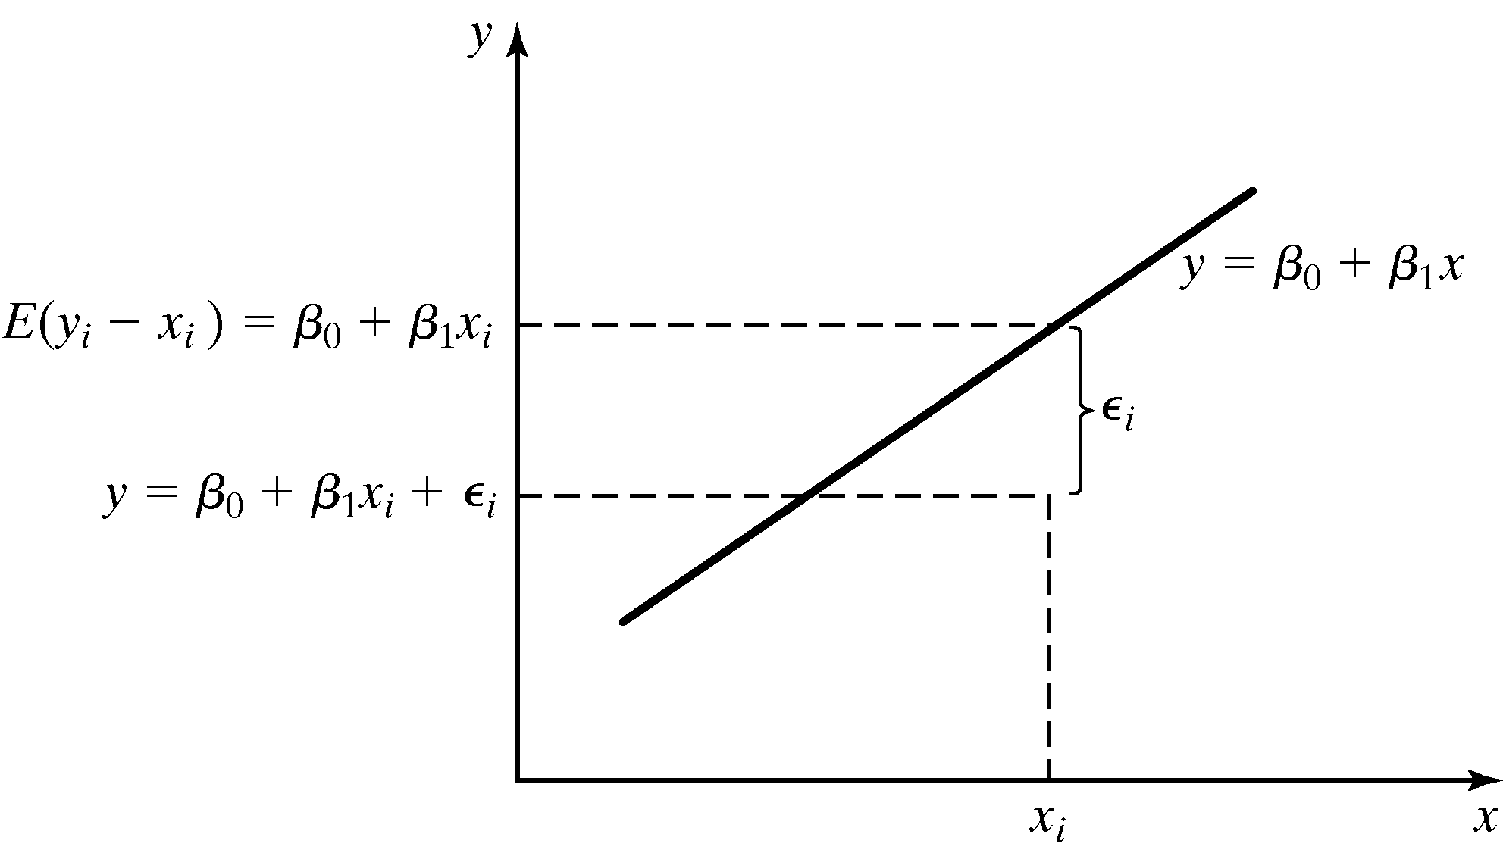
Simple Linear Regression [Metamodeling]
Suppose there are n pairs observations, the method of least squares is commonly used to estimate β₀ and β₁.
  The sum of squares of the deviation between the observations and the regression line is minimized.

Slide 28

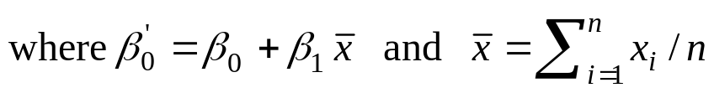

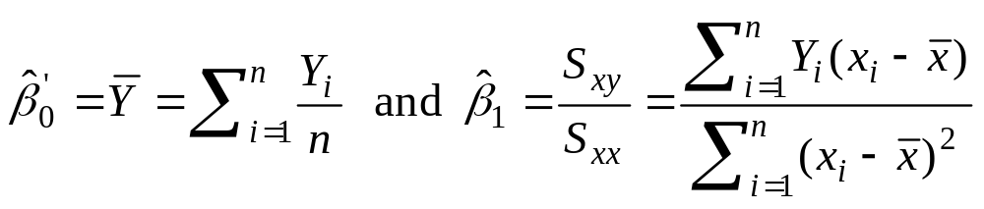
Simple Linear Regression [Metamodeling]
The individual observation can be written as:
Y_{i} = β₀ + β₁x_{i} + ε_{i}
where ε₁, ε₂ ... are assumed to be uncorrelated r.v.
Rewrite:
The least-square function (the sum of squares of the deviations):
To minimize L, find , set each to zero, and solve for:
S_{xx} – corrected sum of squares of x
S_{xy} – corrected sum of cross products of x and Y

Slide 29
Test for Significance of Regression [Metamodeling]
The adequacy of a simple linear relationship should be tested prior to using the model.
  Testing whether the order of the model tentatively assumed is correct, commonly called the “lack-of-fit” test.
  The adequacy of the assumptions that errors are NID(0,σ²) can and should be checked by residual analysis.

Slide 30

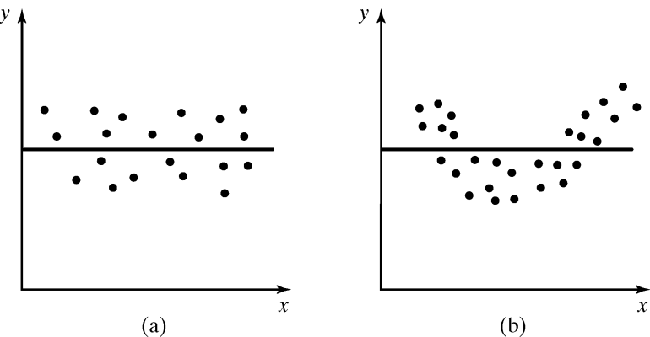
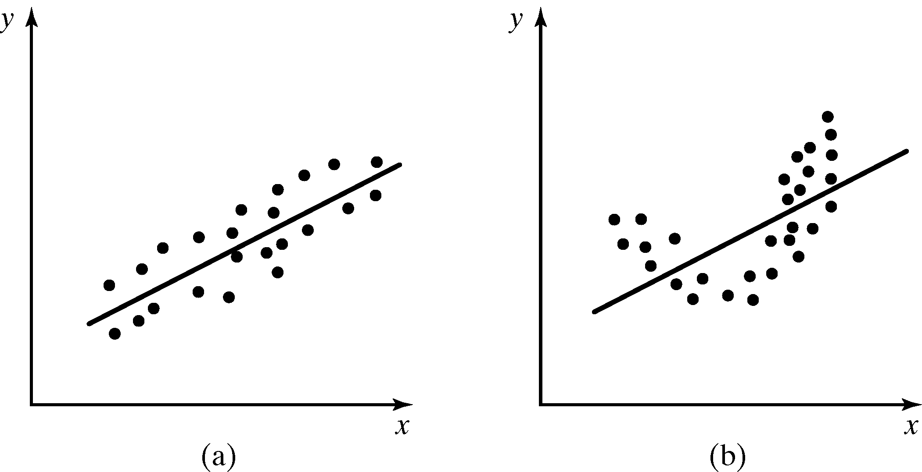
Test for Significance of Regression [Metamodeling]
Hypothesis testing:
  Failure to reject H₀ indicates no linear relationship between x and Y.
  If H₀ is rejected, implies that x can explain the variability in Y, but there may be in higher-order terms.
Straight-line model is adequate
Higher-order term is necessary

Slide 31
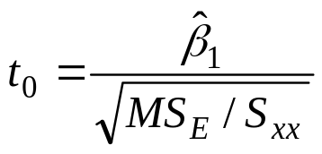
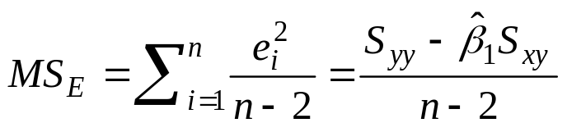
Test for Significance of Regression [Metamodeling]
The appropriate test statistics:
  The mean squared error is:
  which is an unbiased estimator of σ² = V(ε_{i}).
  t₀ has the t-distribution with n-2 degrees of freedom.
  Reject H₀ if |t₀| > t_{α/2, n-2}.

Slide 32
Multiple Linear Regression [Metamodeling]
Suppose simulation output Y has several independent variables (decision variables). The possible relationship forms are:
Y = β₀ + β₁x₁ + β₂x₂ + …+ β_{m}x_{m} + ε
Y = β₀ + β₁x₁ + β₂x² + ε
Y = β₀ + β₁x₁ + β₂x₂ + β₃x₁x₂ + ε

Slide 33
Random-Number Assignment for Regression [Metamodeling]
Independent sampling:
  Assign a different seed or stream to different design points.
  Guarantees that the responses Y from different design points will be significantly independent.
CRN:
  Use the same random number seeds or streams for all of the design points.
  A fairer comparison among design points (subjected to the same experimental conditions)
  Typically reduces variance of estimators of slope parameters, but increases variance of intercept parameter

Slide 34
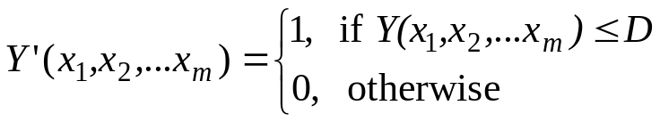
Optimization via Simulation
Optimization usually deals with problems with certainty, but in stochastic discrete-event simulation, the result of any simulation run is a random variable.
Let x₁,x₂,…,x_{m} be the m controllable design variables & Y(x₁,x₂,…,x_{m}) be the observed simulation output performance on one run:
  To optimize Y(x₁,x₂,…,x_{m}) with respect to x₁,x₂,…,x_{m} is to maximize or minimize the mathematical expectation (long-run average) of performance, E[Y(x₁,x₂,…,x_{m})].
Example: select the material handling system that has the best chance of costing less than $D to purchase and operate.
  Objective: maximize Pr(Y(x₁,x₂,…,x_{m})≤ D).
  Define a new performance measure:
  Maximize E(Y’(x₁,x₂,…,x_{m})) instead.

Slide 35
Robust Heuristics
[Optimization via Simulation]
The most common algorithms found in commercial optimization via simulation software.
Effective on difficult, practical problems.
However, do not guarantee finding the optimal solution.
Example: genetic algorithms and tabu search.
It is important to control the sampling variability.

Slide 36
Control sampling variability
[Optimization via Simulation]
To determine how much sampling (replications or run length) to undertaken at each potential solution.
  Ideally, sampling should increase as heuristic closes in on the better solutions.
  If specific and fixed number of replications per solution is required, analyst should:
    Conduct preliminary experiment.
    Simulate several designs (some at extremes of the solution space and some nearer the center).
    Compare the apparent best and apparent worst of these designs.
    Find the minimum for the number of replications required to declare these designs to be statistically significantly different.
    After completion of optimization run, perform a 2nd set of experiments on the top 5 to 10 designs identified by the heuristic, rigorously evaluate which are the best or near-best of these designs.

Slide 37
Summary
Basic introduction to comparative evaluation of alternative system design:
  Emphasized comparisons based on confidence intervals.
  Discussed the differences and implementation of independent sampling and common random numbers.
  Introduced concept of metamodels.

