Slide 1
An Introduction

Slide 2
What is a computer?
An Introduction
Learning Objective(s)
This material should address the following question(s).
Machine language vs. language understood by humans?

Slide 3
Discussion Point
What Is A Computer?

Slide 4



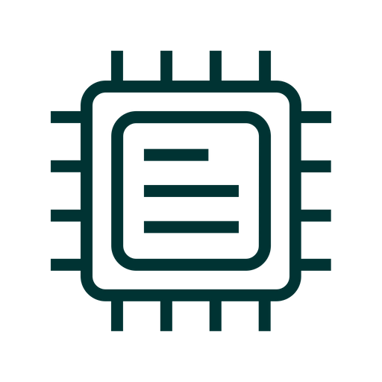

Computer
A computers is a tool, invented to help us doing the dirty job.
  It consists of a bunch of PCBs, ICs, wires, etc.
A computer understands and executes instructions.
  Instructions are bundled in a package called a program.
  Written in machine language 0s and 1s (binary).

Slide 5
Motivations
A problem or a challenge is something that is inefficient, costly, or blocking.
Solutions are developed in many forms to solve the problems.
Examples:
  Finding the smallest number.
  Weather forecasting.
  DNA sequencing.

Slide 6

Programming
To make a computer carrying out a task:
  A precise sequence of instructions has to be developed.
  The instructions follow a specific flow of algorithm.
So, what is programming?
  It is a process of developing a solution to a given problem.
  It starts from understanding the problem, designing
  the algorithm, and translating the algorithm
  into instructions.
Notes:
programming:
(1) the action of writing code in a language consisting of both syntax and semantics. The resulting code is usually compiled or interpreted in order to obtain an executable form of the code allowing the performing of the task addressed with the code.
(2) human task during human-robot interaction: storing a behavioral repertoire via symbols, including words.
Laplante, P. (2020). Dictonary of Computer Science, Engineering, and Technology. CRC Press.

Slide 7
Solution
Algorithm
Data
Solution

Slide 8
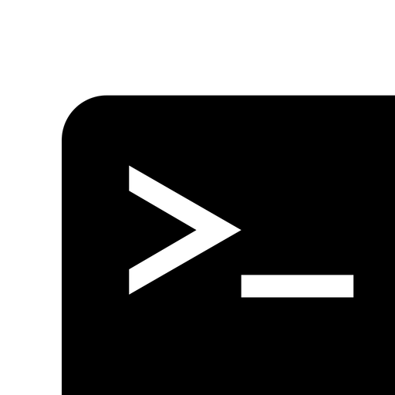
Program
A program is a packed instructions in binaries.
  It is executed by a computer.
  It is a physical form of an algorithm.
Without a program, computer is worthless.
In a broader sense, a program is also called as a software.
  A software may consists of one or more programs.
  A software should have an adequate set of documentation.
Notes:
program:
(1) a specification of an algorithm to be executed by a computer. A program may be represented as source code, an executable file, an applet, a bytecode, or many other representations. The language in which a program is written may be a procedural language, functional language, or nonprocedural language, although traditional usage generally does not refer to nonprocedural specifications as "programs".
(2) any file which is executable by the operating system.
Laplante, P. (2020). Dictonary of Computer Science, Engineering, and Technology. CRC Press.

Slide 9
Discussion Point
Machine Language vs.
Language Understood by Human

Slide 10

Programming Language (PL)
A computer understands machine instructions.
Writing machine instructions are …
  possible, sort of.
  takes a lot of time.
  prone to error.
  impossible for complex algorithm.
A more human-friendly instruction set is needed.
Notes:
programming language:
a formalism for specifying the instructions that have to be executed by the computer. Several different programming languages are available. The selection of a specific programming language may influence the process of development
Laplante, P. (2020). Dictonary of Computer Science, Engineering, and Technology. CRC Press.

Slide 11

Programming Language (PL)
A programming language is a set of computer instructions
used to write computer programs.
  The syntax is close to human language, e.g. English.
There are tons of programming languages out there.
  Some are multi-purpose, while the other are designed
  for specific needs.

Slide 12

Programming Language: Source Code
Having a solid algorithm, a programmer could then
write it down in a specific programming language.
  The algorithm is written in lines of code (codes).
  And the physical document is called as source code.
A programmer is a person who analyze the problem,
designing the solution, and writes the instructions down
into source codes (coding).
HelloWorld.java
class HelloWorld {
public static void main(String[] _args) {
System.out.println("Hello, World!");
}
}
Notes:
source code:
(1) computer instructions and data definitions expressed in a form suitable for input to an assembler, compiler, or other translator.
(2) a set of codewords used to represent messages, such that redundancy is removed, in order to require less storage space,or transmission time.
Laplante, P. (2020). Dictonary of Computer Science, Engineering, and Technology. CRC Press.

Slide 13
Final Thoughts.

Slide 14
Conclusion
Computer is here to serve us.
  Unfortunately, they do not know “what we want”.
Programming is basically writing instructions understood
by computers.
  It is the way to tell them “what we want”.

Slide 15
References
Wassberg, J. (2020). Computer Programming for
Absolute Beginners. Packt.

