Slide 1
Input/Output

Slide 2
What are the importance of input-output?
Input/Output
Learning Objective(s)
This material should address the following question(s).
How to accept input and send output?

Slide 3
Discussion Point
User-Solution Interaction: The Core Concepts.

Slide 4



User-Solution Interaction
input
solution
output
The user-solution interaction is natural.
Sometimes, the user has the control over the solution’s behavior by providing inputs.
Based on the given inputs, the solution then produces outputs and send them back to the user.

Slide 5

Accepting Input
Input is a way for a user to pass values into the solution.
The solution then does it job based on the given inputs.
Captured through devices:
Textual values from keyboard;
Images from sensors;
etc.

Slide 6

Sending Output
Output is a way for a solution to send the results it produces.
Presented in many forms:
Textual values via display;
Files or printed forms;
etc.

Slide 7
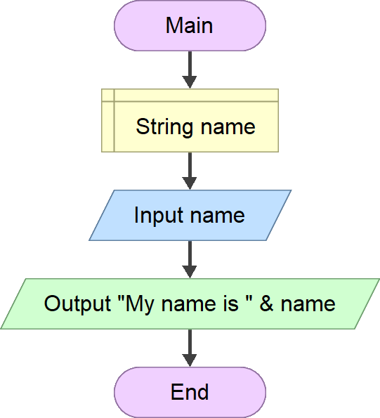
Input/Output in Flowgorithm
Accepting an input from the user and temporarily store it into the name variable.
The input instruction is used for reading an exactly one input.
The output instruction is used for sending an exactly one output.
Sending back an output to the user.

Slide 8
Final Thoughts.

Slide 9
Conclusion
The interaction between a user and a solution is natural.
It is even necessary to control how the solution should behave.
Input is a way for the user to pass values into the solution, and output is similar but in the opposite direction.

Slide 10
References
Wassberg, J. (2020). Computer Programming for Absolute Beginners. Packt.

