Slide 1
Variable & Constant

Slide 2
How to use variable and constant?
Variable & Constant
Learning Objective(s)
This material should address the following question(s).

Slide 3
Discussion Point
Variable & Constant: A Simulation.

Slide 4


Challenge
Calculating the area of a circle.
We have three values:
𝜋 is a constant, whereas
𝑟 and 𝐴 are variable values, their values may change.
$$r$$
$$A=πr^{2}$$

Slide 5
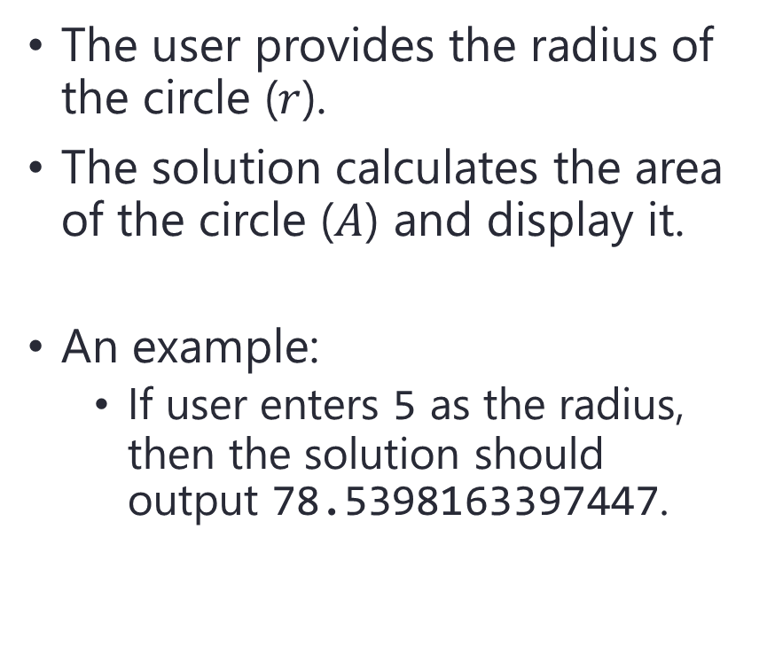

Challenge
$$A=πr^{2}$$
The user provides the radius of the circle ($r$).
The solution calculates the area of the circle ($A$) and display it.
An example:
If user enters 5 as the radius, then the solution should output 78.5398163397447.
$$r$$

