Slide 1
Concatenation Operator

Slide 2
What is concatenation operator?
Concatenation Operator
Learning Objective(s)
This material should address the following question(s).
How to use the concatenation operator?

Slide 3
Discussion Point
Concatenation operator: The Core Concepts.

Slide 4


Problem
In the circle area calculation, we have three values, some of them described with metrics.
𝜋 has no metric.
𝑟 and 𝐴 have.
E.g. cm and cm² respectively.
Variables or constants store values without the metrics.
$$A=πr^{2}$$
$$r$$

Slide 5
Joining Texts
For the user experience sake, sometimes, we need to put a little sugary.
E.g. displaying the metrics together with the values.
We need to join the value and the metric into a single text.
Concatenating the value and the metric.
Without metric
78.54
With metric
78.54 cm²
in some instances, this form is preferred.

Slide 6
Question
What is concatenation operator?

Slide 7

Definition
Concatenation operator is a binary operator that joins two values into a new textual value.

Slide 8
This value is fractional but seen as textual value.
78.54 cm²
Glued with another value also seen as a text.

Slide 9

Concatenation Operator
Concatenation is like gluing a value behind the other in textual context.
The support for this operator is vary from language to language.
Please consult the language specifications.
Specific to Flowgorithm, the ampersand (&) symbol is used to concatenate values.

Slide 10
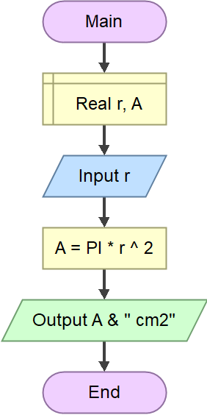
Hands On
In the example, the value stored in the variable A is joined or concatenated with " cm2".
The concatenation operator is symbolized with the &.
Can we concatenate another, say integer value, before A?
concatenates A with “ cm2".

Slide 11
Final Thoughts.

Slide 12
Conclusion
The concatenation operator joins two values into a single text.
The support to this operator vary from language to language.

Slide 13
References
Wassberg, J. (2020). Computer Programming for Absolute Beginners. Packt.
Operators – Flowgorithm http://www.flowgorithm.org/documentation/operators.html

