Slide 1
Branching

Slide 2
What is branching?
Branching
Learning Objective(s)
This material should address the following question(s).
How to use branching?

Slide 3
Discussion Point
Branching: The Core Concepts.

Slide 4

Problem
A book store is currently making a clearance sale.
The discount is segmented as:
50% if the transaction ≥ $200.
20% if the transaction ≥ $100.
Both of the above schemas requires at least 2 books in the transaction.

Slide 5
There are 3 discount schemas:
20% when it reaches $100.
50% when it reaches $200.
0% when it is less than $100.
Both of the schemas require the involvement of at least 2 books in the transaction.
Branching is used to form all the alternatives.
no discount
20%
min. 2 books
min. $100
50%
min. $200

Slide 6
Question
What is branching?

Slide 7

Definition
Branching is a way to create alternative execution paths. This elevates the solution to a higher level of flexibility.
It is possible to create nested alternatives.

Slide 8

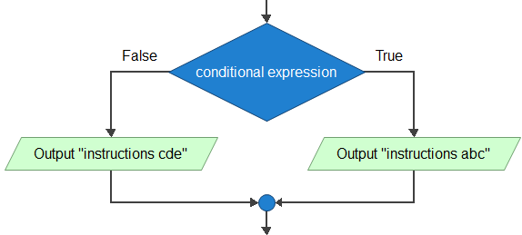
Branching: Basic Form
The basic form of branching is the if-else statement.
The statement creates exactly two alternatives.
Flowgorithm only support this form of branching.
if (conditional expression) {
// instruction abc
} else {
// instruction cde
}

Slide 9
Branching: The Conditional Expression
The conditional expression should produce a logical value.
Relational, logical, and the combination of the two operations.
The evaluation of the expression decides where the program execution goes.
Design it carefully.

Slide 10
There are 3 discount schemas:
0% when it is less than $100.
20% when it reaches $100.
50% when it reaches $200.
Both of the schemas require the involvement of at least 2 books in the transaction.
Branching is used to form all the alternatives.
no discount
20%
min. 2 books
min. $100
50%
min. $200

Slide 11
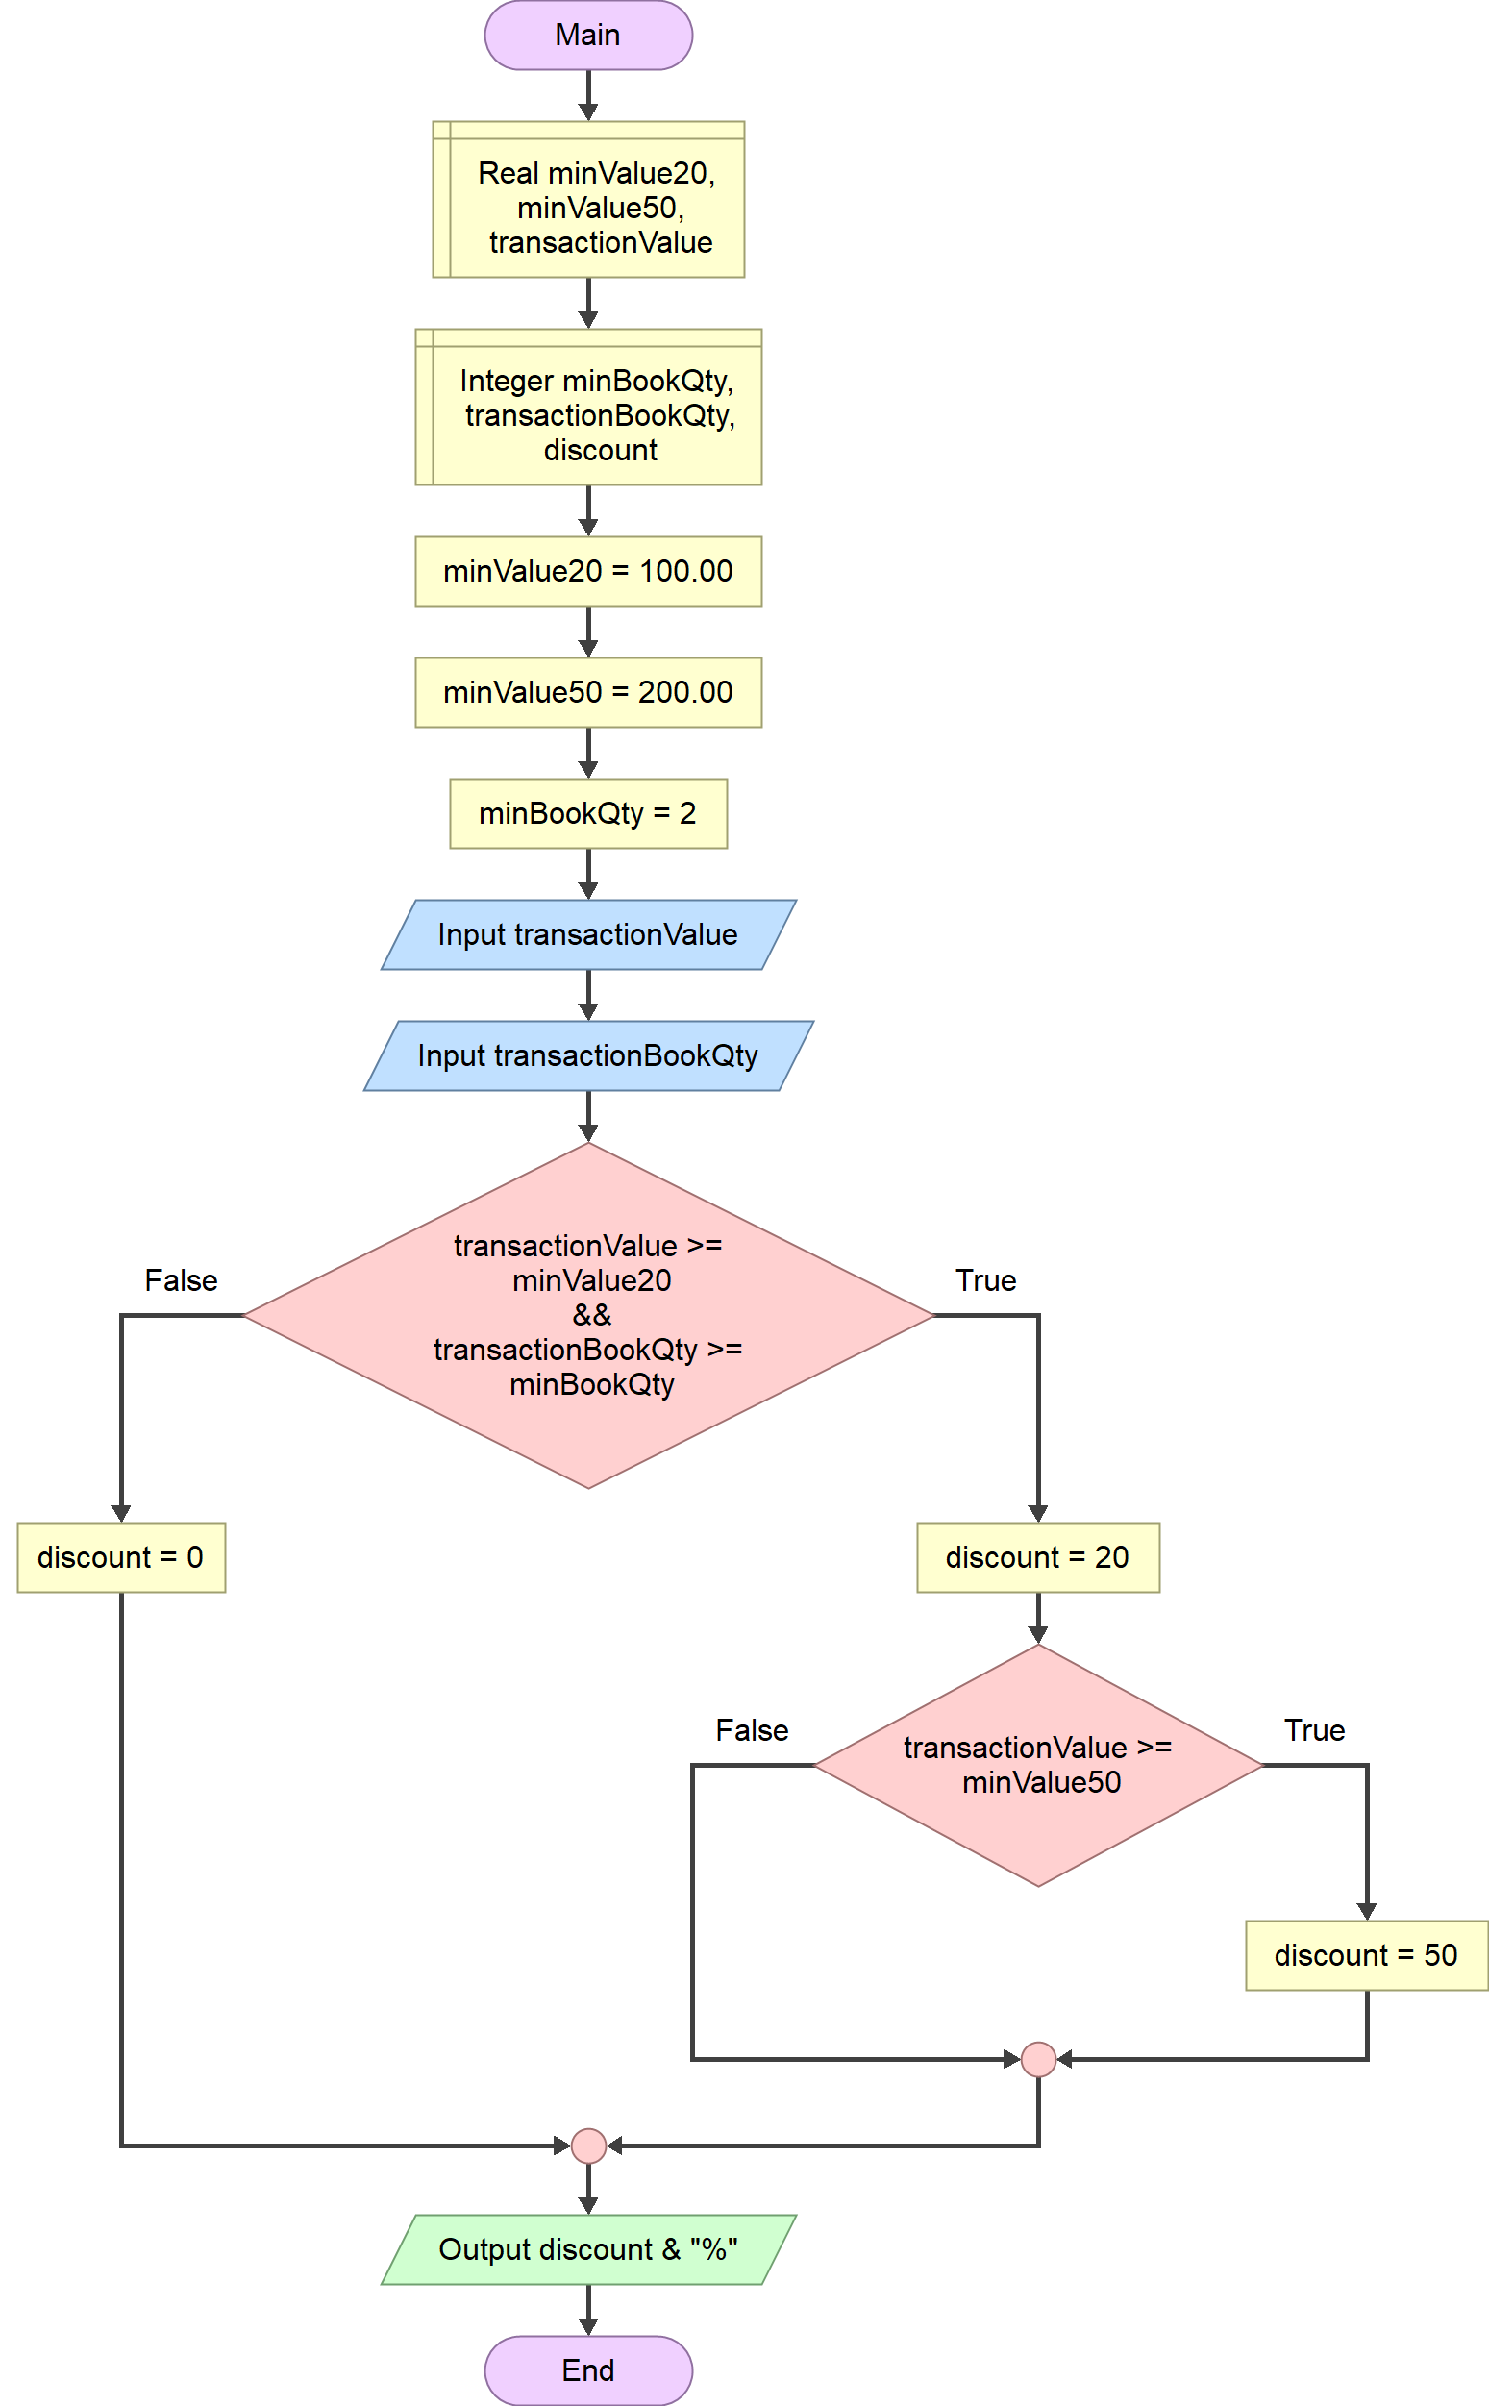
check the 1st alternative

Slide 12
Branching: Advanced Forms
Advanced languages have other forms of the basic if-else.
if form.
if-elseif-else form.
Ternary form.
Other branching statement:
switch-case (will not be discussed here).

Slide 13
Final Thoughts.

Slide 14
Conclusion
Branching is used to create alternative execution flows.
A branching requires a valid conditional expression which its evaluation dictates the flow of the solution execution.
Flowgorithm only support the basic if-else form.

Slide 15
References
Wassberg, J. (2020). Computer Programming for Absolute Beginners. Packt.
If Shape – Flowgorithm http://www.flowgorithm.org/documentation/if.html

