Slide 1
Function

Slide 2
What is function?
Function
Learning Objective(s)
This material should address the following question(s).
How to use it?

Slide 3
Discussion Point
Function: The Core Concepts.

Slide 4
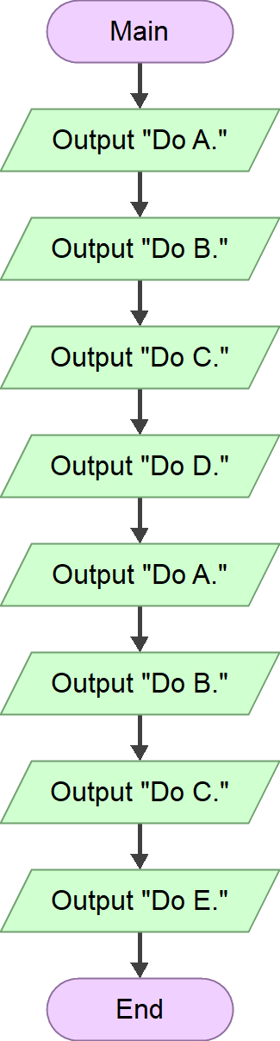
An Example
A solution consists of a set of instructions.
Within it, repetitive patterns of instructions may exist.

Slide 5
An Example
What if, these repetitive instructions:
Appear in different places?

Slide 6
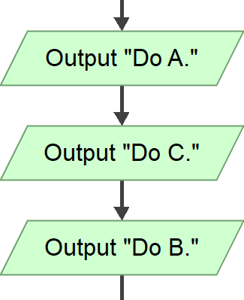
An Example
What if, these repetitive instructions:
Appear in different places?
Are required to change sometimes in the future?
Could be disastrous and impractical when the solution is gigantic and very complex.

Slide 7
Can we isolate the repetitive instructions and make them callable when needed?

Slide 8

Definition
A function is a callable routine with an atomic purpose. It is an essential building block to develop more complex routines.

Slide 9
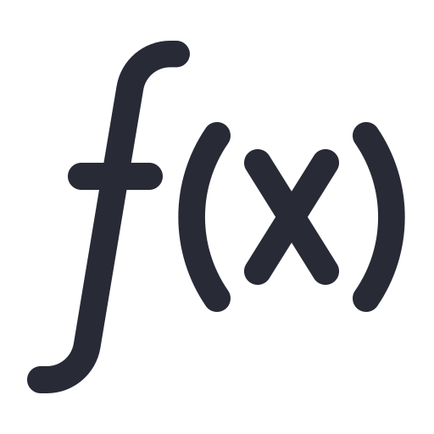
Function
A function has a unique identifier that is:
Meaningful and showing its purpose.
In the form of active action.
E.g. cancel, remove_first, showMessage, etc.

Slide 10
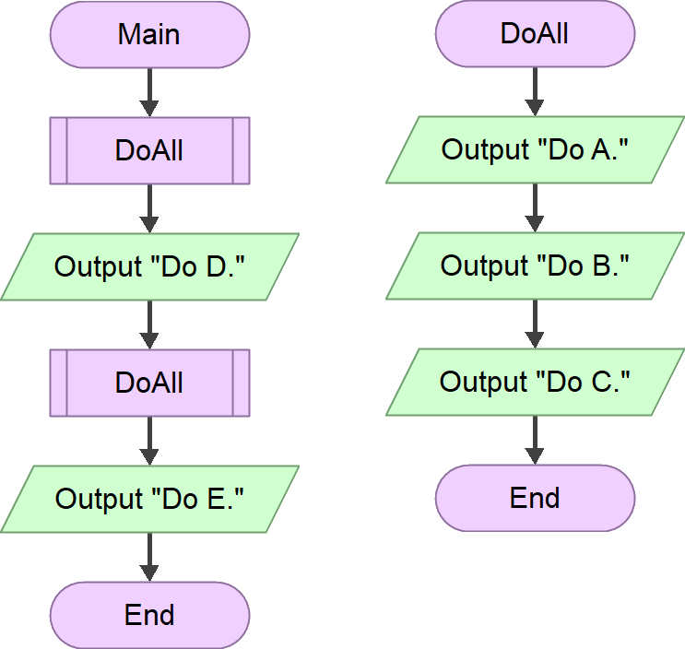
Isolating instructions and call them at will.

Slide 11
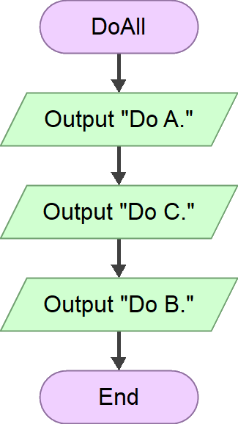
What about changes?
More manageable due to isolation.

Slide 12
Transparency
A function may have its own data in the form of local variable and formal parameter.
The internals of a function is invisible from the outside.
Other parts of the solution do not need to know it.
All they need to know is its interface and how to use it.
E.g. the Main function has no idea what instructions are inside the DoAll function.

Slide 13
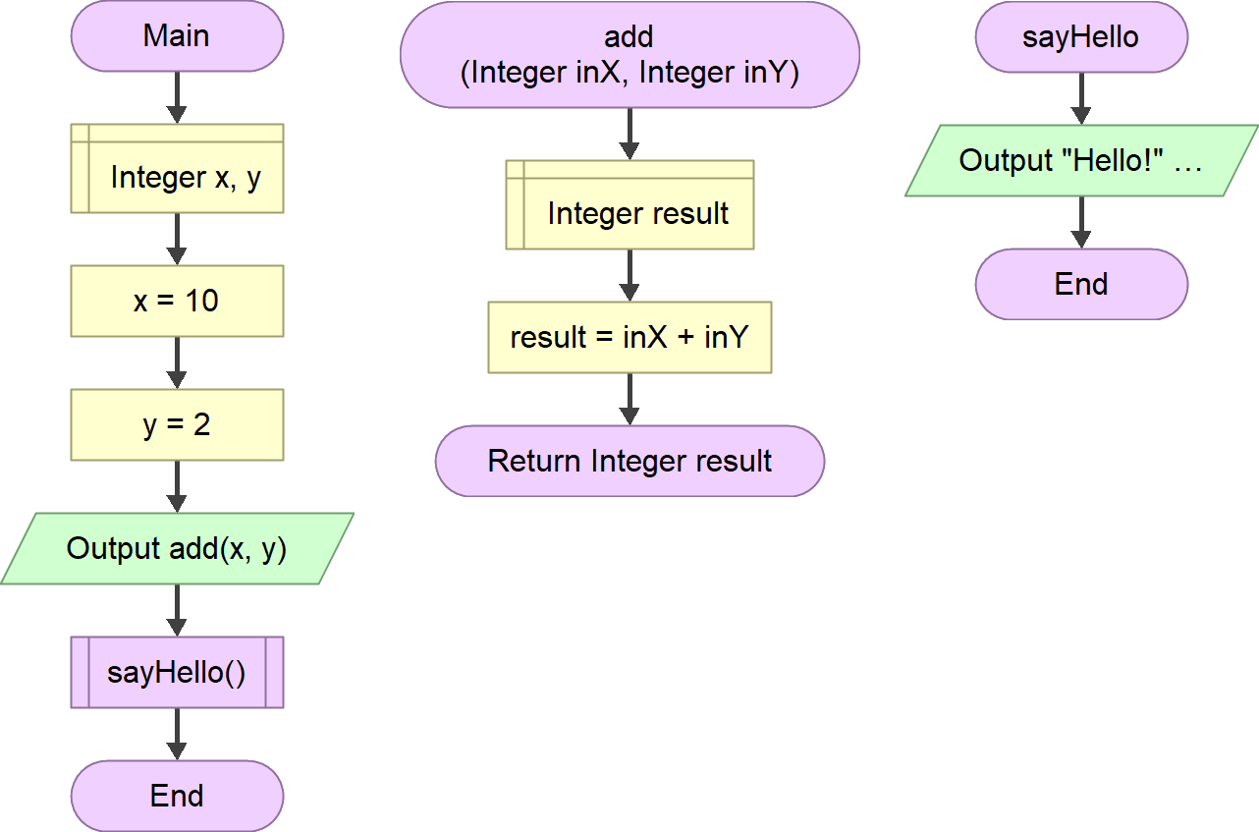
Characteristics
Formal parameters
A procedure, not returning any value.
A function has:
An atomic purpose.
A unique identifier.
A body (instructions).
A set of parameters (optional).
A returned value (optional).
Returning a value.

Slide 14
Main
Workflow
When:
FunctionA is called, the execution flow is transferred from the Main flow to the FunctionA.
The same also applied when FunctionB is called from within FunctionA.
1
FunctionA
call
FunctionB
2
3
call
When:
The execution of FunctionB reaches its end, the execution flow is sent back to the corresponding caller, FunctionA., along with the returned value (if any).
The same applies when FunctionA reaches its end.
return
4
8
7
return
5
6
9

Slide 15
Final Thoughts.

Slide 16
Conclusion
A function is a callable routine with an atomic purpose.
The detail of a function is transparent from the external.

Slide 17
References
Wassberg, J. (2020). Computer Programming for Absolute Beginners. Packt.

