Slide 1
Returning Value

Slide 2
Why and when a function should return a value?
Returning Value
Learning Objective(s)
This material should address the following question(s).
How to return a value?

Slide 3
Discussion Point
Returning Value: The Core Concepts.

Slide 4
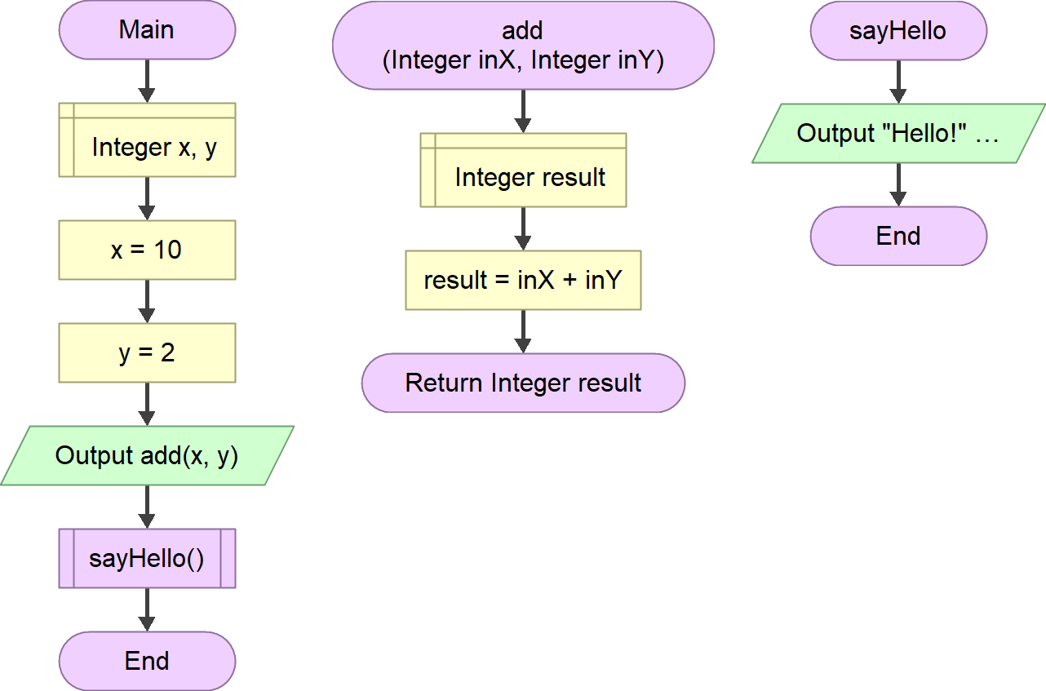
An Example
Formal parameters
Without any formal parameter.
The add function is responsible to do an addition operation to the given arguments.
It is possible to use the result (output) from the add function on the next step.
The function must return the result back to the caller.
Returning a value.

Slide 5
Question
What is returning value?

Slide 6

Definition
A function returns a value back to its caller.
A function which does not return a value is called as a procedure.

Slide 7
Chain of Processes
a is the result of FunctionA.
a = FunctionA()
a is passed into FunctionB which produces b.
b = FunctionB(a)
In the example we see a chain of processes. It shows a case where a process is directly dependent to the previous one.
Returning value plays an important role in the example.
b is passed into FunctionC and the execution produces c.
c = FunctionC(b)

Slide 8
Final Thoughts.

Slide 9
Conclusion
A function returns a value back to its caller.
When it does not, it is called as a procedure.
Returning value is useful to make a chain of processes.

Slide 10
References
Wassberg, J. (2020). Computer Programming for Absolute Beginners. Packt.

