Slide 1
Repetition (Deterministic)

Slide 2
How to use repetition for a deterministic problem?
Repetition (Deterministic)
Learning Objective(s)
This material should address the following question(s).

Slide 3
Discussion Point
Deterministic Repetition: A Simulation.

Slide 4
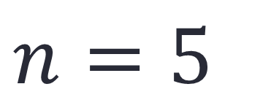
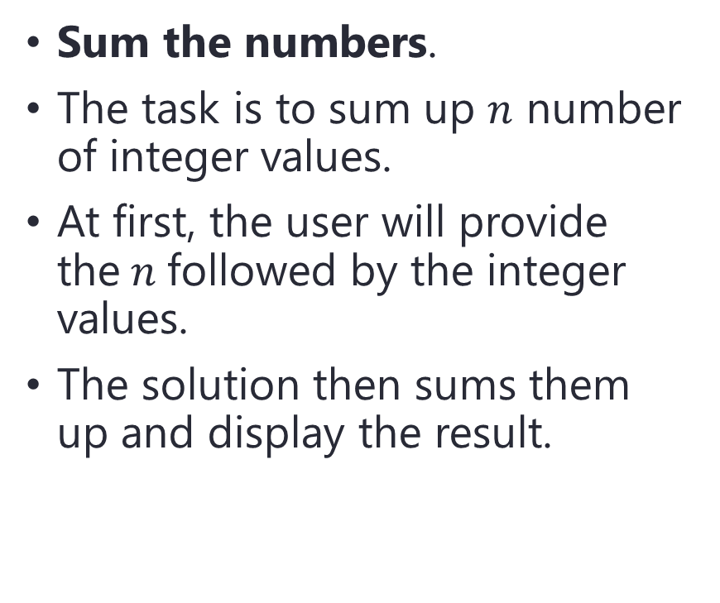
Problem
Sum the numbers.
The task is to sum up $n$ number of integer values.
At first, the user will provide the$n$followed by the integer values.
The solution then sums them up and display the result.
$$n=5$$
4, 8, 4, 2, 6

