Slide 1
Array

Slide 2
How to use array correctly?
Array
Learning Objective(s)
This material should address the following question(s).

Slide 3
Discussion Point
Array: A Simulation.

Slide 4
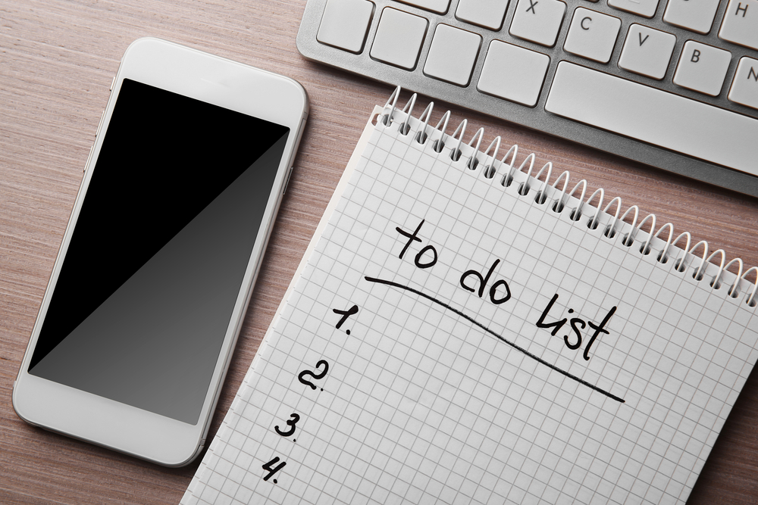
Problem
A to-do list holds a handful of important agenda (items) we need to do.
Any addressed item is marked as finished or done.

Slide 5
Distinction between the “done” and “undone” items.
An example of a to-do list.
Today’s To Do List:
Meeting with supervisor. [done]
Do Math exercise, due tonight. [done]
Group discussion (lunch).
Designing the change-password feature.
The number of items are arbitrary, but planned.
The items are textual and written concisely.
How many variables do we need?
Is 5 enough? 10?

Slide 6
Problem
At the beginning, the user should enter the number of agenda he/she would list.
Afterwards, the user enters his/her agenda, one-by-one.
Later, the solution shows all of the agenda in the list.

