Slide 1
Formal Parameter & Argument

Slide 2
What is a formal parameter?
Formal Parameter & Argument
Learning Objective(s)
This material should address the following question(s).
How it is different to an argument?

Slide 3
Discussion Point
Formal Parameter: The Core Concepts.

Slide 4
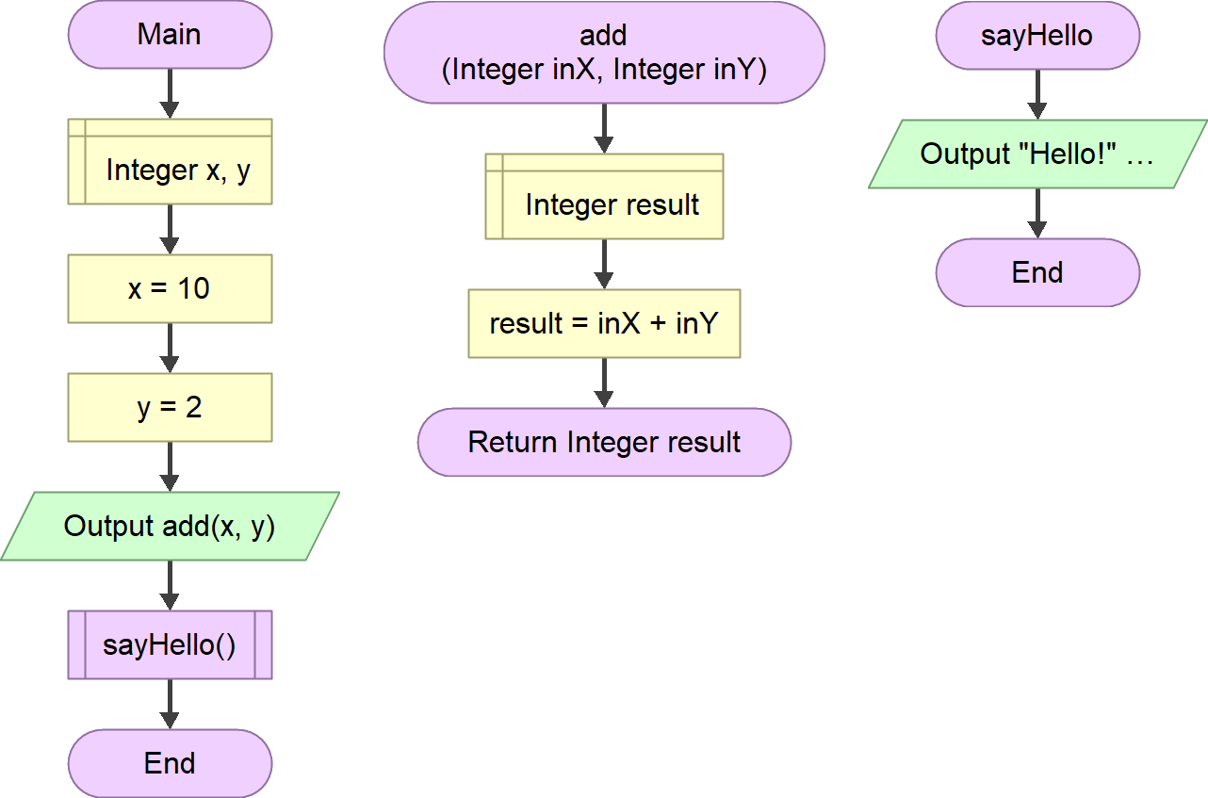
An Example
Formal parameters
Without any formal parameter.
The add function has exactly two formal parameters:
inX – an integer; and
inY – also an integer.
The sayHello function has no formal parameter.
Returning a value.

Slide 5
Question
What is a formal parameter?

Slide 6

Definition
A (formal) parameter is a value passed into a function. It is a way to provide input required by the function or to control the behavior of the function.
A parameter is like a variable but defined at the beginning of a function and set with a value given during the function call.

Slide 7
The passed values are accepted and be available for the function as inX and inY.
Formal parameters.
The value of x and y are passed as arguments at the function call.
Both parameter and argument have the same value but seen from different perspectives.
Argument is from the caller’s perspective and parameter from the callee’s.
Sometimes both can be used interchangeably.

Slide 8
Final Thoughts.

Slide 9
Conclusion
A parameter is a value passed into a function.
The sole difference between argument and parameter is the perspective.
argument sees the value from the caller’s perspective whereas
parameter sees it from the callee’s perspective.

Slide 10
References
Wassberg, J. (2020). Computer Programming for Absolute Beginners. Packt.

